Slide 1
Identification of Neisseria

Slide 2
Plating and Incubation
Plate specimens as soon as possible upon receipt into the laboratory. This includes CAP survey specimens.
Do not let CAP survey specimens sit for a week before plating. If the tech in charge is not here, another person must set up the cultures.
When plating a CAP survey, make sure that you follow the directions included with the specimens. Do not deviate from this process as that will affect results.
If specifically looking for N. gonorrhea or N. meningitidis, add a Thayer Martin media to the culture.
Neisseria are fastidious organisms that require very specific nutritional requirements and a CO2-rich environment. If not properly handled in the lab, it will not grow in culture.
They need to be subbed at least every 48 hours to remain viable. Do not let the organism remain unsubdued for more than 48 hours as it is likely to die at that point.
Incubate immediately after plating at 35C in 3-7% CO2.
Hold the plates for a minimum of 72 hours before resulting as negative.

Slide 3
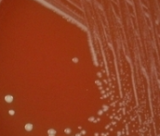
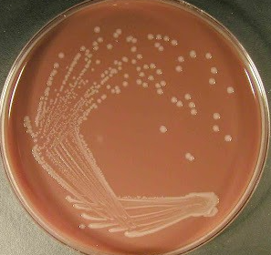
N. Gonorrhoeae
N. gonorrhoeae colonies are small, smooth, translucent, and grayish white in color. They may be mucoid. Often have a greenish color underneath the colony.
Colonies can be easily missed on chocolate agar due to growth of other organisms in the culture.
Thayer Martin media has additional antibiotics to help inhibit growth of non-Neisseria organisms.
Thayer Martin may be too selective for some strains of pathogenic Neisseria.
N. gonorrhoeae will grow chocolate agar in 24-48 hours of incubation at 35-37C.
GC will grow on blood agar but it will grow much better on chocolate agar than on blood agar.
N. gonorrhoeae does not grow well at room temperature at 48 hours.

Slide 4
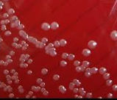
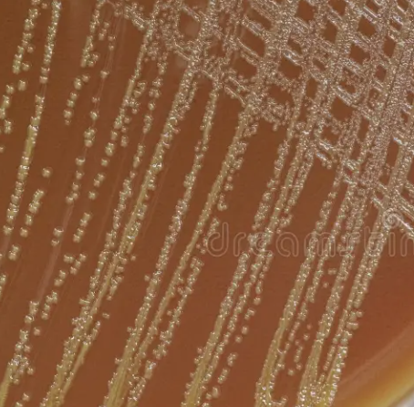
N. meningitidis
N. meningitidis colonies on blood agar are smooth, round, and gray/brown in color. They are also moist, convex, and glistening, with a well- defined edge.
Growth takes 24 hours on blood and chocolate agar
N. meningitidis does not grow well at room temperature at 48 hours.

Slide 5
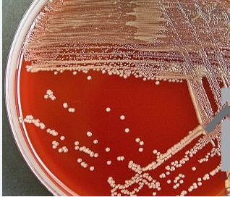
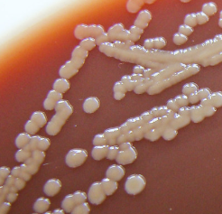
Nonpathogenic Neisseria
N. mucosa, N. subflava, and N. cinerea can readily grow on chocolate and blood agar as small non-hemolytic, grayish colonies. They are smooth, convex, and may show a slight yellow pigment.
Thayer martin agar will inhibit growth of these organisms.
Growth takes 24 hours on blood and chocolate agar
Will grow at room temperature at 48 hours. However, growth is lest robust.

Slide 6
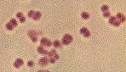
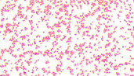
Gram Stain
Gram Stain: Gram Negative Diplococci
They will appear in pairs with the adjacent sides flattened against each other.
N. Gonorrhoeae is kidney shaped diplococci with concave apposing ends.
N. meningitis is semicircular diplococci with flat apposing ends.

Slide 7
Identification
MALDI will identify N. gonorrhoeae and N. meningitis. However, the identifications must be confirmed with a 2nd method.
Rapid NH panels can identify these organisms using biochemical reactions.
N. gonorrhoeae is only positive for glucose fermentation.
N. meningitidis is only positive for glucose and maltose fermentation.
Nonpathogenic Neisseria species are positive for glucose, maltose, and sucrose/fructose fermentation.
Make sure that the NH panels are inoculated, incubated, and read per the SOP. Any deviation can cause the biochemical reactions to be falsely positive/negative and can lead to misidentification.
Catalase Positive
Oxidase Positive

