Slide 1
Hazard Communication
Automated Chemistry

Slide 2
Topics to be Covered
Michigan Right to Know Law
Hazard Communication Program
Safety Data Sheets (SDS)
SDS Availability Poster
Labeling System of Hazardous Chemicals
Personal Protective Equipment
Spill Kit

Slide 3
Michigan Right to Know Law
Chemical manufacturers must evaluate hazards of chemicals they produce
Employees must be provided with info on chemical hazards using a hazard communication program
Communication must include labels, SDSs, warning signs and employee training

Slide 4
Hazard Communication Program
Education
Hazard Communication (Right to Know) module in Halogen MND1412
Department Specific Training
SDS Location
Location and Storage of Chemicals
Location of PPE
Right to Know Law Form

Slide 5
Hazard Communication Program
Obey all safety rules
Proper handling, usage and storage
Proper labeling
Know the location
Spill kit and emergency equipment
SDS
Inform Supervisor
Accident/spill
Missing labels on primary containers

Slide 6
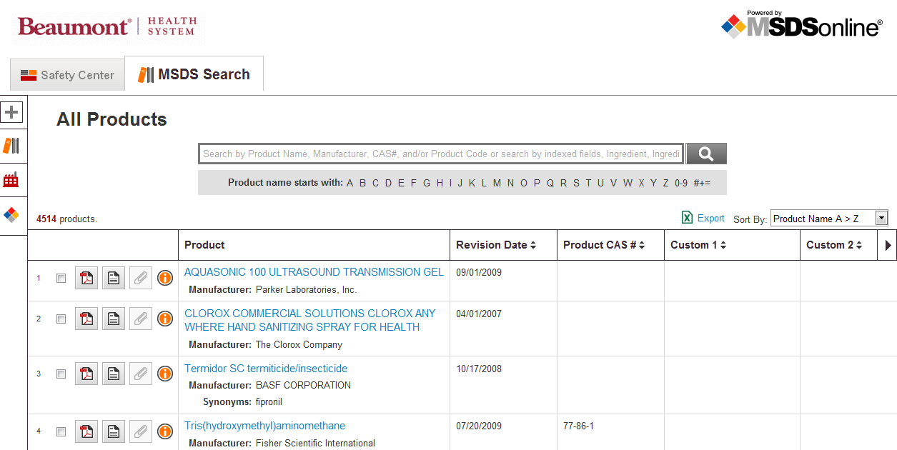
Safety Data Sheets (SDS)
Found on Inside Beaumont
Or call the Safety
Department at
17085
Search Here

Slide 7
Safety Data Sheets (SDS)
Technical bulletin containing detailed information about:
Physical and health hazards
Precautionary procedures for avoiding accidents
Emergency and first aid procedures in the event of an accident
SDSs contain more information than warning labels!

Slide 8
SDS Availability Poster

Slide 9
SDS Availability Poster
Specific for our workplace
Includes directions on finding SDSs on InsideBeaumont
Contact: Margaret Sipple, Safety Coordinator
248-551-1044
If computers are down 1-888-362-7416

Slide 10
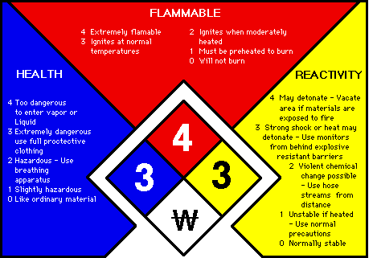
Labeling System of Hazardous Chemicals
Labels are essential!
Inspect all labels for clarity and completeness
Labels should list product’s ingredients and specify chemical’s hazards
Labels are required when chemicals are transferred from a primary to secondary container

Slide 11
Personal Protective Equipment
Safety Data Sheets will provide information regarding the proper use of PPE
Gloves
Gowns
Eye and Face Protection
Respiratory Protection

Slide 12
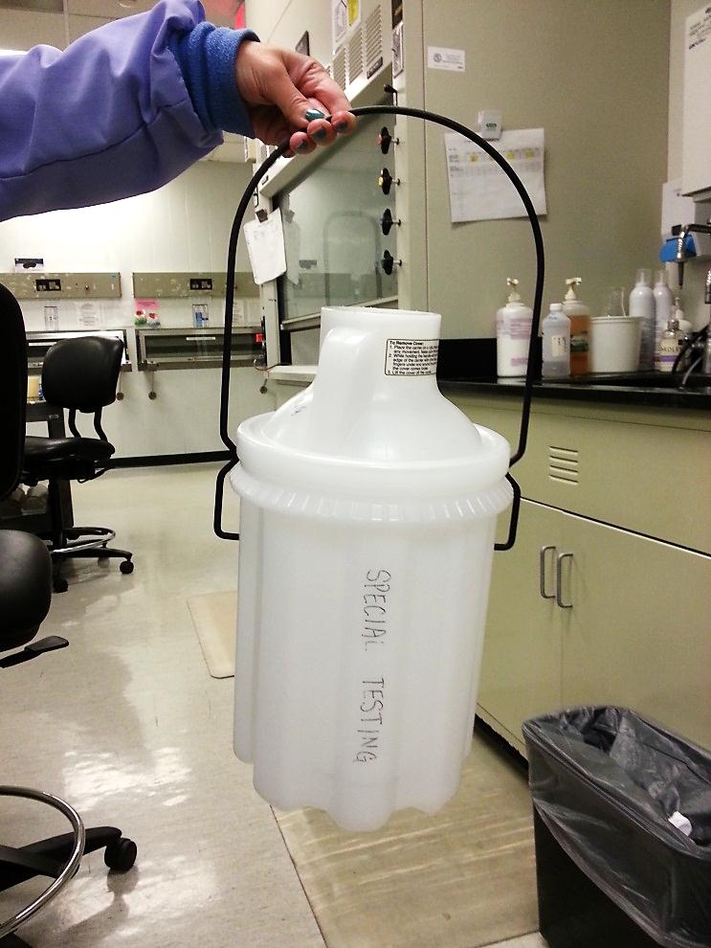
Handling of Hazardous Chemicals
Always Transport Chemicals Safely

Slide 13
Proper Storage of Hazardous Chemicals
Boom Room
Acid Cabinet
Flammable Cabinet
Always store chemicals in the designated areas
Chemicals should be stored based on their specific hazards

Slide 14
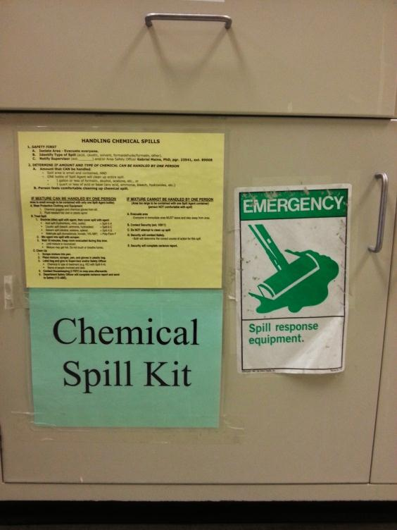
Spill Kit
Directions on the cabinet door
Refer to
Policy 1550 - Spill Response Plan
Procedure SA.SM.011r01 - Spill Cleanup
Call Security at 80911
Contain Spill
Use appropriate spill kit
Prevent the spread of spill
Inform supervisor

Slide 15
Credits
Created by Special Testing—Jessica Czinder

