Slide 1
Introduction Part 2
By: Brittnie Berger, MLS (ASCP)^{CM}

Slide 2
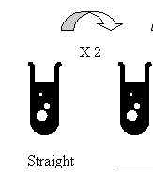
Dilutions
Dilutions are performed using FIXED pipettes, not adjustable pipettes
Straight Dilutions—a dilution from one tube to another
Serial Dilutions—a series of dilutions, starting with one tube and making several dilutions in a row

Slide 3
Making a serial dilution
Start with your “neat” tube
Label the tubes properly with your dilution factor (example: ALT1X2)
Always add the specimen you are diluting to your diluent
Diluents commonly used in chemistry are Saline or DiH₂O
Mix WELL

Slide 4
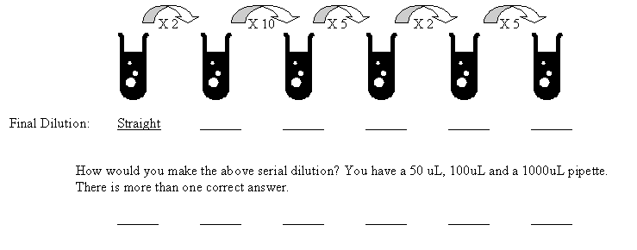
Making a serial dilution

Slide 5
Quality Control and Calibrations
What is quality control and why is it used in the laboratory?
A quality control (QC) is a substance with a known value
Used in the laboratory to ensure our analyzers are functioning properly and producing accurate and precise results
Calibrations use standards (a substance with a known exact concentration) to create a standard curve

Slide 6
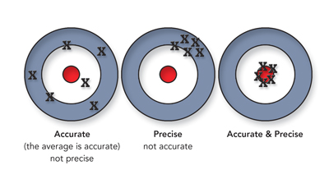
Quality Control—Statistics
Accuracy: Agreement of results with true value for substance in a given specimen.
Precision: The ability to produce a series of results that agree closely with one another.

Slide 7
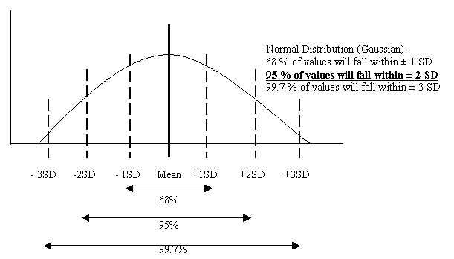
Quality Control—Statistics
Bell Curve demonstrating normal distribution of Quality Control

Slide 8
Quality Control—Statistics
Mean—accuracy of results is measure by the mean:
Standard Deviation—Precision of results is measured by the standard deviation:
Coefficient of Variation—The ratio of the SD to the mean (small CV=greater precision)

Slide 9
Quality Control—Basic Rules
At least 2 levels of QC must be used
Usually a high and normal control are used
Some analytes/analyzers use 3 levels (these may be run across all 3 shifts)
QC is expected to be within 2SD— “QC IN”
QC out on one level 1st time – acceptable, but needs to be watched
QC out on both levels(all levels)—unacceptable
QC out on one level but second consecutive time—unacceptable

Slide 10
Quality Control—Westgard Rules
1:2s(1_{2s})—this is the only WARNING rule
1 control level is outside 2SD
1:3s (1_{3s})—Rejection
2:2s (2_{2s})—Rejection
Can be across runs or within a run
R:4s (R_{4s})—Rejection
The range between two controls exceeds 4SD
4:1s (4_{1s})—Rejection
10x—Rejection

Slide 11
Quality Control
Shift
6 or more consecutive daily values on one side of the mean for one control level
Trend
Values for a control level that either increase or decrease for 6 consecutive days
Are these acceptable or do we reject?

Slide 12
Quality Control—troubleshooting
Re-run QC
Make new QC
Run Assayed QC
Calibrate
Re-run QC
Change Reagent
Consider an instrument problem—call service

Slide 13
Statistics—other formulas and definitions
Sensitivity: the ability to detect small concentrations of a substance
Specificity: the ability to measure ONLY the desired substance
Standard Deviation Index (SDI): Obtained by participation in proficiency testing, used to compare your laboratory’s performance with the peer group

Slide 14
Statistics—other formulas and definitions

Slide 15
Lab practices
Proficiency Testing- laboratories way of verifying their results are correct from the specific methods/analyzers.
CAP surveys- done according to SOP treating surveys as patient samples. Acceptable +/- 3 SDI for Chemistry
Lot to Lot comparisons- performed when reagents are received in the laboratory with a new lot number to verify different lot numbers/shipments are valid.
Run QC on each lot before, run 5-10 samples on old and new to compare, and run QC on each lot after
Results must be within designated percent difference
Linearities: performed on analyzers to verify the that it is running properly. Linearity material can be purchased or made.
Precision Studies: are also performed to verify instrument performance. QC should be ran prior, making sure results are accurate as well as precise. 10 replicates of a patient sample is sufficient.
Notes:
% difference= old-new/ old X100

Slide 16
Things to Review
Quality Control section of your student binders
QC Policies and procedure
Quality control basic statistics
Proficiency testing procedure

