Slide 1
ANATOMIC PATHOLOGY SURGICAL PATHOLOGY
SPECIMEN COLLECTION

Slide 2
OBJECTIVES
Proper Surgical Pathology Specimen Collection
Improper collection/fixation effects
Improve the success of Electronically placed AP orders with SoftID PPID collection process
Purpose of using SoftID PPID

Slide 3
FORMALIN
10 % Neutral Buffered Formalin (NBF)
Clear solution of formaldehyde in water mixed with buffered salts

Slide 4
FORMALIN FUNCTION
Fixation
Critical step in the preparation of tissue specimen.
Preservation of cells and tissue components in a “life-like state” (nearly the same relationship they had in the living body)

Slide 5
ADEQUATE FORMALIN
Formalin ratio
The fixative volume should be 20 times greater than the tissue volume
Specimen container
Use an appropriate sized specimen container when submitting specimens to pathology
Secure lid on container to avoid formalin leakage
Do not use specimen bags

Slide 6
ADEQUATE FORMALIN
The most common error is insufficient ratio of fixative volume to tissue volume.

Slide 7
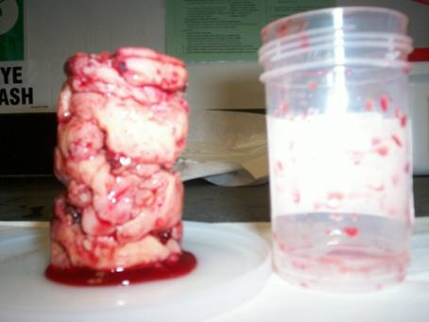
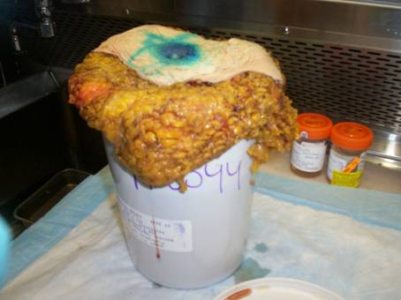
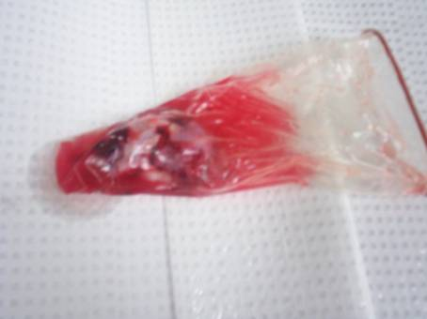
ADEQUATE FORMALIN

Slide 8
No Formalin
Fresh Tissue
Special studies required
Few examples
Lymphoma studies
Cytogenetic studies
Specimen too large for container/formalin
Not safe for transportation
Proper container size not available
Document if Formalin can be added to avoid delay

Slide 9
NO FORMALIN
Fresh Tissue
Deliver to surgical pathology immediately
Keep in refrigerator for next schedule pathology specimen pick up

Slide 10
Delayed/Inadequate Fixation
Tissue specimen can be irreversibly damaged
Show inferior nuclear and cytoplasmic morphology with shrinkage and poorly defined cell margins
Invalidate immunogenicity, hormone receptor(ER/PR) and HER2 analysis.

Slide 11
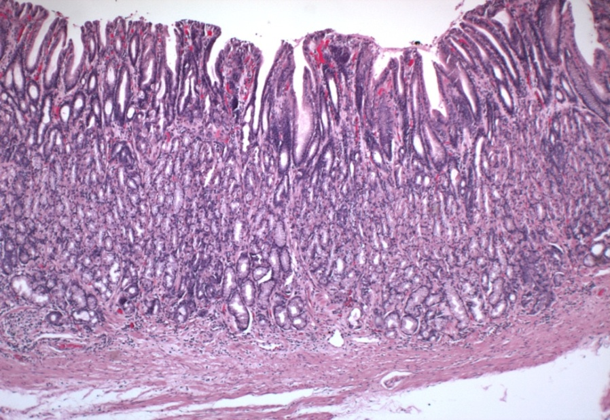
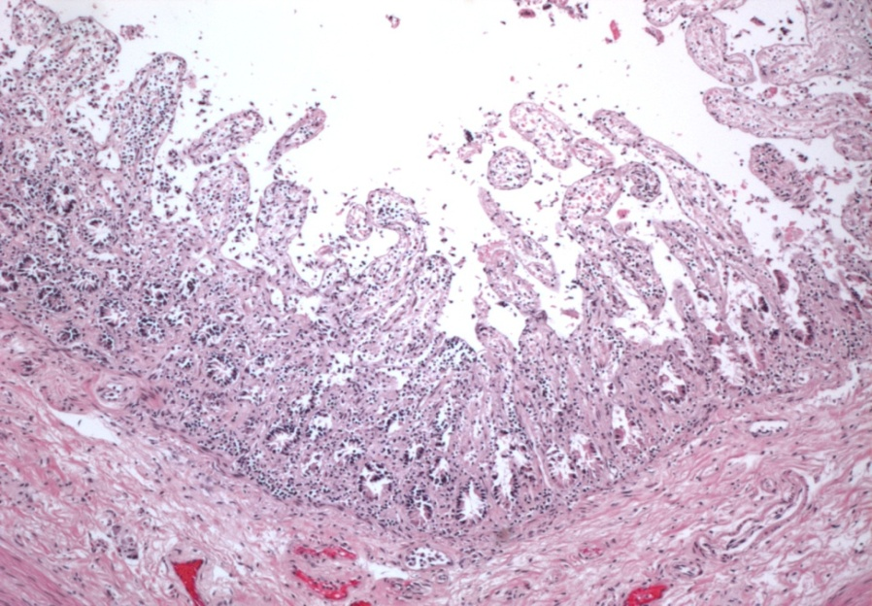
Delayed/Inadequate Fixation
Staining Artifacts
Adequate vs. Inadequate fixation of stomach
Gastric Mucosa lining the stomach shedding off due to improper fixation

Slide 12
Delayed/Inadequate Fixation

Slide 13
Epic oneChart Electronic Ordering and PPID for Anatomic Pathology Specimens
Cytology and Surgical Pathology Order Entry Tip sheet attached.

Slide 14
Epic oneChart Electronic Ordering and PPID for Anatomic Pathology Specimens
Purpose
EPIC Order
SoftID PPID
Cancel Order
EPIC Order only
Cancel in EPIC
Order Collected with SoftID PPID
call pathology to cancel order at 8-9042 option #2

Slide 15
Epic oneChart Electronic Ordering and PPID for Anatomic Pathology Specimens - Issues
Factors that prevent a successful process include but are but limited to:
Nursing turnover/training
Incomplete nursing LIS security
Nursing communication
Nature of Surgical Procedures (time allowances)
Pre-Ordering/Improperly ordering of AP Test(s)
Hardware Issues (i.e. label printer)
Network/Interface delays/issues

Slide 16
Conclusion
Use 20:1 Formalin to Tissue ratio
Use appropriate size specimen container
Use SOFTID PPID for all AP collected specimens
Communicate with Surgical Pathology/Cytology

Slide 17
CONTACT INFORMATION
Surgical Pathology
Jennifer Lehmann – 248-898-5981
Sharon Scalise – 248-898-5981
Ermal Guzi – 248-898-8266
Cytology
Donna Cary – 248-898-2021
Christopher Dalton – 248-898-9032

Slide 18
THANK YOU
Christopher Dalton
Sharon Scalise

