Slide 1
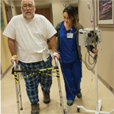
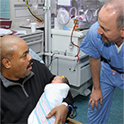
WELCOME TO
Beaumont Health’s
Service Model Training

Slide 2
Today’s session will help you
Understand our service model in the context of:
Living the Beaumont Health Mission, Vision and Values
Building our Culture of Caring Partnerships
Reviewing Patient and Family-Centered Care and its four core concepts
Notes:
Welcome and thank you for coming today to learn more about our culture at Beaumont Health!
During the past 2 years, with our consolidation of Beaumont Health, much work has been done to create a unified experience for our patients and families across the health system.
Today we are going to discuss what this means and how it effects all of us during our work day.
We will be learning about Patient and Family-Centered Care, our Mission, Vision and Values, and a new Service Model with a focus on Standard Behaviors.
Our goal to bring Beaumont Health together as we strive to provide care and service as one health system through our Mission, Vision, Values.

Slide 3
Mission, Vision and Values
Mission: Why we exist
Compassionate, extraordinary care every day
Vision: What we want to become
To be the leading, high-value health care network focused on extraordinary outcomes through education, innovation and compassion
Values: Guide our behavior and actions
Compassion
Respect
Integrity
Teamwork
Excellence
Notes:
So let’s discuss our Mission, Vision and Values…
Read slide now…
So living our Mission through our Values will intentionally create Beaumont Health’s Culture of Caring Partnerships, which supports the practice of Patient and Family-Centered Care.

Slide 4
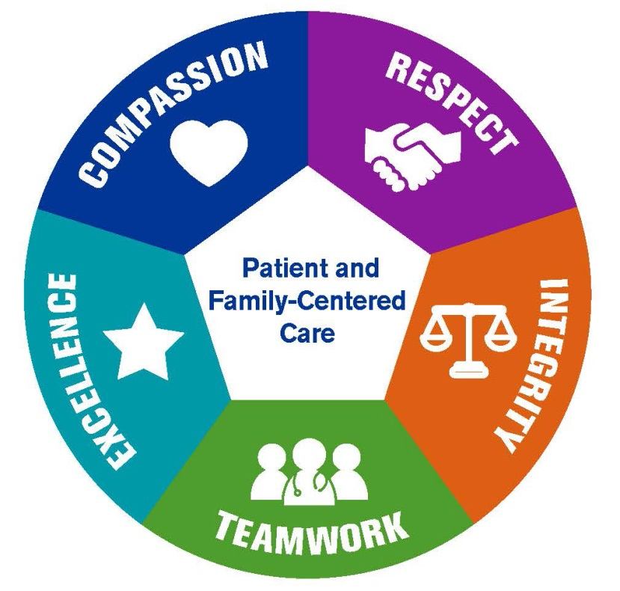
Beaumont Health’s Culture of Caring Partnerships
Our Mission: Compassionate, extraordinary care every day
Notes:
Our Values creates our Culture of Caring Partnerships and places Patients and Families at the center of all we do.
Embracing our “Culture of Caring Partnerships” makes Beaumont Health a place where we are privileged to partner with our patients and families, colleagues, and the community.

Slide 5
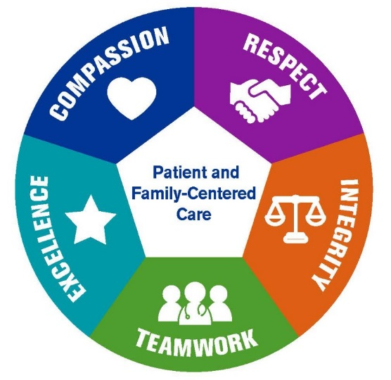
Family Presence
Patient Family Advisory Councils
Physician, employee and volunteer engagement
Service Model
Workplace of Choice
Culture of Safety
Quality
Other initiatives
Our Mission: Compassionate, extraordinary care every day
Notes:
Let’s connect the dots …
Our Culture of Caring Partnerships rests on our Mission and reflects our Values, with Patient and Family-Centered Care in the center.
You can see here many examples of programs and initiatives that build our “Culture of Caring Partnerships” including our Service Model.

Slide 6
Today’s focus
Service Model
Family Presence
Patient Family Advisory Councils
Physician, employee and volunteer engagement
Service Model
Standard Behaviors
10 Tactics
Workplace of Choice
Culture of Safety
Quality
Other initiatives
Notes:
Today, we will focus on the Beaumont Health Service Model.
Through our Service Model we will create an extraordinary “Patient and Family Experience” utilizing our Standard Behaviors for Service and our Tactics.
Our Tactics are “evidence based industry standards” and we anticipate adding Tactics once we master these.

Slide 7
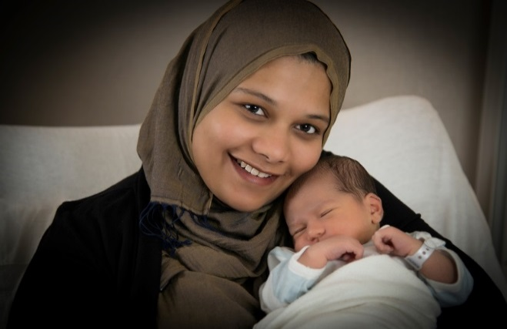
Why is Service important for our Patients and Families?
Research shows that high levels of service:
Provides a high quality and caring environment for our patients and their families
Aligns behaviors with goals and values
Honors individuals and respects choices

Slide 8
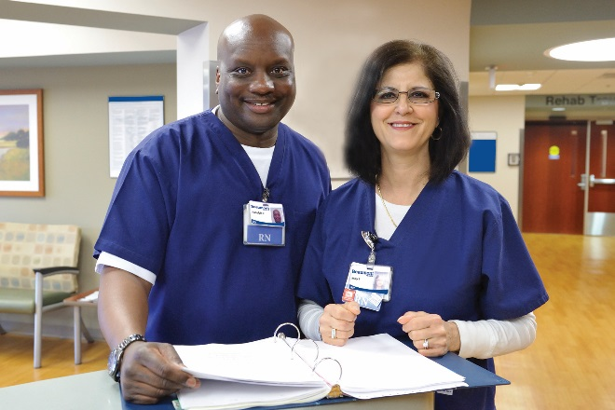
Why is Service important for our Team?
Research shows that high levels of service:
Provides a high level of employee satisfaction and engagement
Creates efficient and effective ways to provide care
Reduces turnover
Service is tied to Beaumont’s overall clinical outcomes:
Quality and safety
Patient satisfaction (CAHPS)
Value-based purchasing performance

Slide 9
BH Video- PFCC https://www.youtube.com/watch?v=mqYqUArB-Rk&feature=youtu.be
Notes:
How does Service fit into “Patient and Family –Centered Care at Beaumont Health?”
This is what our patients had to say…

Slide 10
Key Take Away
Consistency
every patient, every time— no matter what
Notes:
We are all Caregivers, providing care and service to our patients, directly in the field or indirectly in the office.
The Take Away is to create consistency based on our teamwork, for every patient, every time no matter what!!!
This is our opportunity to make a stronger connection with our Patients and Families to improve the “Patient Experience” at Beaumont Health!

Slide 11
Patient and Family-Centered Care is
an approach to planning, delivery, and evaluation of health care
built on mutually beneficial partnerships among patients, families, and providers
shaped by patient preference
about working with patients and families as partners in care rather than doing to and for them
Notes:
In health care, we know that Patients and Families are at the heart of what we do.
Patient and Family Centered Care is….

Slide 12
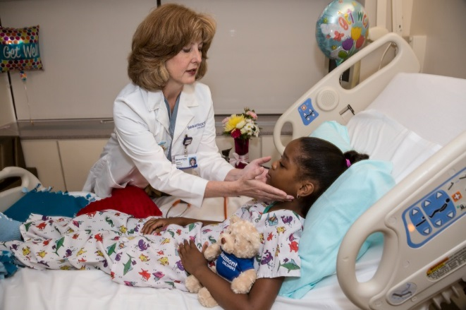
Patient and Family-Centered Care is based on four core concepts
Respect and Dignity
Information Sharing
Participation
Collaboration
The four core concepts guide how we approach care delivery every day.

Slide 13
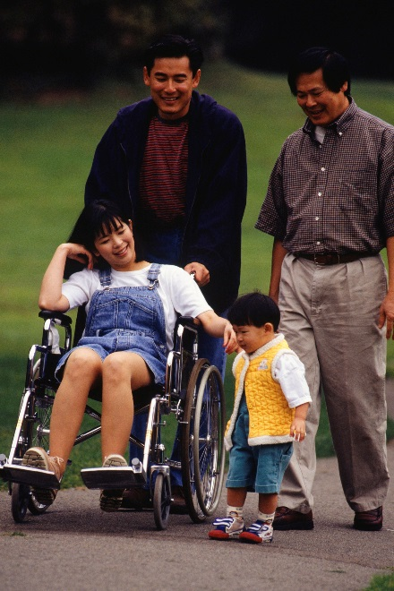
What is meant by the word “Family”?
Patients and families define and determine who their family is.
Families are recognized and welcomed as “partners in care.”
Notes:
What comes to mind when you hear the word “Family” ?
Probably your own Family…..
We want to be mindful of our “Patients and Families” and think about non-traditional family structures.

Slide 14
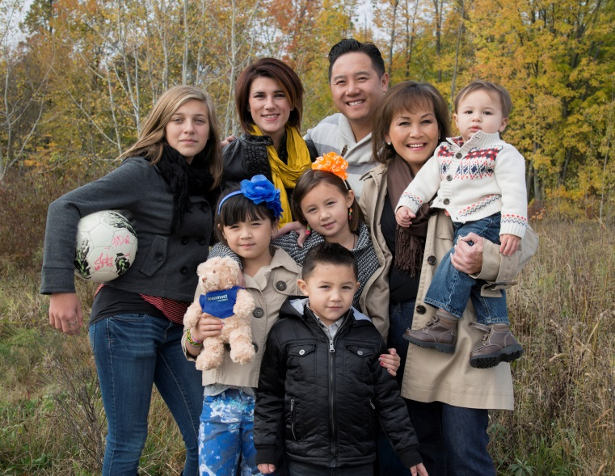
Always Remember
This is Family
We are Visitors
Notes:
Remember, we are guests in their home!

Slide 15
Beaumont Health’s Service Model
Standard behaviors for service: based on the four core concepts of PFCC
Tactics: derived from industry best practices
Notes:
Our Service Model encompasses both our……

Slide 16
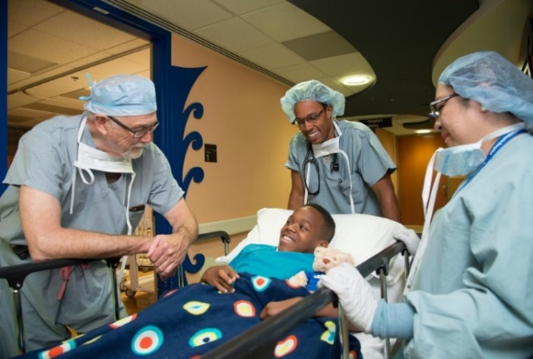
Goals for our Standard Behaviors for Service
Our Goal…
Is for all employees, physicians and volunteers to embrace the standard behaviors for service which promote the delivery of extraordinary, compassionate care every day.
Standard behaviors will be part of the new hire orientation, physician credentialing and our annual performance review.

Slide 17
Standard Behaviors
1. Respect and Dignity
Presence: I will show and will listen to and honor patient and family perspectives and choices. I will treat every patient and family as if he/she is the most important person in our facility by being fully present.
Diversity: I will incorporate patient and family knowledge, values, beliefs and cultural backgrounds into care planning and decision-making. I will value diversity and inclusion by showing care, courtesy and to patients and families I have contact.

Slide 18
Standard Behaviors
2. Information Sharing
Information: I will communicate and share complete and unbiased information with patients and families in ways that are useful and supportive following privacy rules and regulations.
Honesty: I will be professional and act with by being trustworthy, honest and timely in providing unbiased, accurate and complete information to patient and families to effectively participate in care and decision-making.

Slide 19
Standard Behaviors
3. Participation
Involvement: I will encourage and support patient and family participation as partners in their care and decision-making at the level they choose.
Responsiveness: I will take time to listen to and anticipate the needs of patients, families and team members and will proactively offer support. I will handle and address concerns presented to me.

Slide 20
Standard Behaviors
4. Collaboration
Ownership: I will work collaboratively in partnership with
patients, families and team members to ensure and a positive patient experience recognizing that patients and families are equal members of the care team.
Quality and Safety: I will commit to consistently provide safe, high quality care and service. I will acknowledge errors and report safety concerns and incidents in a timely manner and according to our policies.

Slide 21
Service Model Tactics
Care Rounding
Leader Rounding
Quiet Environment
After Visit Calls
After Visit Thank You Cards
Service Recovery
Phone Scripting
Employee Appreciation and Recognition
Service Performance Recognition
Communication Methods (AIDET, IDEAL, PEARLS, SBAR, etc.)
Notes:
Our Service Model Tactics are our actions or methods that are planned and used to achieve our goals.
More information about our Service Tactics will be shared in the coming months.
There will be ongoing dialogue and education to identify and implement “Service Tactics” in a Home Based Setting.

Slide 22
BH Video – Living our Culture https://www.youtube.com/watch?v=2IoZRWLaZIg
(link and thumbnail)
Notes:
This video shows how Beaumont Health employees are living our “Culture of Caring Partnerships” through our Values and Behaviors.
Post video…..
So when our Service Model comes together, everyone wins! …. Our patients, families and all of you.
Patients and Families leave the healthcare setting feeling empowered!!!

Slide 23
In Summary….
Each member of the care delivery team, including patients and families has an important role.
Let us mindfully focus on one patient and family at a time.
Let’s use our service model to partner with our patients and families to create an exceptional experience.
Notes:
Slide…..
As a final reflection… Please read the Standard Behaviors document, and make a commitment to consistently incorporate these behaviors into your day.
Thank you for attending, and in promoting a positive patient experience!
We invite you to be ambassadors for the new Beaumont Health Service Model through living our Mission of Providing Compassionate, Extraordinary Care Every Day.

Slide 24
What is next?
Don’t forget!
Please take a moment to go into your online
e-learning profile and complete the Service Model Training post test.
It is fast and easy and gives you credit for attending today’s session!

Slide 25
THANK YOU FOR PARTICIPATING TODAY!
Beaumont Health’s
Service Model Training

