Slide 1
MICROSCAN MISMATCHED RESULTS
Process Improvement Project
By: Mariam Imsaiah

Slide 2
WHAT DOES A MICROSCAN MISMATCHED RESULT ALERT MEAN?
Microscan Mismatched results occur when an isolate’s preliminary identification sent from SOFT does not match the Microscan final identification.

Slide 3
HOW TO PROCEED WITH A MICROSCAN MISMATCHED RESULT?

Slide 4
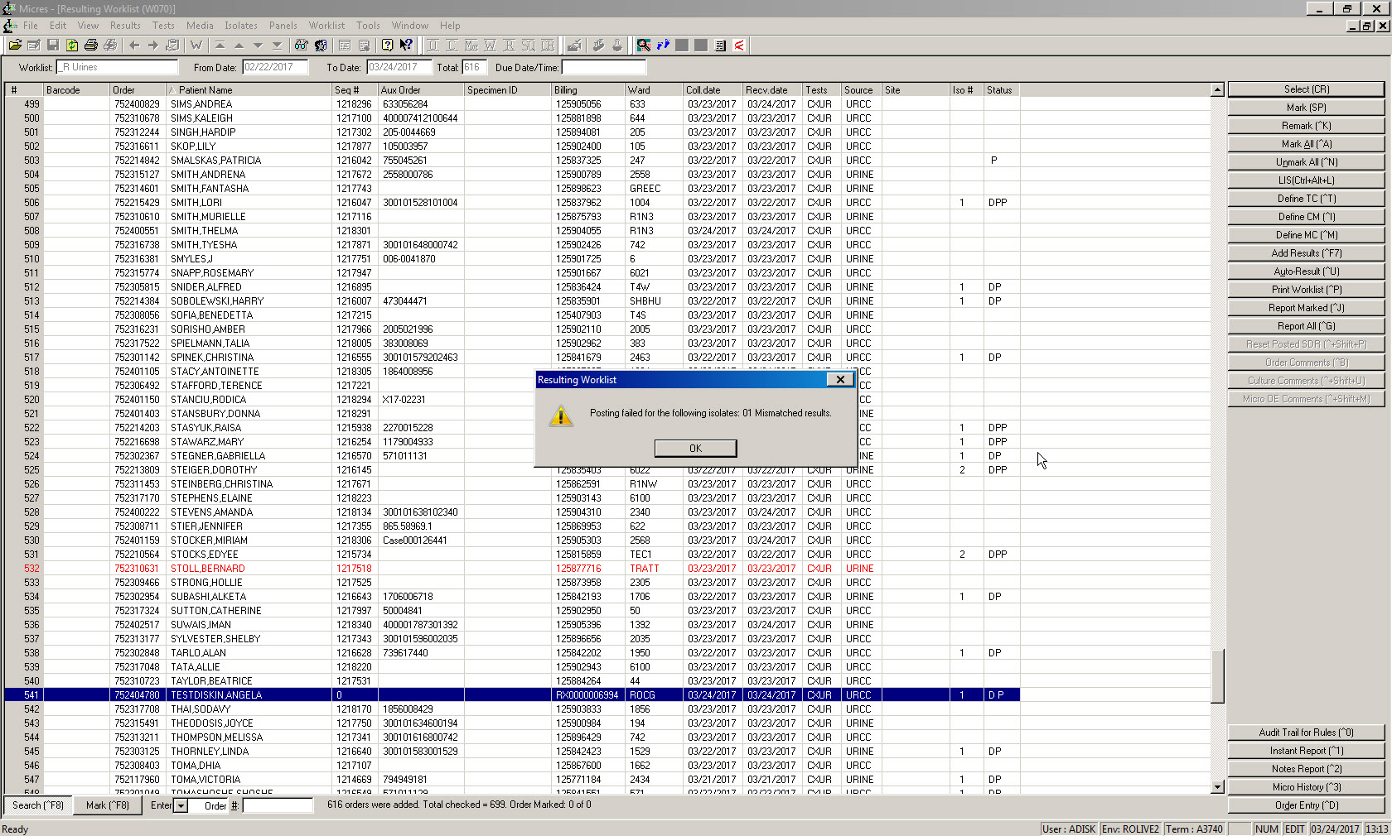
1. SCAN SPECIMEN, THIS ALERT WILL COME UP, CLICK OK

Slide 5
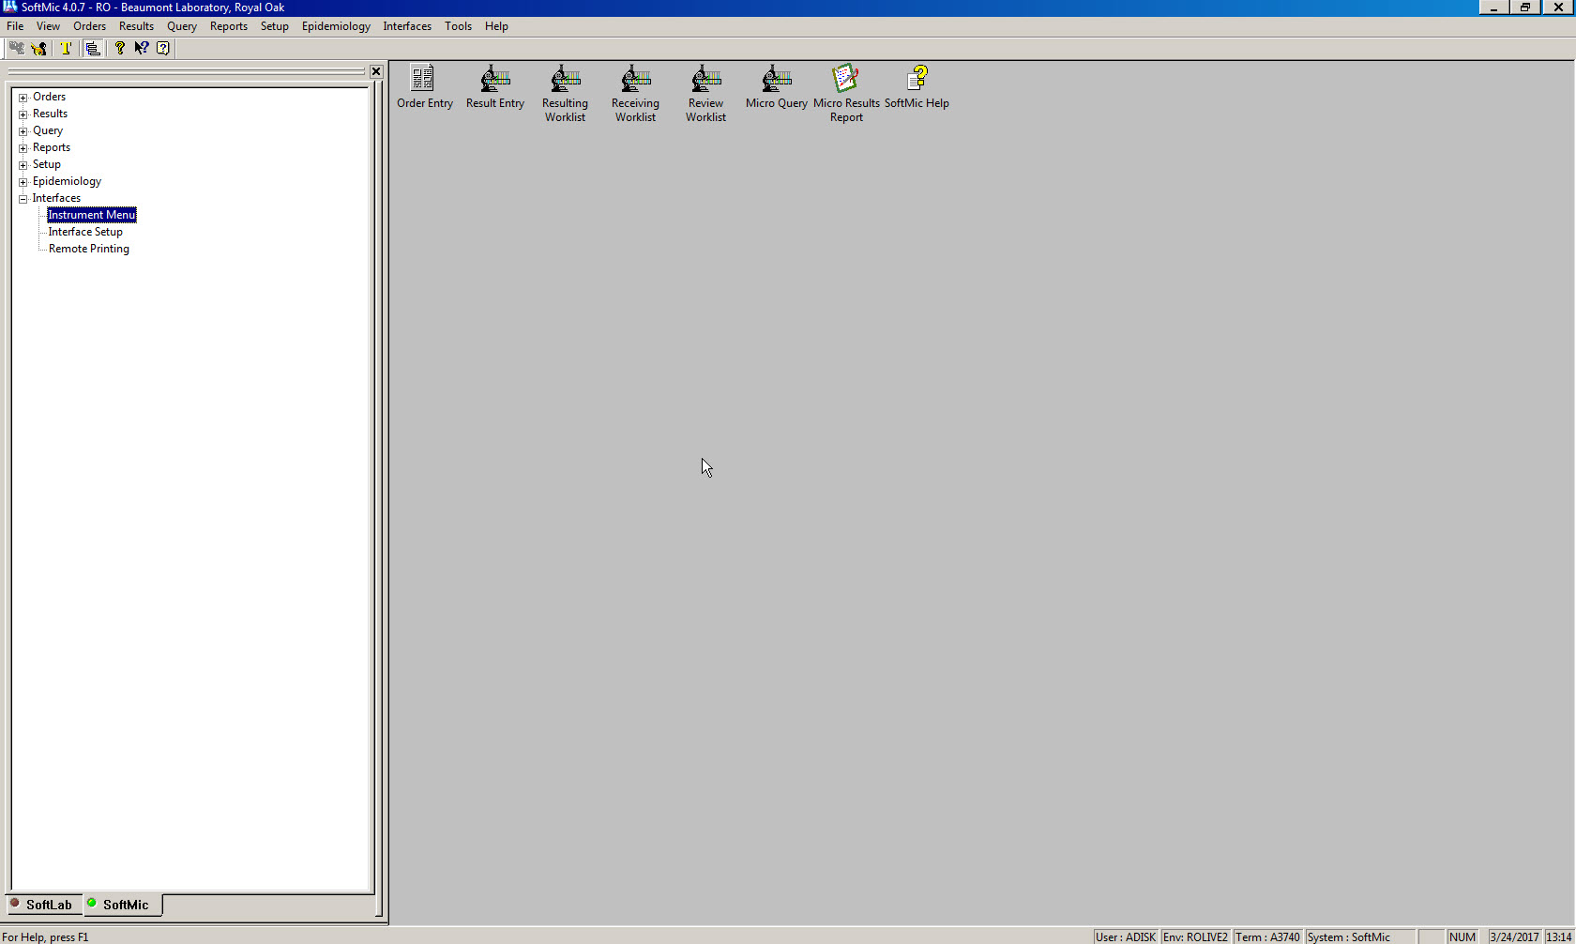
3. CLICK ON INTERFACE
4. SELECT INSTRUMENT MENU
2. ENTER SOFTMIC

Slide 6
5
6

Slide 7
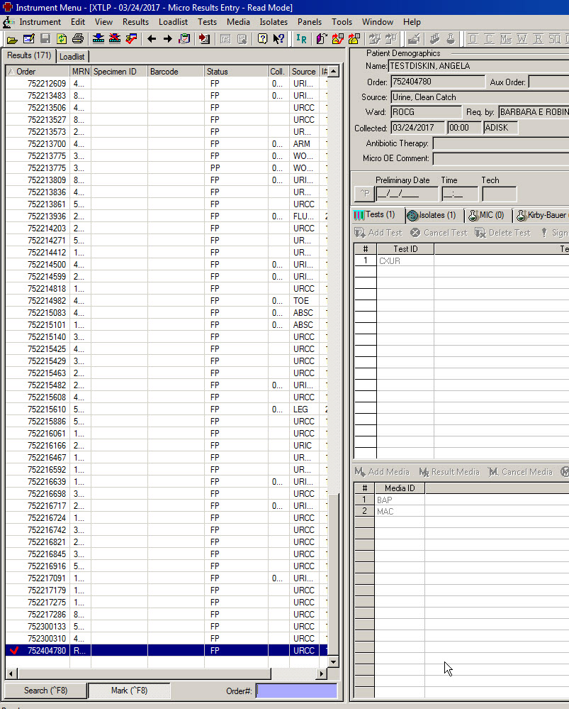
7. SCAN SPECIMEN AND SELECT IT

Slide 8
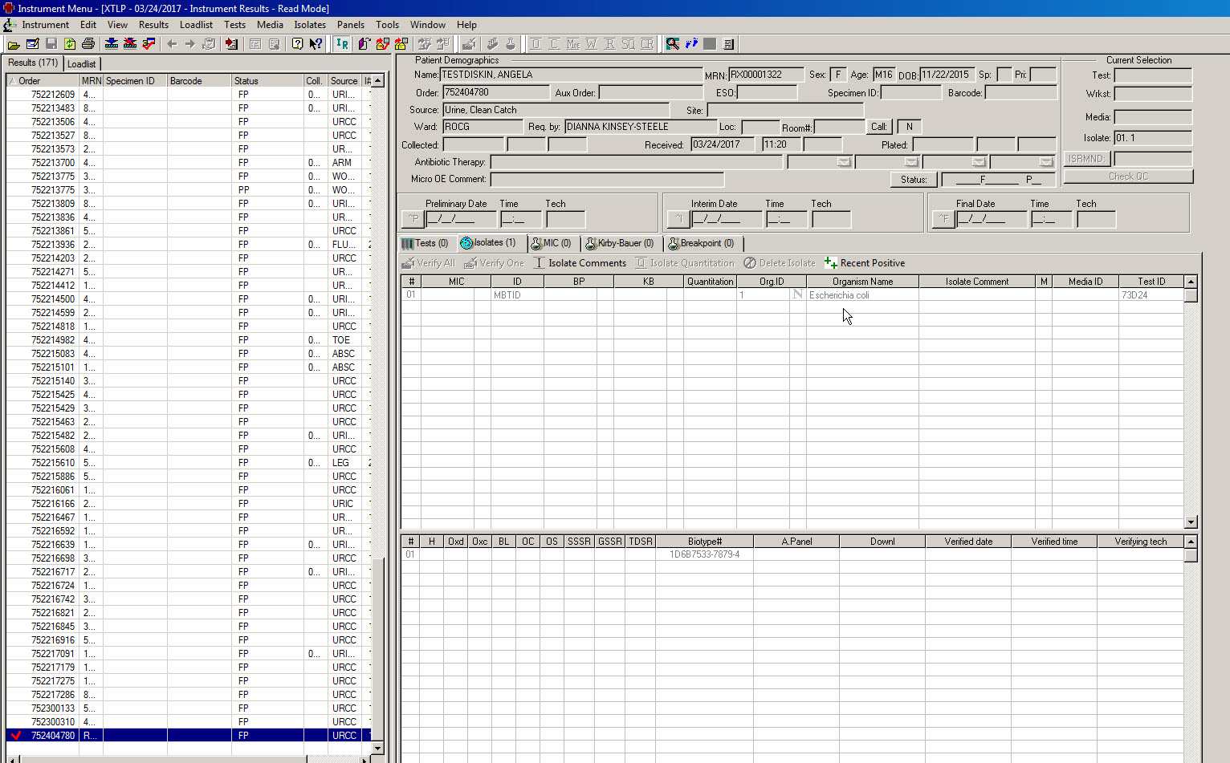
8. CLICK ON IR ICON
9. SEE ID

Slide 9
10. CLICK ON RED CHECKMARK ICON BELOW “TOOLS”

Slide 10
11

Slide 11
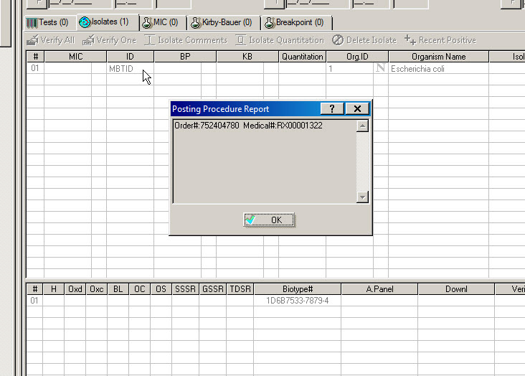
12

Slide 12
After previous steps, the Microscan result will be posted in SOFTMIC.
The medical technologist should troubleshoot why a mismatched result occurred and identify the source of error.
A corrected report needs to be made and called.

