Slide 1
Neisseria meningitidis Workup
Process Improvement Project
By Milad Latif

Slide 2
Learning Objectives
After completing this N. meningitidis workup training session, the user will be able to:
1- Describe the culture growth conditions for N. meningitidis
2- Identify the proper steps required for a suspected N. meningitidis culture.

Slide 3
Nature of the problem
Exposure to Neisseria meningitidis is a serious hazard in the microbiology laboratory.
Medical technologists may become exposed to this pathogen without knowing while
working up patient specimens.
The goal of this project is to inform the staff about the proper procedure for handling
specimens suspicious of containing N. meningitidis.
Ensuring the staff safety was the main reason behind choosing this issue to work on.

Slide 4
The project will address the following points:
Description of Neisseria meningitidis pathogenicity
Comparison to other morphologically similar organisms
Breakdown for the procedure
An MTS module will be created with review questions for the staff to complete as part
of their mandatory assignments in the lab.

Slide 5
Neisseria meningitidis
Neisseria meningitidis is an opportunistic pathogen which can colonize the mucous membranes of humans and may cause significant infection.
Medical laboratory technologists are at increased risk of acquiring infections when dealing with N. meningitidis isolates.
Requires 35-37C, with 5-10% CO2 for growth in the laboratory
Growth on Chocolate, Modified Thayer Martin (MTM) and Blood agars

Slide 6
Neisseria meningitidis
Neisseria meningitidis is a leading cause of bacterial meningitis and sepsis
in the United States. It can also cause focal disease, such as pneumonia
and arthritis.
Meningococcal Disease (very serious and can be fatal)
Symptoms include sudden fever, headache, and stiff neck. Other symptoms can
include nausea, vomiting, increased sensitivity to light, and confusion.

Slide 7
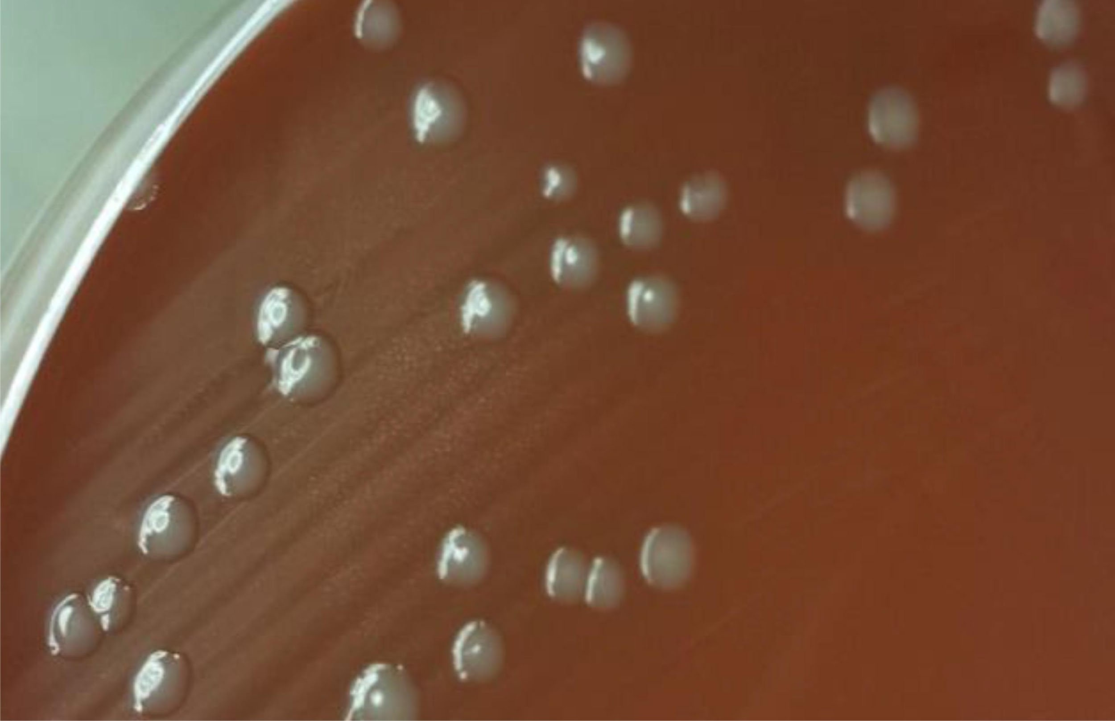
Morphology
Chocolate agar
1-2 mm creamy and gray colonies
Blood agar
Grey and non pigmented and appear
round, smooth, moist, glistening, and convex
N. gonorrhoeae may have similar morphology on Chocolate agar, but shouldn’t grow on blood agar except in rare cases.

Slide 8
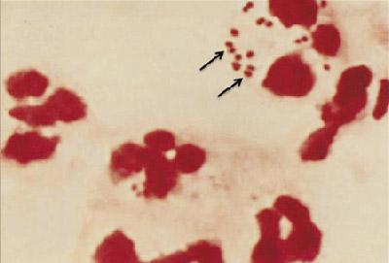
Gram Stain
Gram-negative diplococcus
May be seen intracellularly in PMN’s

Slide 9
Workup
Suspected colony on Chocolate agar + Growth on blood agar
Move to BSC hood
Perform Oxidase test on the suspected organism
Positive
perform gram stain on the suspected morphology

Slide 10
Workup - continued
Other
GNDC
GNCB
Possible N. meningitidis (send to MALDI TOF*)
ID is N. gonorrhoeae
ID is N. meningitidis
ID is Other organism
If MALDI is not available, perform RapID NH.

Slide 11
Workup - continued
ID is N. gonorrhoeae
ID is N. meningitidis
ID is Other organism
Report as presumptive N. gonorrhoeae and send to MDHHS
Report result according to appropriate procedure. Send to MDHHS only if from sterile site
Workup as appropirate

Slide 12
Notes:
When suspecting N. meningitidis, all procedures should be performed in a class II biosafety cabinet (BSC) because other safety equipment does not provide adequate protection from invasive disease.

Slide 13
Training Test
The gram stain shown to the right is:
Gram positive diplococci
Gram positive cocci
Gram negative diplococci
Gram negative bacilli

Slide 14
Training Test
The gram stain shown to the right is suggestive
of which organism?
Neisseria meningitidis
Haemophilus influenzae
Haemophilus haemolyticus
E. coli

Slide 15
Training Test
Growth of suspicious creamy gray colonies noticed on Chocolate agar with similar colonies on blood agar, the next appropriate step a tech should do is:
Re Incubate the plates for an additional day
Perform gram stain
Move the plates to bio safety cabinet (BSC) for processing
Send the suspected organism to MALDI

Slide 16
Training Test
Neisseria meningitidis should be reported to MDHHS in the following cases:
All the time
Isolated from pediatric patients’ specimens
Isolated from sterile sites’ specimens
Isolated from urine specimens

Slide 17
Training Test
You have a suspected colony growth on chocolate agar in addition to blood agar. The organism is gram negative diplococci oxidase positive. The laboratory technologist sent the specimen to MALDI. The next step the tech should do if the MALDI is not available is:
Send the specimen to MicroScan
Send the specimen to molecular testing
Perform RapID NH test
Report results based on gram stain and morphology

Slide 18
References
CASTILLO D, HARCOURT B, HATCHER C. Chapter 7: Identification and Characterization of Neisseria meningitidis. Centers for Disease Control and Prevention. https://www.cdc.gov/meningitis/lab-manual/chpt07- id-characterization-nm.html. Published March 15, 2012. Accessed May 5, 2017.
Characteristics of N. gonorrhoeae and Related Species of Human Origin. Centers for Disease Control and Prevention. https://www.cdc.gov/std/gonorrhea/lab/ngon.htm.Published October 17, 2008. Accessed May 1, 2017.

