Slide 1
MAX
C. difficile and Group B Streptococcus Results Interpretation
Process Improvement Project
By Milad Latif

Slide 2
Learning Objectives
After completing this BD MAX training session, the user will be able to:
1- Identify the correct viewing mode to interpret test results.
2- Describe the use of internal control in BD MAX test.
3- Identify invalid test results.

Slide 3
Nature of the problem
Technologists’ interpretation of the results from the system generated graph may be
different than the system interpretation. The graph doesn’t show scale on the Y axis
which poses a problem. Positive results might be falsely interpreted as negative
results.
The goal of this project is to illustrate to laboratory technologists the correct approach
to read the graphs and give multiple scenarios to ensure accurate reading of results.
PCR technology is an accurate method of testing. This project was chosen to ensure the staff understanding of the test results.

Slide 4
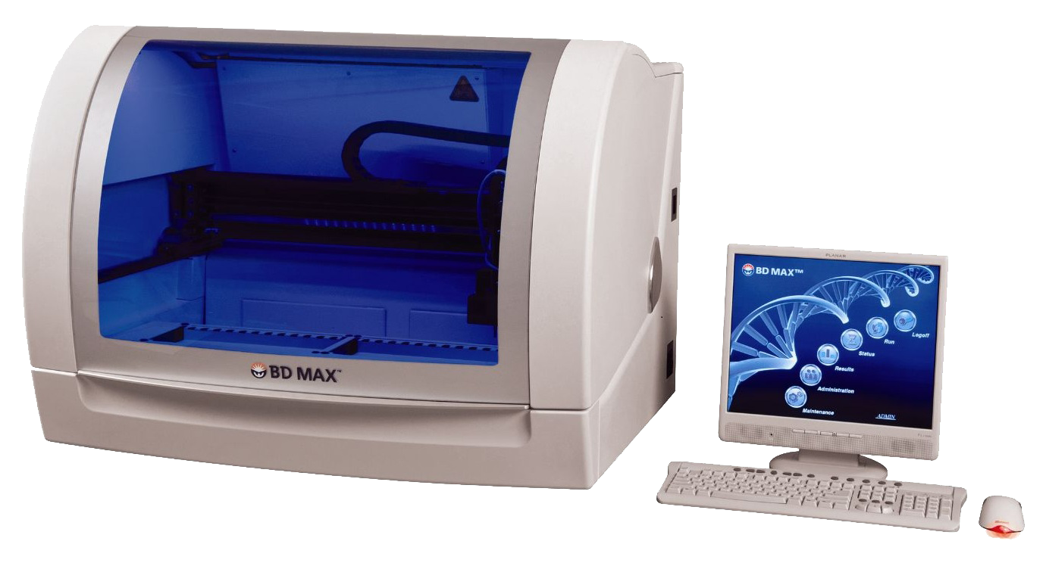
Plan of Action
The project will address the following points:
Group B strep and Cdiff assays methodologies
Real time polymerase chain reaction curve analysis
Results interpretation based on curve analysis
An MTS module will be created with review questions for the staff to complete as part
of their mandatory assignments in the lab.

Slide 5
Test Methodologies
BD MAX™Cdiff Assay
The test, performed directly on the specimen (human liquid or soft stool) utilizes real-time polymerase chain reaction (PCR) for the amplification of C. difficile toxin B gene DNA and fluorogenic target-specific hybridization probes for the detection of the amplified DNA
BD MAX™ GBS Assay
The test incorporates automated DNA extraction to isolate the target nucleic acid from the specimen (Lim Broth culture of vaginal-rectal swab specimens from antepartum pregnant women) and real-time polymerase chain reaction (PCR) to detect a 124 bp region of the cfb gene sequence of the Streptococcus agalactiae chromosome.

Slide 6
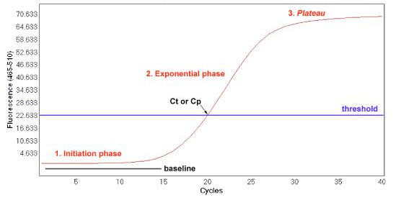
Real Time PCR Curve
The fluorescence emission during qPCR is proportional to the synthesized DNA, and can be visualized as an amplification plot.
Threshold is the level of signal that reflects a statistically significant increase over the calculated baseline signal
Crossing threshold (CT) value is the cycle at which fluorescence achieves a defined threshold.CT value is inversely related to the starting amount of target.

Slide 7
Baseline is the signal level during the initial cycles of PCR, usually cycles 3 to 15, in which there is little change in fluorescent signal.
Initiation phase: it occurs during the first PCR cycles where the emitted fluorescence can not be distinguished from the baseline
Exponential phase: at every cycle, the amount of product is doubled (assuming 100% reaction efficiency).
Plateau: No more product accumulates due to exhaustion of reagents and enzyme.

Slide 8
An Internal Control is provided in each BD MAX Assay. This internal control monitors the efficacy of the DNA extraction and PCR amplification processes. A test result may be called as NEG (negative), POS (positive), or IND (Indeterminate) based on the amplification status of the target and Internal Control.

Slide 9
Each curve should be checked individually. Every specimen should have two curves, one for the Internal control and one for the patient. The graph labeled 475/520 is the patient graph and the one labeled 585/630 is the internal control.
Internal control curve can take various shapes (sometime flat line) when the patient is positive and becomes irrelevant to the interpretation of the result.
On the other hand, internal control curve should be valid (a smooth curve in an upwards "s”-shape) when the patient result is negative.

Slide 10
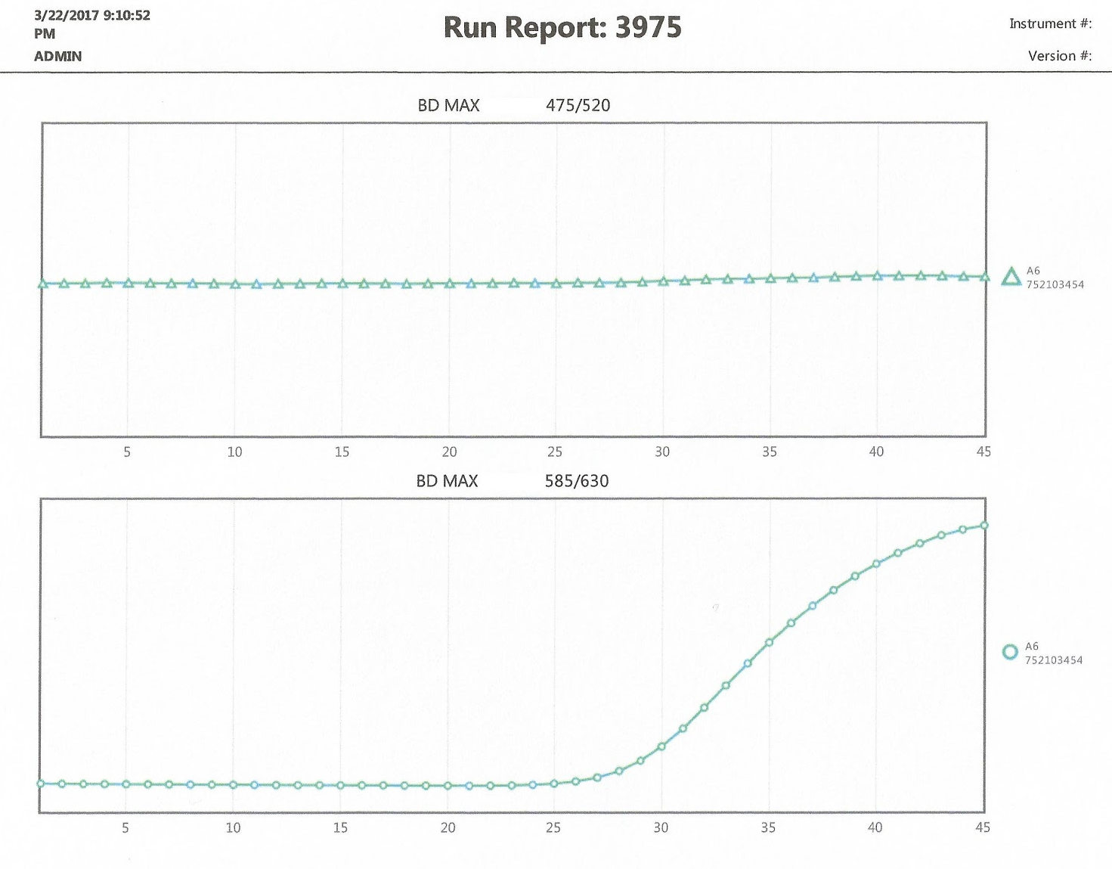
Negative Test Result
Negative Group B Strep or CDiff
Target curve
Internal Control
Target curve

Slide 11
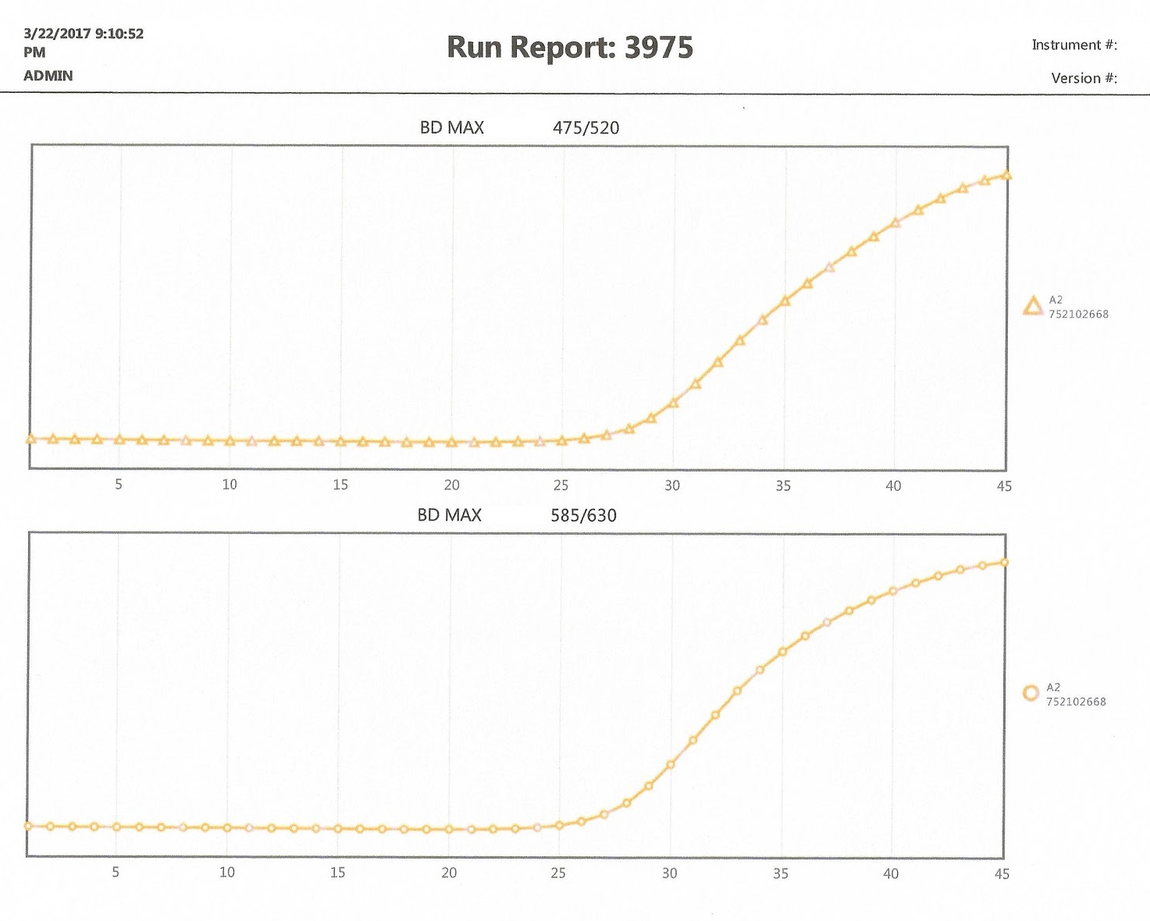
Positive Result. Example 1:
Both Patient and Internal Control Have Positive Curves.
Positive Group B Strep or CDiff
Target curve
Internal Control
Target curve

Slide 12
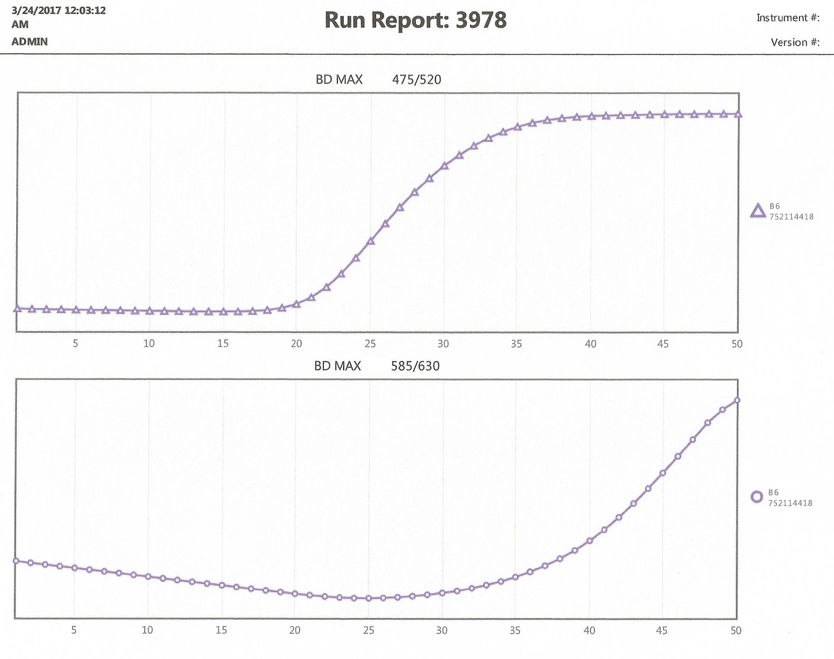
Positive Result. Example 2:
Positive Patient with Odd Internal Control*
Positive Group B Strep or CDiff
Target curve
* When patient result is positive, internal
control can be of any shape.
Internal Control
Target curve

Slide 13
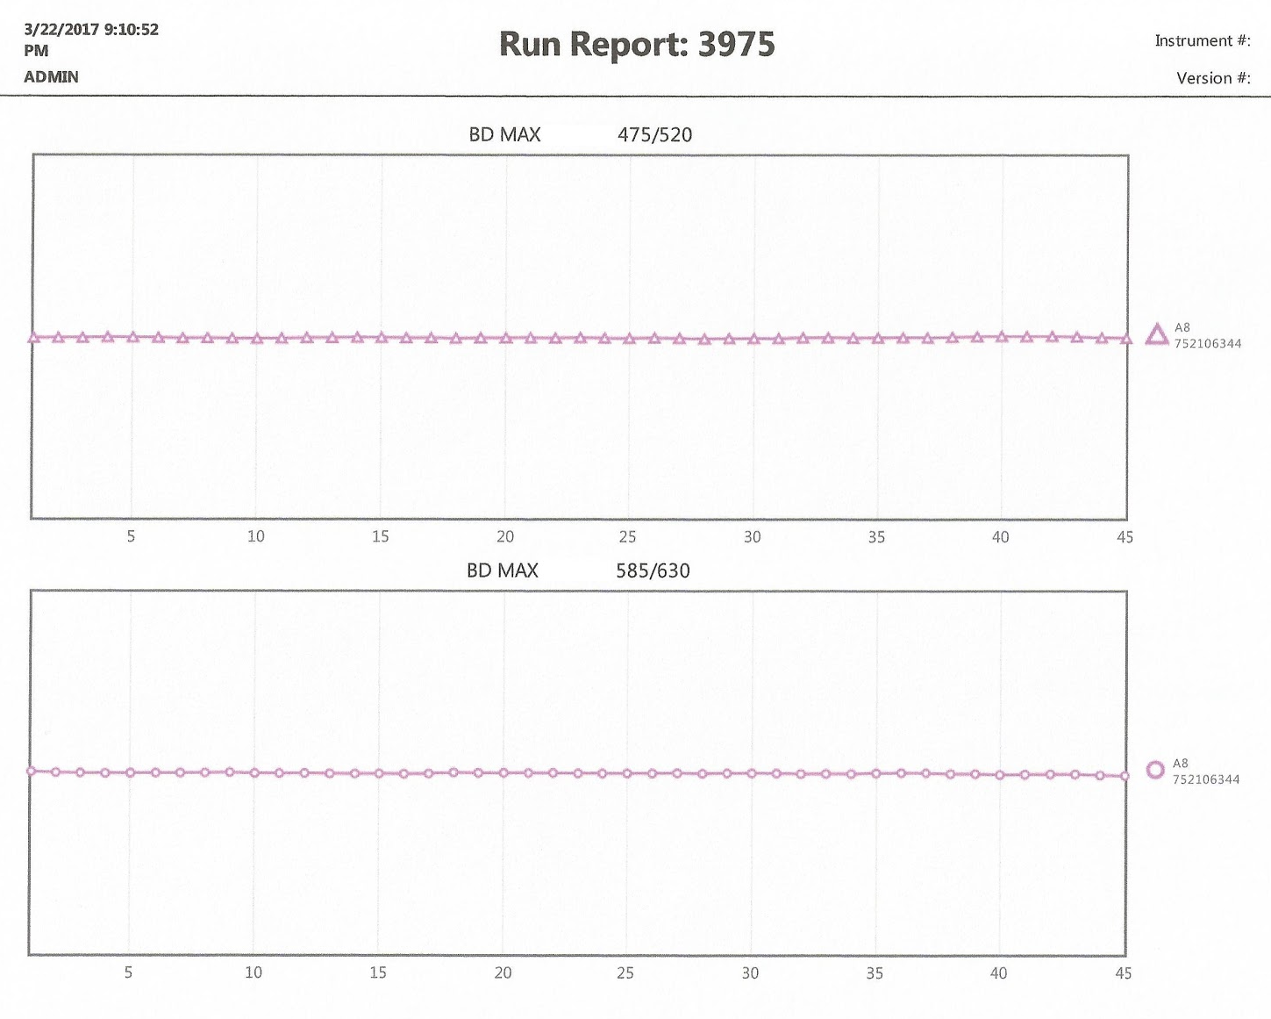
Example of Indeterminate Test Result
Invalid test result
Invalid Internal Control
When internal control is flat line
patient result can NOT be interpreted as negative

Slide 14
Indeterminate Results Procedure
In the case of Indeterminate test result on the BD MAX, follow the procedure outlined below:
Group B Streptococcus
Repeat once, If specimen remains indeterminate, result as such in a preliminary report
then do the culture.
C. difficile Toxin
Repeat once using the original stool specimen, if still indeterminate– send to Troy for alternate method.

Slide 15
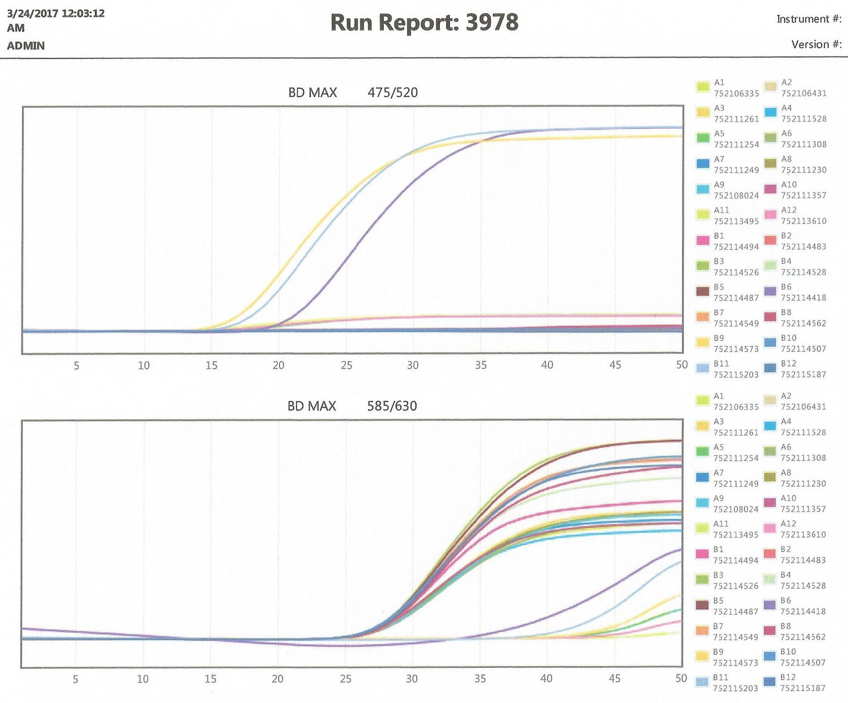
Proper interpretation of test results should always be performed on each test curve individually. It is not recommended to look at the whole test run results at the same time. BD MAX software does not offer scale for the Y axis which makes the interpretation of results inaccurate and misleading.
The report to the right shows only three tests to be positive while actually a total of six tests were positive.

Slide 16
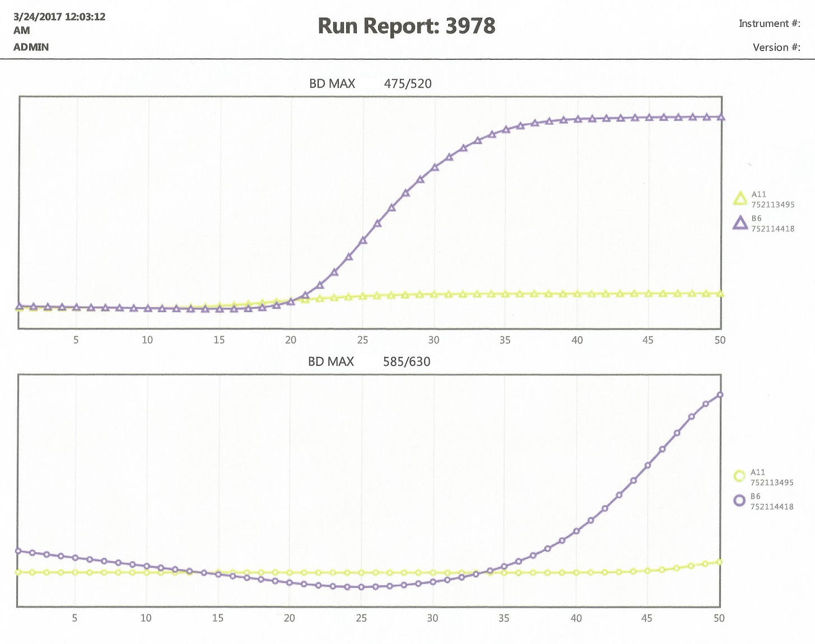
Upon observing the report shown to the right. It will be assumed that one test (B6) is positive and the other test (A11) is Indeterminate.
In the next slide, the results of each test will be shown in an individual report.

Slide 17
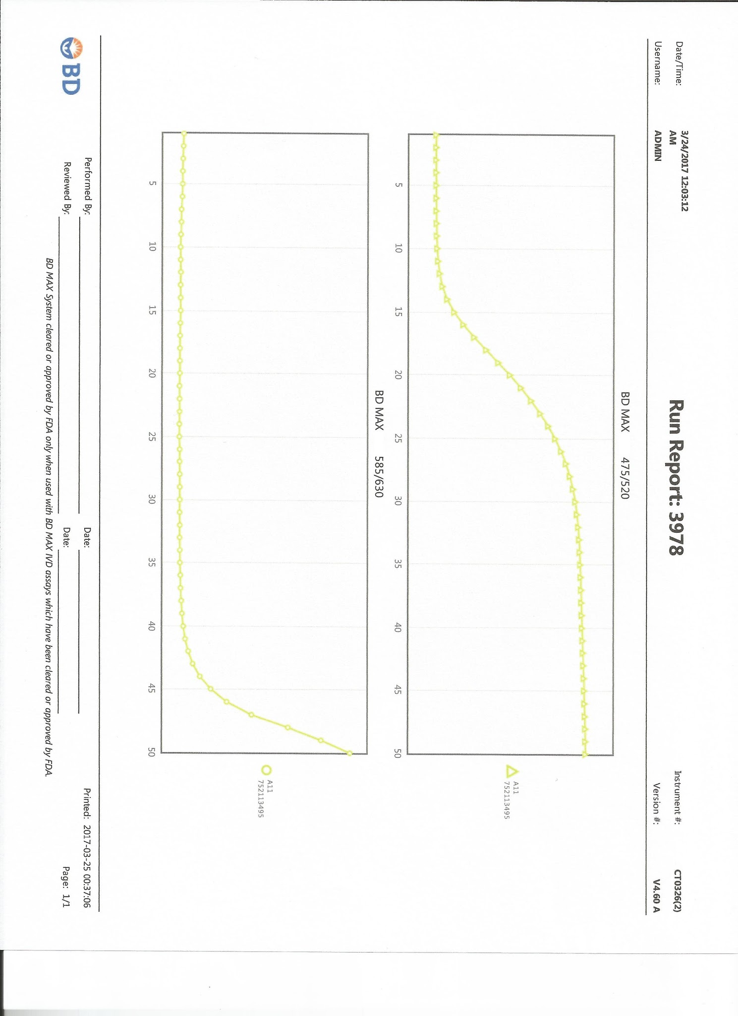
Positive
Positive
Both B6 and A11 are positive. Separating each test into an individual curve is recommended for accurate interpretation of results. Inconsistencies between the instrument results and the laboratory technologist interpretation will occur when reading multiple curves at once.

