Slide 1
Neisseria meningitidis Workup
Process Improvement Project
By Milad Latif

Slide 2
Learning Objectives
After completing this N. meningitidis workup training session, the user will be able to:
1- Describe the culture growth conditions for N. meningitidis
2- Identify the proper steps required for a suspected N. meningitidis culture.

Slide 3
Nature of the problem
Exposure to Neisseria meningitidis is a serious hazard in the microbiology laboratory.
Medical technologists may become exposed to this pathogen without knowing while
working up patient specimens.
The goal of this project is to inform the staff about the proper procedure for handling
specimens suspicious of containing N. meningitidis.
Ensuring the staff safety was the main reason behind choosing this issue to work on.

Slide 4
The project will address the following points:
Description of Neisseria meningitidis pathogenicity
Comparison to other morphologically similar organisms
Breakdown for the procedure

Slide 5
Neisseria meningitidis
Neisseria meningitidis is an opportunistic pathogen which can colonize the mucous membranes of humans and may cause significant infection.
Medical laboratory technologists are at increased risk of acquiring infections when dealing with N. meningitidis isolates.
Requires 35-37C, with 5-10% CO2 for growth in the laboratory
Growth on Chocolate, Modified Thayer Martin (MTM) and Blood agars

Slide 6
Neisseria meningitidis
Neisseria meningitidis is a leading cause of bacterial meningitis and sepsis
in the United States. It can also cause focal disease, such as pneumonia
and arthritis.
Meningococcal Disease (very serious and can be fatal)
Symptoms include sudden fever, headache, and stiff neck. Other symptoms can
include nausea, vomiting, increased sensitivity to light, and confusion.

Slide 7
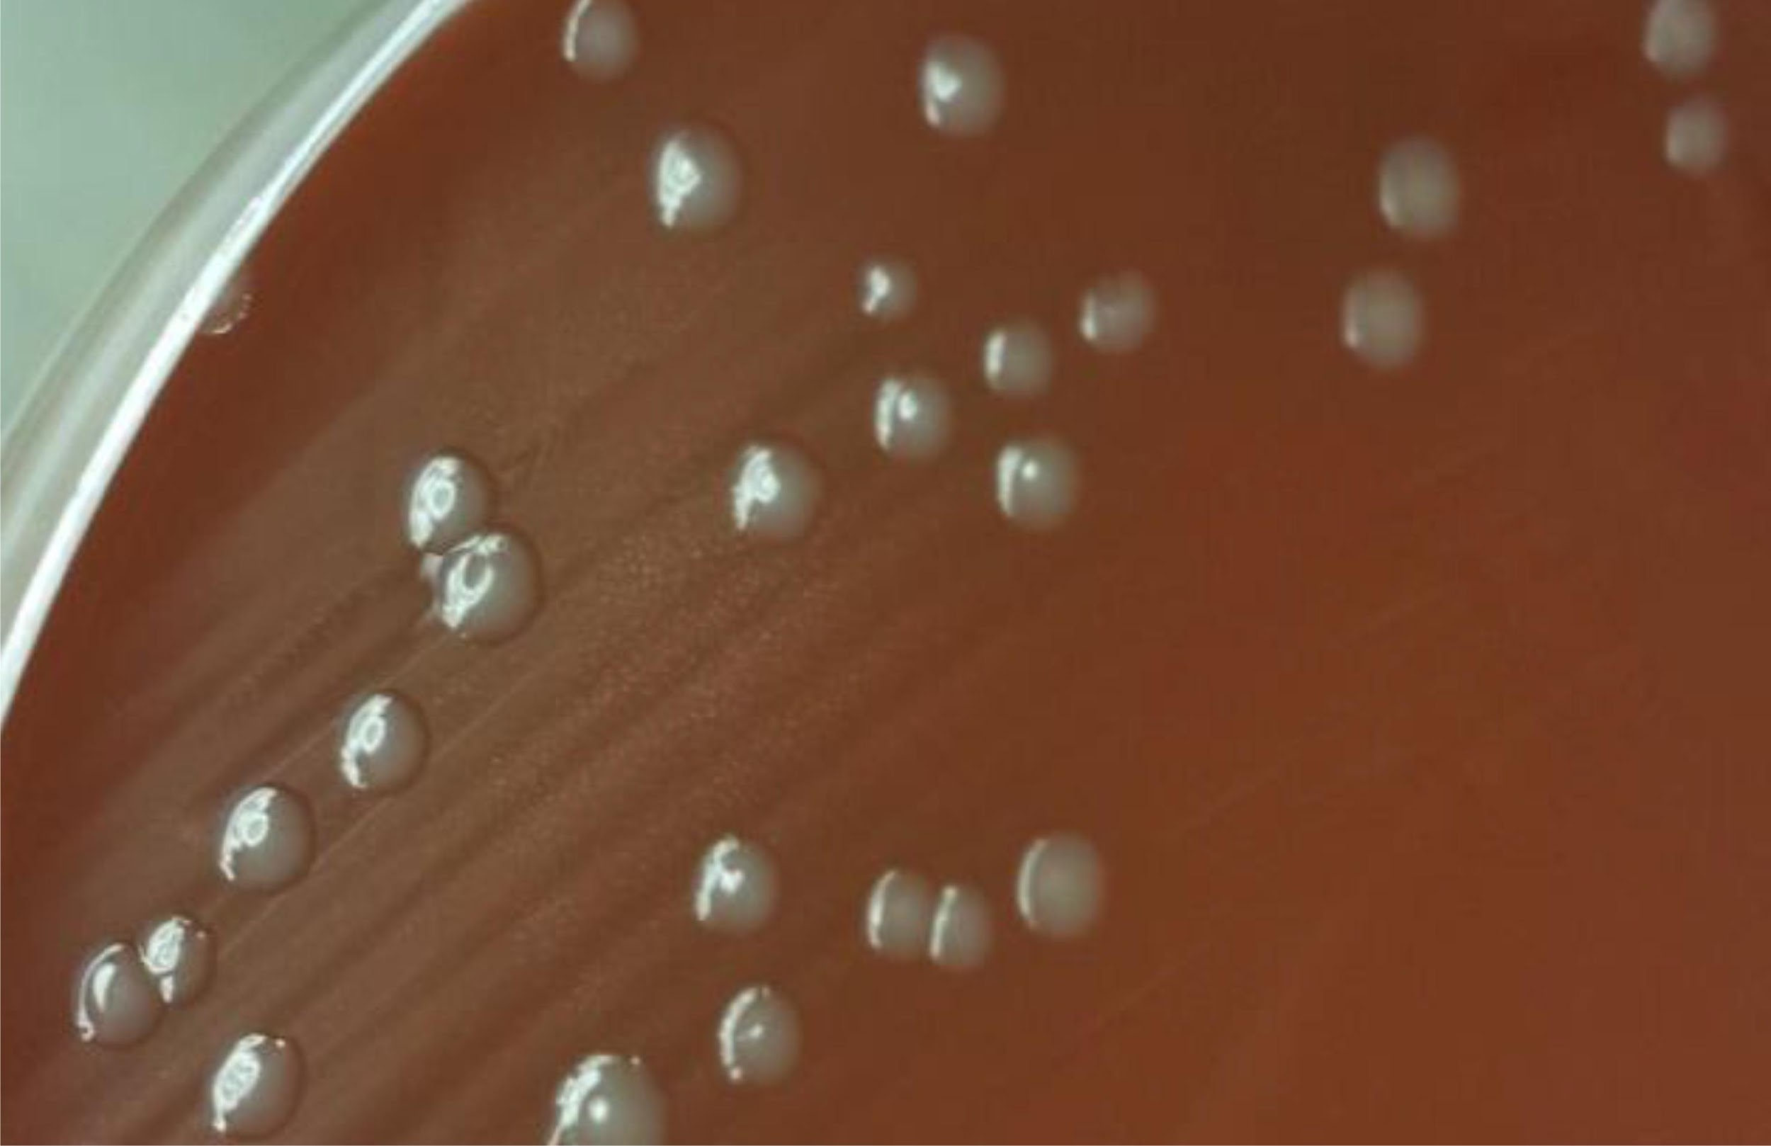
Morphology
Chocolate agar:
1-2 mm creamy and gray colonies
Blood agar:
Grey and non pigmented and appear
round, smooth, moist, glistening, and convex
N. gonorrhoeae may have similar morphology on Chocolate agar, but shouldn’t grow on blood agar except in rare cases.

Slide 8
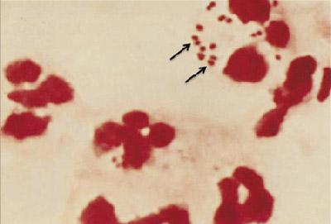
Gram Stain
Gram-negative diplococcus
May be seen intracellularly in PMN’s

Slide 9
Workup
Suspected colony on Chocolate agar + Growth on blood agar
Move to BSC hood
Perform Oxidase test on the suspected organism
Positive
Perform Gram stain on the suspected morphology

Slide 10
Workup - continued
Other
GNDC
GNCB
Possible N. meningitidis (send to MALDI TOF*)
ID is N. gonorrhoeae
ID is N. meningitidis
ID is Other organism
If MALDI is not available, perform RapID NH.

Slide 11
Workup - continued
ID is N. gonorrhoeae
ID is N. meningitidis
ID is Other organism
Report as presumptive N. gonorrhoeae and send to MDHHS
Report result according to appropriate procedure. Send to MDHHS only if from sterile site
Workup as appropirate

Slide 12
Notes:
When suspecting N. meningitidis, all procedures should be performed in a class II biosafety cabinet (BSC) because other safety equipment does not provide adequate protection from invasive disease.

