Slide 1
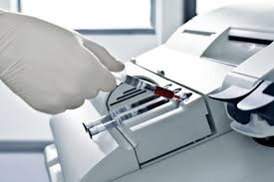
blood gases 2018
Running and resulting

Slide 2
Collection and receipt of blood gases
Arterial, venous, and cord blood is collected in heparinized syringe
MUST be on ice and received in the lab within ONE HOUR post draw
MUST contain no air bubbles
MUST be labeled correctly with the cap on

Slide 3
Instrument viability (Daily function checks)
Instrument QC and calibrations status should be reviewed at the beginning of each shift and periodically throughout the shift
The ABL radiometer is scheduled to run calibrations and QC throughout the day
It is the responsibility of the technologist to verify that the results of these are valid before running patient samples.
In the event that a calibration or QC parameter is out of range it is the technologist’s responsibility to troubleshoot the analyzer before running patients.

Slide 4
Why ice?
Icing the specimen reduces glycolytic activity in the sample
Glycolysis results in CO2 production
Blood gas results affected by not icing the sample include
pH → decreased
PO2 → decreased
PCO2 → increased

Slide 5
Why no air exposure? (NO bubbles!)
Exposure to room air occurs from
Uncapping specimens
Air bubbles introduced during collection
This exposure leads to changes in
pH → increase
PCO2 → decrease
PO2 → approaches 150mmHg (O2 pressure of ambient air)

Slide 6
Running blood gases
Specimens should be processed immediately when received in STAT lab
After the specimen is sampled
Express the resulting air bubble (caused by sampling)
Recap specimen (if cap was removed)
Place specimen back on ice
Specimen should remain sealed and on ice until results are reviewed and sent to the HIS

Slide 7
Automatic Hemoglobin corrections
The ABL will automatically correct for the presence of various types of hemoglobin
Most commonly we see the warning message for Fetal Hemoglobin correction on cord blood specimens
The presence of Sulfhemoglobin is also corrected for and will have a similar warning message at the bottom of the ABL printout

Slide 8
Sulfhemoglobin
The presence of Sulfhemoglobin in a blood gas specimen is a critical result!
Sulfhemoglobin cannot transport oxygen
Sulfhemoglobinemia can result from medications and exposure to SO₂, H₂S, trinitrotuene, or severe air pollution
This result will NOT flow into the LIS automatically
It is crucial that ALL blood gas printouts be reviewed for Sulfhemoglobin presence

Slide 9
What are you supposed to do?
When the warning message for Sulfhemoglobin is present the tech must:
Report the SUHBA field as present on the resulting screen
This will flag as a critical result in SOFT
Call the result as a critical to the floor
See resulting examples on the following slide

Slide 10
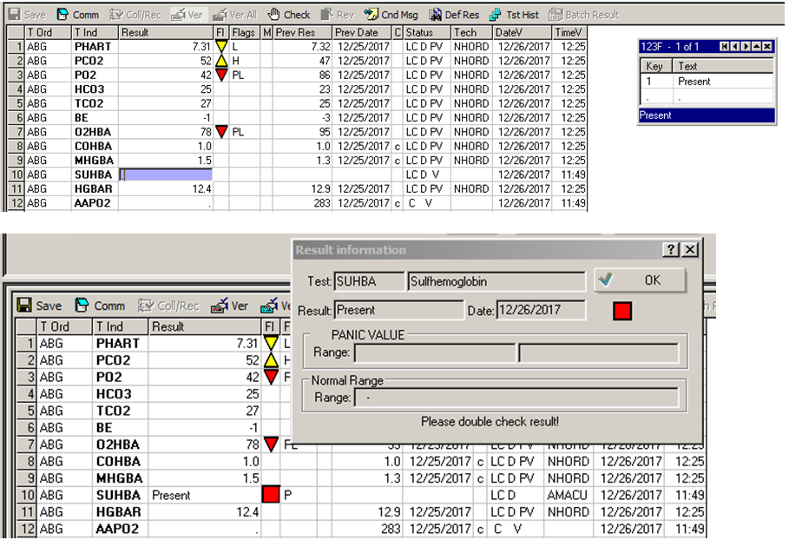

Slide 11
Please make sure to review and sign off on the updated SOP RC.CH.CSL.ABL.PR.001r05 Radiometer ABL 825 Blood Gas Analyzer Operating Procedure

