Slide 1
Competency Assessor Training Module
Sara Wagner MLS(ASCP)^{CM}

Slide 2
Definition of Competency
Competency is the ability of personnel to apply their skill, knowledge, and experience to perform their laboratory duties correctly.
Competency Assessments are required by federal regulation spelled out by CLIA.

Slide 3
Who Can Be an Assessor/Direct Observer?
Job title of Manager, Supervisor, Medical Technologist II, Medical Technologist, Cytogenetic Technologist, Cytotechnologist, or Molecular Pathology Technologist with a BS/BA degree in chemical, physical, biological or clinical laboratory science AND at least 2 years’ of training and/or experience in non-waived testing in the designated specialty/subspecialty area.
Trained and competent in the test systems and procedures they have been approved to assess.
Understands he/she is not permitted to do any self-assessments.
Demonstrates good communication skills.

Slide 4
CLIA
Clinical Laboratory Improvement Amendments (CLIA) of 1988 are United States federal regulatory standards that apply to all clinical laboratory testing performed on humans in the United States, except clinical trials and basic research.

Slide 5
CLIA and CAP
CLIA is the Law that puts forth certain standards that we in the lab need to maintain.
CAP is our CLIA Approved Accrediting Agency here at Beaumont
They enforce the regulations the CLIA law sets forth

Slide 6
CLIA Approved Accrediting Agencies
AABB
American Association for Laboratory Accreditation
American Osteopathic Association/Healthcare Facilities Accreditation Program(AOA/HFAP)
American Society for Histocompatibility and Immunogenetics
COLA
College of American Pathologists
Joint Commission

Slide 7
The 6 CLIA Elements of Competency Assessment
Direct observations of routine patient test performance, including patient preparation, if applicable, specimen handling, processing and testing;**
Monitoring the recording and reporting of test results;
Review of intermediate test results or worksheets, quality control records, proficiency testing results, and preventive maintenance records;*
Direct observations of performance of instrument maintenance and function checks;**
Assessment of test performance through testing previously analyzed specimens, internal blind testing samples or external proficiency testing samples; and*
Assessment of problem solving skills.*
*Employee Responsibility – Gather documentation
**Direct Observer Responsibility – Directly observe and document on Competency Assessment Checklist

Slide 8
Element 1
Direct observations of routine patient test performance, including patient preparation, if applicable, specimen handling, processing and testing;
Accomplished in Two possible ways:
Employee has a live specimen or CAP specimen at the bench for you to watch them do. (As they do this I like to ask about a scenario we don’t often encounter and what the correct course of action would be)
Oral Query – Direct observer asks employee to verbally explain stepwise how they would perform the procedure. (Again, ask a scenario question) Document this on the form in the “Comments” section that it was an Oral Query.

Slide 9
Element 2
Monitoring the recording and reporting of test results;
Accomplished in one way:
A screen shot of the results that have been reported in the LIS(Laboratory Information System).
* Be sure that the Technologist ID and date reported are clearly visible!!!!!

Slide 10
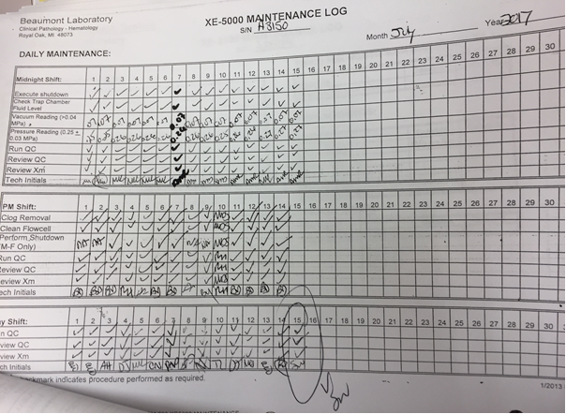
Element 3
Review of intermediate test results or worksheets, quality control records, proficiency testing results, and preventive maintenance records
Accomplished in one way:
Attach a photocopy of the corresponding bench maintenance log clearly displaying your initials as the maintenance performer/QC performer. (We need evidence of both) Some test systems have QC reported in the LIS so you can also submit a screenshot.

Slide 11
Element 4
Direct observations of performance of instrument maintenance and function checks
Accomplished in Two possible ways:
Employee performs some kind of maintenance (Daily/Weekly/Monthly/Quarterly/As Needed) while direct observer is present.
Oral Query - Direct observer asks employee to verbally explain stepwise how they would perform the maintenance. Document this on the form in the “Comments” section that it was an Oral Query.

Slide 12
Element 5
Assessment of test performance through testing previously analyzed specimens, internal blind testing samples or external proficiency testing samples
Accomplished in Three possible ways:
Proficiency Samples (provide proof with your date and initials)
Blind sample created by department (Old QC or a previously reported patient designated by management)
MTS Quiz (You must achieve a 100% passing score)

Slide 13
Element 6
Assessment of problem solving skills
Accomplished in Three possible ways:
Writes explanation of what to do if QC was unacceptable or limitations of procedure.
Performs troubleshooting and provides a screenshot. (Ex: Failed QC)
MTS Quiz (Our MTS quizzes include questions on limits and troubleshooting)

Slide 14
Things to Remember
You must assess someone twice within their first year of employment
Once in the first 6 months
Once before their first year is up
Training does NOT count as Competency assessment!!
Competency Assessment must be done annually after the first year
If someone who is a long standing employee with consistently trustworthy performance, you do not have to do the 6 month competency assessment with them when they are trained on a new bench. They can simply lump it in with their annual competency assessment the next calendar year.
We set a deadline of June 30th every year
Direct observers need to be competency assessed themselves by another assessor! No self assessment!

Slide 15
Thank You
Any questions or concerns can be brought to the attention of your educational coordinator in your lab section.
Please review the Competency Assessor Roster 2018 on the next slide.

Slide 16
