Slide 1
PI: Implementing A Molecular SharePoint Site
Molecular Pathology Laboratory
Amy Karle
Anne Prada
John Gibson

Slide 2
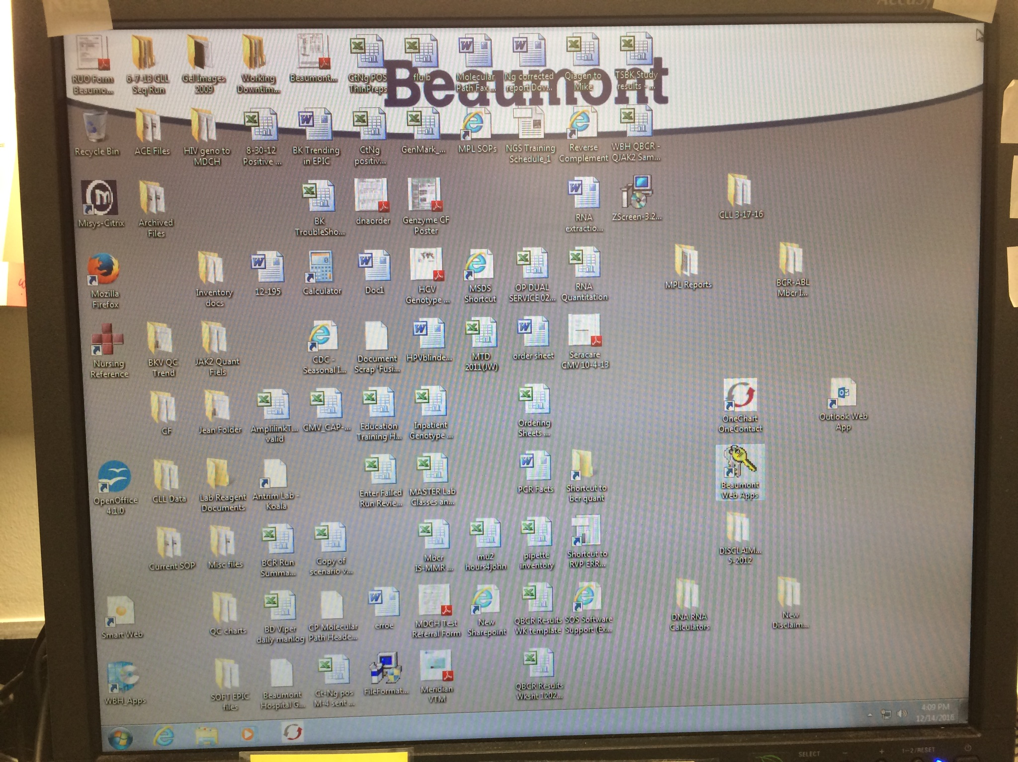
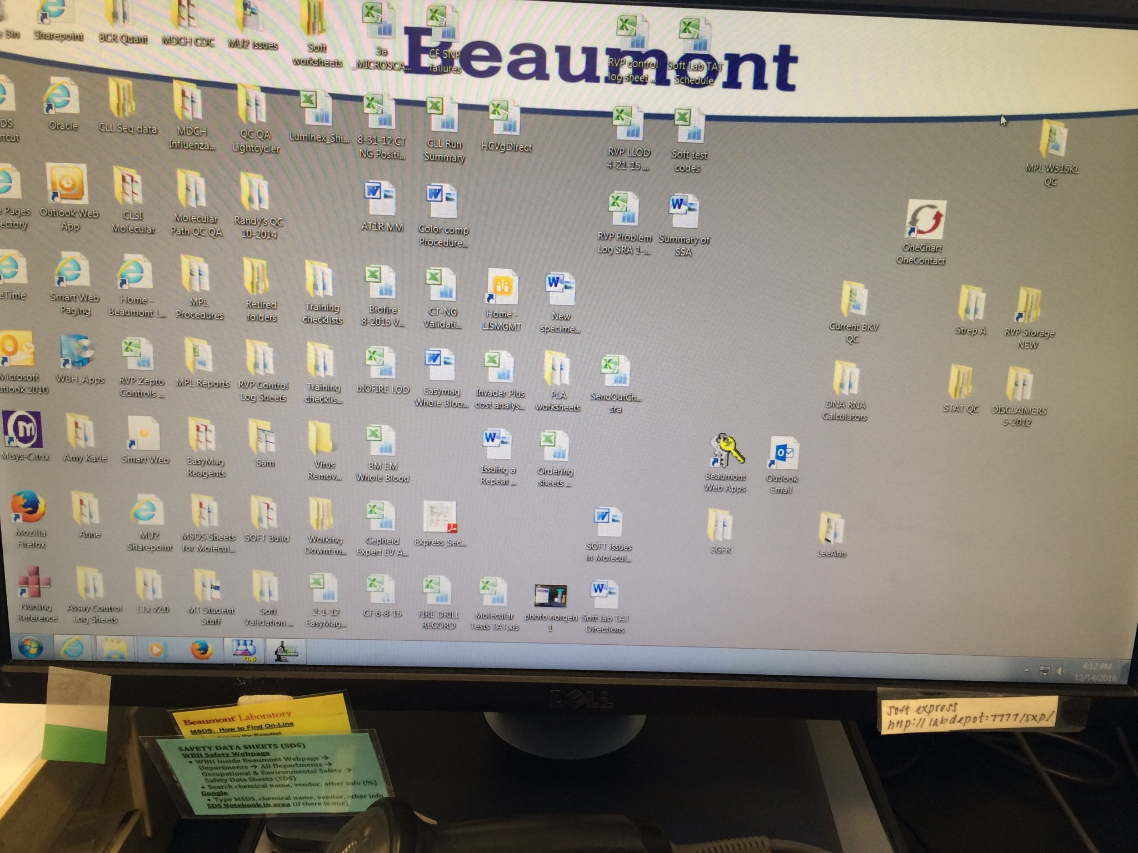
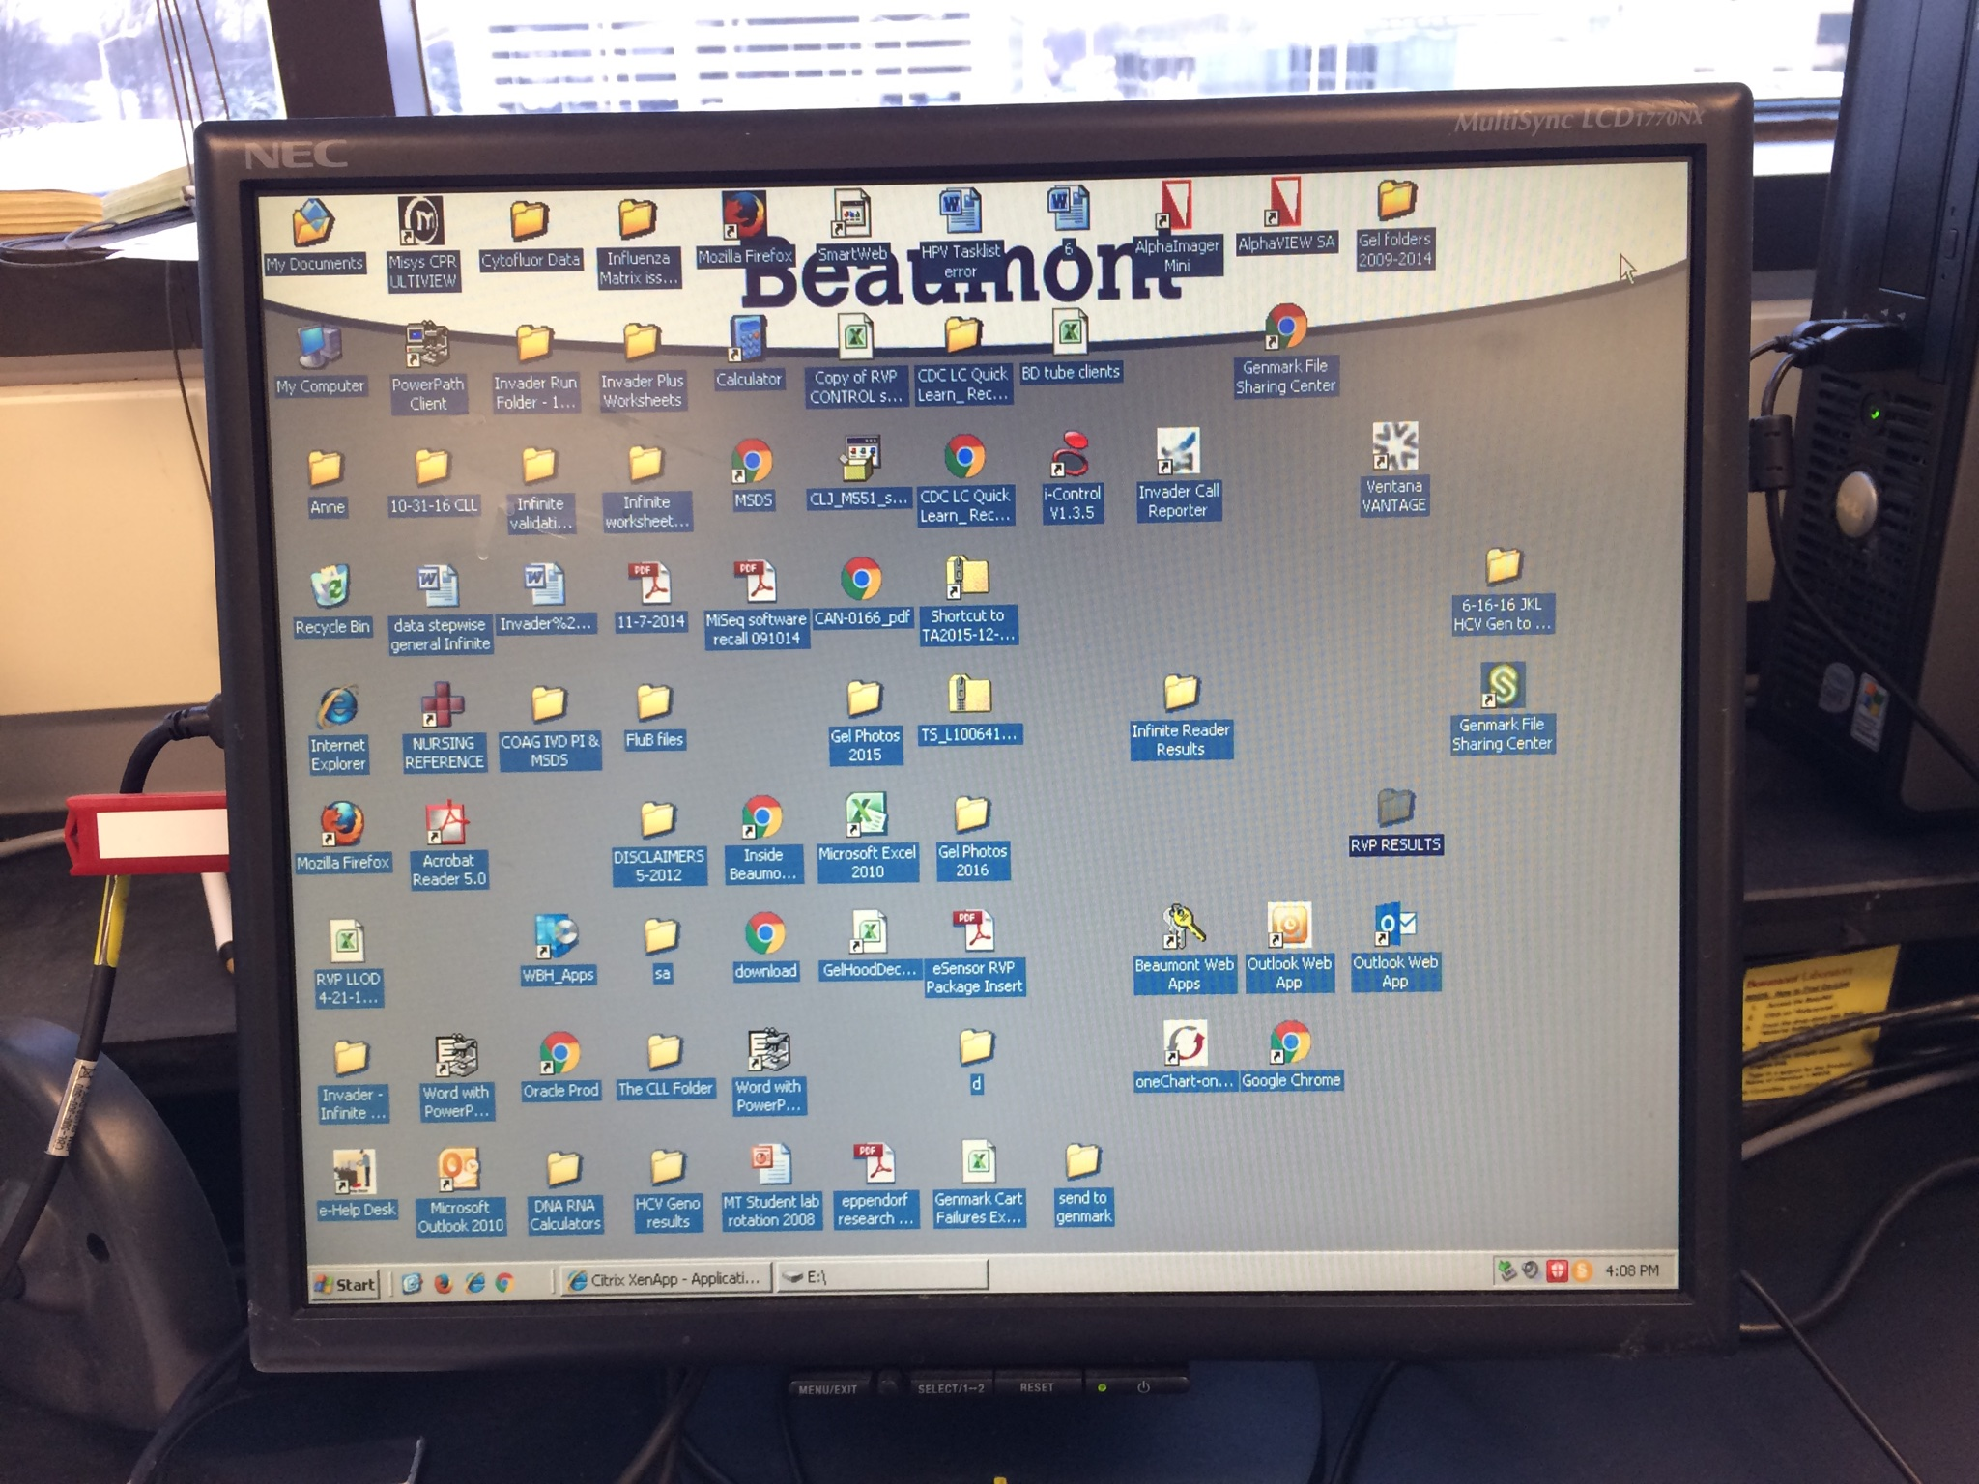
Utilizing Kaizen-Lean-HRO Principles: Improve Day to Day Operations Prevent A Patient Safety Issue
Issues: Molecular Lab desktops were used to save any document/file/website with no over site or updating.
A critical file with patient charting information was located on one hard drive without backup.

Slide 3
Sensitivity to Operations
MOL Lab QC/QA Documentation Issues
Providing Quality of Care Unique QC/QA documents are developed in lab to meet CAP requirements for Modified FDA and Lab Developed testing.
Molecular Inter Laboratory IT limitations Molecular QC/QA documentation not easily supported with SOFT Total QC. Beaumont IT did not support easy file sharing (before SharePoint). S: drive not accessable by all staff.
Document Control Keeping copies of QC documents on various pc’s to facilitate workflow led to multiple versions adding confusion and inconsistancies.
Issues Identified Staff limited access to usable workstation files, correct electronic data and QC files; affecting workflow and TAT.

Slide 4
“DEFERRING TO OUR SHAREPOINT EXPERTS” Patrick Flynn and Cindy Jagger A Molecular Laboratory Site Was Planned and Implemented: Jan 2017.
Features
Molecular SharePoint workgroup met to layout features.
Molecular SharePoint

Slide 5
Patient Safety and “Preoccupation with Failure”
BCR/ABL Quantitation Patient Charting
Providing Quality of Care Resulting BCR/ABL Quantitation requires trend analysis when reporting patient history of Major Molecular Response (MMR).
Limitation of LIS - Molecular Suite SOFTMOL does not trend patient results. Historical chart review is limited in EPIC and MISYS.
One Excel File Molecular maintained a data file of each patient containing result history for BCR/ABL Quantitation Analysis testing. This file existed on one laboratory desktop. (197 patients, from ~2007). No backup file was maintained.
Issue Identified Deletion or corruption of the Excel file would cause irretrievable loss of patient data and staff data input time.

Slide 6
Again, “Deference to Expertise”
We Consulted With Our SharePoint Experts
Identified Solution
A searchable database could replace the Excel file.
The database could be built from existing Excel file.
IT would backup database
Staff could add/update patient files from any computer
SharePoint provides data security for PHI.

Slide 7
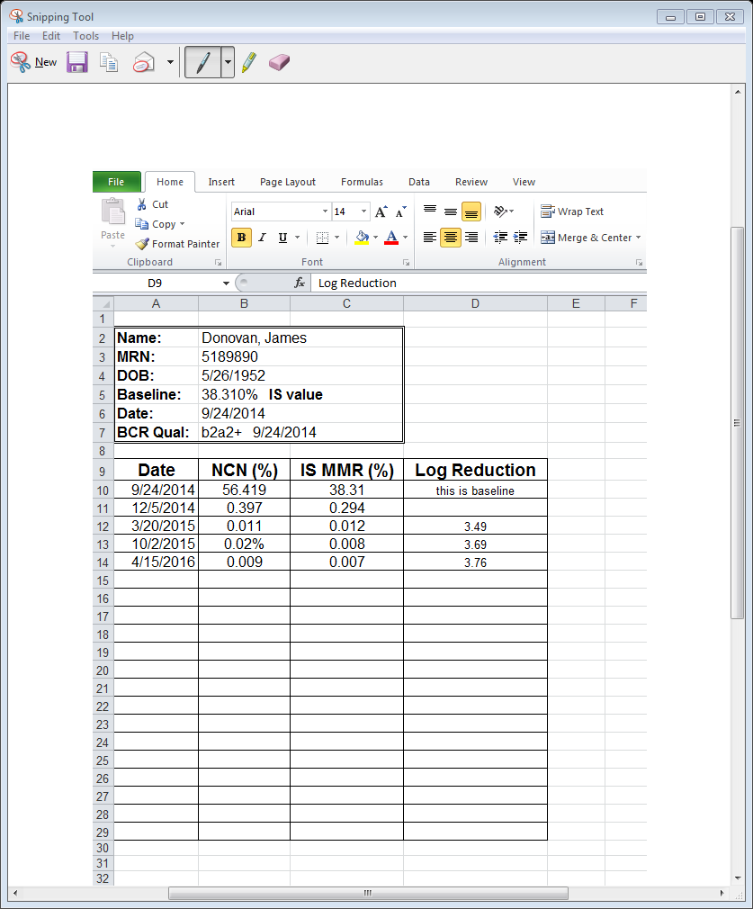
Staff Performs Patient Trend Analysis BCR/ABL Patient Database on Sharepoint Molecular SharePoint
Original BCR/ABL Patient File
Resolution?
BCR/ABL Quant. resulting remains a very manual exercise for the staff.
LIS resolutions to consider: Reporting BCR/ABL Quant in SOFTLAB..

Slide 8
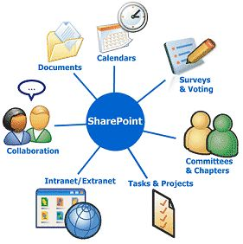
Molecular SharePoint Site Implementation: Other Thoughts
Staff have full access to Molecular site
Staff folders replace use of USB drives and desktop folders
QC data files are easily reviewed by management staff
Original documents stored on S: Drive
Could make use of “Task” features

Slide 9
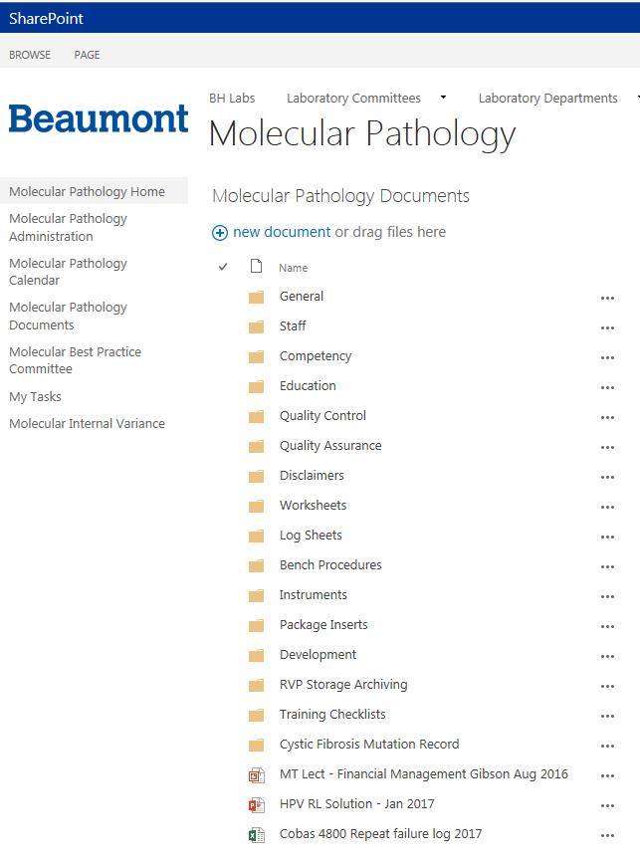
Pending Issues:
Molecular SharePoint Site (Nov 2017)
Site organization still in progress
Some original documents need revision
Documents controlled with conversion to PDF
Workstation software versions do not match
Implementing full use of documents (Pre-Analytical Monitoring, Repeat Testing)
Variance Reporting linked to Management Staff and Director (in progress)

Slide 10
Variance/Root Cause
BK Virus Quantitation Assay Internal Control Failed and Again Upon Repeat
Why An Internal Control DNA introduced to each patient specimen at extraction was “Undetected” by qPCR in all samples; upon repeat extraction and testing the process failed again.
Why “Undetected” Internal Control DNA indicated: 1) Internal Control DNA was not added to the extraction, 2) Internal Control DNA had degraded, 3) Internal Control Primers/Probes failed or were missing from the qPCR reaction.
Why With investigation 1) A new BK qPCR reagent was used 2) An outdated QA Reagent Verification Worksheet was used to make up the qPCR reagent incorrectly. 3) QC review of the reagent verification test missed the error.
Why Old and new worksheets were available in BKV QC/QA books. Also, the current worksheet had yet to be moved to SharePoint.

