Slide 1
The Importance Of Accurate Calibrations
Beaumont Royal Oak – Automated Chemistry
2018

Slide 2
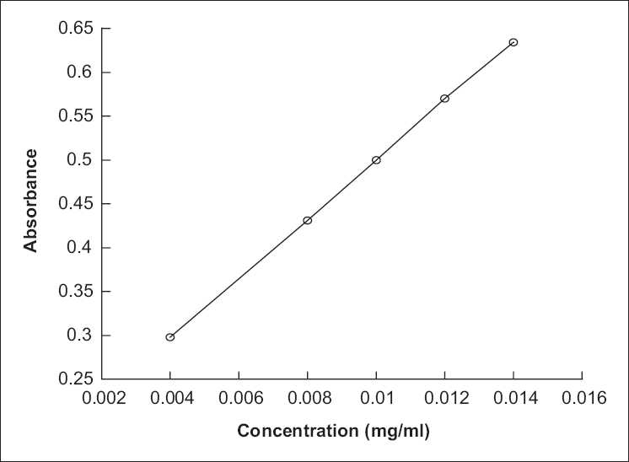
Calibration:
The process of configuring an instrument to provide a result for a sample within an acceptable range.
This is achieved by creating a standard curve using calibrators of known concentration.

Slide 3
Why is calibration important?
Calibration ensures that accurate results are consistently achieved for patient samples.
Without accurate calibrations, the standard curve for the analyte will indicate an incorrect result for the patient.
For this process to be successful, the instrument needs to be given the expected values of the calibrators.
These values change from lot-to-lot and must be updated on the analyzers
For example a master curve disk is included with each box of calibrators for the DxC.

Slide 4
Calibration “Passed”
It is possible for a calibration to “pass” with the wrong set points loaded on the analyzer.
This is due to the fact that similar set points are consistently used to create the standard curves.
In this case when the calibration is run, the analyzer will adjust the curve resulting in a shift of QC results and patient results.
In some cases this can result in clinically significant changes in patient results.

Slide 5
Lipase on the DxC 800
A new lot of calibrators was used to calibrate Lip on the DxC 800
The set points for the new calibrator were not uploaded to the analyzer
This resulted in a shift in QC and an investigation into the shift
Although the calibration “passed” QC was unacceptable due to the curve being incorrect

Slide 6
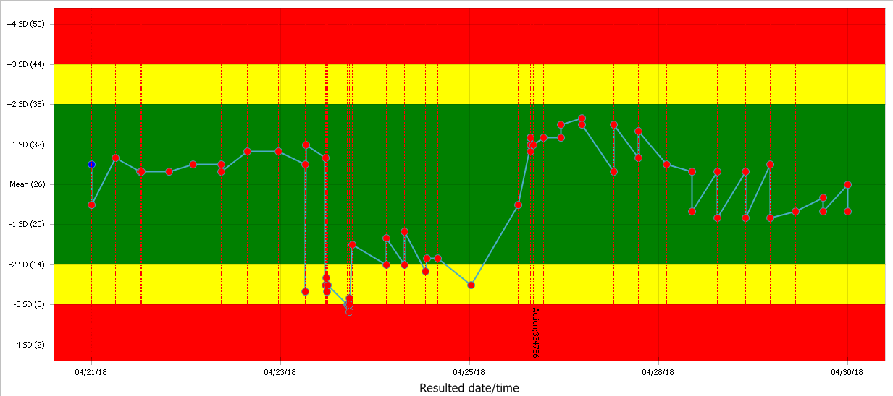
Lipase on the DxC 800

Slide 7
Lipase on the DxC 800
As you can see from the previous slide, QC abruptly dropped on the 23rd of April
Where you see the work “Action” in the red area at the bottom of the Levy-Jennings Chart is when the proper set points were loaded and the assay re-calibrated.

Slide 8
Summary
Always be sure that the correct calibration information is loaded onto any analyzer before calibrating
When opening a new lot of calibrators, double check that the correct set points have been loaded/scanned into the instrument
Be sure to consider this type of scenario when troubleshooting QC that has failed shortly after a calibration

Slide 9
Quiz Time!
Please complete the associated quiz by June 30, 2018.
A minimum passing score of 80% is required. Please request a retake if you score below 80%.

