Slide 1
Stat Lab Hematology Review

Slide 2
Objectives
How to replace reagents on XE-2100 in Stat lab and document.
How and where to document Auto-rinse and background count.
When and how to document a Corrective Action Form for QC or X-bar failure.
Where and how to document troubleshooting.

Slide 3
Reagent Replacement
1. The XE2100 will alarm. User should stop the alarm and replace the reagent indicated.
2. User will replace the empty reagent with a new reagent.
**Make sure to replace the old reagent with the correct new reagent!!

Slide 4
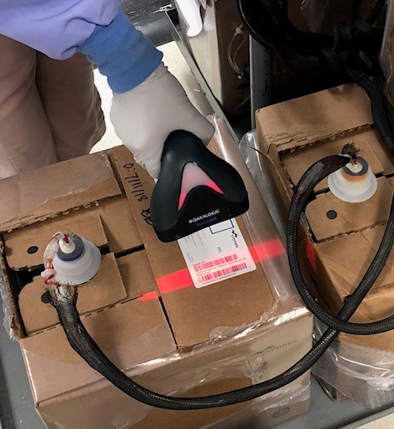
Reagent Replacement
3. User must document the open date and initials on the reagent.
4. Then scan the “Reagent Barcode”.

Slide 5
Reagent Replacement
5. If correctly scanned, “Replace” will appear on the line of the reagent that was scanned. (You do not need to press, “Replace”.)
Also, the reagent lot number, expiration date, and amount of reagent will update on the instrument screen.
Push, “Execute” to complete reagent replacement.

Slide 6
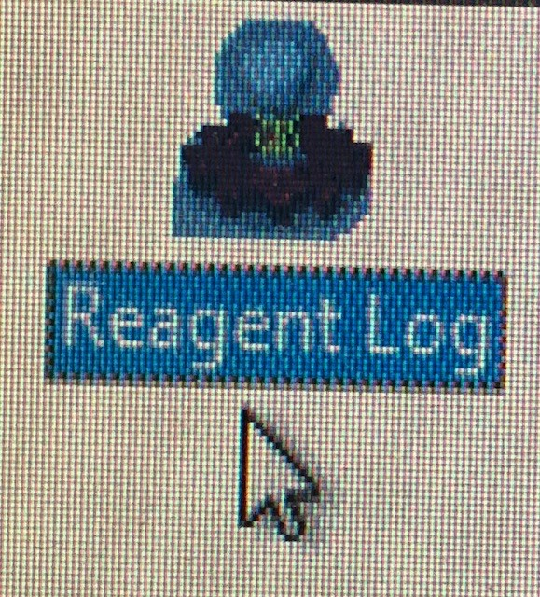
Reagent Replacement
Users no longer need to fill out the paper Reagent Log because the instrument has a Reagent Log in the IPU.
Steps to view the Reagent Log on the IPU:
Click on “menu”
Click on “Controller”
Double click on, “Reagent Log”

Slide 7
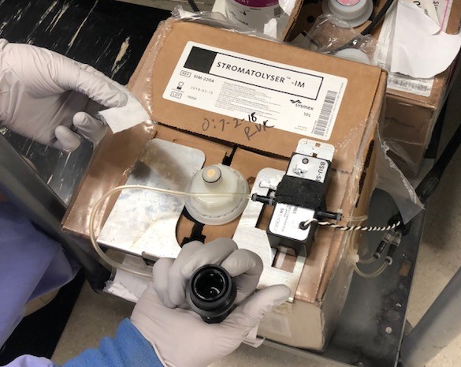
Reagent Replacement Reminders:
When Stromatolyser-IM (SIM) reagent is replaced, the cap and the nozzle should be cleaned with alcohol prep pads to prevent contamination.
Do not remove the nozzle from the old SIM reagent. The new SIM reagent will have a nozzle. You only need to connect the metal plate and black cap to the new SIM reagent’s nozzle.

Slide 8
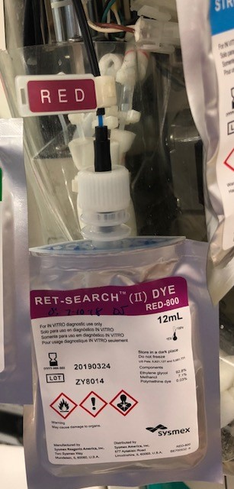
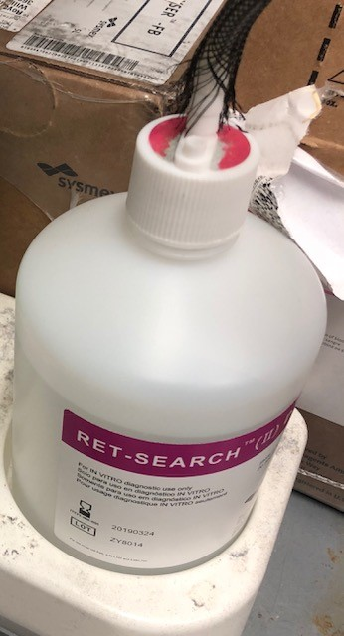
Reagent Replacement Reminders:
3. Stromatolyser-NR (SNR) dye packet and bottle MUST be replaced together.
4. RET-SEARCH-II (RED) dye packet and bottle MUST be replaced together.

Slide 9
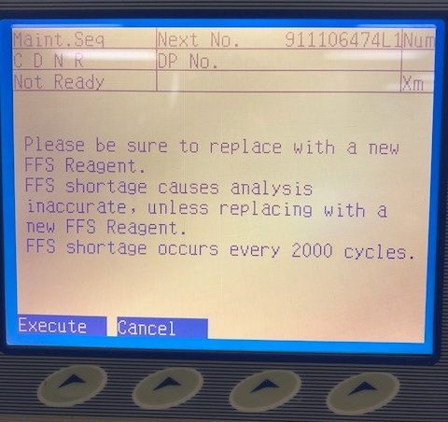
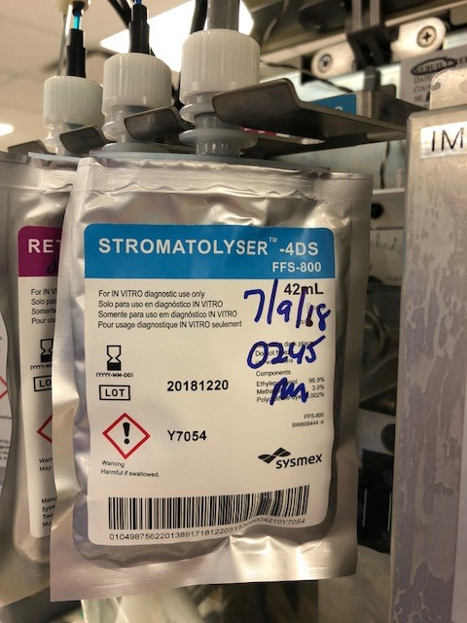
Reagent Replacement Reminders:
5. BE AWARE- When replacing Stromatolyser-4DS (FFS): ensure you have changed the packet before pressing “Execute”!

Slide 10
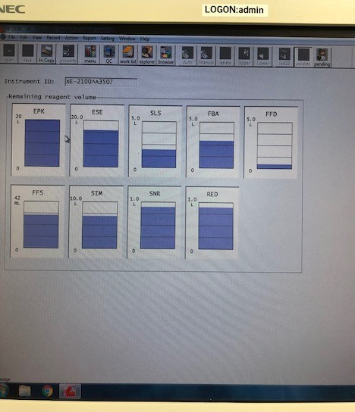
Reagent Replacement Reminders:
6. To view remaining reagent volumes:
-Click “menu”
-Click “Controller”
-Double click “Remaining reagent volume”.

Slide 11
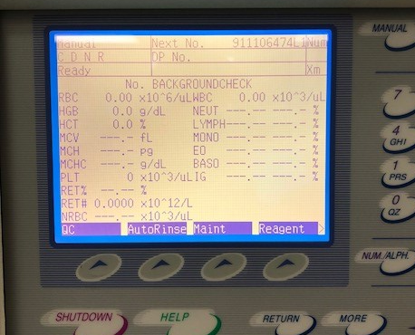
Auto-Rinse Documentation
Auto-rinse should be performed one hour after reagent replacement.
Auto-rinse should be documented in the instrument’s IPU.

Slide 12
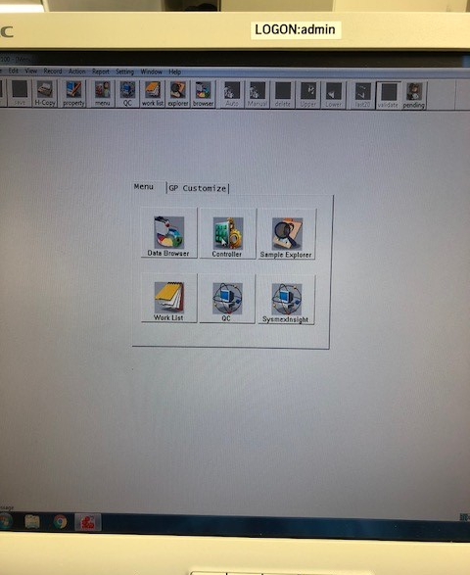
Auto-Rinse Documentation
To document a successful auto-rinse, User should follow these steps:
Click on “menu”

Slide 13
Auto-Rinse Documentation
2. Click on “Controller”.
3. Click on “Reagent Log”.

Slide 14
Auto-Rinse Documentation
4. Double click on the comment field of the reagent replaced and performed the auto-rinse on.
5. Type, “AR performed, BG ok”, and your initials.

Slide 15
Auto-Rinse Documentation
6. The auto-rinse has now been documented.
This log shows the date/time, the reagent that was replaced, the lot, the expiration, the on board stability, who performed the auto-rinse, and that the auto-rinse (AR) was performed with an acceptable background (BG).

Slide 16
Corrective Action and Troubleshooting Log Binder:
The Corrective Action Forms and Troubleshooting Log binder is kept on top to each analyzer.

Slide 17
Corrective Action Forms
Corrective Action Forms should be completed when QC or Xbar-M controls are not within established ranges.

Slide 18
Troubleshooting Log
The Troubleshooting Log should be filled out any time there is a problem or issue with the instrument (AR-background check failed, QC out of control, service was called.)

Slide 19
Corrective Action and Troubleshooting Example:

Slide 20
Corrective Action and Troubleshooting Example:

Slide 21
QC Reminders
When opening a new vial of QC label:
-Open date
-Expiration date
-Initials
Always make sure you check expiration dates before running QC.

Slide 22
QC Reminders
NEVER mix Hematology QC on the rocker!
Thoroughly mix QC manually by inverting and rolling between hands.
Allow to come to room temperature before running.

Slide 23
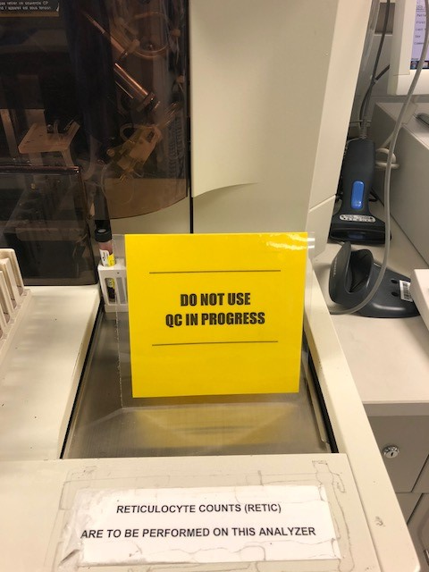
*NEW: QC in Progress Sign
Place this on the instrument to alert others not to use the instrument until QC is performed and reviewed.

Slide 24
Thank you!
Thank you for taking time to review this information.
If you have any questions or concerns, please see Becky, Alyssa, Teri or Myrna.

