Slide 1
Hematology Review WAM & QC
Created by:
Dana Snyder, MLS(ASCP)^{CM}SH^{CM}
^{November, 2013}
Updated by:
Sara Wagner, MLS (ASCP)^{CM}
February, 2019

Slide 2
Disclosure:
This presentation is to be used as a review for resulting technologists and technicians.
It is NOT to be substituted for a procedure, policy or workflow.
All current and updated procedures, polices and workflows can be found online.

Slide 3
Turn Around Times (TAT)
CBC – STAT – 30 minutes
CBC with Differential – STAT – 30 minutes
Cancer Center Specimens:
20 minute TAT once received into the lab

Slide 4
Test Cancellations
Never “Un-cancel” a test in SoftLAB.
Always cancel a sample in BOTH the sysmex WAM and SoftLAB (LIS).

Slide 5
WAM
Review of Sysmex WAM Workflow Guidelines
**See Hematology WAM Workflow on Inside Beaumont

Slide 6
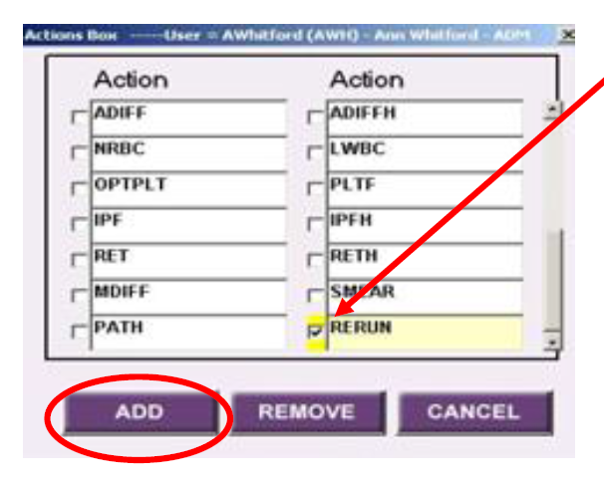
WAM Workflows
MCHC > 38 on first run:
ADD a RERUN and send to Core Hematology.
Sample needs to be warmed at 37ºC.
Linearity Issues:
WBC and PLT are most frequent.
It is possible to have Reticulocytes out of linearity.
1:5 dilutions need to be made
ADD a RERUN in WAM
Run in capillary mode (multiplies results X5)
Result 2nd CBC valid results and 1st CBC diff results.

Slide 7
WAM Workflows
CBCND that requires WBC or PLT Slide Review:
If all parameters except WBC and PLT autoverify
“Quit”
Send for morphology review
If none of parameters autoverify
In Result Validation Tab, click ALL to check all parameters
De-select parameter to be reviewed (PLT or WBC or WBCOR) so smear can be reviewed
Select Validate Selection
Send for morphology review

Slide 8
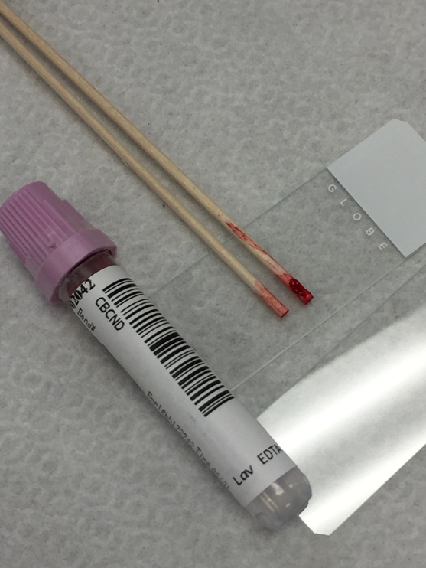
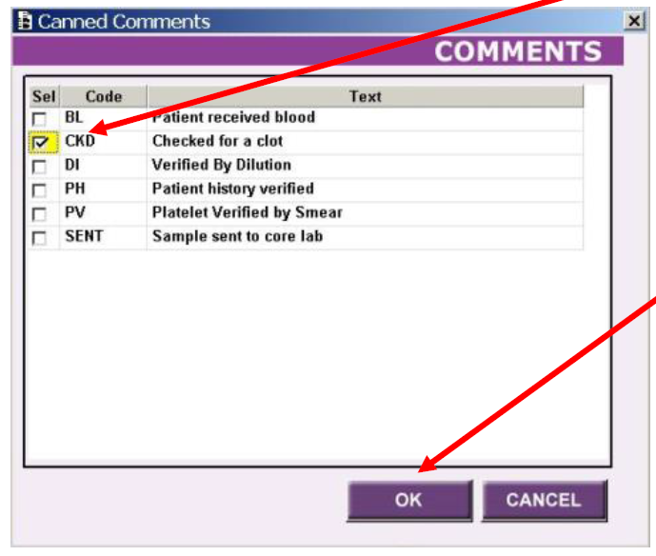
WAM Workflows
Platelet value < 75:
ALWAYS check for a clot and document!!
Will automatically reflex for an optical PLT
Compare Run 1 vs Run 2 results
Click on Run 2 results
Return to Result Validation Tab:
Comment “Platelet verified by alternate method” will now appear
Send for morphology review if 1st occurrence and ADD Smear through Action Button
Do NOT release PLT count before Slide Review performed

Slide 9
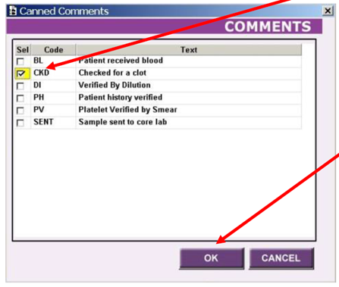
WAM Workflows
Clumped Platelets:
ALWAYS check for a clot and document!!
Select CBC parameters to be validated, excluding the PLT, and validate selection
Send for morphology review

Slide 10
WAM Workflows
WBC < 1.0:
WBC <1.0 with #nm for diff parameters and NO previous differential
Partial validate and send for morphology review
WBC <1.0 with #nm for diff and previous differential within same hospital stay
#nm converts to “Unable to Perform” in LIS.
Choose your run first, then replace all numerical percentages and absolutes values with #nm
Validate results
Cancel Smear in pop-up box

Slide 11
WAM Workflows
BLAST flag:
Validate CBC only after addressing flags, Op Alerts, etc….
Always send for morphology review
NRBC Abnormal Scattergram:
If AFTER a NRBC? flag sample is reflexed and the NRBC Abn Scattergram is present:
Place checkmarks next to all CBC parameters except WBC/WBCOR/WBCUN
Do NOT check diff parameters and validate selection
Send for morphology review

Slide 12
WAM Workflows
RET Abnormal Scattergram:
Check to see if RET value has exceeded linearity
If YES, 1:2 or 1:3 dilution is necessary per SOP
Refer to Workflow procedure for more details on how to input dilution information into WAM. It can calculate for you if you input the dilution factor in the right place.

Slide 13
WAM Workflows
Checking a Previous Path Review in WAM:
Previous Result tab
“HE 25” code will appear in Diff Comment field
NOTE: Trending and patient previous results can be found under Previous Result Tab, or can be viewed in SoftLIS or EPIC.
It is a very important step to trend patient results!

Slide 14
WAM Workflows
Delta Checks:
HGB or MCV varies greater than + 3.0
50% change in WBC and/or PLT count
1. Check previous results in WAM
2. Retrieve specimen, check for clot and document
3. Contact nursing unit for B# verification
4. If unable to discern discrepancy and specimen is not mislabeled (consistent RBC parameters), enter comment “___ result change from previously reported value. Suggest repeat if not compatible with clinical picture.”
5. If any question, request redraw, notify nursing and write PSQI

Slide 15
WAM Workflow
CBC-Differential specimens always must be scanned when it is the FIRST TIME with the following:
PLT < 75
Neutrophil # < 0.5
Lymphocyte # > 15.0 bil/L
Monocyte # > 3.0 bil/L persistant for 3 months
MCV < 66 or > 114
> 60% Lymphocytes
(age>12 months & <18 years)

Slide 16
WAM Workflow
CBC Differentials must ALWAYS be scanned manually when:
Previously reported blasts
Platelet Clumps (do not release PLT count)
Fragments (do not release PLT count)
Any IP flag (Blast, Atypical/Abn Lymph, etc..)
Exception: Left Shift, PLT ABN DIST, or Atypical Lymphocyte flag with lymphocytes < 50.0%

Slide 17
WAM Workflows
NOTE: WBC and PLT results may vary significantly with patient condition (e.g. infection, surgery, chemotherapy, etc.), the more stable parameters such as RBC indices including RDWs should be used to check specimen validity.
NOTE: The most common reason for deceased platelets is a clotted specimen!!

Slide 18
WAM Workflows
ALWAYS follow the Op Alerts provided in the dialog box!!!
If in doubt, contact Hematology Department.
COMMUNICATION IS KEY!!

Slide 19
Quality Control
**Always follow procedures, policies and actions!!

Slide 20
Quality Control
e-Check controls must be Room Temperature prior to running
Do NOT place e-Check controls on rocker
ALWAYS validate controls before releasing patient results
ALWAYS validate XbarM values before releasing results
Can be a great indicator to larger problem…..
ALWAYS fill out maintenance record forms
If not documented…did it happen??

