Slide 1
Hematology Fluids Case Set Patients #1-12
School of Medical Technology
Beaumont Health

Slide 2
Slide #1
A 72 year old woman entered the EC with upper and lower extremity swelling. Patient was treated for edema and a thoracentesis for a right pleural effusion was performed.

Slide 3
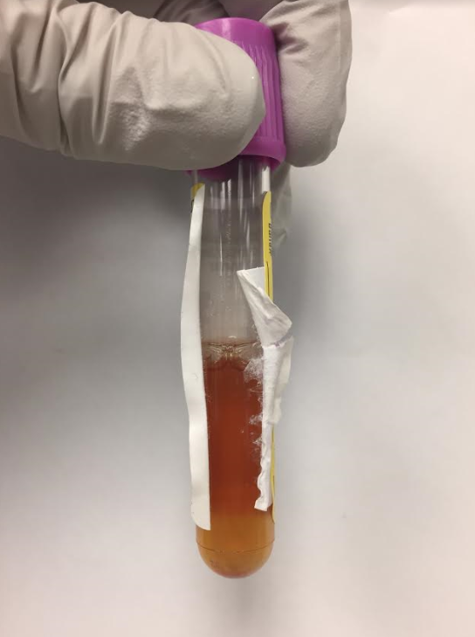
#1 Macroscopic Appearance
Parameter | Result
Source | Pleural
Body Site | Right
Color | Amber
Clarity | Cloudy

Slide 4
#1 XE-5000 Results
Parameter | Result | Reference Range
WBC | 75 | 0-5/mcL
RBC | 11000 | Absent/mcL
Should a differential be performed on this Specimen?
Yes, perform differential

Slide 5
#1 Differential Results
Parameter | Result | Reference Range
Neutrophils | 14 | %
Lymphocytes | 20 | %
Monocytes | 3 | %
Macrophage | 63 | %

Slide 6
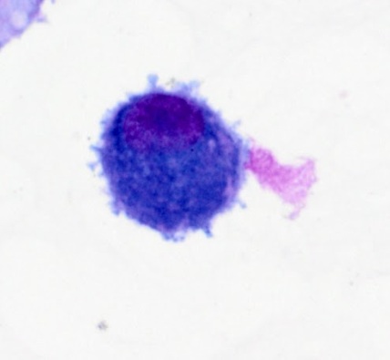
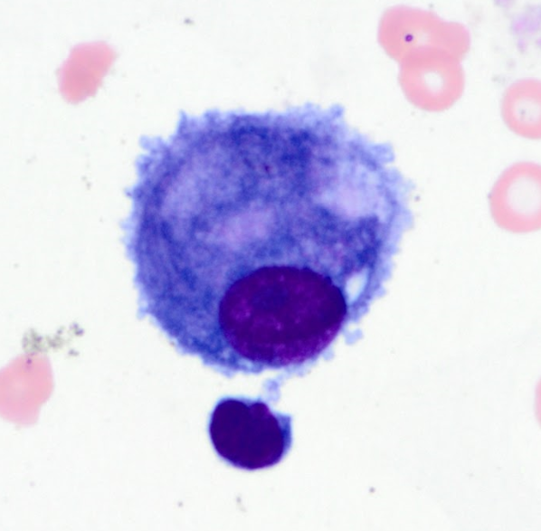
#1 Morphologic Findings
Reactive mesothelial cells

Slide 7
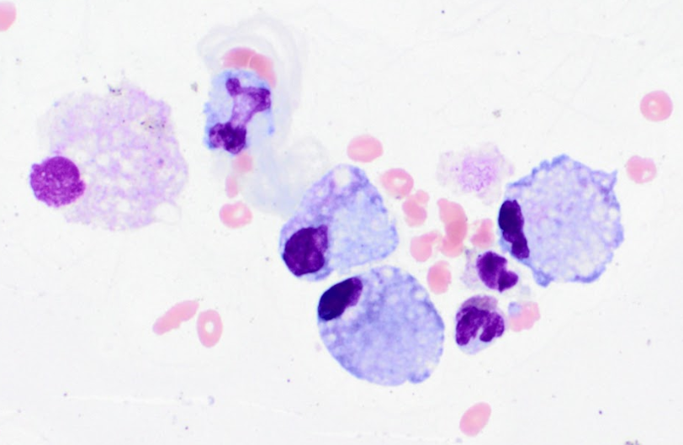
#1 Morphologic Findings (continued)
Predominance of macrophages

Slide 8
#1 Differential Diagnosis
Benign adenoma
Bacterial pneumonia
Drug-induced pulmonary edema

Slide 9
#1 Diagnosis
Benign adenoma with reactive mesothelial cells
Benign reactive mesothelial cells shed easily and may have features that mimic malignancy
Reactive mesothelial cells shed as individual cells, in clusters or sheets, with adjacent cells separated from one another by spaces referred to as “windows”

Slide 10
Slide #2
A 64 year old woman comes into the EC with complaints of joint pain in her right knee. The joint pain started several days prior. Patient presents with a fever.

Slide 11
#2 Macroscopic Appearance
Parameter | Result
Source | Synovial
Color | Yellow
Clarity | Hazy

Slide 12
#2 XE-5000 Results
Parameter | Result | Reference Range
WBC | 40270 | 0-5/mcL
RBC | 2840 | Absent/mcL
Should a differential be performed on this Specimen?
Yes, perform differential

Slide 13
#2 Differential Results
Parameter | Result | Reference Range
Neutrophils | 94 | %
Lymphocytes | 4 | %
Monocytes | 2 | %

Slide 14
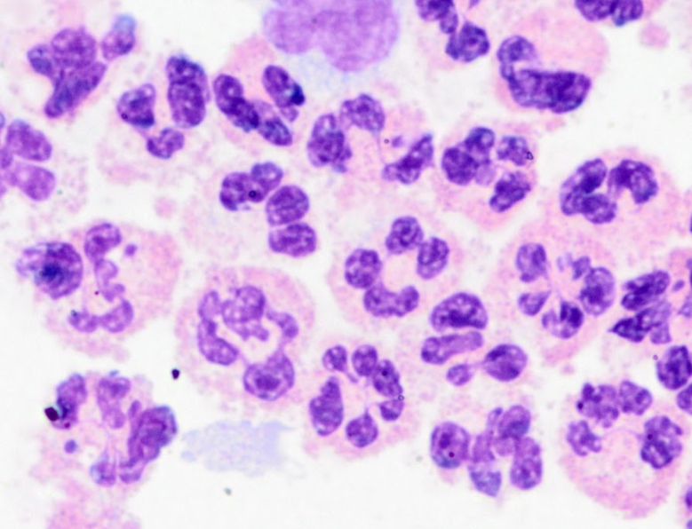
#2 Morphologic Findings
Abundant polymorphonuclear leukocytes

Slide 15
#2 Differential Diagnosis
Bacterial infection of the joint
Acute cartilage disease
Joint Inflammation

Slide 16
#2 Diagnosis
Joint Inflammation is common with different types of arthritis, infections, and injuries.
Some examples are osteoarthritis, rheumatoid arthritis, gout, bursitis, tendonitis and fractures.

Slide 17
Slide #3
A 27 day old premie in the NICU presents with difficulty breathing. Infant also has enlarged cranium. Pneumothorax and chest tube was inserted.

Slide 18
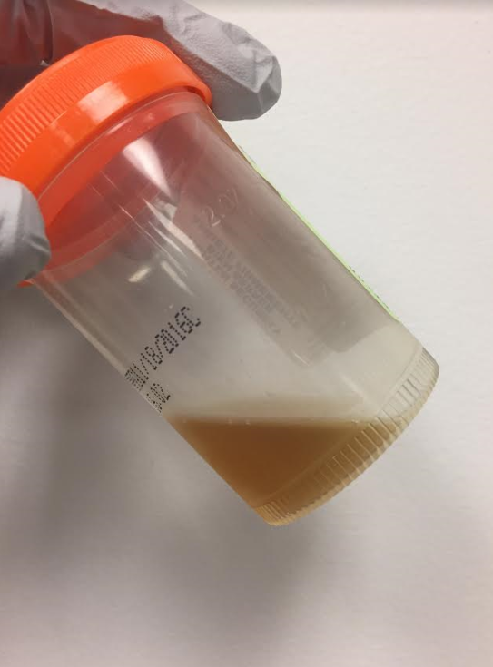
#3 Macroscopic Appearance
Parameter | Result
Source | CSF
Color | Light Brown
Clarity | Hazy
Xanthochromia | Present-brown
Tube # | Sterile cup

Slide 19
#3 Hemocytometer Count
Parameter | Result | Reference Range
WBC | 48 | 0-5/mcL
RBC | 4000 | Absent/mcL
Should a differential or scan be performed on this Specimen?
Yes, perform differential

Slide 20
#3 Differential Results
Parameter | Result | Reference Range
Neutrophils | 37 | %
Lymphocytes | 12 | %
Monocytes | 12 | %
Macrophage | 39 | %

Slide 21
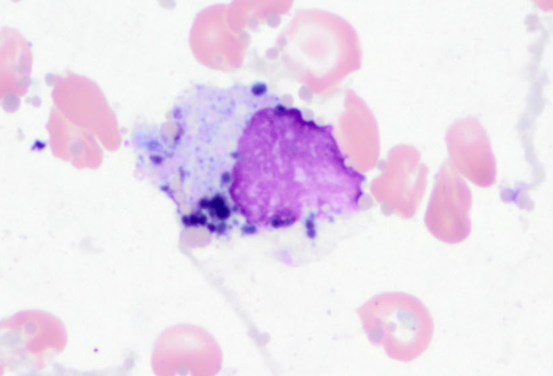
#3 Morphologic Findings
Hemosiderin

Slide 22
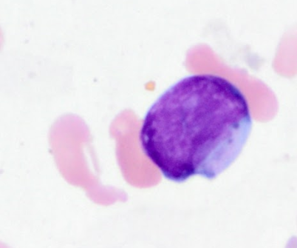
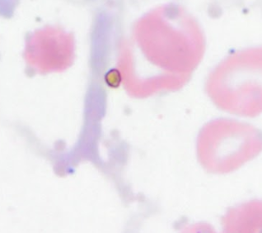
#3 Morphologic Findings (continued)
Hematoidin Crystals

Slide 23
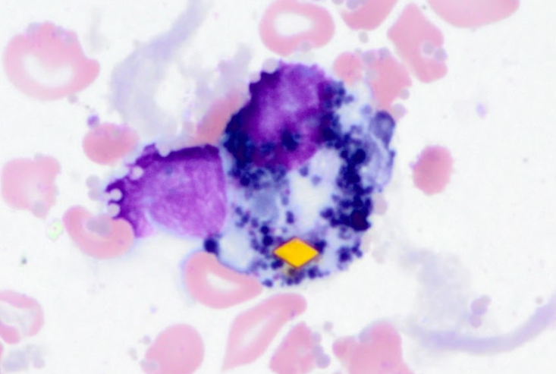
#3 Morphologic Findings (continued)
Hematoidin crystal with hemosiderin in the macrophages

Slide 24
#3 Differential Diagnosis
Hemolysis resulting from bacterial infection
Post-hemorrhagic hydrocephalus
Hyperemia

Slide 25
#3 Diagnosis
Post-hemorrhagic hydrocephalus causes bleeding in cerebrospinal fluid.
RBCs in the CSF are ingested by macrophages and are broken down to form hemosiderin and hematoidin crystals.
Hemosiderin is observable from 2 days to 2 months after an intracranial hemorrhage.
Hematoidin crystals are recognizable in 2-4 weeks after an intracranial hemorrhage.

Slide 26
Slide #4
A 74 year old woman is admitted to the hospital due to a fall. She is very confused and disoriented. After four days, her state worsens and swelling in her knee is observed.

Slide 27
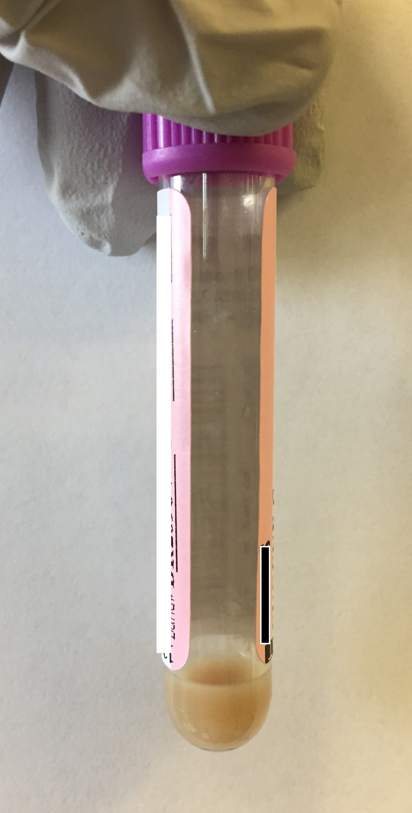
#4 Macroscopic Appearance
Parameter | Result
Source | Synovial
Color | Brown
Clarity | Milky

Slide 28
#4 XE-5000 Results
Parameter | Result | Reference Range
WBC | 108400 | 0-5/mcL
RBC | 11800 | Absent/mcL
Should a differential be performed on this Specimen?
Yes, perform differential

Slide 29
#4 Differential Results
Parameter | Result | Reference Range
Neutrophils | 96 | %
Monocytes | 4 | %

Slide 30
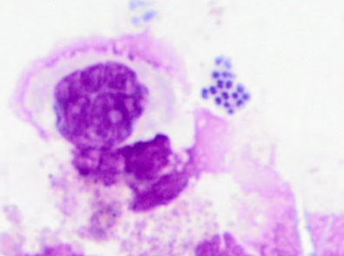
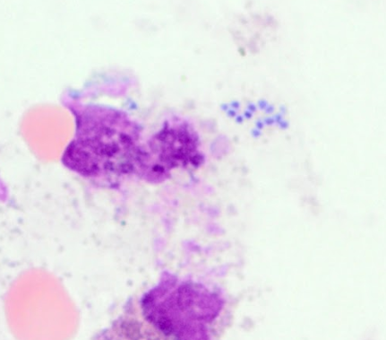
#4 Morphologic Findings
Extracellular bacteria

Slide 31
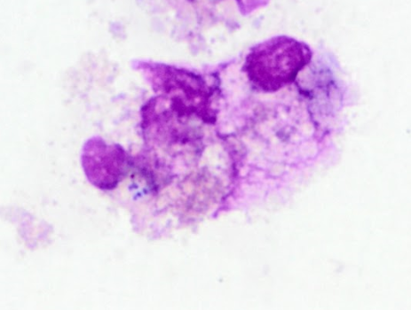
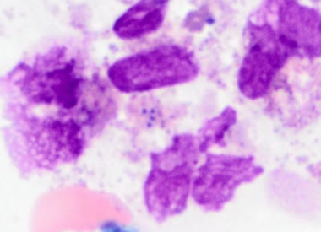
#4 Morphologic Findings (continued)
Intracellular bacteria

Slide 32
#4 Differential Diagnosis
Bacterial joint infection
Septic arthritis
Lyme Disease

Slide 33
#4 Diagnosis
The bacterial joint infection was contracted during patient’s hospital stay.
Hospital infections may be caused by a variety of bacteria, viral, or fungal pathogens.
Most common types include urinary tract infections, surgical site infections, and bloodstream infections.

Slide 34
#4 Further Testing
Gram Staining
Blood and urine glucose levels
Urine protein levels

Slide 35
Slide #5
A 83 year old male with history anemia and coronary artery disease presents to the EC complaining of difficulty breathing. Patient was seen by his cardiologist the previous day and noted he was having dyspnea. He was advised to come to the EC if symptoms worsened. He also complains of chest discomfort with inspiration, mild diaphoresis/dizziness, and right-sided abdominal pain.
Notes:
MRN 1752214. This is a bloody pleural fluid with squamous cell carcinoma.

Slide 36
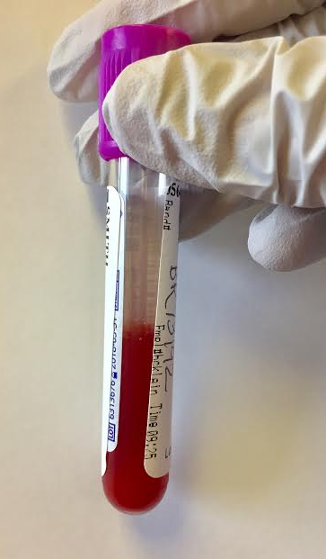
#5 Macroscopic Appearance
Parameter | Result
Source | Pleural
Body Site | Rt Lower
Color | Bloody
Clarity | Cloudy

Slide 37
#5 XE-5000 Results
Parameter | Result | Reference Range
WBC | 8233 | 0-5/mcL
RBC | 1,795,000 | Absent/mcL
Should a differential be performed on this Specimen?
Yes, perform differential

Slide 38
#5 Differential Results
Parameter | Result | Reference Range
Neutrophils | 28 | %
Lymphocytes | 18 | %
Monocytes | 4 | %
Macrophage | 4 | %
Eosinophils | 1 | %
Other Cells | 45 | %

Slide 39
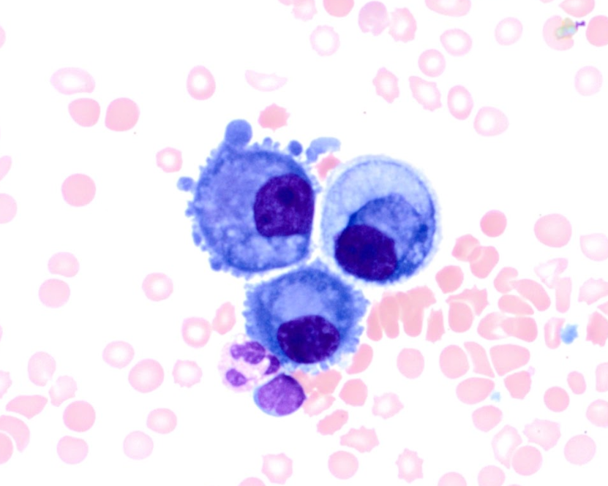
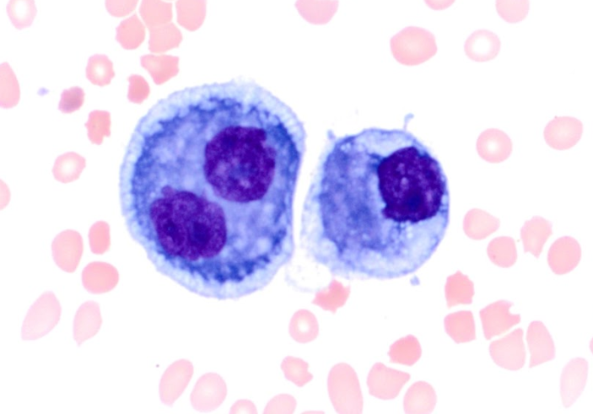
#5 Morphologic Findings
Malignant Cells

Slide 40
#5 Differential Diagnosis
Metastatic lung cancer
Squamous cell carcinoma
T cell lymphoma

Slide 41
#5 Diagnosis
Squamous cell carcinoma is caused by the uncontrolled growth of abnormal squamous cells.
This cancer is caused by long-term exposure to cancer-causing chemicals, such as tobacco use, tar exposure, arsenic-contaminated drinking water, or uses some insecticides or herbicides.

Slide 42
Slide #6
A 28 year old woman presents to the EC for evaluation of nausea, vomiting, and increased facial swelling and pain. Patient is between radiation treatments and has recently been on chemotherapy.

Slide 43
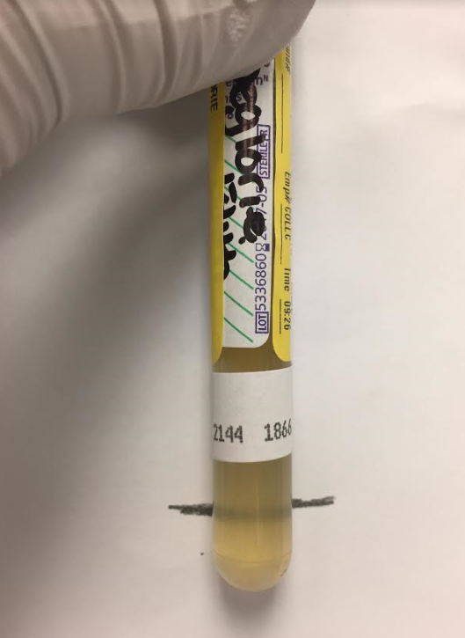
#6 Macroscopic Appearance
Parameter | Result
Source | Pericardial
Color | Yellow
Clarity | Hazy

Slide 44
#6 XE-5000 Results
Parameter | Result | Reference Range
WBC | 145 | 0-5/mcL
RBC | <2000 | Absent/mcL
Should a differential be performed on this Specimen?
Yes, perform differential

Slide 45
#6 Differential Results
Parameter | Result | Reference Range
Neutrophils | 7 | %
Monocytes | 18 | %
Macrophage | 55 | %
Mesothelial | 1 | %
Other | 19 | %

Slide 46
#6 Morphologic Findings
Abnormal cells

Slide 47
#6 Differential Diagnosis
NK/ T cell lymphoma
Malignant breast carcinoma
Congestive heart failure

Slide 48
#6 Diagnosis
Extranodal NK/ T cell lymphoma primarily presents with pericardial effusion.
NK/T cell lymphoma is an uncommon subtype of non-Hodgkin's lymphoma.
The frequent malignant lymphocytes that can be observed on this slide, are indicative of malignancy.

Slide 49
Slide #7
A 15 month old girl was brought to her physician after four days of a fever. Her temperature was 103.4ºF. She continued to have low grade temperatures for the next three days, which were controlled with antipyretics. The patient spiked a temperature to 105ºF and vomited twice and was admitted to the EC.

Slide 50
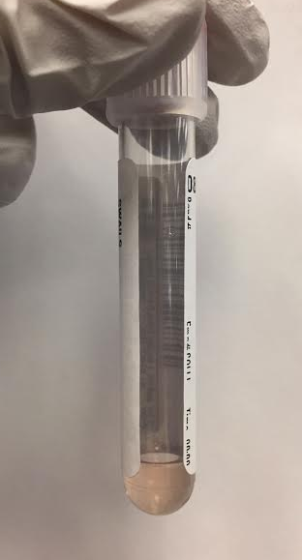
#7 Macroscopic Appearance
Parameter | Result
Source | CSF
Color | Slightly Pink
Clarity | Cloudy
Xanthochromia | Absent
Tube # | 3

Slide 51
#7 Hemocytometer Count
Parameter | Result | Reference Range
WBC | 220 | 0-5/mcL
RBC | 883 | Absent/mcL
Should a differential or scan be performed on this Specimen?
Yes, perform differential

Slide 52
#7 Differential Results
Parameter | Result | Reference Range
Neutrophils | 74 | %
Lymphocytes | 7 | %
Monocytes | 19 | %

Slide 53
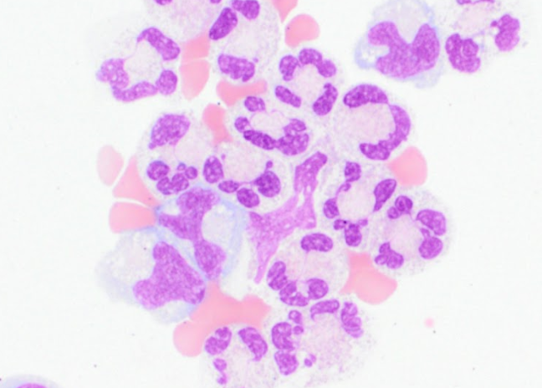
#7 Morphologic Findings
Neutrophilia

Slide 54
#7 Differential Diagnosis
Bacterial meningitis
Viral meningitis
Traumatic tap

Slide 55
#7 Diagnosis
Bacterial meningitis
Children between the ages of one month and two years are the most susceptible to bacterial meningitis.
Common symptoms are a high fever, headaches, and an inability to lower your chin to your chest due to stiffness in the neck.

Slide 56
Slide #8
A 57 year old female presents to the EC with shortness of breath and complaints of chest pain. Patient recently fell twice at home and injured her right arm and leg. The patient states that last time she had “this”, she had a lot of fluid on one of her lungs which need to be removed.

Slide 57
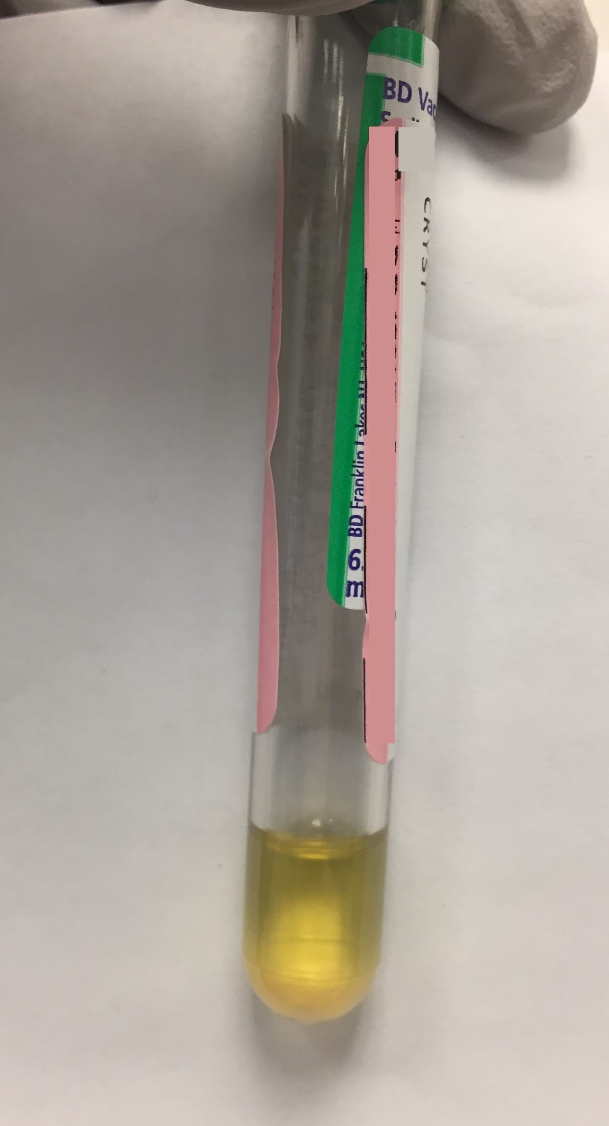
#8 Macroscopic Appearance
Parameter | Result
Source | Pleural
Body Site | Right
Color | Yellow
Clarity | Clear

Slide 58
#8 XE-5000 Results
Parameter | Result | Reference Range
WBC | 35 | 0-5/mcL
RBC | <2000 | Absent/mcL
Should a differential be performed on this Specimen?
Yes, perform differential

Slide 59
#8 Differential Results
Parameter | Result | Reference Range
Neutrophils | 1 | %
Lymphocytes | 17 | %
Monocytes | 9 | %
Others | 73 | %

Slide 60
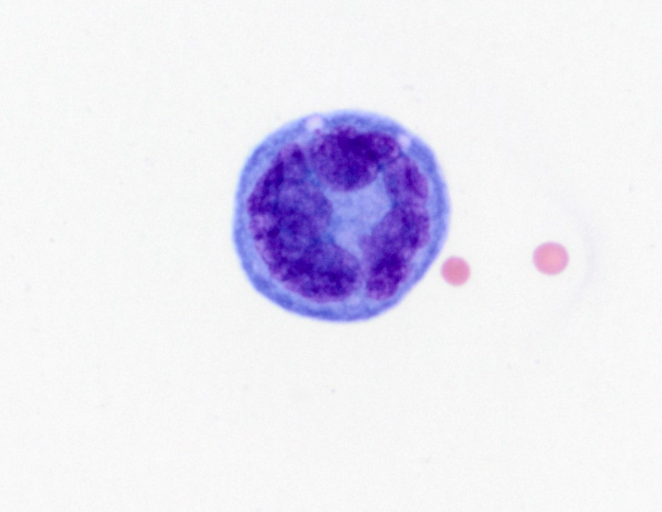
#8 Morphologic Findings
Malignant Cells

Slide 61
#8 Differential Diagnosis
Acute Myeloid Leukemia (AML)
Hodgkin’s disease
Metastatic cancer to bone and lung

Slide 62
#8 Diagnosis
Metastatic cancer to bone and lung
Metastasis occurs when cancer cells from the primary tumor relocate to another location through the blood or lymph system and develop secondary malignant growths.
The bone is a common site for metastasis. Cancers such as prostate, breast, and lung are most likely to spread to the bone.

Slide 63
Slide #9
A 57 year old man presents to the EC with symptoms of lightheadedness, diaphoresis and tightness in his jaw and upper neck. Chest CT PE protocol is performed and result are negative for PE however a spiculated nodule is identified. An endoscopy and BAL is performed. The patient denies any smoking history.

Slide 64
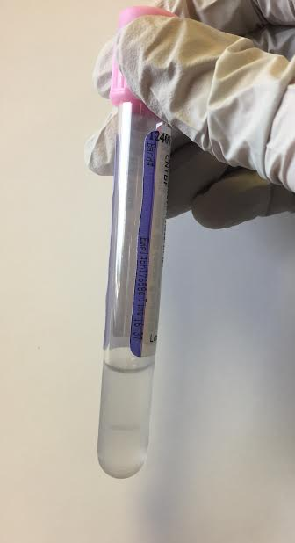
#9 Macroscopic Appearance
Parameter | Result
Source | BAL
Color | Colorless
Clarity | Hazy

Slide 65
#9 XE-5000 Results
Parameter | Result | Reference Range
WBC | 61 | 0-5/mcL
RBC | <2000 | Absent/mcL
Should a differential be performed on this Specimen?
Yes, perform differential

Slide 66
#9 Differential Results
Parameter | Result | Reference Range
Neutrophils | 53 | %
Lymphocytes | 4 | %
Monocytes | 2 | %
Macrophage | 6 | %
Eosinophils | 1 | %
Non-Hematologic Cells | 34 | %

Slide 67
#9 Morphologic Findings
Non-hematologic cells

Slide 68
#9 Morphological Findings (cont.)
Bronchial lining cells are non-hematologic cells commonly observed in BAL samples.
Non-hematologic cells may appear in sheets and clumps on cytospin preparations.
These cells appear as rectangular smears with cilia present along one end with a smudged nucleus at the base of the elongated cytoplasm shape.

Slide 69
#9 Differential Diagnosis
Benign lung mass
Pneumonia
Pulmonary edema due to CHF

Slide 70
#9 Diagnosis
A benign lung mass is classified based on histologic findings.
Solitary pulmonary nodules have several causes, however the major distinction must be made is between neoplastic or inflammatory lesions.
A biopsy of a lung nodule should be performed bronchoscopically or via CT-guided transthoracic needle aspiration (TTNA) to determine whether it is malignant.

Slide 71
Slide #10
A 55 year old man with a history of degenerative joint disease presents to his primary care physician with complaints of left knee pain. Patient says the pain has been constant for four day and began after spending the afternoon doing yard work.

Slide 72
#10 Macroscopic Appearance
Parameter | Result
Source | Synovial
Body Site | Left Knee
Color | Yellow
Clarity | Hazy

Slide 73
#10 XE-5000 Results
Parameter | Result | Reference Range
WBC | 669 | 0-5/mcL
RBC | 2000 | Absent/mcL
Should a differential be performed on this Specimen?
Yes, perform differential

Slide 74
#10 Differential Results
Parameter | Result | Reference Range
Neutrophils | 6 | %
Lymphocytes | 10 | %
Monocytes | 9 | %
Macrophage | 9 | %
Non-Hematologic cells | 66 | %

Slide 75
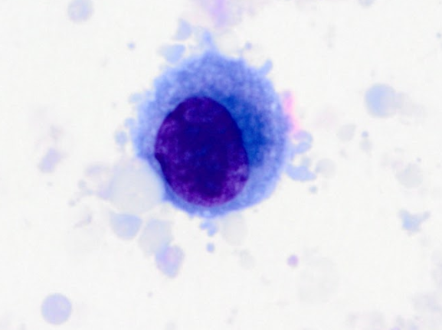
#10 Morphologic Findings
Synovial lining cells

Slide 76
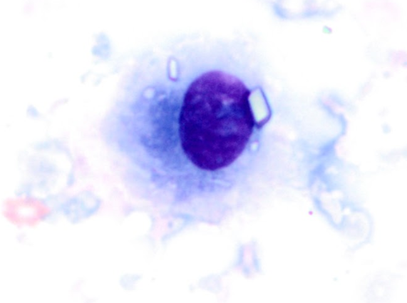
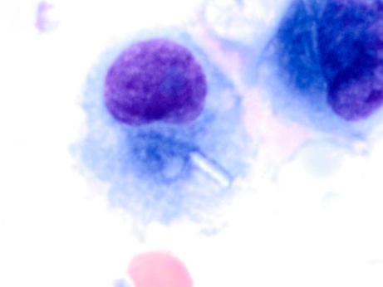
#10 Morphological Findings (cont.)
Pseudogout sticking to synovial lining cells

Slide 77
#10 Differential Diagnosis
Pseudogout
Joint infection
Internal bleed into the joint

Slide 78
#10 Diagnosis
Pseudogout is a form of arthritis that causes pain, stiffness, tenderness, redness, warmth, and swelling in some joints.
Pseudogout is caused by calcium pyrophosphate crystals whereas gout is caused by monosodium urate crystals.
Medication is a short-term treatment and lifestyle changes (diet, exercise etc.) are long-term treatments for gout and pseudogout.

Slide 79
#10 Further Testing
Crystal analysis
- Check to make sure crystal analysis is ordered. If not, make comment to encourage doctor to order.
Blood studies of triglycerides, glucose and high-density lipoprotein levels

Slide 80
Slide #11
A 43 year old woman enters EC with complaints of nausea and vomiting. Patient recently underwent surgery on her left ankle. The nausea has been ongoing for 3 days and she is unable to hold down food or fluids. The patient is concerned because she is a kidney transplant patient and has been unable to keep down her medications.

Slide 81
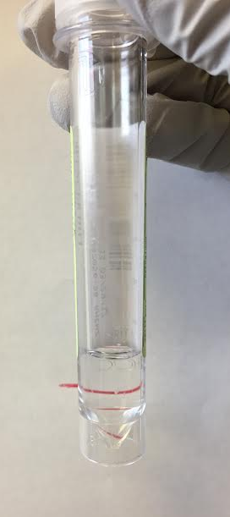
#11 Macroscopic Appearance
Parameter | Result
Source | CSF
Color | Colorless
Clarity | Clear
Tube # | 3

Slide 82
#11 Hemocytometer Count
Parameter | Result | Reference Range
WBC | 73 | 0-5/mcL
RBC | 1 | Absent/mcL
Should a differential or scan be performed on this Specimen?
Yes, perform differential

Slide 83
#11 Differential Results
Parameter | Result | Reference Range
Neutrophils | 30 | %
Lymphocytes | 48 | %
Monocytes | 19 | %
Macrophage | 3 | %

Slide 84
#11 Morphologic Findings
Budding Yeast

Slide 85
#11 Differential Diagnosis
Cryptococcus spp. complicated transplantation
Fungal meningitis
Viral meningitis

Slide 86
#11 Diagnosis
Cryptococcus spp. complicated transplantation due to immunosuppressant medication.
Immunosuppressants are used to prevent graft-versus-host disease in patient who have received a transplant, however they lower the recipients protective immunity.
Although Cryptococcus spp. infections in organ transplant recipients are not common, invasive fungal infections have been reported in 5% to 59% of organ transplant recipients.

Slide 87
#11 Further Testing
Cryptococcus spp. Antigen Testing
Gram Staining
Culture

Slide 88
Slide #12
A 49 year old man enters the EC complaining of left lower back and hip pain. The patient reports that this is the third day with sharp and severe pain. He has been using a wheelchair to get around. He also is experiencing chills as well as nausea and vomiting.

Slide 89
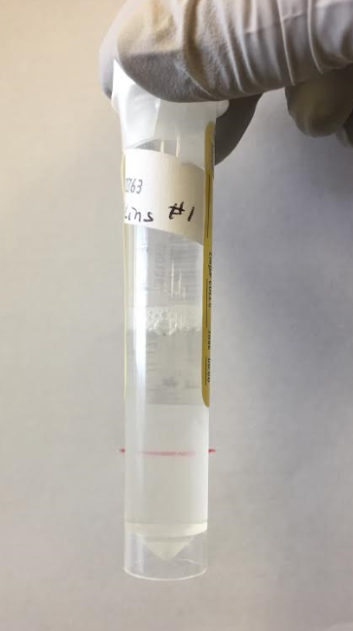
#12 Macroscopic Appearance
Parameter | Result
Source | CSF
Color | Colorless
Clarity | Hazy
Tube # | 1

Slide 90
#12 Hemocytometer Count
Parameter | Result | Reference Range
WBC | 1175 | 0-5/mcL
RBC | 100 | Absent/mcL
Should a differential or scan be performed on this Specimen?
Yes, perform differential

Slide 91
#12 Differential Results
Parameter | Result | Reference Range
Other | 100 | %
Remember: Designate others!

Slide 92
#12 Morphologic Findings
Atypical lymphocytes

Slide 93
#12 Differential Diagnosis
Non-Hodgkin Lymphoma
Hodgkin Lymphoma
Spinal cord tumor

Slide 94
#12 Diagnosis
Non-Hodgkin Lymphoma cells are characterized by the open chromatin and nucleoli
These cells are often seen in “grape-like” clusters

Slide 95
#12 Further Testing
Bone marrow aspiration
Flow cytometry
Cytogenetics

Slide 96
References
Rodak, B., & Carr, J. (2017). Clinical Hematology Atlas (Fifth ed.). St. Louis, MO: Elsevier.
Rodak, B., Fritsma, G., & Keohane, E. (2011). Hematology: Clinical Principles and Applications (Fourth ed.). St. Louis, MO: Elsevier.

