Slide 1
Beaumont Laboratory & School of Medical Laboratory Science COMMUNICATION GUIDELINES
School of Medical Laboratory Science Orientation
Updated: June 2020

Slide 2
Goals:
Review basics of effective communication
Illustrate the Beaumont Health chain of command
Illustrate the Beaumont Laboratory table of organization
Provide tips for a smooth transition into your role as a student and future medical laboratory science professional

Slide 3
COMMUNICATION BASICS

Slide 4
Communication: The Weakest Link
If we could eliminate or dramatically reduce:
No communication
Untimely communication
Inaccurate communication
Inappropriate communication….
How much more effective/efficient would we be?
How much would morale improve?
Would it effect employee/student satisfaction?
Would it effect patient satisfaction?

Slide 5
Beaumont Laboratory’s Professional Bi-Directional Communication Mantra
The right people,
at the right time,
in the right place,
in the right spirit,
about the right issue.

Slide 6
Communication: Expectations & Realities
It is not just the message; it’s the delivery too.
Bi-directional communication:
You can’t be listening if you are always talking.
A question is the least offensive way to make a point.
Utilize “I” messaging…

Slide 7
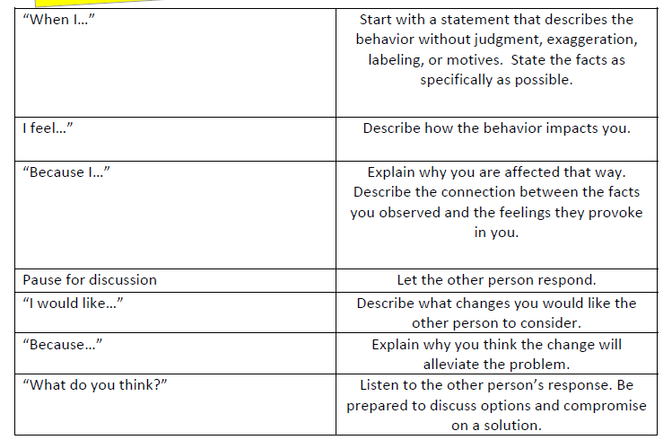
“I” Messaging

Slide 8
Communication: Expectations & Realities
For discussions to be effective and bear fruit, they cannot be a complaint session.
Provide ideas and suggestions to improve the situation.
Ask. Don’t assume.
Ask twice, if necessary!!
Gather facts from all parties before drawing conclusion.

Slide 9
Nonverbal Behaviors
Kinesics (body language)
Kinesics includes facial expressions, hand gestures, stares, body stiffness, movements.
A staff or student’s body language is always being observed by others around him/her.

Slide 10
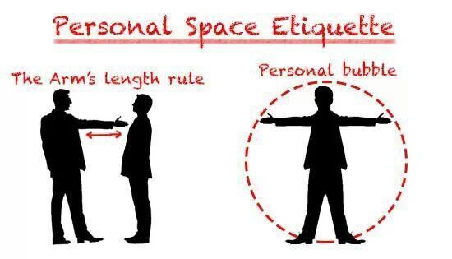
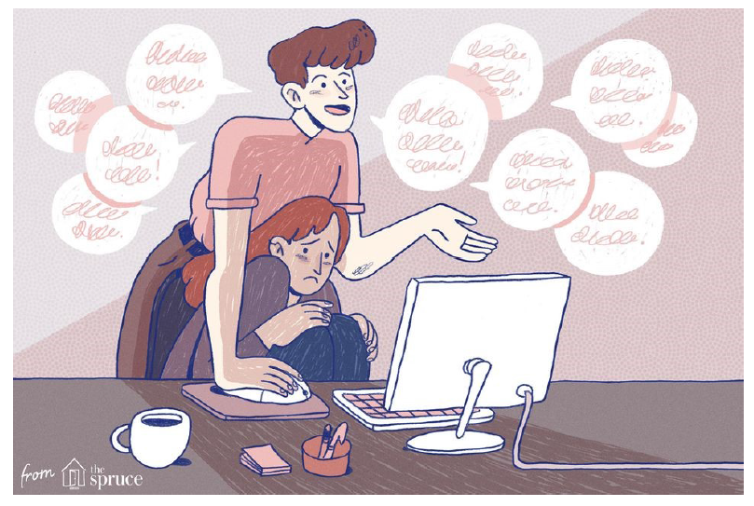
Nonverbal Behaviors
Proxemics (personal space)
Typical comfort zone is about 1.5 to 3.0 feet.
Varies with situation, culture, size, profession, sex, age, history, relationship, race, appearance, etc.
Also includes personal belongings such as wheelchair, etc.
Improper proxemics can increase the anxiety of an individual.

Slide 11
Paraverbal Communication
The link between verbal and nonverbal.
( How we say what we say – aka “Total Voice Control”.)
Tone: Try to avoid inflections of impatience, condescension, inattention, etc.
Volume: Keep the volume appropriate for the distance and the situation.
Cadence: Deliver your message using an even rate and rhythm.

Slide 12
BEAUMONT HEALTH & BEAUMONT LABORATORY COMMUNICATIONS

Slide 13
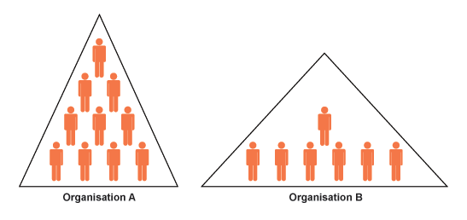
Chain of Command
Why is it there?
Respect it.
Use it.
It is a two-way street.
No circumventions allowed.
Varies within each organization.

Slide 14
Chain of Command – Beaumont Health & Laboratory
Corporate Beaumont Health
Corporate Hospital Presidents / Administrators
Beaumont Laboratory
Campus Laboratory Section Managers
Bench Technologists / Non-technical Staff
Corporate Compliance
Support Departments – e.g., Human Resources, Information Technology, Security
Lead Technologists (e.g., Clinical Instructors)
Laboratory Departments
Students
Medical Chief and Medical Chairs **
Laboratory Administrator
System Operation Directors
System Managers
PhD Technical Directors **
** Medical and PhD Technical Directors hold the Diagnostic & Consultant Roles

Slide 15
Lab Leadership’s Goals
Address any and all issues consistently utilizing professional bi-directional communication throughout the laboratory.
Promote open and honest communication without fear of retribution.

Slide 16
How
Promote a framework and structure to the communication process.
Laboratory Committee Meetings
Director Meetings with Managers
Town-Hall Staff Meetings with Lab Administrator and Medical Chief
E-mail communications
Lab Section Manager-to-Staff meetings
Laboratory Test Bulletins to Healthcare Staff and Clients

Slide 17
School of medical laboratory science communications

Slide 18
What does all this have to do with Students?
Adherence to policies and procedures
Complete learning activities as assigned
Maintain professional behavior
Effective communications with fellow students, instructors and program director
Understand the additional responsibilities of those you will interact with.

Slide 19
Effective Communications with Clinical Instructors
Read technical procedure before laboratory session
Work on objectives as assigned
Don’t dominate class discussions
Take turns answering questions and allow others a chance to respond
Ask questions when appropriate

Slide 20
Clinical Instructor Responsibilities
Educator & Mentor
MLS Students - ~60% of their time (larger rotations)
Personnel
Scheduling & PTO requests
New Employee Training
Staff Competency Assessment - ~50% of time
QA / QC / PI tasks
Nursing unit / specimen issue resolution
Maintaining personal continuing education

Slide 21
Efficient Communications with Program Director
Open door policy although appointment preferred
Not available during all program hours; 1-4 pm best
E-mail preferred
Reply promptly when asked a question via e-mail
Participate in seminar & class meeting discussions
Have you checked:
SharePoint?
Student Handbook? Special Topics Resource Manual?
FAQ’s?

Slide 22
Program Director’s Responsibilities
Students
Beaumont MLS Students
Orientation, Graduation & Admissions
University MLS Students – FH, Troy, DB
Technologist Students – Micro, Chem
Phlebotomy and Lab Assistant Externships
Employees / Managers
Training & Competency Assessment SOPs
Certification, CM and CE guidance
Manager questions on MT job applicants
Chair: Lab Education Committee
Laboratory Education webpage oversight
Laboratory HealthStream™ Administrator

Slide 23
Program Director Responsibilities – cont.
Clinical Instructors
Course curriculum development and review
Guidance, monthly faculty meetings
Oversight: Quarterly CMS time studies; semi-annual course evaluation response; annual course assessment
Lab & Hospital Administration
Monthly standing meeting with Lab Administrator
Monthly Clin Path Manager meetings
HR questions on MT job applicants
Annual program cost report to Reimbursement
NAACLS
Annual program report and webpage updates
Annual student outcomes assessment
Annual Advisory Committee meeting

Slide 24
Major Communication Tools
Outlook E-Mail
All students and employees have access
Program Director’s preference
Keep up-to-date with your e-mails
Check daily; at minimum weekly

Slide 25
E-Mail Etiquette
Professional
Do NOT send non-business related e-mails (e.g., humor, chain letters, etc.)
Formal and Brief
Black text; standard font
Remember to include a Subject
Address at highest level of courtesy
“Hello, Mr. Anderson” (not “Hey Joe”)
BC:
Use with caution; only use when contacts do not personally know each other.

Slide 26
E-Mail Etiquette – cont.
Once sent, can’t correct!!
Messages are permanent and stored!
Privacy and confidentiality cannot be guaranteed.
RESPONDING:
Assume good intentions of sender.
Not necessary to respond to every e-mail with a Thank You!
Not necessary to respond to e-mail’s you are CC:’d on.
“Reply to All” – use with discretion; be considerate of other’s time and interest in your response
Reply to your manager’s e-mail requests in a timely manner!!
SENDING:
Never insult or criticize.
Keep recipients and CC:’s to a minimum.
Keep acronyms to a minimum.

Slide 27
Beaumont Hospitals Information Security Policy
E-mails must be work-related and business appropriate
Contents are not private and may be reviewed, monitored and copied by authorized representatives of Beaumont Hospitals
In addition, they may be disclosed to law enforcement officials with or without notice to employees

Slide 28
Beaumont Hospitals Information Security Policy
Electronic mail systems may NOT be used:
To send confidential patient information outside of the hospital; a secured file must be used if needed
To communicate or solicit non-management approved personal activities or products
To send messages that are obscene or harass employees, patients, patients’ families or outside e-mail accounts
Any material that can be interpreted a sexually explicit, profane, obscene, harassing, fraudulent, racially offensive, ethically offensive, defamatory or otherwise unlawful

Slide 29
Other Communication Tools
MLS Program SharePoint
Shared access to all program documents
Students and instructors have access
Common workspace for entire class
Individual workspace folder for each student
MLS Program Student Meetings
Four meetings during Weeks 2-25
Dates provided on Program Schedule

Slide 30
Other Communication Tools
MLS Program SharePoint
Shared access to all program documents
Students and instructors have access
Common workspace for entire class
Individual workspace folder for each student
MLS Program Student Meetings
Four meetings during Weeks 2-25
Dates provided on Program Schedule

Slide 31
REMINDERS

Slide 32
HIPAA
Employees (students) are prohibited from accessing, releasing, reading, copying or reproducing any patient PHI without the patient's prior written authorization or as required for performance of their job responsibilities.
It is every employee's responsibility to protect the confidentiality of patient information. Department Managers, in conjunction with the Privacy and Information Security Officers, are responsible for safeguarding a patient’s PHI from improper access and/or release. Department Managers are responsible to limit employees’ access of PHI to the minimum necessary required to perform their job functions. Department Managers are responsible to conduct at least yearly audits to determine unauthorized access.
Any improper access and/or release of patient information, in any form, is grounds for dismissal.
Beaumont Hospital Corporate Policy:
Confidentiality and Disclosure of Protected Health Information (PHI)

Slide 33
HIPAA
Access to patients’ EPIC oneChart™ files:
Technologists: Permitted within normal work process (e.g., chart review; specimen problem-solving)
Students: Case study investigation only
Respect coworkers’ (and fellow student’s) privacy.
NOTE: Compliance audits on Clinical Pathology and Outreach staff/student access to EPIC and SOFT are performed twice a year!

Slide 34
SUMMARY Communication Mantra
The right people,
at the right time,
in the right place,
in the right spirit,
about the right issue.

Slide 35
FINAL TIP…

Slide 36
Handling Challenging Staff
Questions/comments you may hear at the working bench from disgruntled staff:
Suggested Response
Stay calm and don’t overreact.
Stay neutral. Get a neutral person’s perspective on the situation
Beware of agreeing with someone who is badmouthing others.
Avoid complacency.
Focus on increasing your skills, knowledge and performance.
You get out of the career what you put into it.
Why did you chose this career?
Med techs should earn as much as nurses.
I haven’t had a raise since I started.
Contradictory behaviors of staff.

