Slide 1
Transition to the Role of a Clinical Laboratory Professional
2023 Student Orientation

Slide 2
Dos and Don’ts: A Guide to Professional Behavior for MLS Program Students

Slide 3
Why do I need to watch this? (Objectives)
To illustrate various forms of unacceptable behavior exhibited by former Medical Laboratory Science students which required counseling (probation or dismissal) to meet program and hospital behavior requirements.
To appreciate key program graduate competencies. (See next slide for a refresher.)
To appreciate published code of ethics from our laboratory professional organizations.
To encourage you to think about your own professional development.

Slide 4
Objectives – cont.

Slide 5
What is your concept of professionalism?
Close your eyes and think for a minute.
What terms comes to mind when you hear the word laboratory professional?
Notes:
Generate a class list on board if delivering in person.

Slide 6
Terms describing professionalism …

Slide 7
Determine whether the following scenarios depict “Do” or “Don’t” behaviors of allied health professionals in the clinical laboratory and hospital setting.

Slide 8
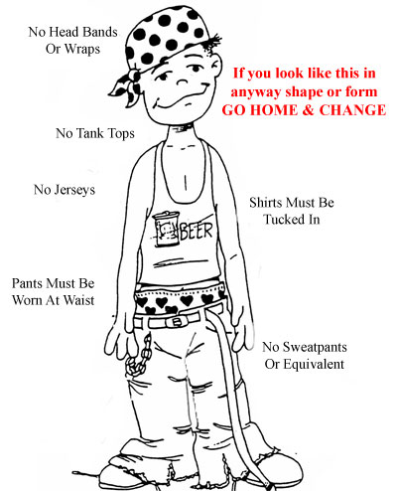
Do or Don’t?
Including No Hats.
Improper shoes
No frayed pant hems

Slide 9
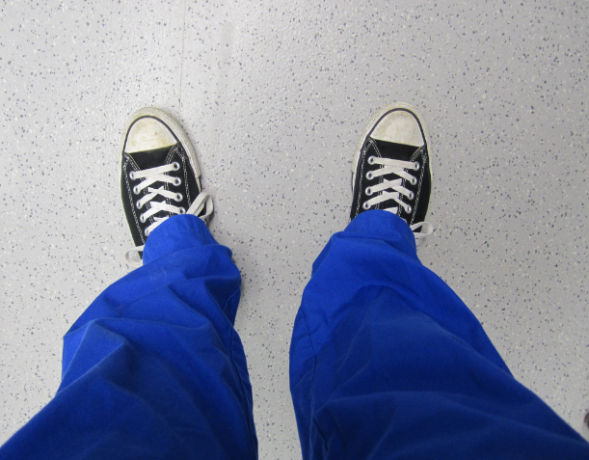
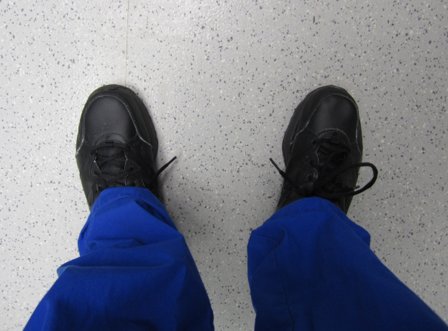
Starting from the ground up: What kind of shoes are you wearing?
Your shoes should be non-canvas
Canvas shoes like All-Star Converse which are mostly cloth would be permeable to any chemical reagents or specimen substances spilled on them
Non-canvas shoes like those on the right would not as readily absorb anything spilled on them
DON’T
DO

Slide 10
Do or Don’t?

Slide 11
Scrubs should be in good condition, clean and properly hemmed.
Non-logo knit shirts can be worn underneath for additional warmth.

Slide 12
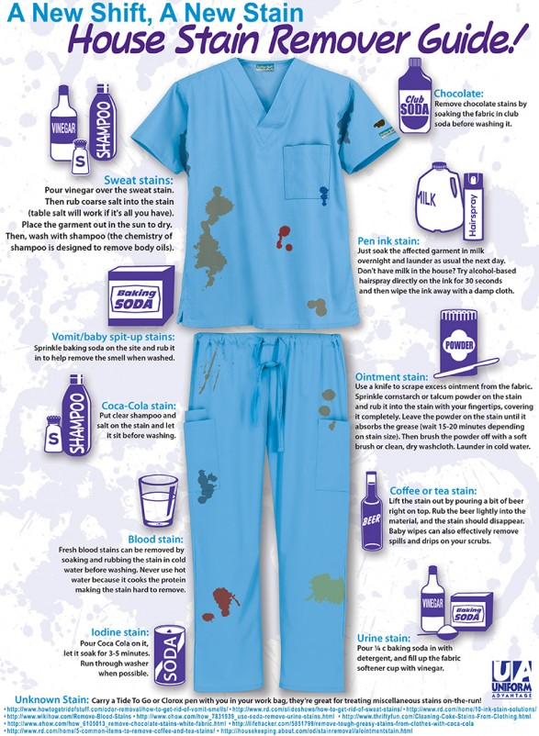
Do keep your scrubs clean and neat.
http://www.bartonassociates.com/2013/09/12/how-to-remove-stains-from-medical-scrubs-infographic/

Slide 13
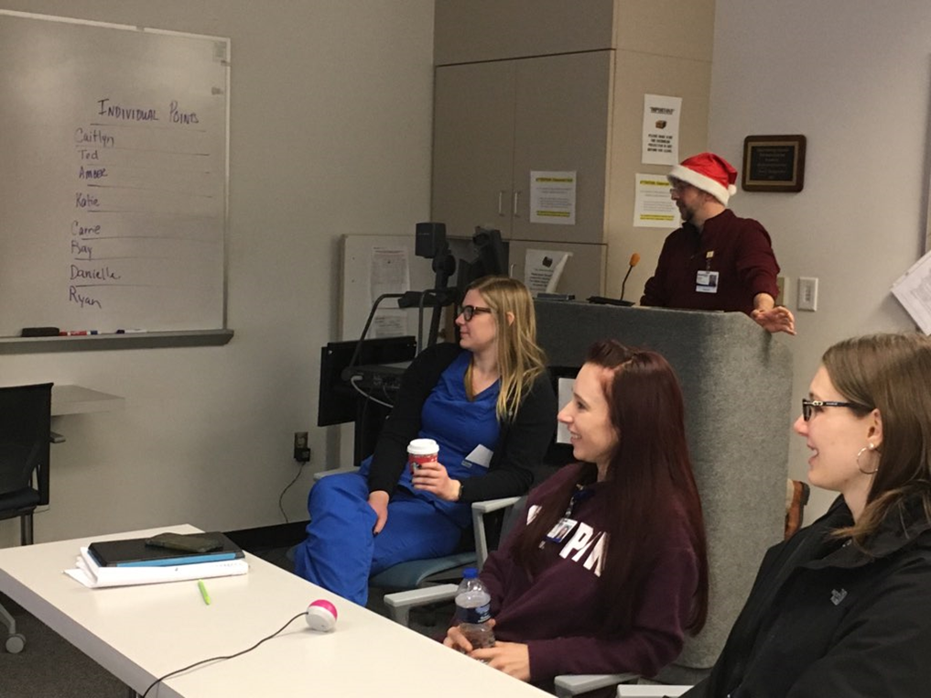
Do or Don’t?

Slide 14
Reminders:
DO actively participate in class activities.
No sleeping during lecture.
Get plenty of rest before class.

Slide 15
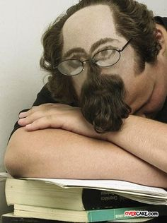
Reminders:
And please don’t sleep in public lobby areas within the hospital. Go to your car during lunch if you need a nap.

Slide 16
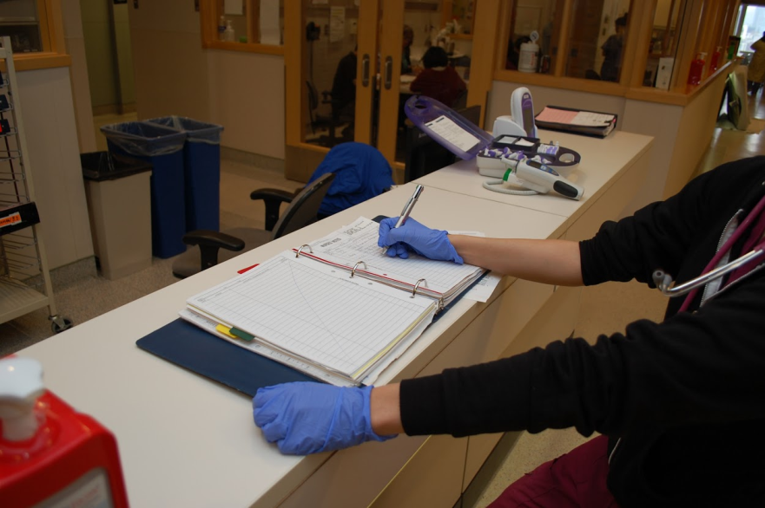
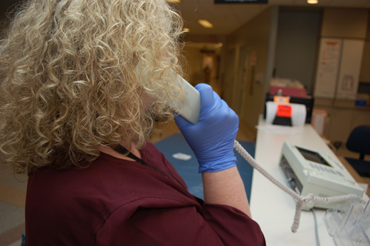
Do or Don’t?

Slide 17
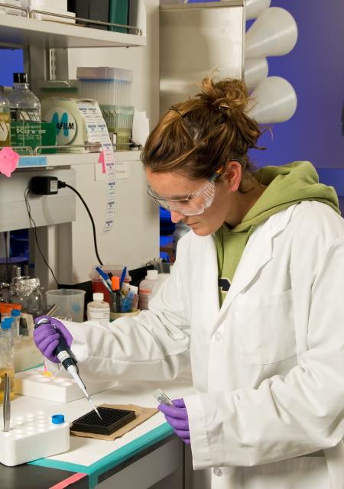
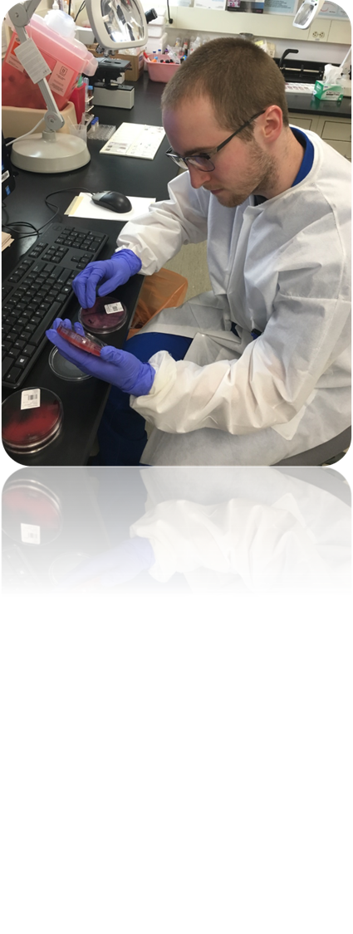
Do or Don’t?

Slide 18
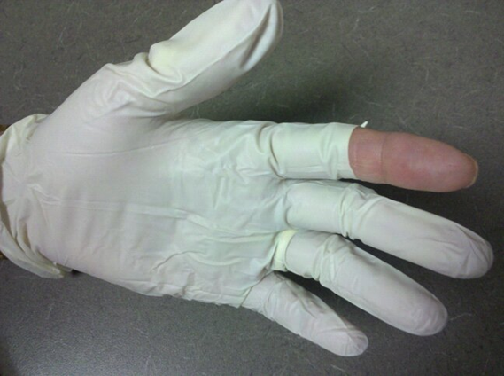
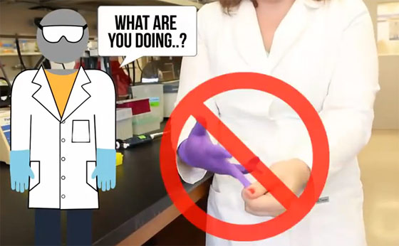
Do or Don’t?

Slide 19
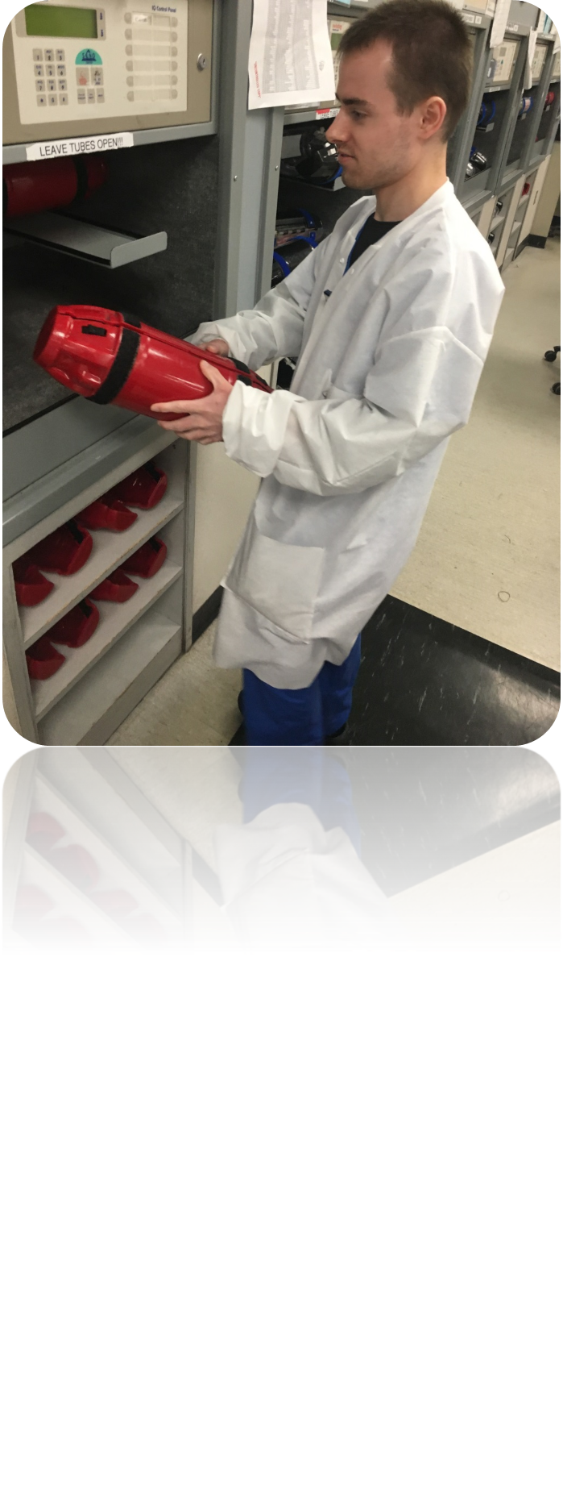
Do or Don’t?

Slide 20
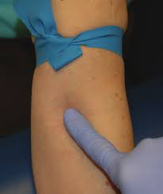
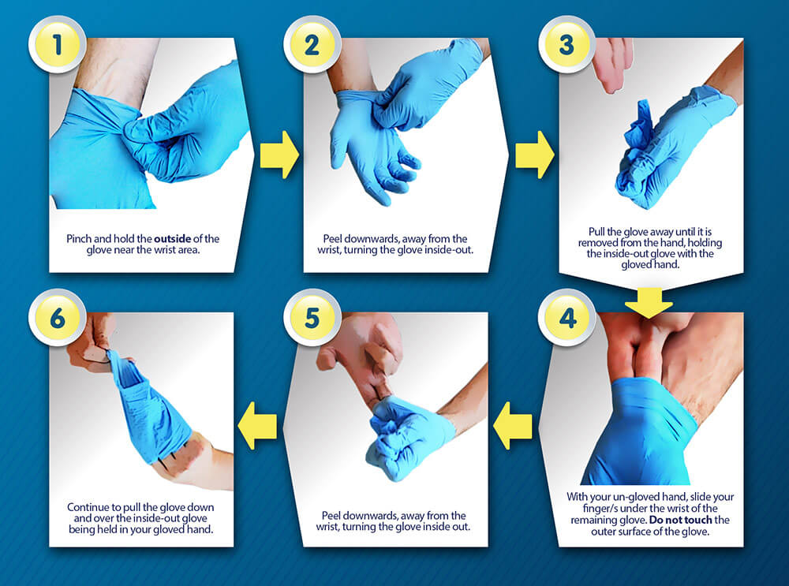
Reminder:
Use gloves and other PPE properly.
“Don” an “doff” PPE correctly.

Slide 21
Do or Don’t?

Slide 22
Do or Don’t?

Slide 23
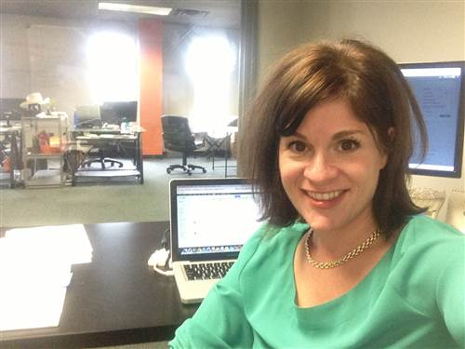
Do or Don’t?

Slide 24
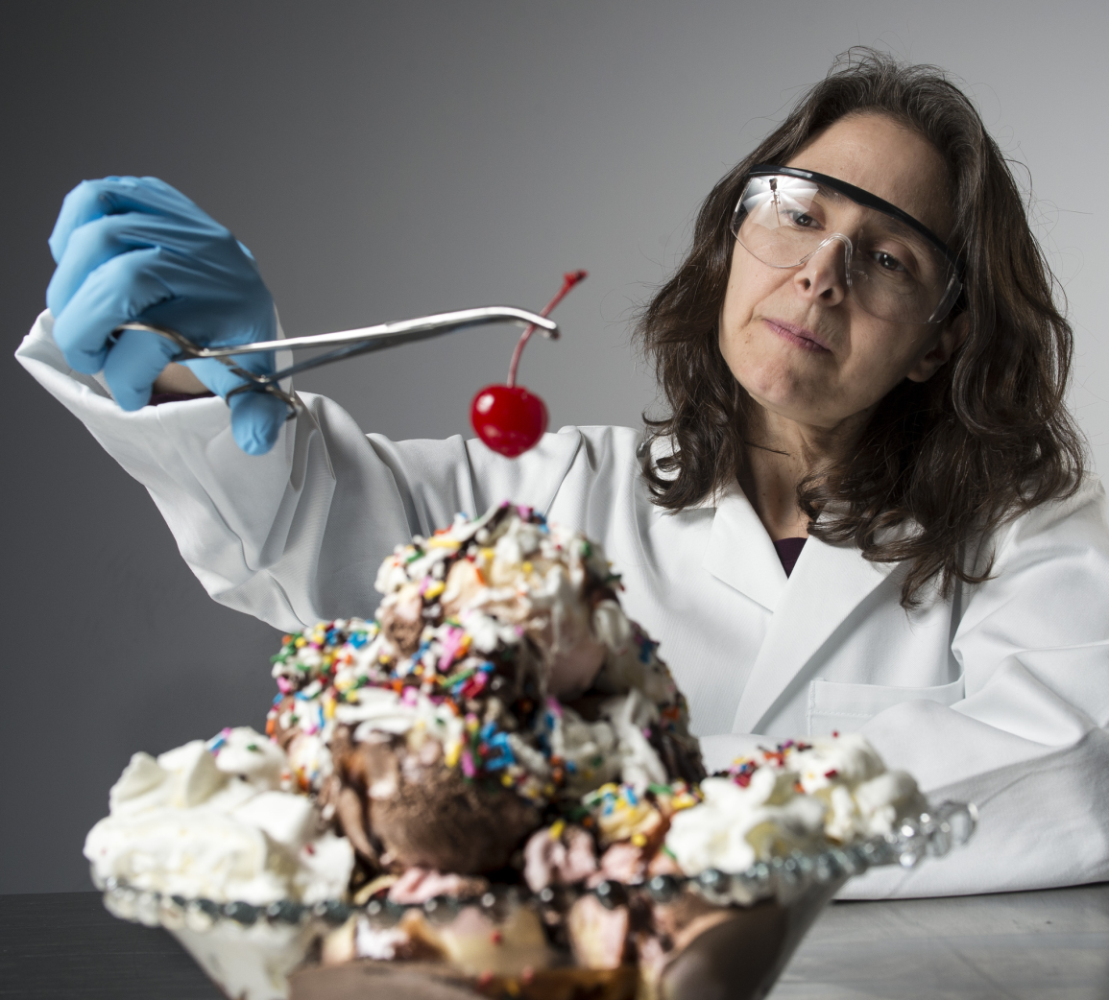
Do or Don’t?

Slide 25
Do or Don’t?

Slide 26
Reminders:
Keep pens/pencils out of your mouth
No eating in the lab
No makeup or personal hygiene in lab
No personal items in lab
No cell phone use during lecture, in the student lab, on the working bench or during exams
This includes NO selfies in lab either.

Slide 27
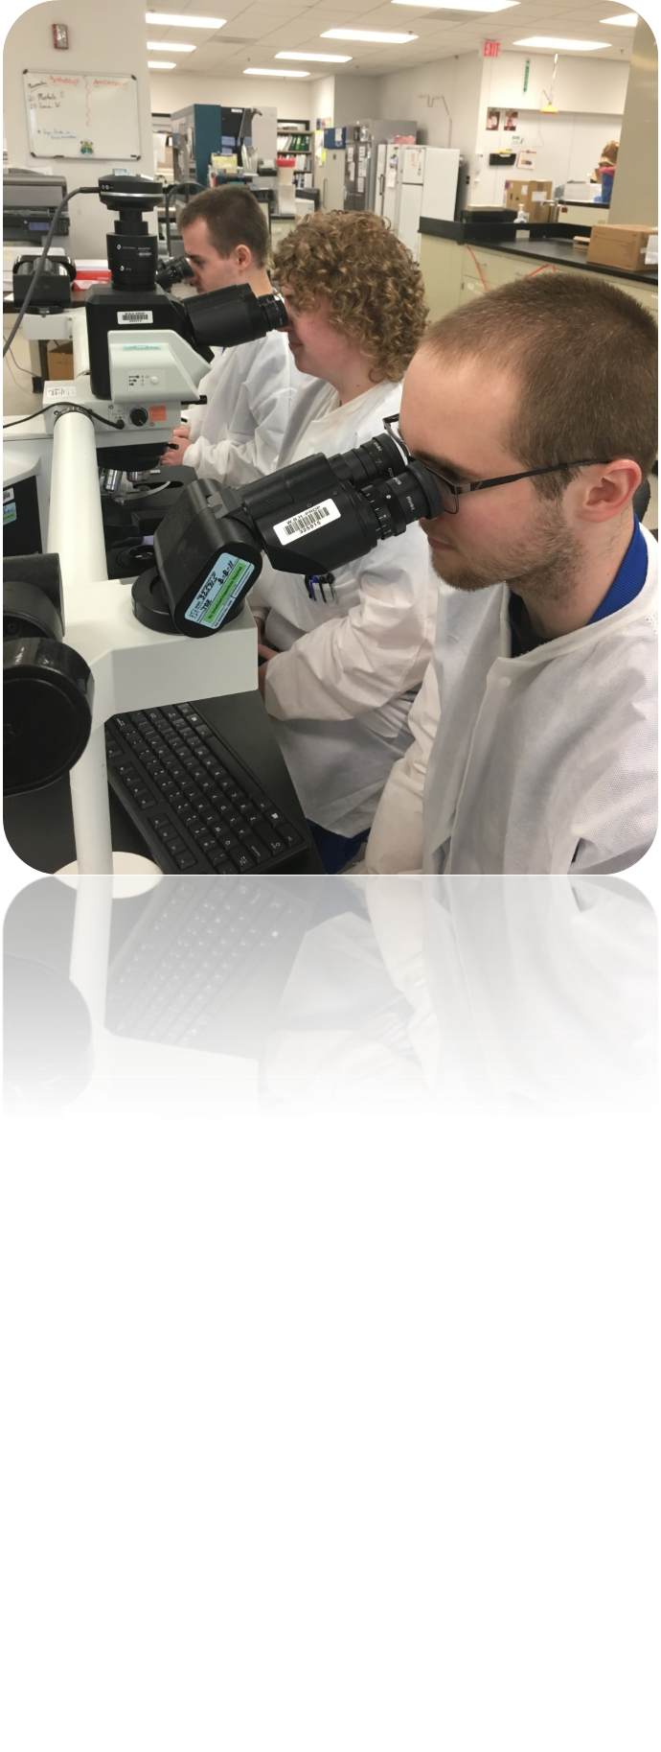
Do or Don’t?

Slide 28
Do or Don’t?

Slide 29
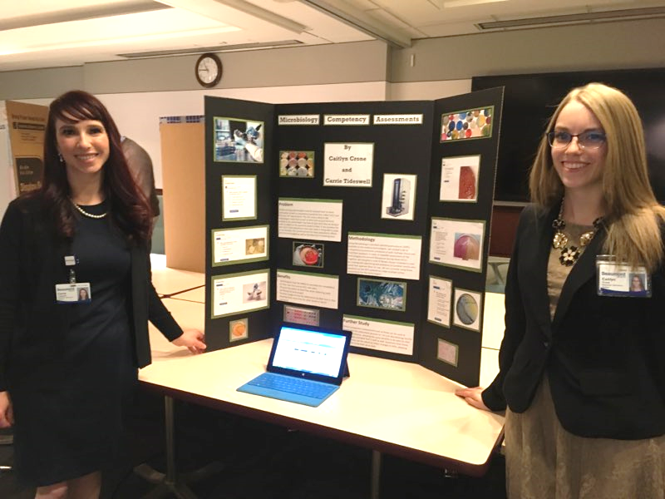
Do or Don’t?
Well rested, awake and happy

Slide 30
Do or Don’t?

Slide 31
Reminders:
Don’t become a “BMW” – aka “b***cher, moaner and whiner”.
Control the volume of group conversations. Be considerate of other students/staff working nearby;
Work as a team;
Take turns in group discussions;
Control the frequency of casual, social chatter – AND -
Focus on the task at hand.

Slide 32
Additional Note:
Many students comment on exit surveys the desire for more BOC “reviews” during the program.
Yet, keep in mind that every assignment and bench activity should be taken seriously and considered a form of ASCP BOC preparation. You never know what real world example may appear in a BOC question.

Slide 33
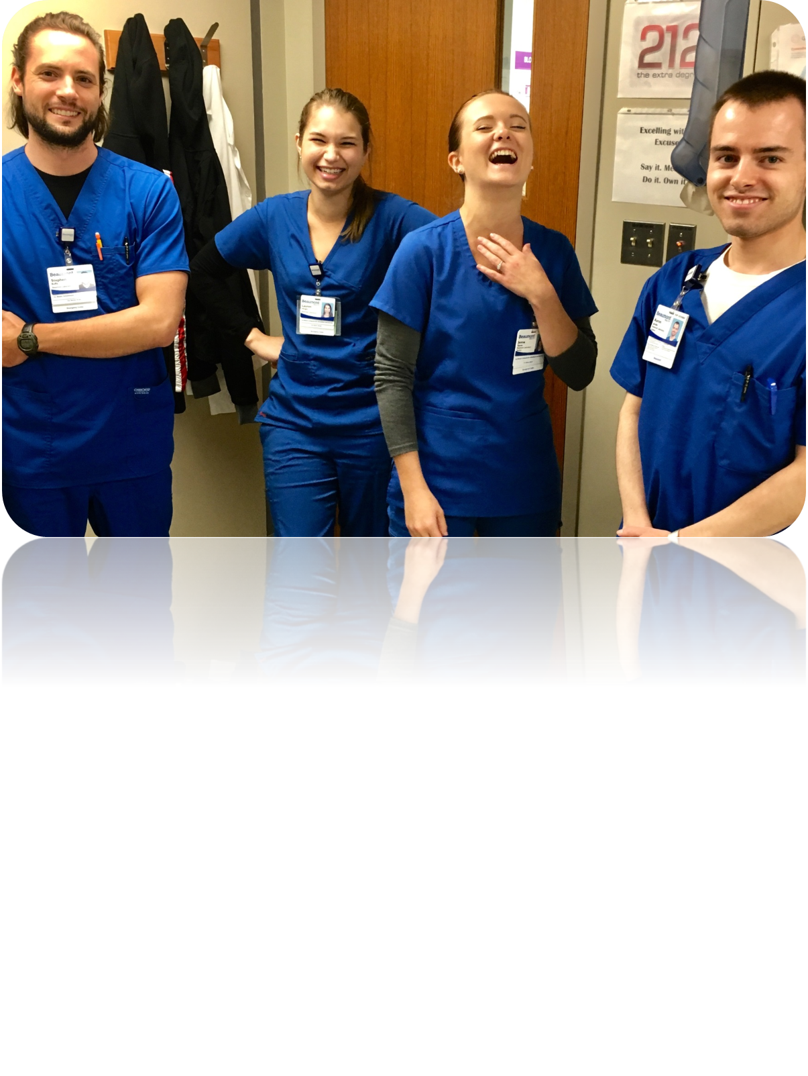
Do or Don’t?

Slide 34
Do or Don’t?

Slide 35
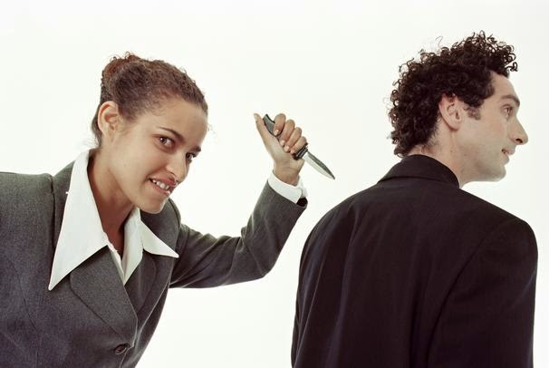
Do or Don’t?

Slide 37
It’s a Matter of Respect
Demonstrate sensitivity to cultural, gender, religious, and other differences;
Speak appropriately to patients, public, superiors, and colleagues;
Recognize the contributions from all members of the health care team;
Speak up if any concerns.

Slide 38
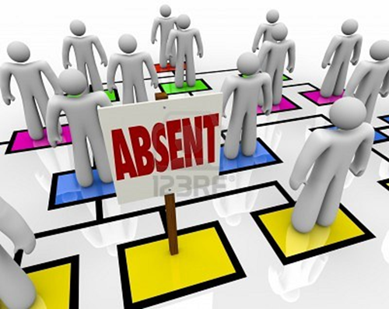
Do or Don’t?

Slide 39
Reminders:
Arrive to assigned workstation on time.
Communicate your whereabouts .
Don’t leave working bench without instructor or teaching tech permission.
Ask how you can help.
Complete assignments on time.

Slide 40
Summary: What is Professionalism?
Competence in the knowledge and skills required by the profession;
Responsibility and accountability;
Lifelong learning and continued professional development;
The concept of service and public vs. self-interest;
Confidence; and
A commitment to excellence and improved practice.

Slide 41
Professional “Identity”: ASCLS and ASCP Codes of Ethics

Slide 42
Preamble
The Code of Ethics of the American Society for Clinical Laboratory Science (ASCLS) sets forth the principles and standards by which clinical laboratory professionals practice their profession.
[These are discussed on the next three slides.]

Slide 43
I. Duty to the Patient
Clinical laboratory professionals are accountable for the quality and integrity of the laboratory services they provide. This obligation includes maintaining individual competence in judgement and performance and striving to safeguard the patient from incompetent or illegal practice by others.
Clinical laboratory professionals maintain high standards of practice. They exercise sound judgment in establishing, performing and evaluating laboratory testing.
Clinical laboratory professionals maintain strict confidentiality of patient information and test results. They safeguard the dignity and privacy of patients and provide accurate information to other health care professionals about the services they provide.

Slide 44
II. Duty to Colleagues and the Profession – (ASCLS cont.)
Clinical laboratory professionals uphold and maintain the dignity and respect of our profession and strive to maintain a reputation of honesty, integrity and reliability. They contribute to the advancement of the profession by improving the body of knowledge, adopting scientific advances that benefit the patient, maintaining high standards of practice and education, and seeking fair socioeconomic working conditions for members of the profession.
Clinical laboratory professionals actively strive to establish cooperative and respectful working relationships with other health care professionals with the primary objective of ensuring a high standard of care for the patients they serve.

Slide 45
III. Duty to Society (ASCLS – cont.)
As practitioners of an autonomous profession, clinical laboratory professionals have the responsibility to contribute from their sphere of professional competence to the general well being of the community.
Clinical laboratory professionals comply with relevant laws and regulations pertaining to the practice of clinical laboratory science and actively seek, within the dictates of their consciences, to change those which do not meet the high standards of care and practice to which the profession is committed.

Slide 46
ASCP BOC - Pledge to the Profession
As a clinical laboratory professional, I strive to:
Maintain and promote standards of excellence in performing and advancing the art and science of my profession.
Preserve the dignity and privacy of others.
Uphold and maintain the dignity and respect of our profession.
Seek to establish cooperative and respectful working relationships with other health professionals.
Contribute to the general well being of the community.
I will actively demonstrate my commitment to these responsibilities throughout my professional life.

Slide 47
Don’t forget…..
Think of all the individuals with BS degrees in biology, chemistry, microbiology, etc. who cannot find a job and are now either looking for job training or a job.
Not all MLS program applicants were matched for a MTIMPM internship. Be grateful you were one of them!

Slide 48
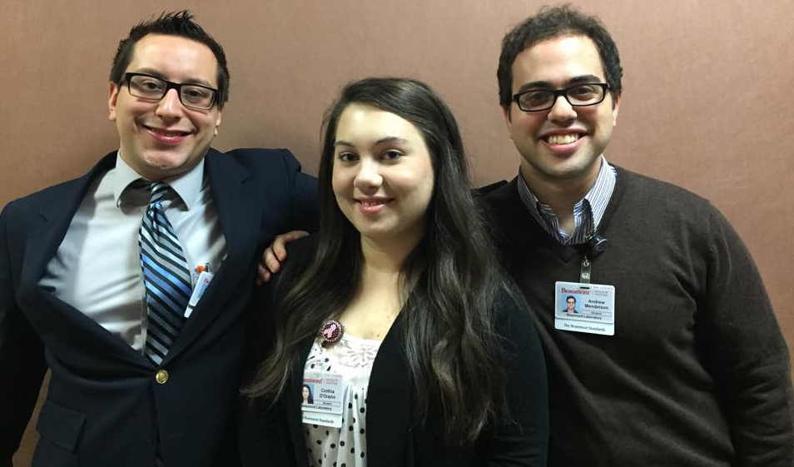
Do: Always strive to look your best and do your best work!

Slide 49
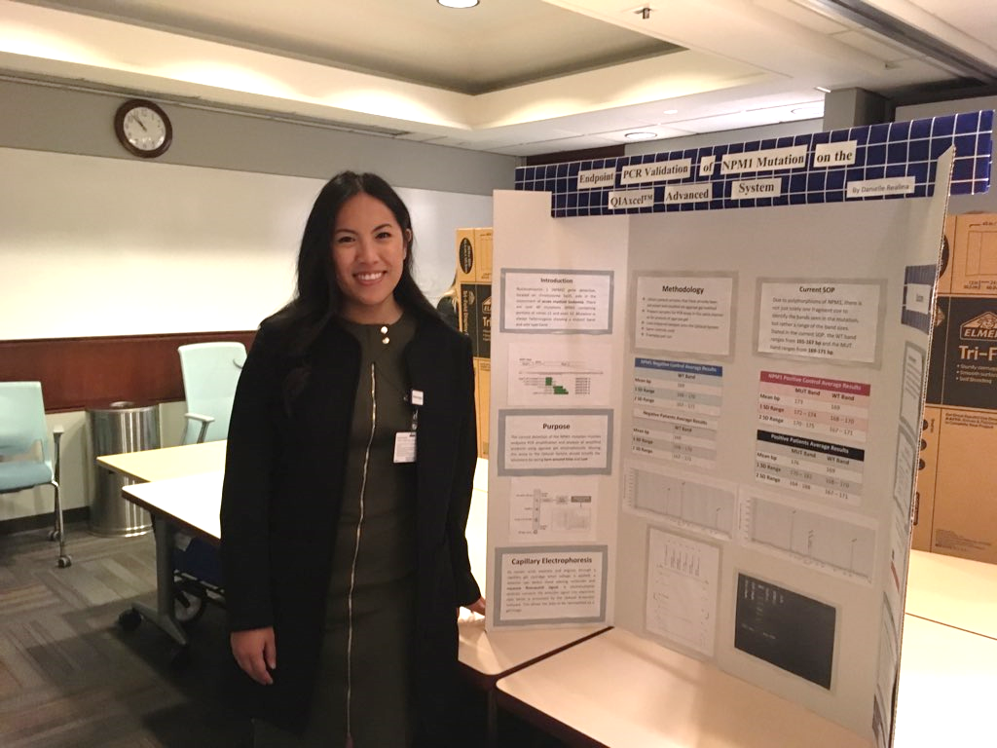
Think of your internship as an interview process AND…
Well rested, awake and happy

Slide 50
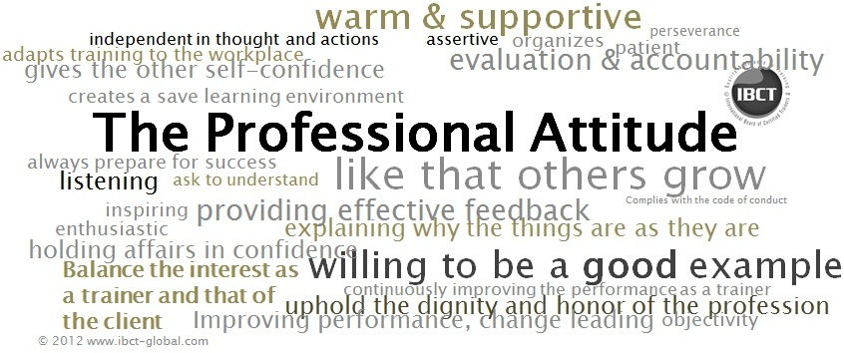
Keep your focus on professional behavior and how you are presenting yourself to others. Become a change advocate to make the profession and patient care better each day.

Slide 51
Final Words….
Remember every specimen you analyze is a real patient who has concern and anxiety over the results. It should never be considered an “annoyance” but a privilege.
You are privileged to be intelligent enough to take care of that patient.
You can help save a person’s life.

Slide 52
Next Step: Reflection and Confirmation
To confirm you have viewed this entire presentation, please complete the following:
Attestation statement in MTS.
Write a short 2-4 paragraph reflection titled “Professional Work Ethics” answering the questions below. Post this in your SharePoint workspace.
Which laboratory professional organization code of ethics did you find the most helpful on this topic and why?
What work behaviors or work ethics do you personally need to improve to become a better laboratory professional?

Slide 53
The End!

