Slide 1
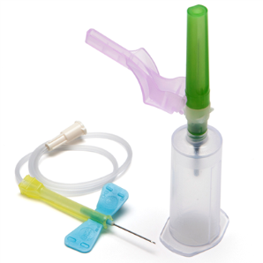
Sharps Safety
Training Module for Corewell Laboratory Phlebotomists
Updated: September, 2018

Slide 2
Making Safe Choices
This module provides critical information/steps needed to ensure that our patients consistently receive safe care. It is your responsibility to notify your supervisor/educator if you have questions about the information in this module, or if you are unable to complete the steps as described.
Not following these steps may cause harm to our patients, ourselves or others and is called at-risk behavior. You should expect to be coached if you misstep, or drift, from the described procedures.
Should you choose to not follow this procedure (after being coached on the correct procedure) that may be considered reckless behavior and may result in punitive action.

Slide 3
The purpose of this module is to provide:
Incidence and risks of sharps injury
Work practices to prevent sharps injuries
Instructions/demonstrations on the proper use and safe handling of currently used needle products including:
Single use blood collection needle
Blood collection set
Blood transfer device
Fingerstick lancets
Infant heel lancets
Urine collection kits
Current sharps disposal practices

Slide 4
Incidence of Injuries
CDC estimates ~385,000 sharps injuries annually among hospital-based healthcare personnel (>1,000 injuries/day)
Many more in other healthcare settings (e.g., emergency services, home care, nursing homes)
Increased risk for bloodborne virus transmission
Costly to personnel and healthcare system

Slide 5
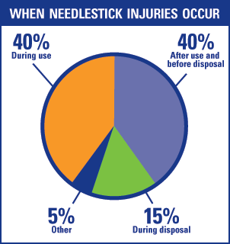
High Risk Situations
Injuries can occur….
During patient care:
Inserting or withdrawing a needle
Using a lancet
Using a urine collection container
Immediately after sharp use:
Activating a needle safety shield
During and after sharp disposal:
Disposing of sharps into sharps containers
Cleaning up after a procedure
Sharps left on floors and tables, or found in linen, beds or waste containers

Slide 6
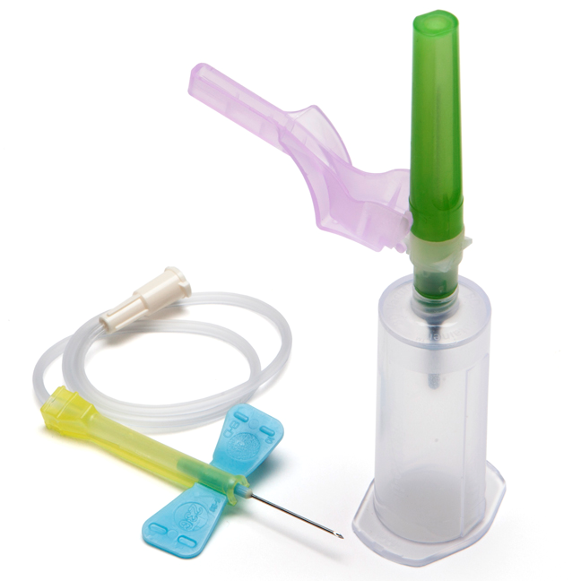
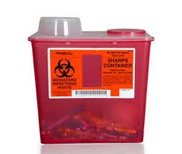
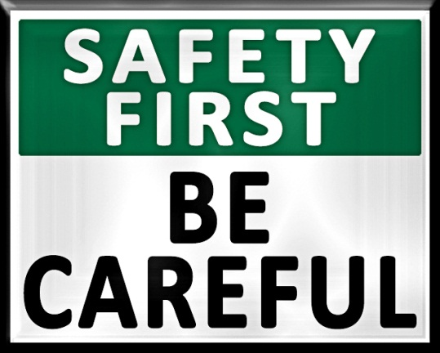
Sharps Safety:
Be Prepared
Be Aware
Dispose with Care

Slide 7
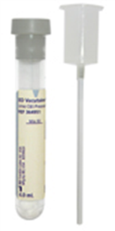
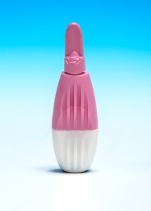
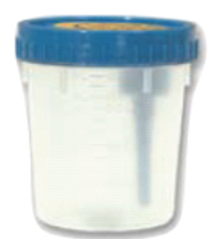
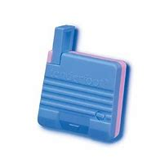
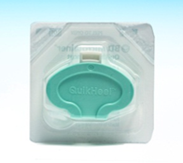
Sharps Safety:
Be Prepared:
Organize your work area with appropriate sharps disposal containers within reach:
Sharp containers should be in locked cabinets, with keys removed, when located in areas where patients are left unattended
Sharps containers should not be located on the floor where a patient or child can gain access
Work in well-lit areas
Learn how to properly use the BD sharps safety devices that we currently use.
Read the manufacturer’s educational literature and
Watch a demonstration (see the following slides)

Slide 8
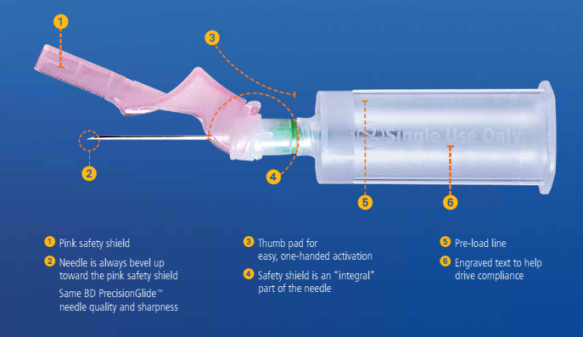
BD Vacutainer®needles

Slide 9
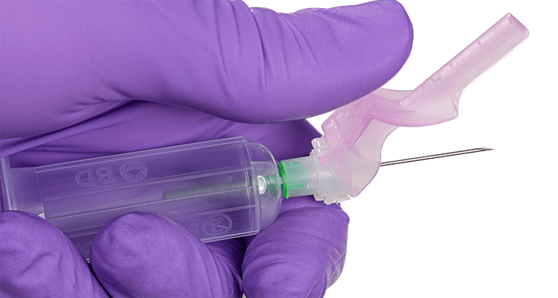
BD Vacutainer® needles

Slide 10
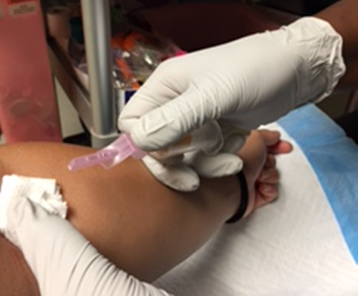
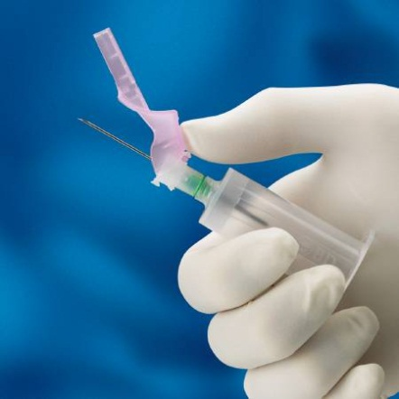
IMPORTANT!
To avoid an accidental needle stick, activate the Vacutainer needle safety shield immediately upon removal from the vein.
Do NOT hold the needle up in the air before activating!

Slide 11
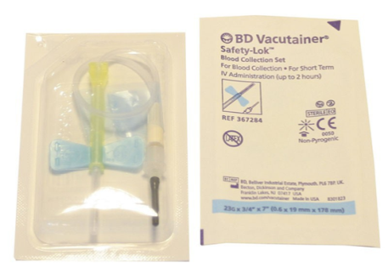
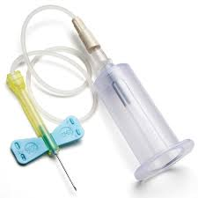
BD Safety-LokTM Blood Collection Set (aka Butterfly)
Butterflies are one of the most common sources of needle stick and blood splash injuries for phlebotomists.
To minimize your risk, activate the butterfly safety shield during removal from the vein following the recommended steps demonstrated in the photos on the next few slides.

Slide 12
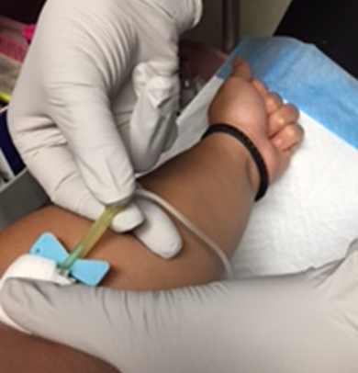
Safety-LokTM Activation
Upon completion of collection, apply gauze over site with free hand but do not apply pressure yet.
While gripping the base of the yellow safety shield with thumb and index finger, position the tubing between your middle and ring finger.
1.
2.

Slide 13
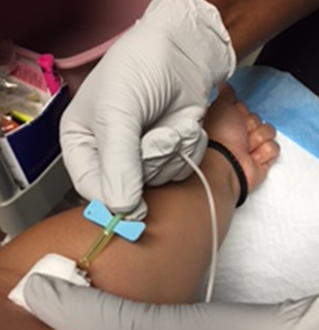
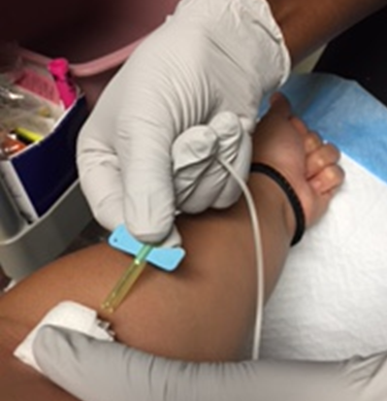
Safety-LokTM Activation
Grasp tubing tight between both fingers and then .....
Close fingers into a tight fist until the safety shield is completely locked in place over the needle.
Apply pressure over site and dispose of collection set and adapter (hub) into sharps container.
3.
4.

Slide 14
Video: Safety-LokTM Activation
Be patient while the Video start paying.

Slide 15
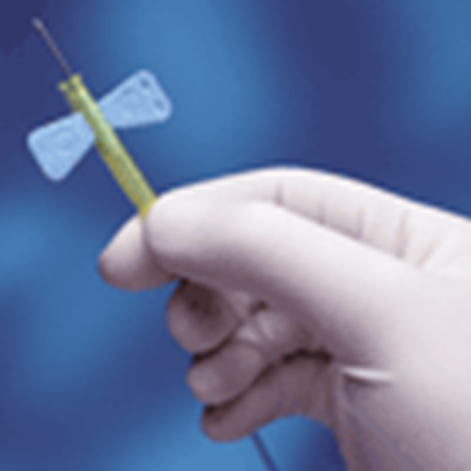
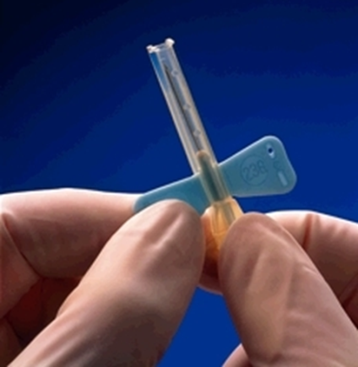
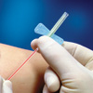
IMPORTANT!
Do NOT hold a needle up in the air before activating!
Do NOT use two-handed techniques to activate the Safety-Lok safety shield!

Slide 16
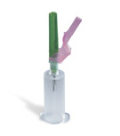
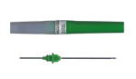
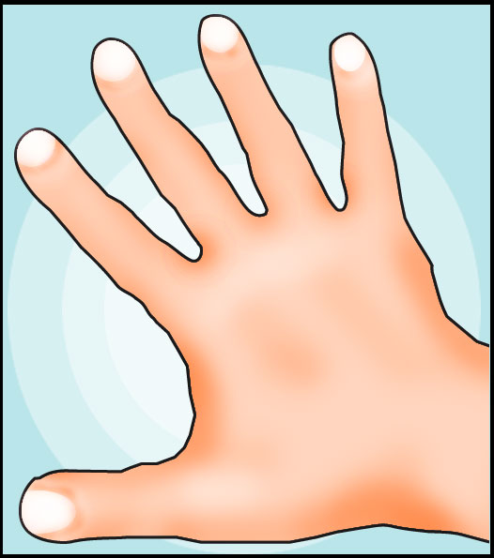
BEWARE!
Do NOT place fingers into a hub (adapter) connected to a Vacutainer needle, butterfly or blood transfer device.
Remember, there is a needle under the rubber sheath!
Do NOT gather up remaining blood collection equipment in one hand.
It’s possible the butterfly needle may not be fully retracted into safety shield!

Slide 17
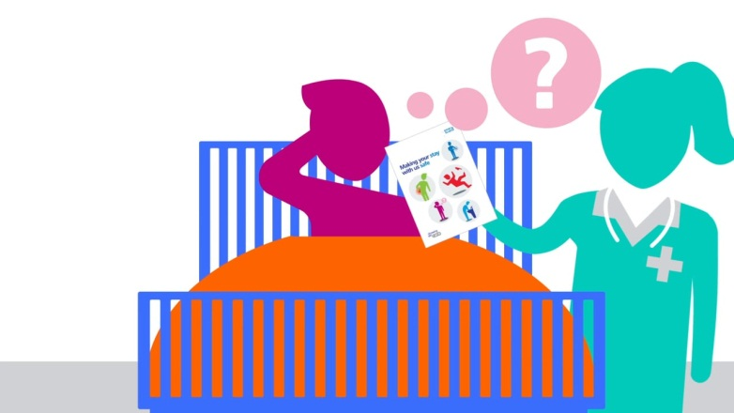
BEWARE!
When dealing with agitated or combative patients, do not try to continue the venipuncture.
STOP the procedure and step back to avoid risk of injury.
Tip: If possible, stick the needle into the sheet or nearby object to secure it until patient is back under control.

Slide 18
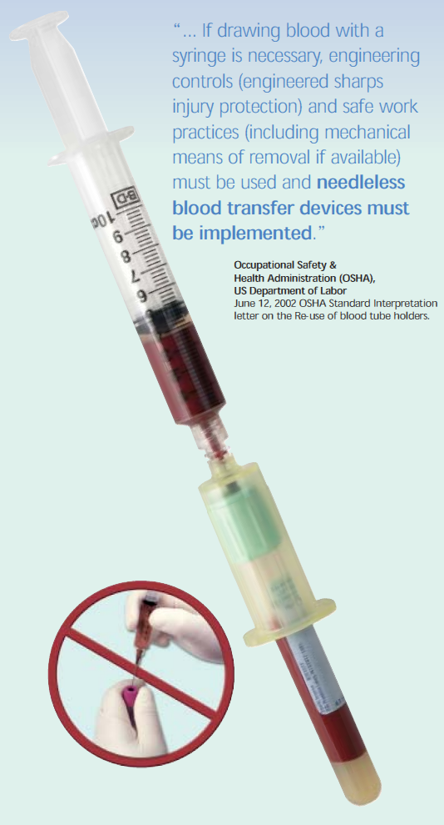
Blood Transfer Device

Slide 19
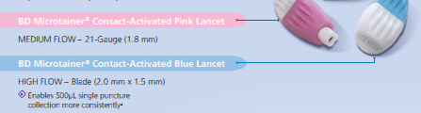
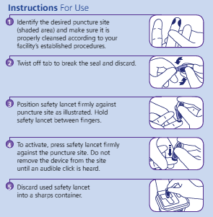
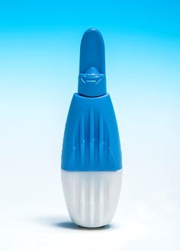
Capillary Blood Lancets – Pediatric/Adult Finger Sticks (Royal Oak, Troy, Grosse Pointe)

Slide 20
Capillary Blood Lancet – Newborns (Royal Oak, Troy, Grosse Pointe)

Slide 21
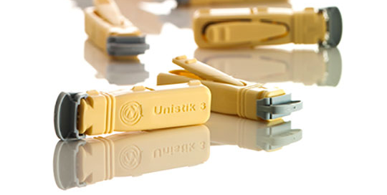
Capillary Blood Lancets – Pediatric/Adult Finger Sticks (Dearborn, Taylor, Trenton, Wayne)
Owen Mumford Unistik® 3 lancets
Features Comfort Zone Technology® (CZT®) with eight raised pressure points to reduce pain for a more comfortable sampling experience.
Needle retracts immediately after use to reduce the risk of needlestick injuries
Lock out indicator prevents reuse
Indicator for targeted positioning

Slide 22
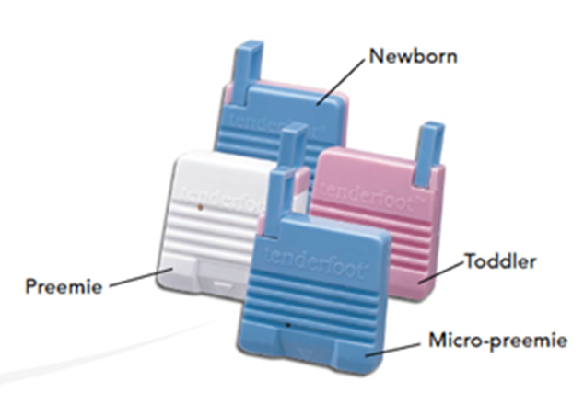
Capillary Blood Lancets – Newborns (Dearborn, Taylor, Trenton, Wayne)
Accriva Tenderfoot™ lancets
Safe, easy to use, and virtually pain free Softsweep™ incision method controlled to a depth just above most nerve fibers
Less bruising as compared with traditional lancet devices
No need for heel warmers, repeat sampling, and excessive squeezing of the heel
Blade permanently retracts back into the device, eliminating any chance of an accidental stick and creates a high-quality incision resulting in a sample free of tissue contamination
Available in four different incision depths: micro-preemie, preemie, newborn, and toddler

Slide 23
Accriva Tenderfoot™ method
YouTube Video link for tutorial: https://www.youtube.com/watch?v=w1v0B_9fOXI

Slide 24
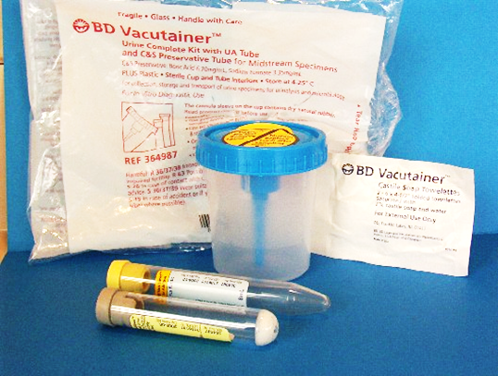
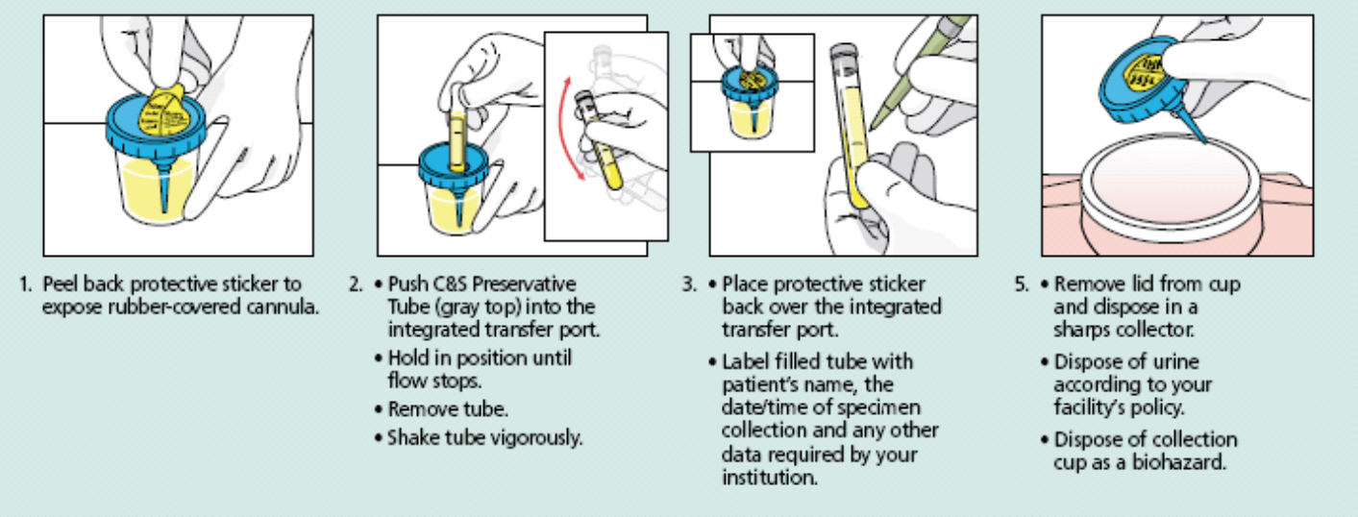
Urine Collection using BD cup with transfer device in lid
Review the steps below for proper specimen processing and safe disposal.
Discard remaining urine in sink.
Remove patient identifiers on label with a Sharpie.
Dispose of empty cup in regular trash.
6. Repeat steps 1-5 for the yellow UA tube.

Slide 25
Urine Collection using BD transfer straw
Review the steps below for proper specimen processing and safe disposal.
Discard remaining urine in sink.
Remove patient identifiers on label with a Sharpie.
Discard empty cup in regular trash .
Repeat steps 1-5 for the yellow UA tube.

Slide 26
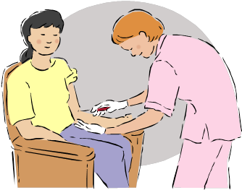
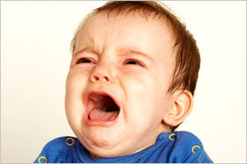
Sharps Safety:
Be Prepared – continued:
Before handling sharps, assess any hazards such as a combative or confused patient
Explain to the patient the importance of avoiding sudden movement that could dislodge the needle and possible discomfort or injury
Ask for assistance, if needed

Slide 27
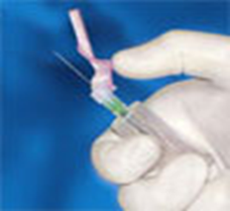
Sharps Safety:
Be Aware
Activate safety feature immediately after use with one hand, not both
Keep exposed sharp in view
Be aware of other people around you as well as where you are pointing the sharp device
Focus on task; stop if you feel rushed or distracted
Avoid hand-passing sharps; use verbal alerts when moving sharps
Watch for sharps in linen, beds, on the floor or in waste containers

Slide 28
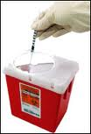
Sharps Safety:
Dispose of Sharps with Care:
Dispose of devices into designated rigid biohazard sharps containers
Keep fingers away from the openings of sharp containers
Do NOT overfill sharps containers; replace when safe capacity level is reached

Slide 29
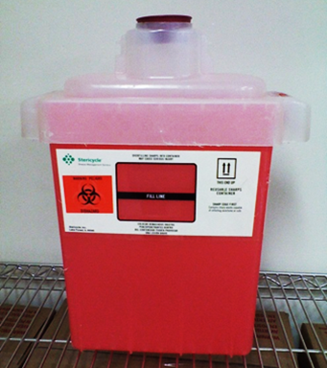
Biohazard disposal containers currently in use:
PHLEBOTOMY AREAS:
Dispose of the following items into the Stericycle red plastic, drop containers located on phlebotomy carts, in patient rooms and at phlebotomy draw sites:
Vacutainer needles and holders
Blood collection sets (butterflies)
Lancets
Blood transfer devices
Syringes
Urine straws/transfer needle

Slide 30
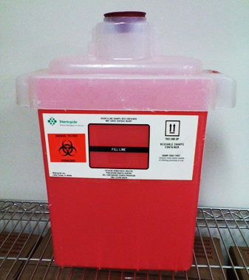
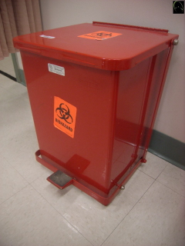
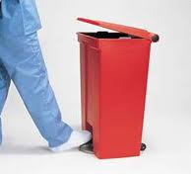
Biohazard disposal containers currently in use:
TECHNICAL AREAS:
Dispose of the following items into red plastic, drop containers on countertops -or- large metal, foot pedal controlled containers with retractable lid:
glass slides
glass coverslips
glass pipettes
wood sticks
needles

Slide 31
First Aid:
If you experience a needle stick or sharps injury or are exposed to the blood or other body fluid of a patient during the course of your work, immediately follow these steps:
Wash needle sticks and cuts with soap and water
Flush splashes to the nose, mouth, or skin with water
Irrigate eyes with clean water, saline, or sterile irrigants
Report the incident to your supervisor.
Complete the on-line Employee Illness/Injury Form posted on the Occupational Health website.
Immediately seek medical treatment from Occupational Health Service. Patient source testing will be performed.

Slide 32
Summary:
Be Prepared
Learn proper use and disposal of specimen collection devices
Assess potential hazards
Be Aware
Focus on task and keep exposed sharps in view
Dispose with Care
Use safe techniques and correct biohazard disposal containers

Slide 33
References:
Sharps Safety for Healthcare Professionals, www.cdc.gov/sharpssafety
Sharps Workbook – Appendix C www.cdc.gov/sharpssafety
BD Venous Blood Collection Product Literature http://www.bd.com/vacutainer/products/venous/
BD Capillary Blood Collection Product Literature http://www.bd.com/vacutainer/capillary/
BD Urine Collection Literature http://www.bd.com/vacutainer/products/urine/

