Slide 1

Anti-A1 and
A2 or Weaker subgroups
Updated 12/2023
Let’s clear up the confusion!

Slide 2
Anti- A1 and A2 or weaker subgroups
Subgroup
There are two principal subgroups of A
    A1 and A2
          Approximately 80% of group A individuals are A1 subgroup; the remaining 20% are A2 or weaker subgroup
          Several weaker A subgroups have been described:
              A3, Ax, Am, Ael, etc.
              We don’t differentiate between these A subgroups; they are just considered A2 weaker subgroup
          The Vision detects the subgroups better than tube testing with weaker forward A wells or mixed field A wells.

Slide 3
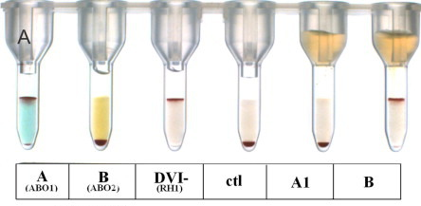
When do we suspect that a patient’s RBCs are A2 subgroup?
Subgroup
There will be an ABO discrepancy…
  There is a problem in the forward “A” well
  The “A” well may be mf (mixed field), 2+ or less

Slide 4
How do we prove that the patient’s RBCs are A2 or weaker subgroup?
Subgroup
The reagent Anti-A1 lectin made from the extract of the plant, Dolichos biflorus, has specific Anti-A1 specificity.
It will react with A1 cells, but not other subgroups of A.
The patient’s RBCs strongly agglutinate with Anti-A1 lectin if he or she is group A1.
The patient’s RBCs fail to agglutinate with Anti-A1 lectin if he or she is group A2. Note that patient’s A2 cells do agglutinate with the regular Anti-A in our TQ1 and TQ2 racks (and in ProVue forward A well)

Slide 5
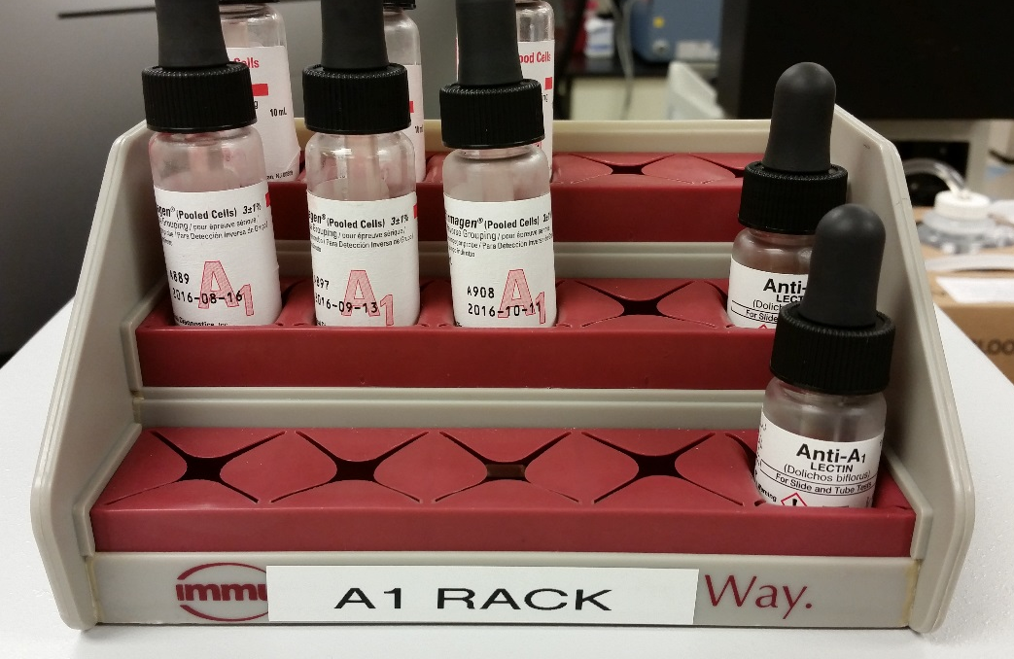
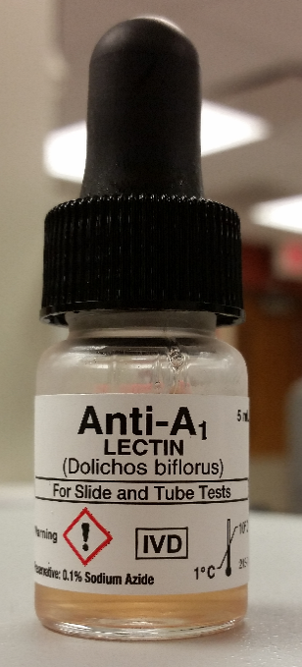
Where do I find the Anti-A1 lectin?
Subgroup
The Anti-A1 lectin is kept in the A1 rack located in the double door Helmer refrigerator beside the other antigen typing reagents.
The A1 rack contains: 3 sets of A1 cells (1 in-date and 2 expired) 3 sets of A2 cells (1 in-date and 2 expired)
Anti- A1 Lectin

Slide 6

How do I type the patient’s
A cells with Anti- A1 Lectin?
Subgroup
Follow the directions in the manufacturer’s insert
Make sure you DO NOT INCUBATE! You are instructed to read at immediate spin.
Anti-A1 lectin typing should not be performed on cord blood samples or on patients less than 2 years old due to incomplete development of the A antigen on these RBCs.
Document your results on the form, Resolution of ABO Discrepancies for A subgroups and Patients with Anti-A1

Slide 7
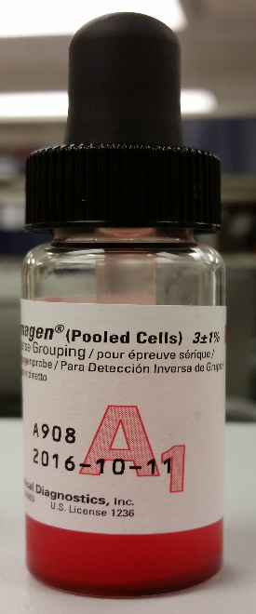
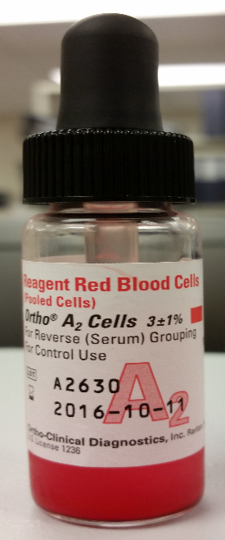
What do I use as control cells when subtyping with Anti-A1 Lectin?
Subgroup
For positive control , use the in-date A1 cells in the A1 Rack
For the negative control, use the in-date A2 cells in the A1 Rack

Slide 8
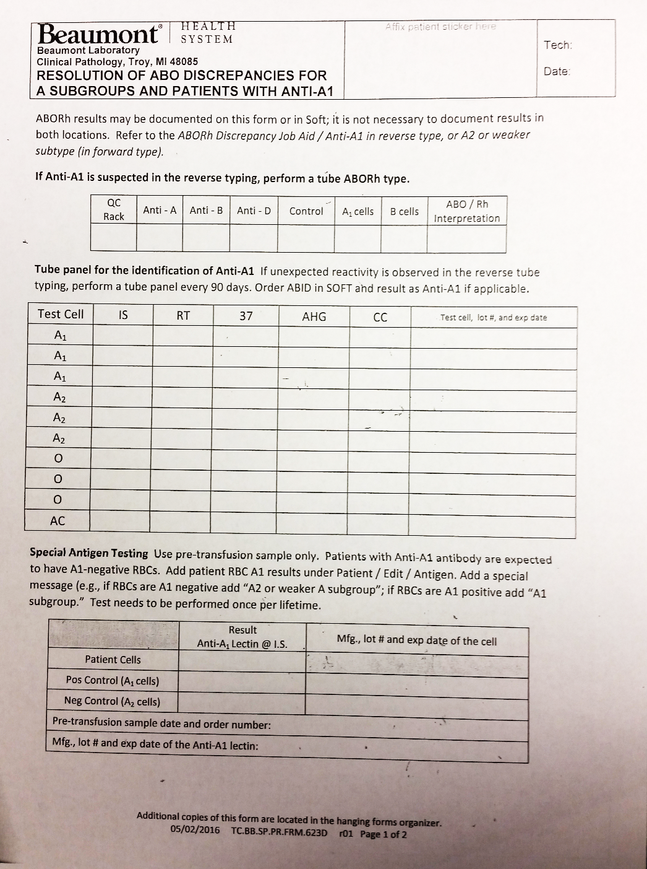
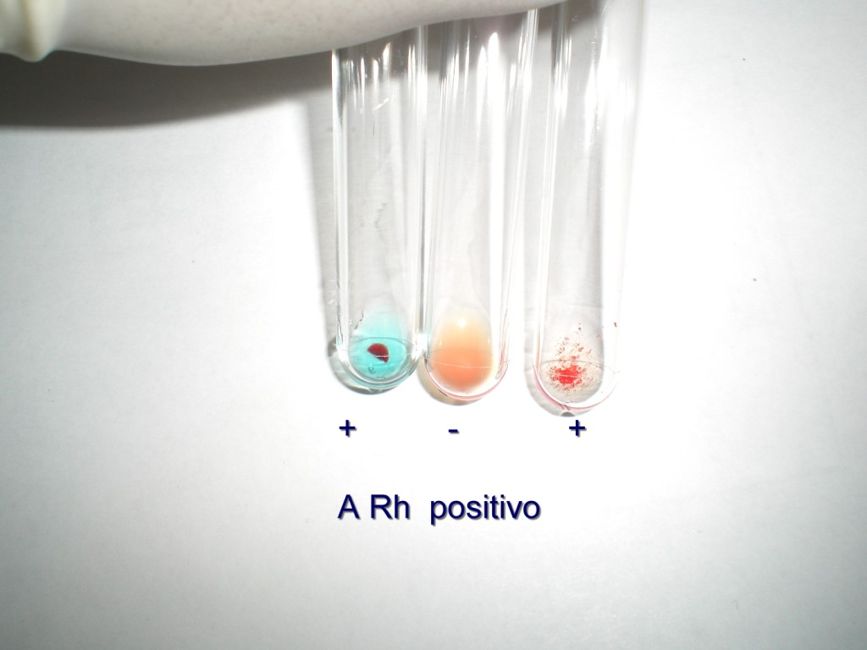
Subgroup
Document the results on the proper form
Positive
Negative
The results for the
Negative control cell
and the
Positive control cell
are documented here

Slide 9
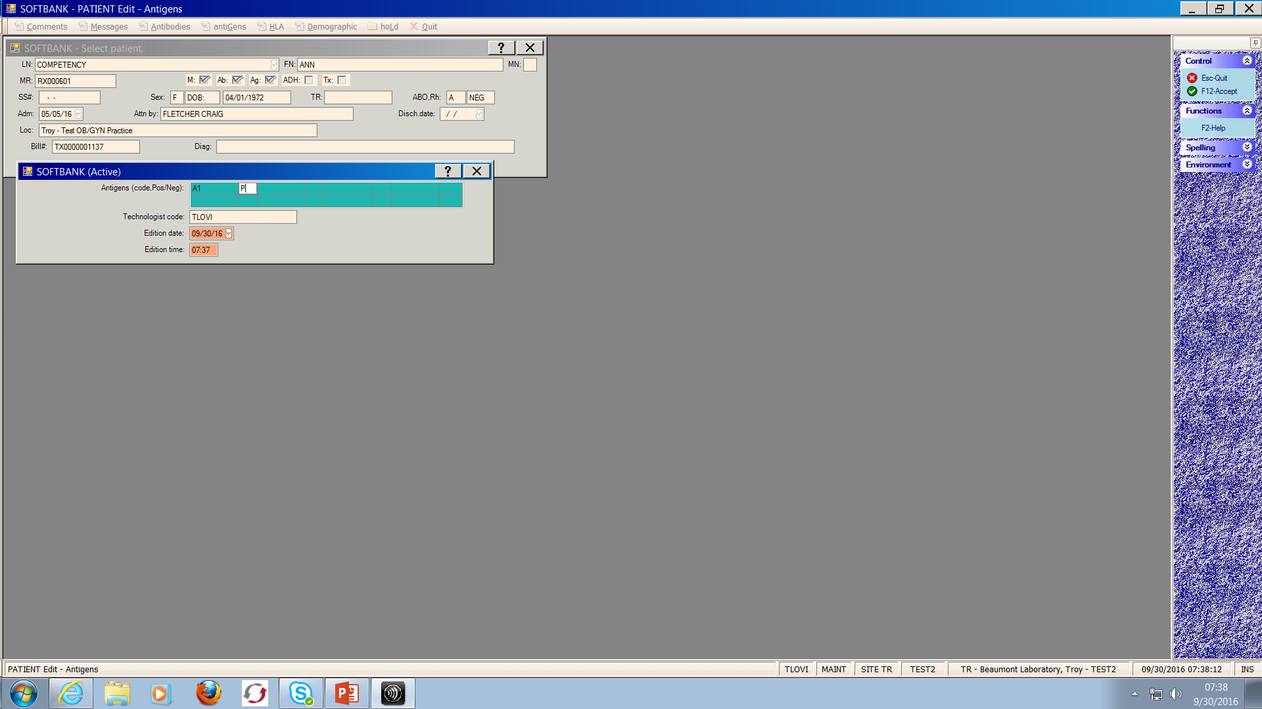
What’s next?
Subgroup
Add patient’s RBC A1 results in Soft:
  Patient / Edit / Antigen
This patient’s cells are positive with Anti-A1 Lectin

Slide 10
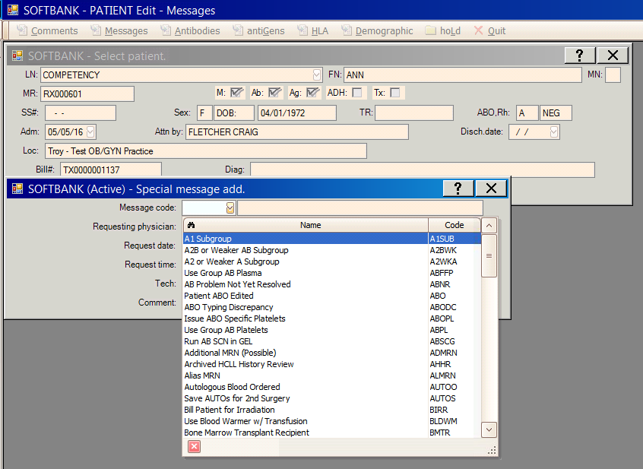
Don’t forget the comment!
Subgroup
  Patient / Edit / Messages
  If the RBCs are A1 positive
  …that means there is agglutination when the
  RBCs are mixed with
  Anti-A 1 Lectin…
  Add the comment
  “ A1 subgroup”

Slide 11
Don’t forget the comment!
Subgroup
  Patient / Edit / Message
  If the RBCs are A1 negative
  …that means there is
  NO agglutination
  when the RBCs are
  mixed with
  Anti-A 1 Lectin…
  Add the comment
  “ A2 or weaker subgroup”

Slide 12

Keep in Mind…
To make Anti-A1, the patient’s RBCs must be A2 or weaker subgroup.
  Just like with any other antibody.
  For example: A patient should be negative for the Kell antigen to make Anti-Kell.
Not all A2 or weaker subgroups make Anti-A1. Only approximately 5% of A2 patients actually make the antibody.
The A1 antigen testing only needs to be performed once in a lifetime… just like Kell or other antigens.
A2B or weaker subgroup is just a patient who is type AB, but the A is an A2 or weaker subgroup.

Slide 13
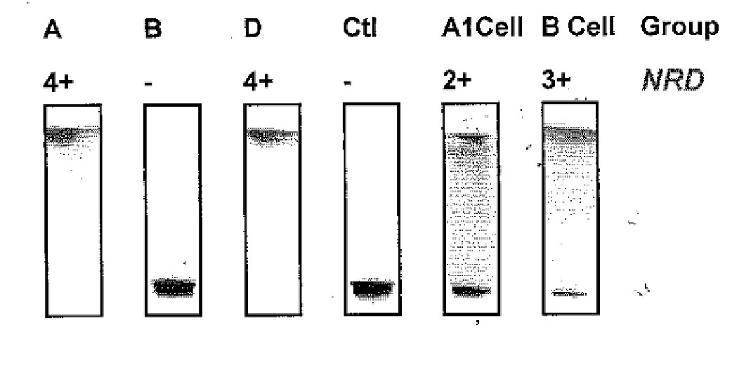
Remember, only 5% of A2 or weaker subgroups will make Anti-A1.
So… when do suspect Anti-A1?
When you detect unexpected reactivity in the Reverse A well in a patient who otherwise appears to be type A or type AB
(i.e. A discrepancy between the forward typing reactions and the reverse typing reactions).
Unexpected reactivity in
“a reverse” well
Forward as an “A”

Slide 14

How do you prove Anti-A1?
First, do a test tube ABO.
        If the unexpected reactions are still present
        in the reverse tube typing, then…
  Do a tube panel to identify Anti-A1
        See procedure Resolution of ABO Discrepancies due to A subgroup or Anti-A1

Slide 15
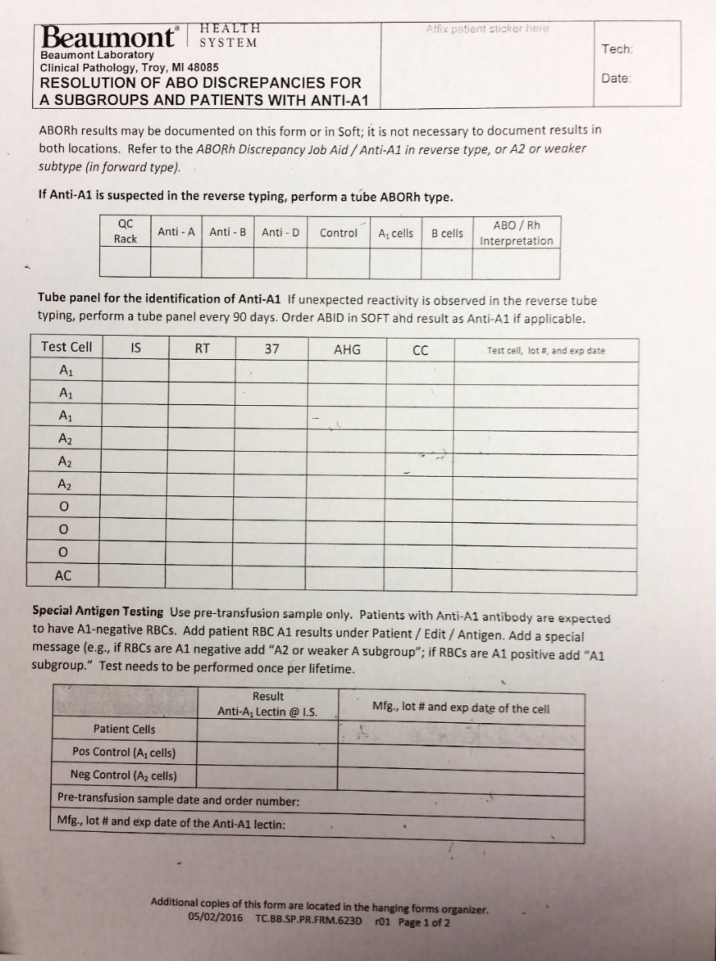



Tube Panel to ID Anti-A1
The A1 and A2 cells are from A1 Rack.
The O cells can be any panel cells

Slide 16
How do you interpret the tube panel to ID Anti-A1?
If the patient has Anti-A1, expect the three A1 cells to be reactive and the A2 and O cells to be non-reactive.

Slide 17

What if your panel is pan-reactive???

Slide 18

Don’t PANIC!!!
It may be a cold reacting antibody.
See the procedure for Cold Antibodies

Slide 19

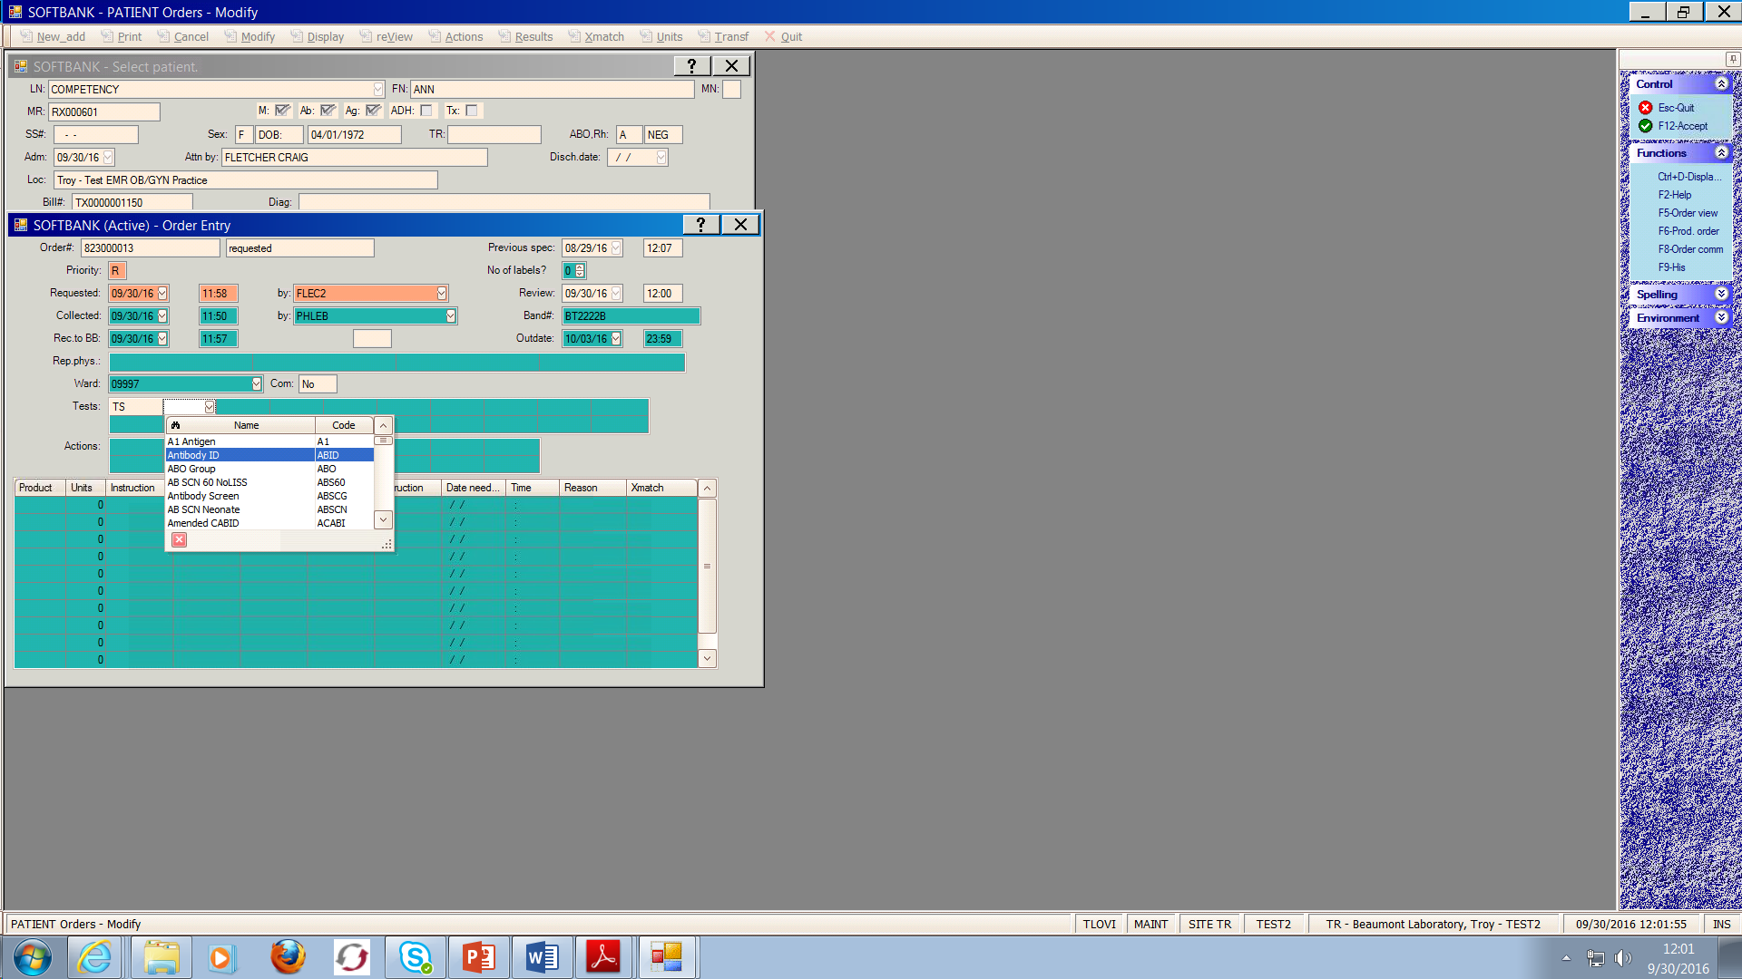
How do you record your results in SOFT?
If the antibody screen is negative, the ABID is not automatically ordered.
  Order an ABID on the patient
    Patient / Order / Modify
Select ABID from the drop down menu

Slide 20
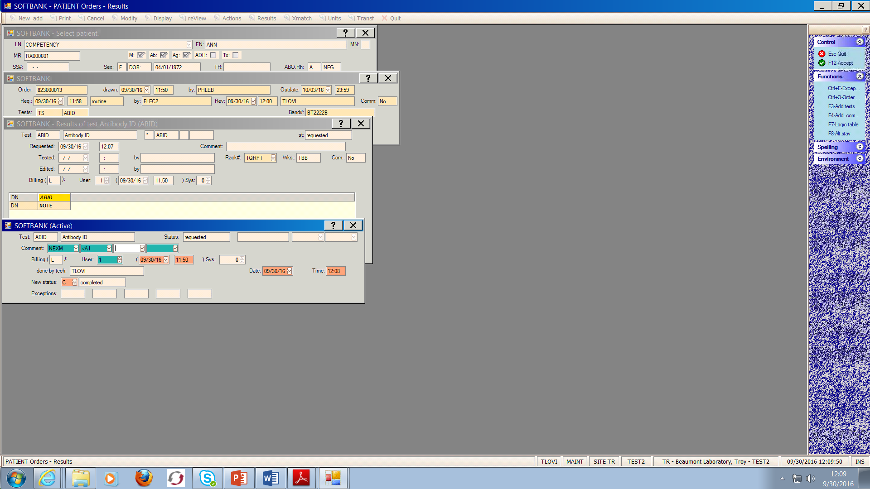
How do you record your results in SOFT?
Answer the ABID
  Patient / Order / Results
  Result the antibody as Anti-A1
  Add the NEXM comment

Slide 21
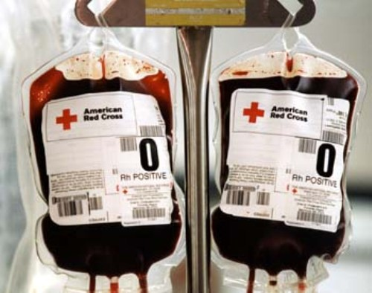
How do you crossmatch a patient with Anti-A1?
Immediate spin crossmatch
  See the Crossmatch Job Aid
Use group O donor RBCs
  or
You can antigen type group A donor RBCs for A2 or weaker subgroup (if you have a lot of extra time on your hands!)

Slide 22

Keep in mind…
If a patient’s RBCs agglutinate in Anti-A1 lectin , then he/she is group A1.
Just like if a patient’s RBCs agglutinate in Anti-Kell, then they are Kell positive.
If a patient’s RBCs do not agglutinate in Anti-A1 lectin but agglutinate in Anti-A, then they are A2 or weaker subgroup.
Group A1 patient do not generally make Anti-A1.
Just like patients that are Kell positive generally do not make Anti-Kell.
A2 or weaker subgroups may produce Anit-A1.
The presence of Anti-A1 can cause ABO discrepancies between the forward and reverse typing.
A patient will forward type as a group A and reverse type as a group O.

Slide 23


As a General Rule…
Forward typing discrepancies ARE NOT generally resolved in the tube method. They are resolved by the transfusion history or performing a subtype with Anti-A1 lectin.
Reverse typing discrepancies can be resolved by starting with a tube type.

Slide 24

Any Questions?

