Slide 1
2025 Wet Prep Competency
Companion Images for Wet Prep MTS Quiz

Slide 2
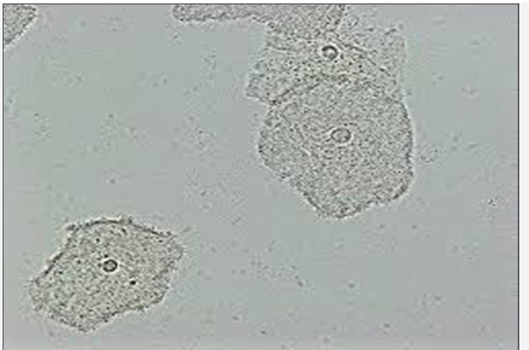
Slide 1

Slide 3
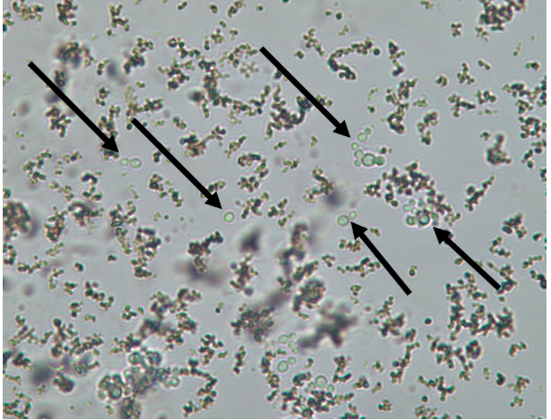
Slide 2

Slide 4
Slide 3

Slide 5
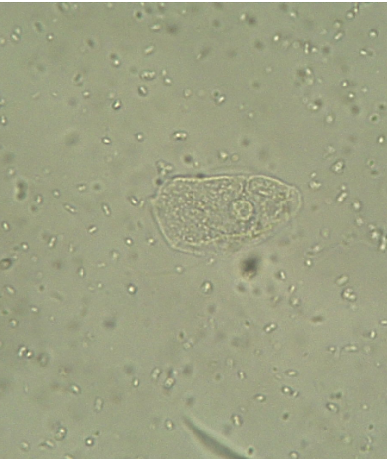
Slide 4

Slide 6
Slide 5

Slide 7
Slide 6

Slide 8
Slide 7

Slide 9
Slide 8

Slide 10
Slide 9

Slide 11
Slide 10

