Slide 1
Massive Transfusion Protocol (MTP) Documentation 2025
Katie Holtz, BSN, RN
Patricia Barr, MSN, RN
Cris Barnaby, BSN, RN, CEN
Stephen Essenburg, MSN, BSN, RN
Tracy Hosford, MSN, APRN, AGCNS-BC
October 2025

Slide 2

Massive Transfusion Protocol (MTP) Update
Current state of MTP documentation is a clunky combination of paper and electronic tools leading to incomplete and incorrect documentation.
A recent Epic Nova Note update allows us to greatly improve MTP documentation.

Slide 3
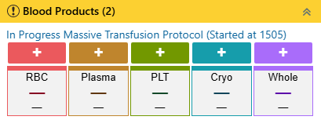
Policy Change Highlights
Remove or change references about documentation on the paper record and require EHR entry except for downtime.
Remove standard components of the MTP pack as these are different and may change to half packs in some spaces.
Use of scanning for documentation of unit- aligns with emergent blood care flows.

Slide 4
Highlights of the new MTP Tool
Facilitates real-time scanning of products
Running tally of # units and volume given
Standard volumes speed up documentation (Policy-based)
  Adult only – can be edited if necessary
  Pediatric volumes need to be manually entered
Standard Infusion times also speed up documentation
Paper documentation will only be used during downtime, with subsequent data re-entry
An order is required to initiate MTP
  Does not replace a phone call to Blood Bank
  Best practice is to have two RNs focused on MTP:
    Documentation RN: uses portable workstation with scanner
    Infusion RN: manages rapid infusion of products

Slide 5
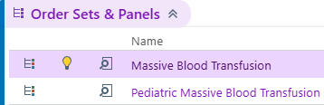
The process begins with the MTP Order
The new MTP documentation begins with the MTP Order.
  **This is a critical step.**
  While it “kicks off” the documentation, it does not replace a call to the Blood Bank.
Massive Blood Transfusion (Adult)
Pediatric Massive Blood Transfusion

Slide 6

Epic Demo

Slide 7
Education and Resources
Mass Transfusion Protocol (MTP) Documentation Updates Flier
Mass Transfusion Documentation WorkDay Module
    Assigned to nurses in applicable spaces the week of 10/5
    Available for self assignment via this Link
  General – Mass Transfusion Documentation Workbook
    Facilitates Emergency, Inpatient, and Obstetrics nurse practice in the Epic Upgrade Playground.
  General – Mass Transfusion Documentation tip sheet (in progress)
    Being updated to new process, will be available on the Epic Education Sharepoint page
  Epic Upgrade Documents
    As Epic Upgrade Application Highlight documents are created Mass Transfusion Documentation will be featured where applicable and resources will be linked.
    Highlight documents will be assigned to nursing via WorkDay on 11/3.
    Epic Upgrade High Impact Changes Slides will be available for leadership on 10/21

Slide 8


Slide 11

Initiating the MTP
Click the Massive Transfusion Protocol Documentation Start task
This launches the MTP Toolbox

Slide 12
The Process begins with the MTP Order
Click the plus icon for the first blood product being administered.

Slide 13
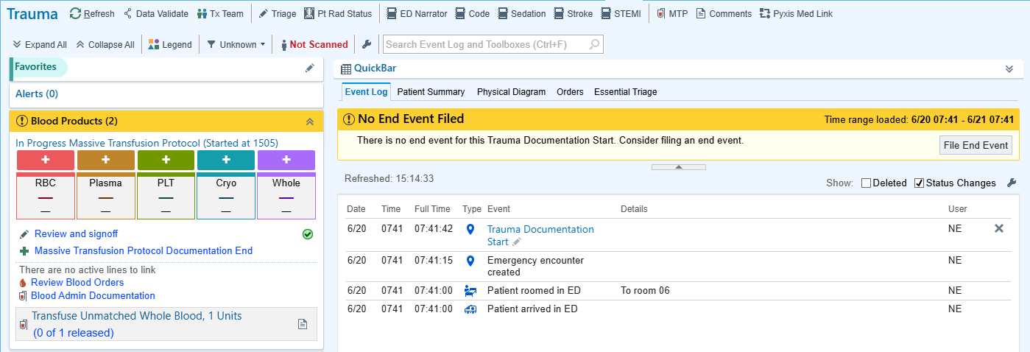
The Process begins with the MTP Order
Click the plus icon for the first blood product being administered.

Slide 14
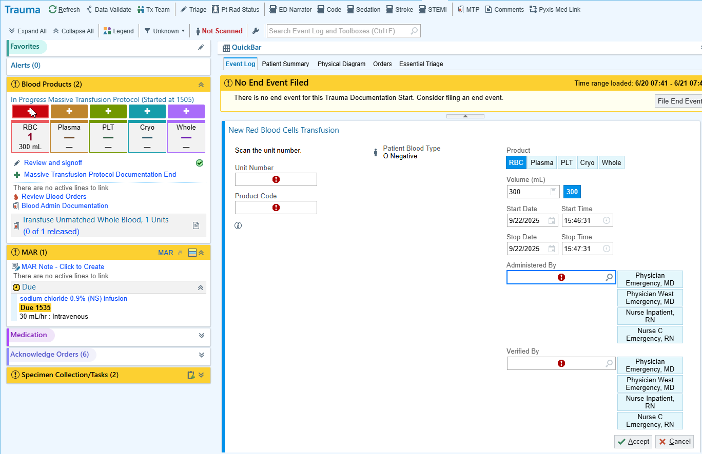
Scan the product Unit Number and Product Code.
Scan the product barcodes to populate details about it.

Slide 15
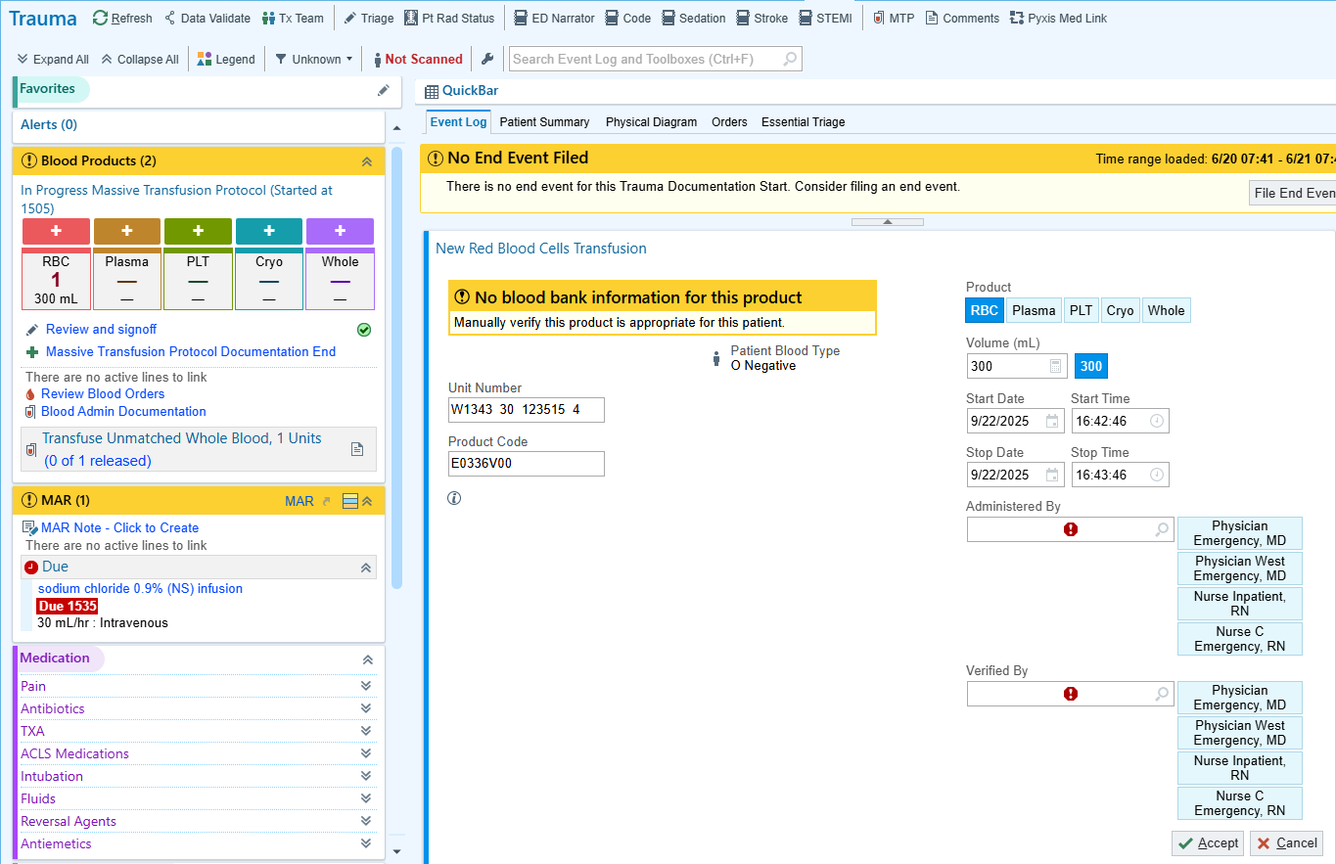

Standard volume defaults in per policy for Adults only. Can be changed if needed.
Click here to review standard blood product volumes.

Slide 16
Infusion start and stop times are automatically entered. These can be changed if needed.
Click here to review standard Infusion times.

Slide 17
Arrived staff pull in as options for the administering and verifying users. After you do this for the first unit for an MTP, you can use quick buttons to select these users for later units.

Slide 18
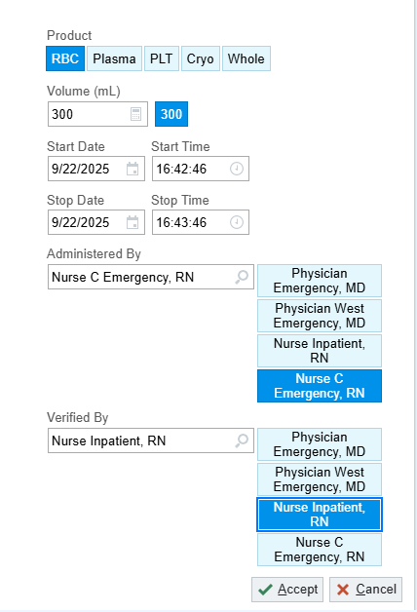
Definitions
Administered by is who is physically administering the product.
Verified by is the MTP documentation RN, verifying MTP is being performed on the correct patient.

Slide 19
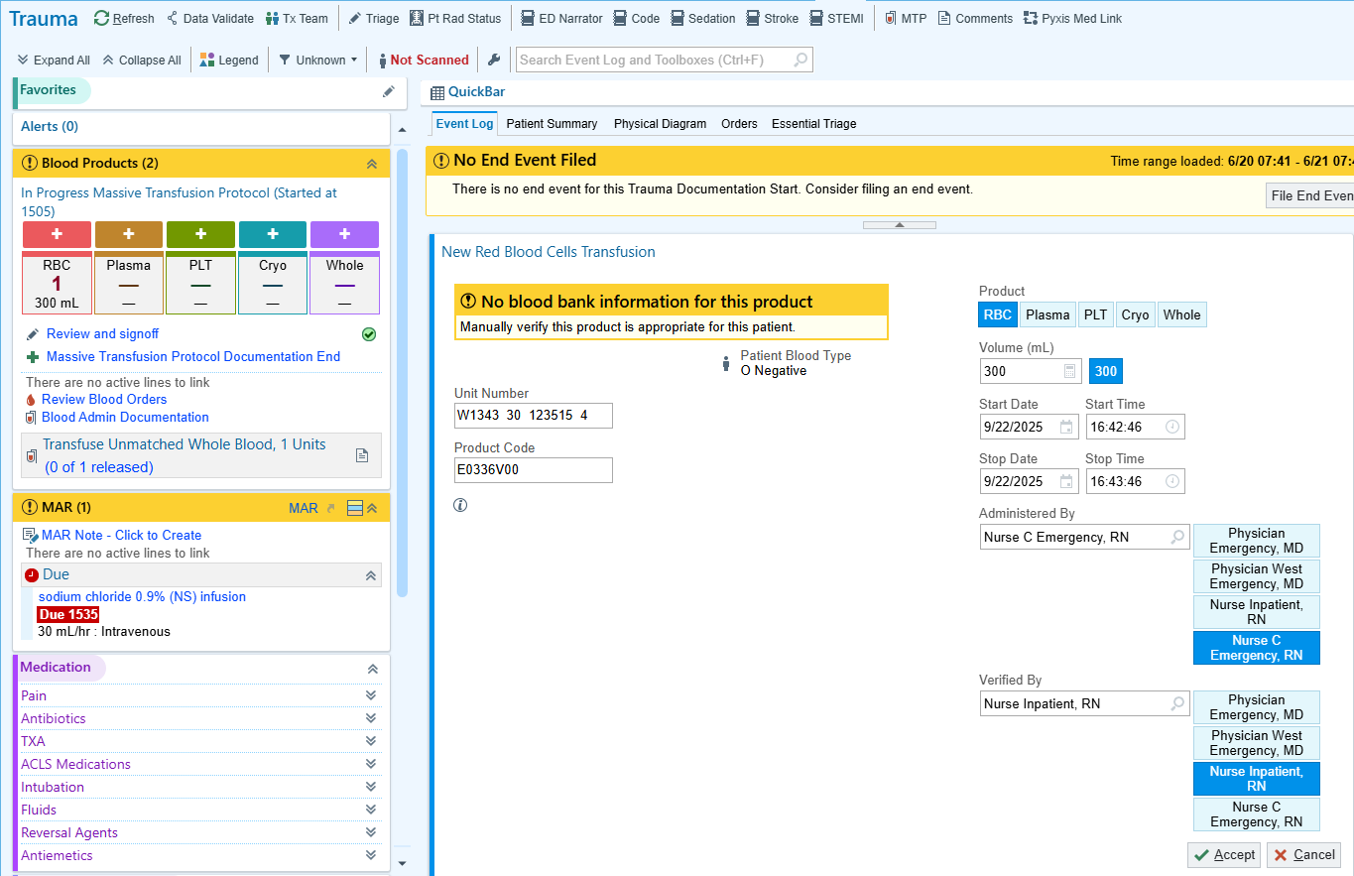
Click Accept to file this in the patient’s chart.

Slide 20
Click the + sign above RBC to administer another unit.

Slide 21
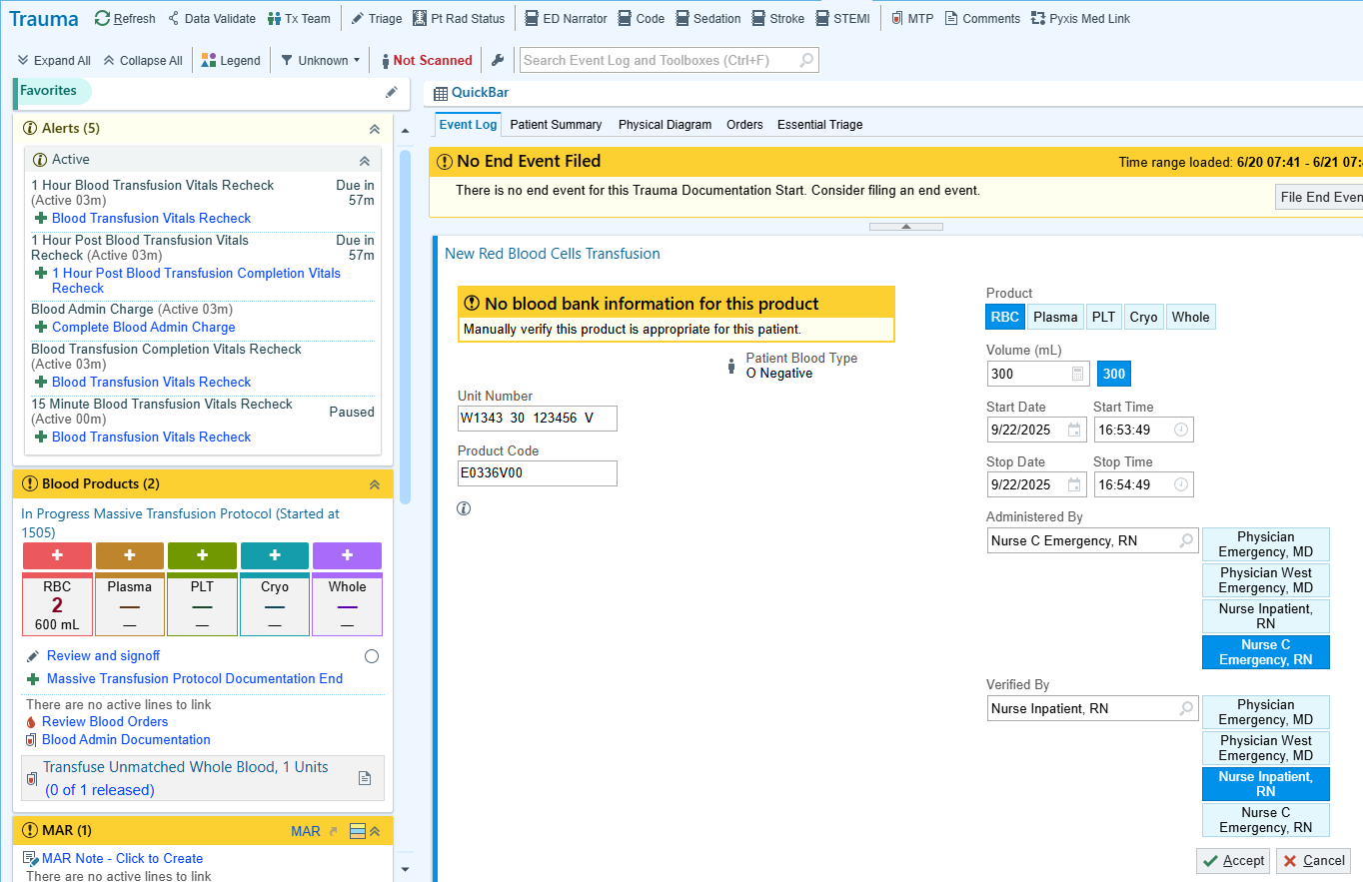
Notice the number of units and total volume given has updated.
Continue the same process for all additional units administered.

Slide 22
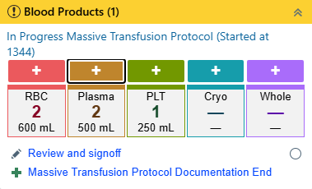
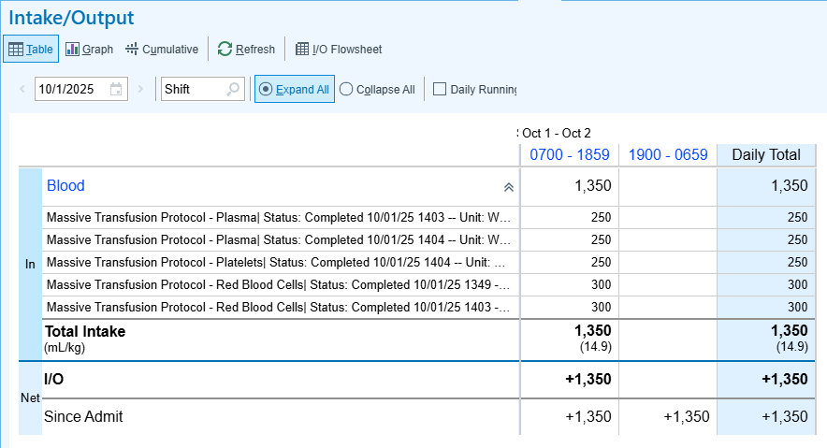
MTP Intake & Output
MTP volumes flow to I&O reports and flowsheets.

Slide 23
MTP Documentation Review and Sign Off
MTP documentation must be reviewed and signed off by everyone who was selected in the “Administered By” or “Verified By” fields.

Slide 24
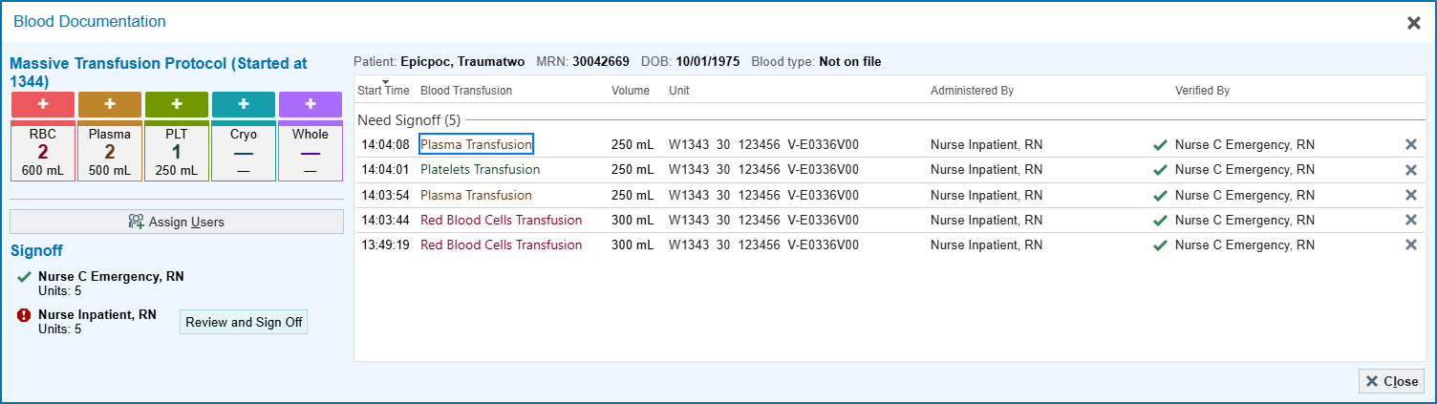
MTP Documentation Review and Sign Off
On this screen, review all products given during MTP to ensure documentation is accurate. If a change needs to be made, click on the product that requires editing.
In this example, the checkmarks next to Nurse C Emergency’s name indicate that documentation has already been signed off by her since she was logged into Epic doing MTP documentation.

Slide 25
MTP Documentation Review and Sign Off
Nurse Inpatient needs to Review and Sign Off as the Verified By user since he was not logged into the computer during the MTP event.

Slide 26
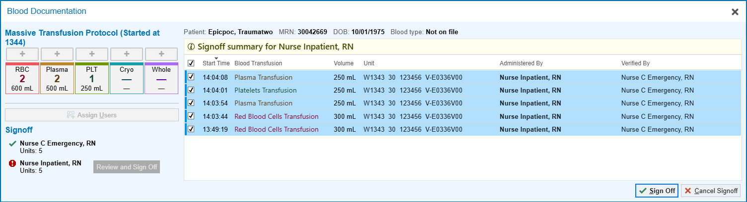
MTP Documentation Review and Sign Off

Slide 27
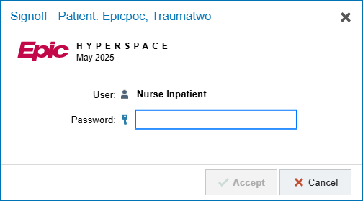
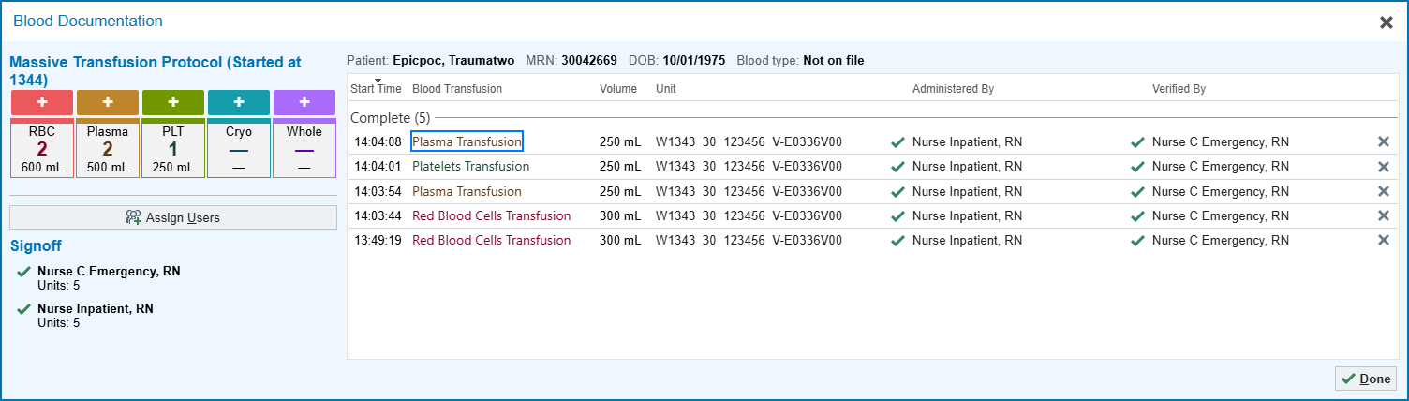
Blank Slide
Nurse Inpatient enters his password and clicks Accept and Done.

Slide 28
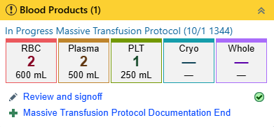
Blank Slide

Slide 29

Standard Infusion Volumes
Standard volumes are for ADULTS only.
Pediatric volumes must be entered manually.
Return

Slide 30
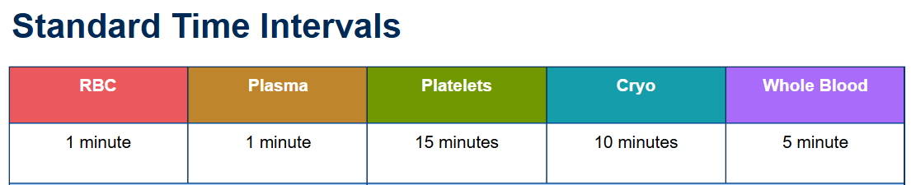
Standard Time Intervals
Standard time intervals are the same for both Adult and Pediatric patients.
Return

