Slide 1
2026 Topics in Clinical Education & Laboratory Operations
This presentation provides illustrations on how to complete the application activity documents posted to your individual student folder in the LAB SharePoint site and a brief summary of the 2026 curriculum.
12/26/25
Acknowledgement:
Caroline VanDenBrouck, MLS Graduate, Nov. 2025

Slide 2
Presentation Objectives:
Upon completion of this module, the learner will be able to successfully complete the following objectives:
Comply with neat and orderly completion of the various application activities that are part of the Clinical Education & Laboratory Operations curriculum. This will be illustrated via exemplary examples from a November 2025 graduate.
Describe the 2026 curriculum revisions and expectations.
Reread the Clinical Education & Laboratory Operations syllabus for complete comprehension of the curriculum expectations summarized in this presentation.

Slide 3
Part I – Illustration of How to Complete the Application Activities

Slide 4
Application Activity Location & Completion:
A copy of each “application activity” is provided in your individual student working folder in the LAB SharePoint for easy editing and completion using a Corewell device.
The activities are provided in two sub-folders:
Clinical Education
Laboratory Operations
For 2026, most of the activities are now provided in fillable-PDF format while some remain in Word where beneficial (e.g., objectives).
You are expected to rename the activity with your last name-topic-date upon completion.
The next slides illustrate “exemplary” completion of these application activities from a November 2025 graduate.

Slide 5
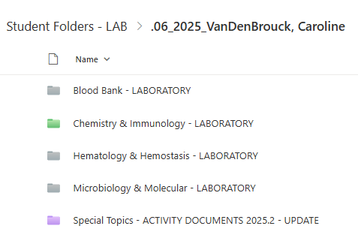
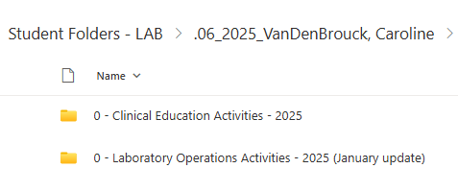
2025 Student Folder – CHE-MLS LAB SharePoint

Slide 6
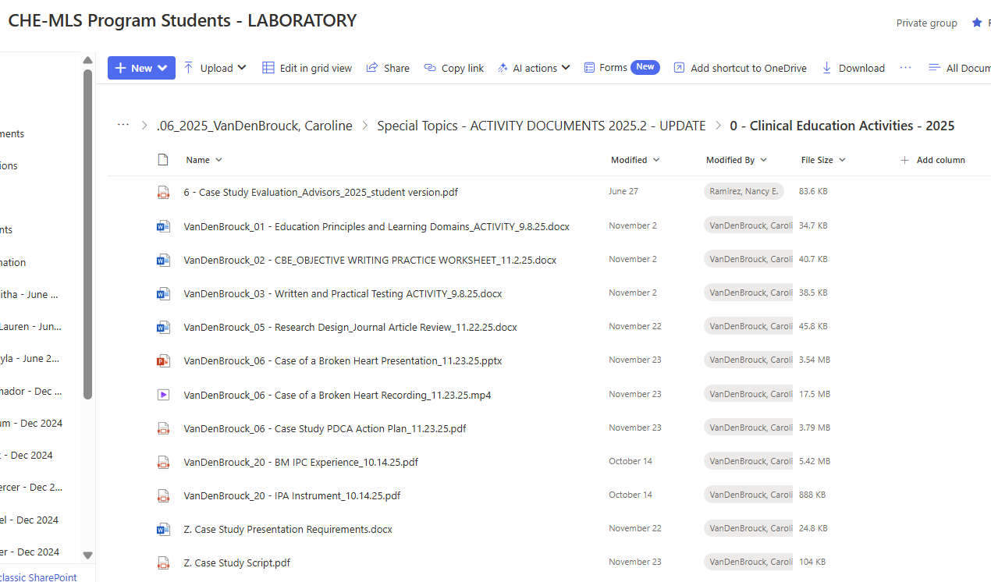
Clinical Education Activities – 2025 Student Example

Slide 7
Clinical Education Activities
Note the uniform file naming that includes student last name, activity # and topic plus date completed.
This is requested for efficient transfer of the completed documents to the student’s official program file in the Corewell document retention database - OnBase.

Slide 8
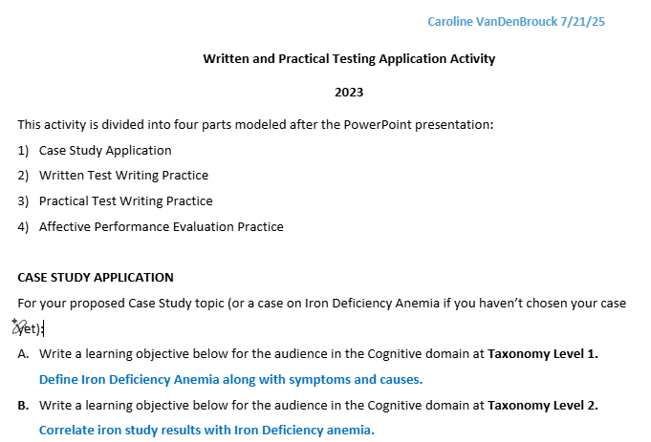
Example completion of a Clinical Education Activity: Written & Practical Testing
Note the student’s use of blue font to highlight her answers. ☺

Slide 9
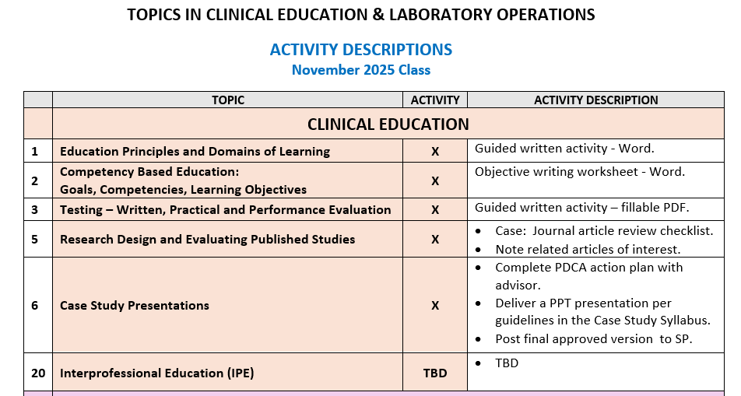
Former 2025 Clinical Education Activities
NOTE:
The required Case Study has been replaced with a required Research presentation in 2026.

Slide 10
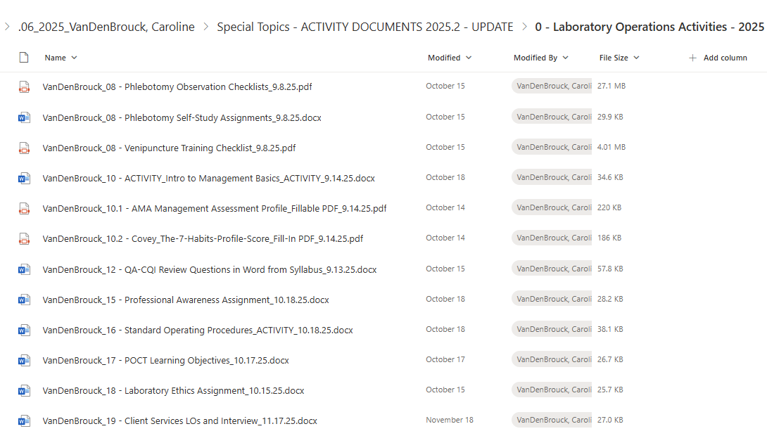
Laboratory Operations Activities – 2025 Student Example

Slide 11
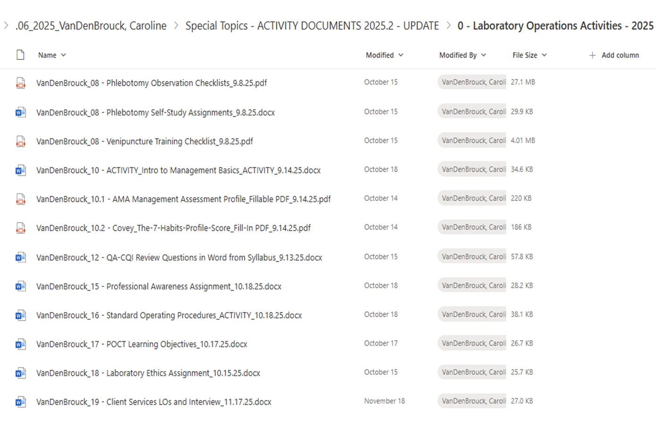
Laboratory Operations Activities
Again, note the uniform file naming that includes student last name, activity # and topic plus date completed.
This is requested for efficient transfer of the completed documents to the student’s official program file in the Corewell document retention database - OnBase.

Slide 12
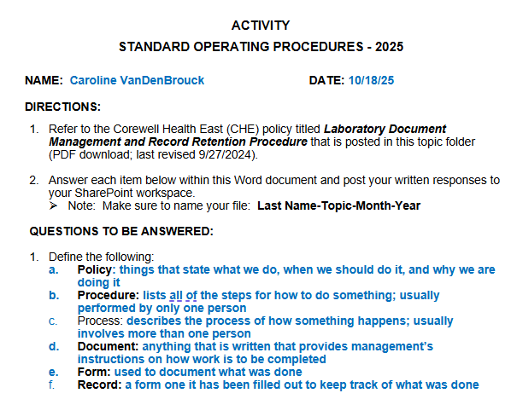
Example completion of a Laboratory Operations Activity: Standard Operating Procedures
Note the student’s use of blue font to highlight her answers. ☺

Slide 13
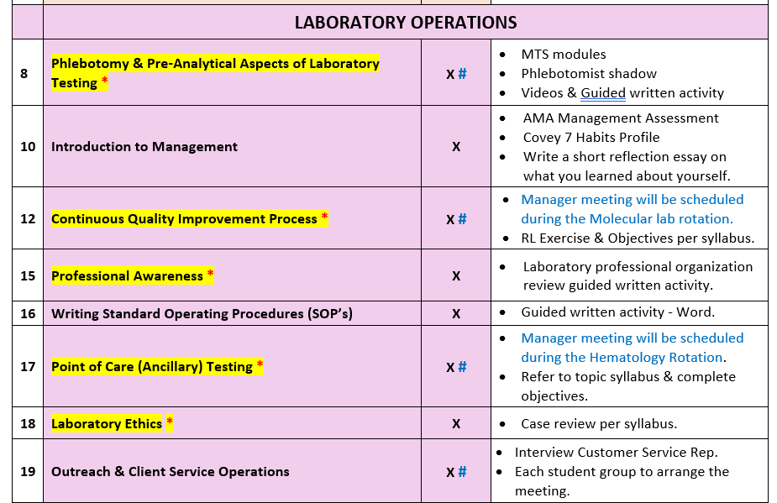
Former 2025 Lab Operations Activities

Slide 14
Conclusion & Reminders
It is expected you will utilize the “Edit” access provided in your individual student folder to complete these application activities.
Tip: This will be easier by using a Corewell device in one of the MLS program student laboratories.
As illustrated in these examples, it is very easy to complete the provided documents by simply typing your answers directly in the fillable PDF or Word document.
Tip: If the activity is a Word document, can even assist the reviewer by changing the font color of your answers like our 2025 graduate. ☺

Slide 15
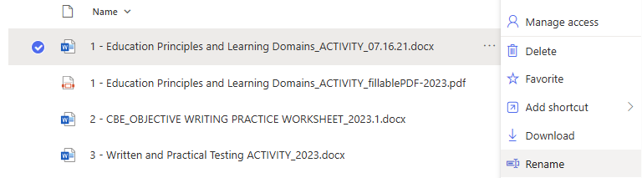
Conclusion & Reminders – cont.
Lastly, please rename the file to include:
Last Name - Activity Topic - Date
This is simple to do by right clicking the 3 dots and selecting Rename.

Slide 16
Part II – 2026 Curriculum Overview & Guidelines

Slide 17
2026 Special Topics Curriculum Overview:
View each presentation posted in the Special Topics SharePoint site.
The format may be a simple PDF, narrated PPT and/or MP4 video.
Choose the one that best suits your learning style.
These are accessible for off-site, remote viewing 24/7.
Complete the review quiz for each presentation – AFTER viewing the presentation.
These are also accessible for off-site completion via your MTS account.
Quizzes cannot be reset.
The overall average scores from all quizzes will be factored into your Laboratory Operations grade for your MLS program transcript.

Slide 18
2026 Special Topics Curriculum Overview – cont.
Complete the written activities using a Corewell device which allows full edit access to documents in your working folder.
Handwritten completion of activities will NOT be accepted as they are often difficult to read, sloppy and usually done last minute due to poor time management.
Again, most of the 2026 activities are now provided in fillable PDF format along with some in Word.
Complete the application activities per the progressive grading table in the 2026 syllabus.
It is highly recommended you complete as many activities as possible for better ASCP BOC exam readiness and career entry understanding of clinical laboratory services including corporate and regulatory requirements.

Slide 19
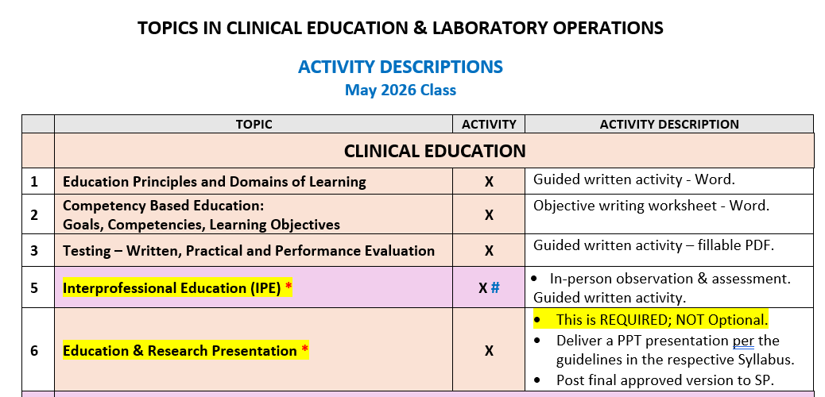
2026 Revisions – Clinical Education Activities
Changes include:
A rework of the 2025 case and research topics into topic #6.
Reassignment of IPE from #20 to #5.

Slide 20
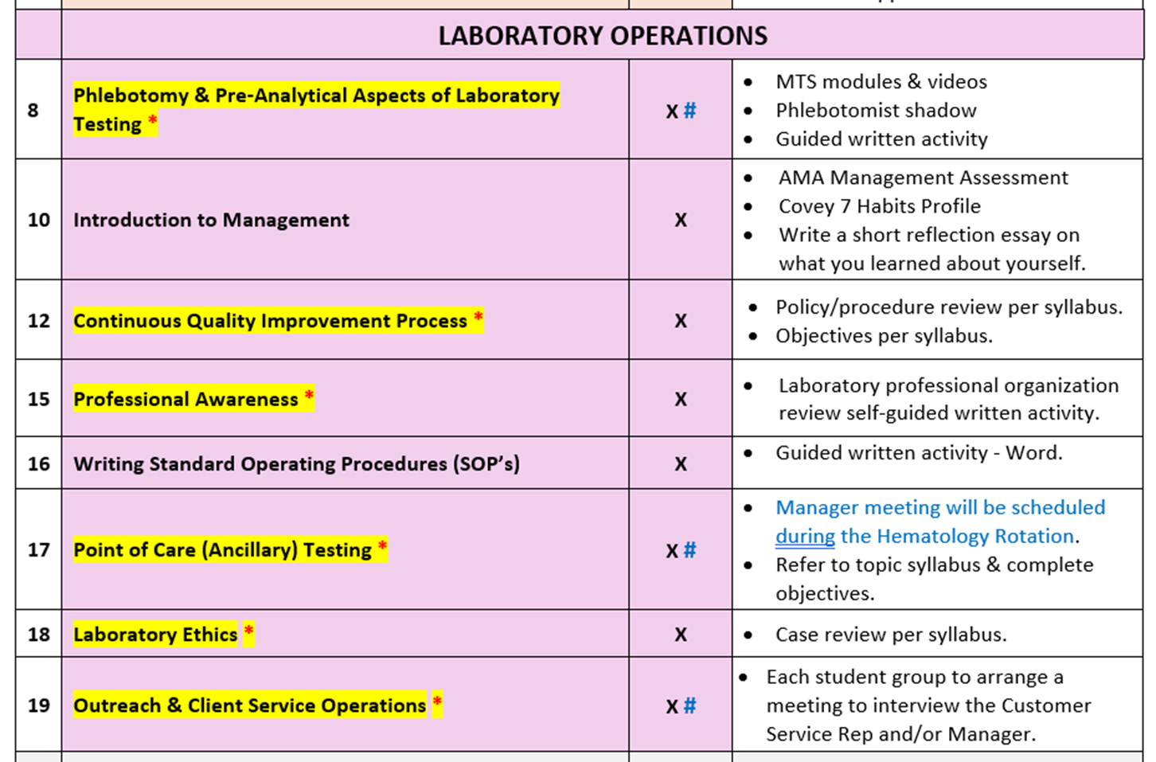
2026 Lab Operations Activities
NOTE:
These have NOT changed from 2025.
Additional topics in Personnel and Financial Management will be added in 2026 as time permits.

Slide 21
Conclusion
Learn to use SharePoint to your advantage to easily manage this curriculum component.
Reread the 2026 syllabus for more detailed information and guidelines.
Please reach out with any questions about this curriculum component.
Upcoming class meeting agendas will include this topic for further review and discussion s as well.
Lastly, please complete the attestation in MTS confirming you have viewed this presentation.

