Slide 1

TEG® 6s Hemostasis Analyzer
Operator Training

Slide 2
TEG® 6s Analyzer
The TEG 6s hemostasis analyzer is a non-invasive diagnostic instrument designed to monitor and analyze the hemostasis state of a whole blood sample in order to assist in the assessment of patient clinical hemostasis conditions.
The TEG analyzer is indicated for use in adult patients where an evaluation of their blood hemostasis properties is desired. Hemostasis evaluation with the TEG 6s system is used to assess clinical conditions:
In cardiovascular surgery and cardiology procedures to assess hemorrhage or thrombosis conditions (item codes 07-601-US, 07-614-US, and 07-615-US).
In a trauma setting to assess bleeding or clotting conditions (item code 07-605-US).
In patients where heparin/heparinoids may be present and who are at an increased risk of coagulopathy, in cardiovascular surgery, cardiovascular procedures (e.g. minimally invasive valve replacement or repairs) and liver transplantation (item code 07-604-US).
Please refer to the TEG 6s User Manual (115191-US) for Indications for Use, Contraindications, Warnings, Precautions, and Potential Adverse Events.
For technical support, please call 1-800-GET-A-TEG (1-800-438-2834) Option 3 or your local Haemonetics representative

Slide 3
Topics
System overview
Cartridges
Principle
Starting the analyzer
Running a patient sample
Test completion
Results display
Running a quality control sample
Troubleshooting and maintenance

Slide 4
TEG® 6s System
Overview
Set up
Analyzer

Slide 5

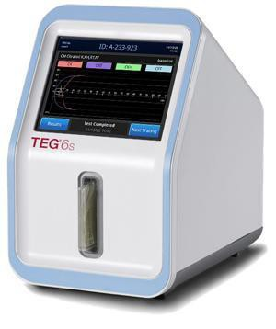
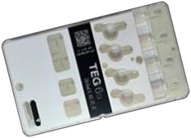
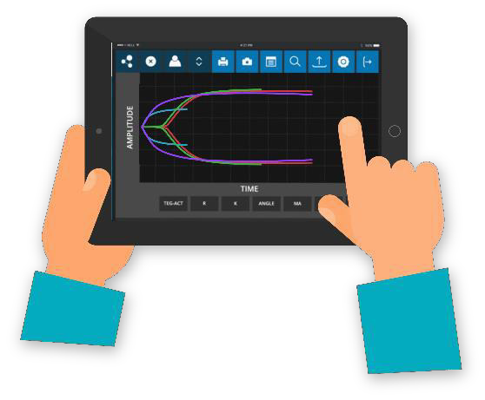
TEG® 6s System Overview
Analyzer
All-in-one, stand-alone analyzer
Moves, measures, mixes and tests sample
Displays and stores results
Cartridge
Contains up to 4 test channels and associated reagents
TEG Manager® software (Optional)
Browser-based remote viewing and administration software
Analyzer
System configuration by technician via PC Ethernet connection
Cartridge

Slide 6

Set Up
Location
Reasonably flat and level
Protected from accidental damage
30 cm (12 in) clearance at back for air flow
Isolate the analyzer from all sources of heat
For example, laptops, heaters or other heat-admitting equipment
Power
Connect AC power adapter to grounded outlet (100 – 240V, 50/60 Hz)
Power cord is firmly screwed into power jack on back side of analyzer
Consider use of UPS during operation
Optional
Barcode scanner attached to USB port Thermal printer attached to USB port
Ethernet cable connecting network port to analyzer for TEG Manager® software

Slide 7
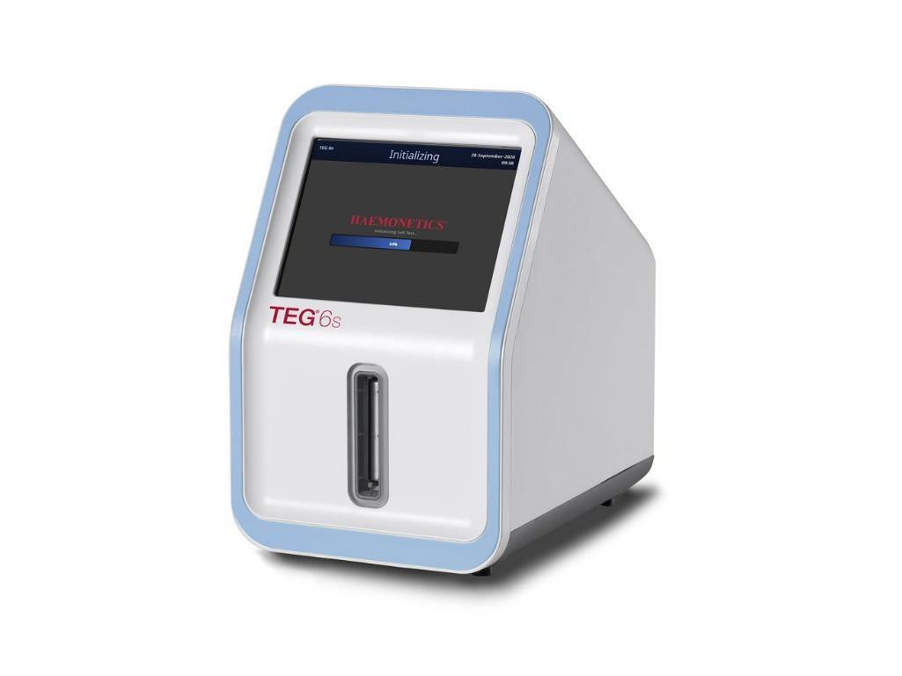
Analyzer Front
LCD touch screen
User interface
16.5 cm (6.5 inch) color screen
Prompts, directions, selections, and results are displayed
Cartridge slot
Accepts analyzer cartridge
Locks cartridge in place during test
Lighted strip
LED lights up for cartridge insertion and flashes for cartridge removal
Touch screen
Cartridge slot
Lighted strip

Slide 8
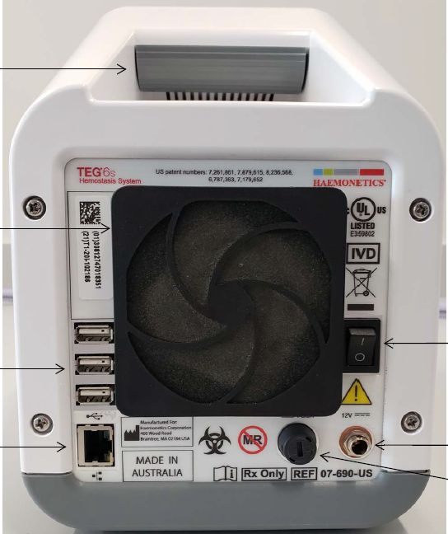
Analyzer Back Panel
Carrying handle
Vent
Serial Number
Cooling fan with filter
On/off
switch
USB
connections
Power jack
Ethernet
port
Fuse

Slide 9
Cartridges
Packaging
Cartridge parts
Storage
Cartridge types
Blood samples

Slide 10
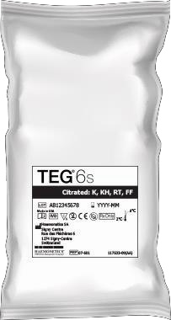
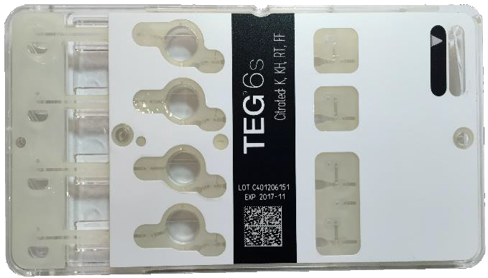

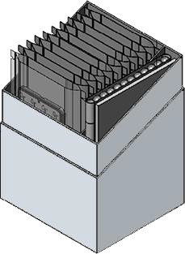


Patient Cartridge Package
What’s in the box?
Instructions for Use
Test cartridges (10)
Transfer pipettes (12)
x10
x12
Insert

Slide 11

Cartridge Storage
Store in sealed pouches at 2 – 8 ⁰C until use
Ideally cartridges should come to room temperature prior to use
If needed cartridges may be run immediately after removal from the refrigerator
However, if error occurs, remove cartridge, rub barcode to remove condensation, wait a minute to warm and then re-run
Unused cartridges in sealed pouch may be returned to the refrigerator

Slide 12
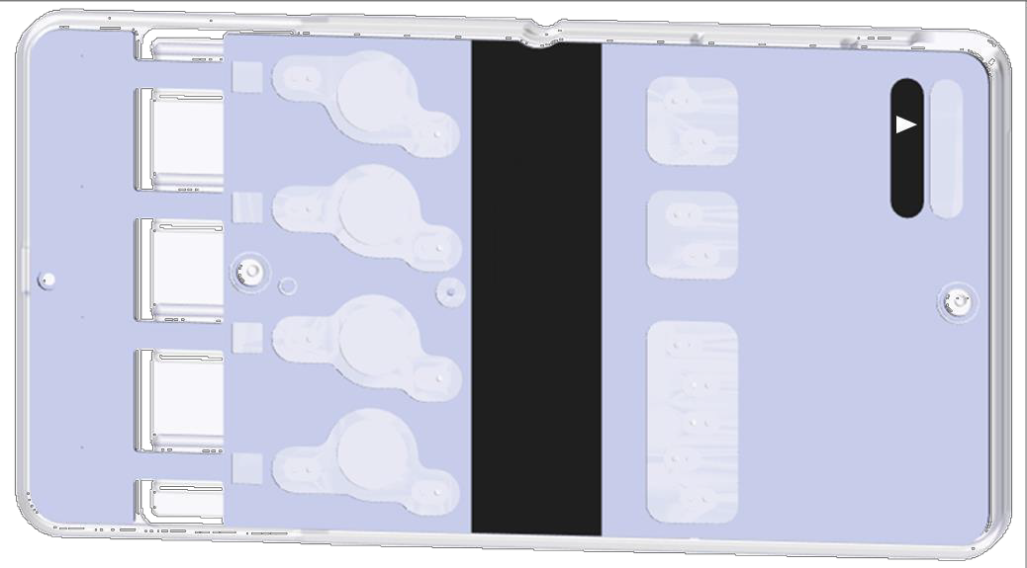


Cartridge Parts
Cartridge type
Minimum fill level indicator
Sample port
Citrated: K, KH, RT, FF
Reservoir window
EXP 25NOV15
Barcode read by analyzer
Expiration date for cartridge

Slide 13
Global Hemostasis Cartridge (07-601-US*)
CK (R parameter)
Assesses clot rate
Kaolin (CK)
CFF (MA
parameter) Assesses fibrin clot
strength
Functional Fibrinogen (CFF)
Kaolin Heparinase (CKH)
CKH (R parameter) Assesses clot rate (heparin neutralized)
RapidTEG™ (CRT)
CRT (MA parameter) Assesses overall clot strength
* Indicated for use in cardiovascular surgery and cardiology procedures

Slide 14
Global Hemostasis – HN Cartridge (07-604-US*)
CK (R parameter)
Assesses clot rate
Kaolin (CK)
CFFH
(MA parameter) Assess fibrin clot strength (heparin neutralized)
Functional Fibrinogen (CFFH)
Kaolin Heparinase (CKH)
CKH (R & LY30 parameter) Assesses clot rate and stability (heparin neutralized)
RapidTEG™ CRTH)
CRTH (MA parameter) Assesses overall clot strength (heparin neutralized)
* Indicated for use in cardiac surgery, liver transplant surgery and cardiovascular procedures

Slide 15
Global Hemostasis with Lysis Cartridge (07-605-US*)
CK (R & LY30 parameter) Assesses clot rate and clot stability
Kaolin (CK)
CFF (MA parameter) Identifies fibrin clot strength
Functional Fibrinogen (CFF)
CRT (MA parameter) Assesses overall clot strength
RapidTEG™ (CRT)
* Indicated for use in trauma settings

Slide 16
PlateletMapping® Cartridge (07-614-US/07-615-US*)
HKH (MA parameter) Assesses clot strength
Kaolin Heparinase (HKH)
AA (MA parameter) Assesses AA stimulated clot strength to determine aspirin response
Arachidonic Acid (AA)
ActF (MA parameter) Assesses fibrin – only clot strength
ActivatorF (ActF)
Adenosine Diphosphate (ADP)
ADP (MA parameter)
Assesses ADP stimulated clot strength to determine response to ADP inhibitors eg. clopidogrel
* Indicated for use in cardiovascular surgery and cardiology procedures

Slide 17

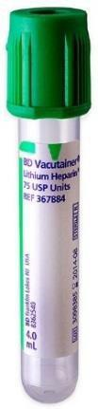
Blood Sample Types
Citrated (Global Hemostasis) Cartridges
3.2% Sodium Citrate Vacutainer – prevents clotting in the tube by binding with calcium
Global Hemostasis (07-601-US)
10 mins (incubation) – 4 hours
Global Hemostasis – HN (07-604-US)
10 mins (incubation) – 2 hours
Global Hemostasis with Lysis (07-605-US)
10 mins (incubation) – 2 hours
PlateletMapping® Cartridges
Non-Gel Sodium or Lithium Heparin Vacutainer – heparin prevents thrombin generation activating platelets
≥ 14.5 IU but ≤ 20 IU Heparin per mL of Blood
ADP & Arachidonic Acid (AA) (07-614-US)
30 mins (incubation) – 2 hours
Adenosine Diphosphate (ADP) only (07-615-US)
15 mins (incubation) – 3 hours
3ml waste for phlebotomy
3 x dead space for A- Line or similar
No under-filling, completely fill under vacuum
Invert x 5-7 prior to testing
Note: In urgent situations, samples may be tested immediately
Note: If red-top tube is used for waste, ensure the tube does not contain any additives as this can affect results.

Slide 18
Principle
Sample measurement and mixing
Resonant frequency technology
Test result – coagulation components

Slide 19
Sample Moved to Mixing Chamber
Test area
Reagent addition and mixing area
Sample reservoir
TEG 6s automatically draws a metered amount of blood into the Reagent addition and mixing area.
Metered amount is the exact amount required for performing up to 4 simultaneous tests from one blood sample.

Slide 20
Sample Moved to Test Ring
Reagent addition and mixing area
Test area
Sample reservoir

Slide 21
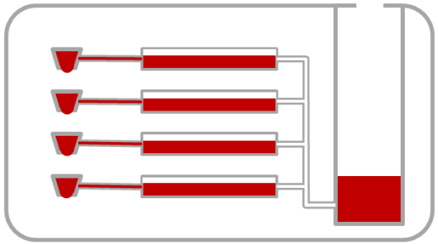
Sample Testing
By subjecting the pendant drop of blood to external vibration through resonant frequency, the device is able to monitor the harmonic motion of the blood drop to detect clotting and lysis.

Slide 22


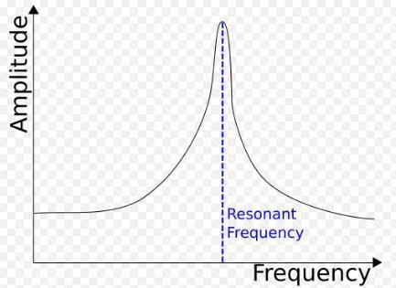

Resonant Frequency
Liquid State Gel-Like State
Modulus of elasticity and resonant frequency increase as blood clots and is plotted graphically to create the tracing
_{X} X XX X X X X
_{X}X
X X
X
X X X X ^{X}
Hz

Slide 23
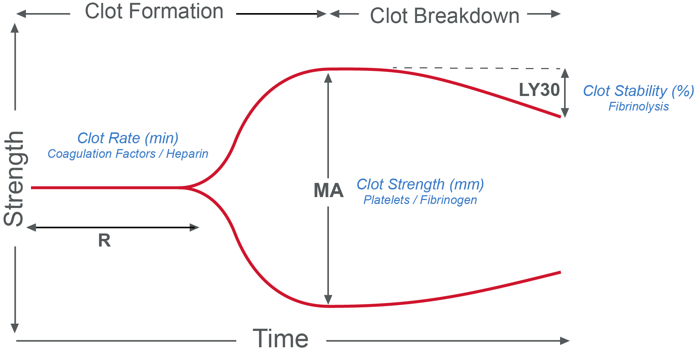
TEG® 6s Test Results
R | Reaction time. The amount of time between the start of the test and the beginning of coagulation.
MA | Maximum Amplitude. The ultimate strength of the clot.
LY30 | Percent lysis at 30 minutes after MA is achieved. The rate of clot breakdown.
Not all parameters are reported on all cartridges. Refer to the TEG 6s User Manual and/or the Package Inserts for completed information.

Slide 24
Starting the analyzer
Power on
Login
Home
Settings

Slide 25

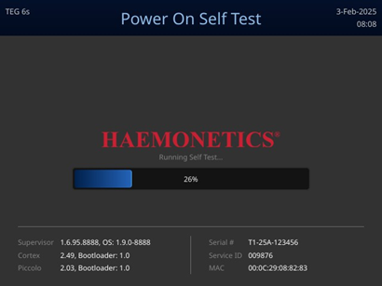
Power On
If OFF, move power switch at rear of analyzer to “I” position
Wait for Power On Self Test to complete

Slide 26
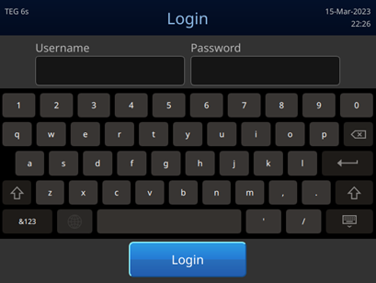
Login
Enter Username first, then press return key or touch Password field
Enter password, then press login
Return key

Slide 27
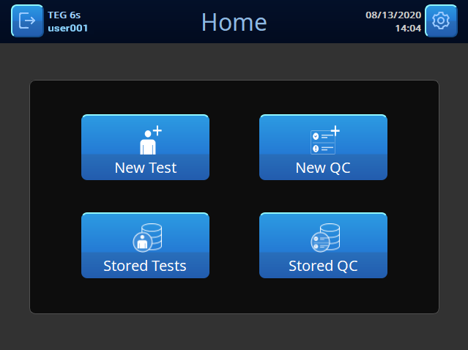
Home Screen
Logout
Set date and time (Administrator only)
Run a new
test
View list of stored
tests

Slide 28
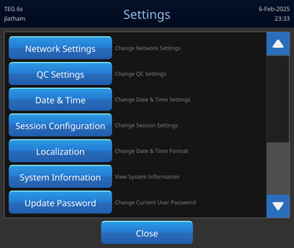
Settings*
QC settings are grayed out and cannot be configured via the analyzer if TEG Manager® software is configured, in which case use TEG Manager to change them.
If using TEG Manager software, do not update password on device. Only update password in TEG Manager.
*Note: All Settings options only available to Administrators only.

Slide 29
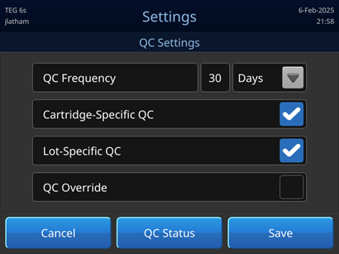
Settings- QC Settings*
Cartridge Specific QC- When enabled, the analyzer prevents patient tests using cartridges that have either not passed QC or that have expired based on the QC Frequency setting.
Lot Specific QC- When enabled, a cartridge manufacturing lot must pass all applicable QC levels prior to allowing patient tests to be run using cartridges from that lot.
*Note: Option only available to Administrators.

Slide 30
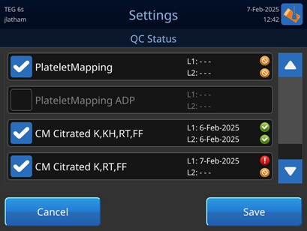
Settings- QC Status*
Indicates QC Status is failed, expired, or incomplete.
Status of each cartridge regardless of the QC mode or product code enabled.
*Note: Option only available to Administrators.

Slide 31
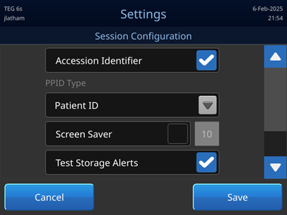
Settings- Session Configuration*
When enabled, an alert is displayed when the analyzer has exceeded 90% of its storage capacity for patient tests, QC tests, or a combination of both.
*Note: Option only available to Administrators.

Slide 32
Running a patient sample

Slide 33
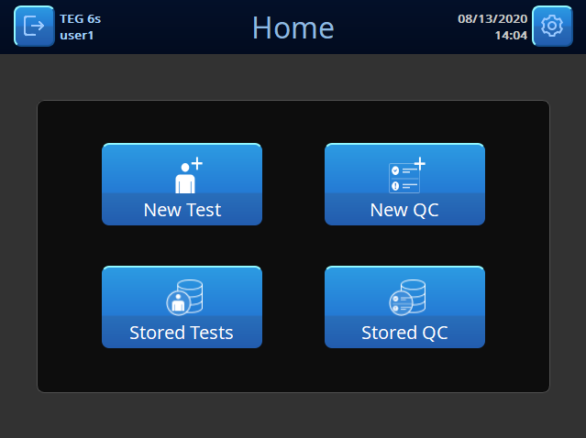
New Test
From the “Home” screen, press New Test

Slide 34

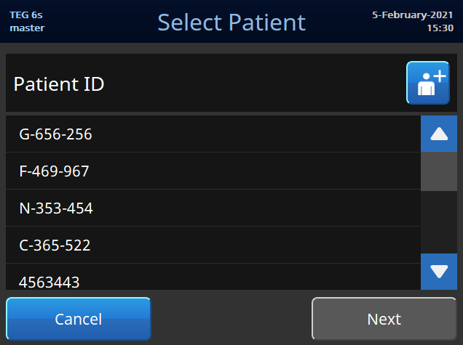
Select Patient
Select the patient ID from the list or press Then press Next.
to add a new patient.
Add new patient
Scroll bar to view patient list
Select correct
patient

Slide 35
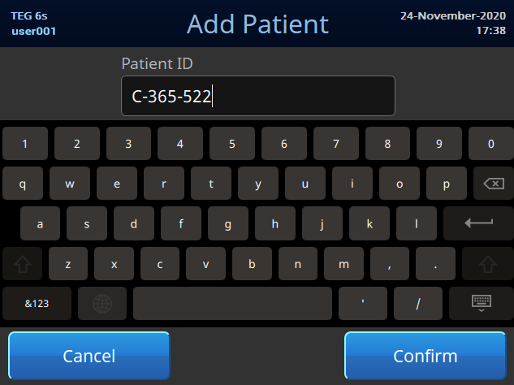
Add Patient
For a new patient, enter a patient ID or scan patient barcode. Press Confirm.
Patient ID
Select Confirm

Slide 36
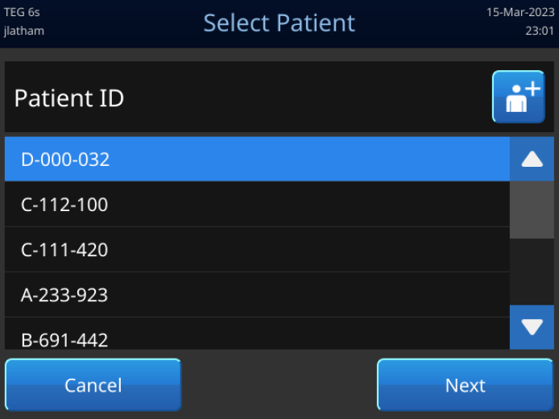
Confirming Patient
Return to selection screen with confirmed patient highlighted.
The press Next.

Slide 37
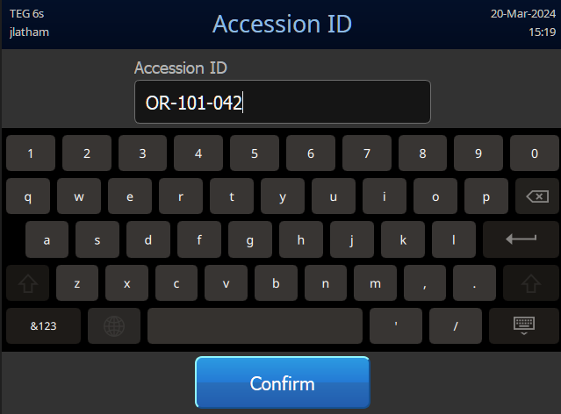
Program Accession Number
Manually enter, or scan the tube barcode, to enter Accession Number.

Slide 38
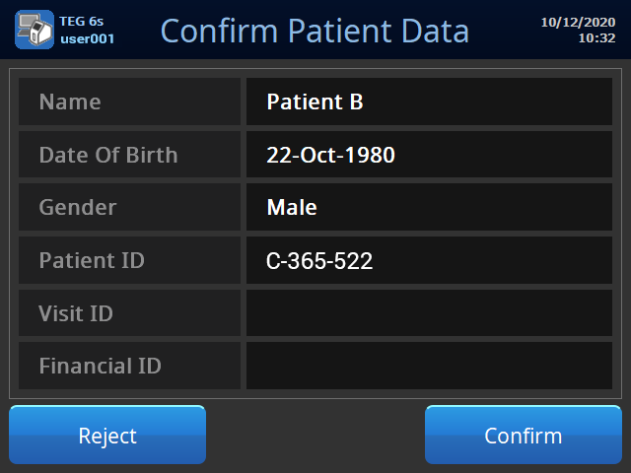
Confirm Patient Data
If ADT Feed or ADT Query is implemented, the analyzer will extract patient identifying information.
Confirm if patient details are correct.
Select Confirm

Slide 39
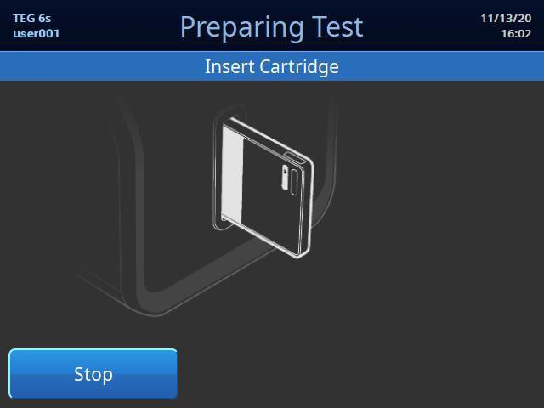

Preparing Test
When cartridge port is illuminated remove cartridge from sealed pouch.
Insert cartridge into slot (barcode on left side).
Barcode identifies cartridge type, test type, expiration date, and lot number
NOTE: Cartridge is inserted prior to addition of blood

Slide 40
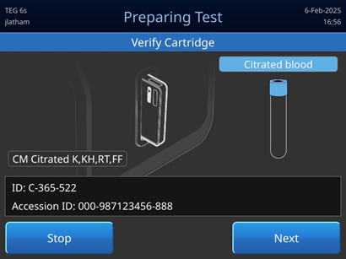
Verify cartridge
Barcode information downloaded and cartridge tested.
Verify correct cartridge and sample type, then press Next.
Verify cartridge and sample type

Slide 41
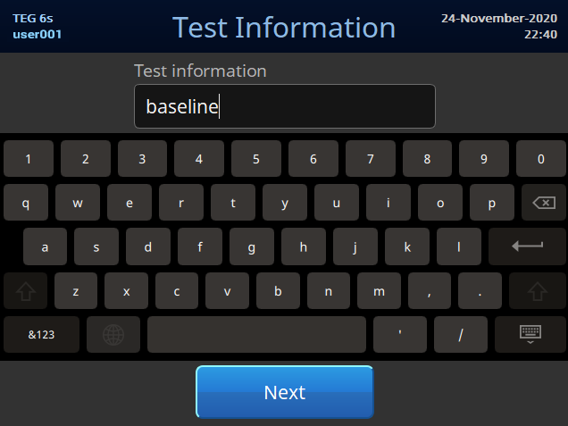
Enter Test Information
Optional – Enter information that will identify test.
Do not enter any PHI into this field.
Press Next.
Optional text field

Slide 42
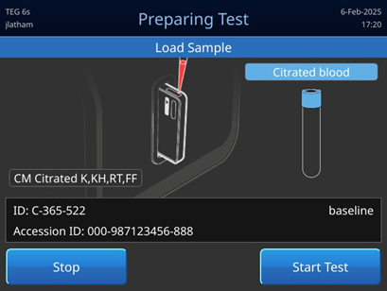
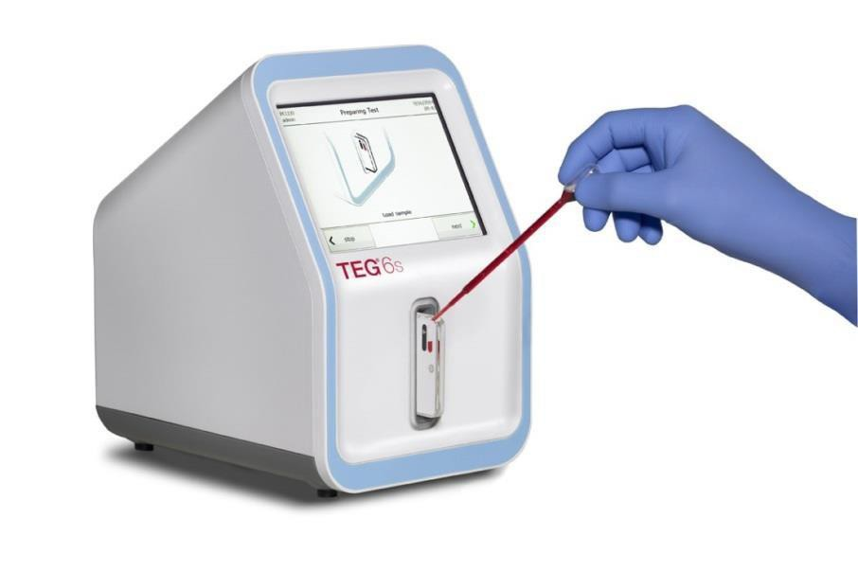

Load Sample
Add blood to or above FILL line
Press Start Test
The sample will automatically:
Be drawn in
Mixed with reagents
Initiate testing
Arrow indicating fill line

Slide 43
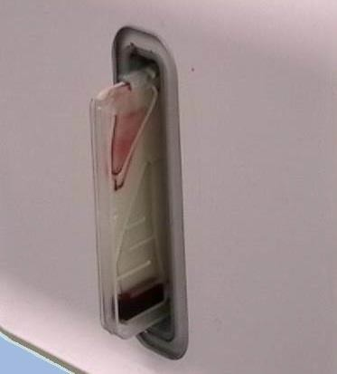
Sealed Cartridge
Reagent mixing and testing occurs automatically within sealed cartridge.
Excess blood moved to sealed waste area in cartridge.
Sample reservoir emptied
Waste reservoir

Slide 44
Test completion

Slide 45
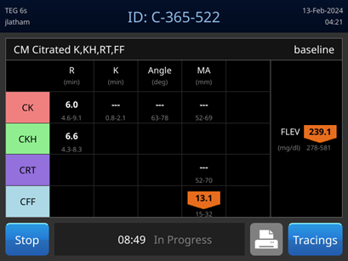
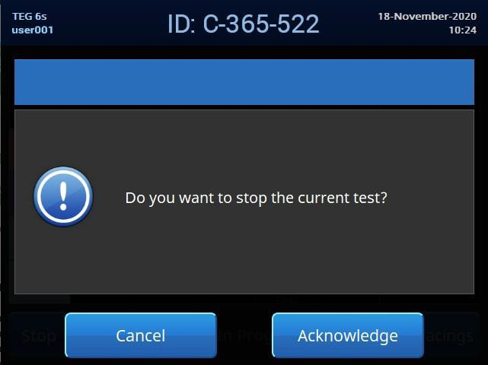
Stopping a Sample Prematurely
Patient and QC tests can be stopped prematurely if desired.
To stop early: press Stop from the results screen.
Choose Acknowledge to proceed with test termination or Cancel to continue testing.
Note: Only finalized results will be saved.

Slide 46
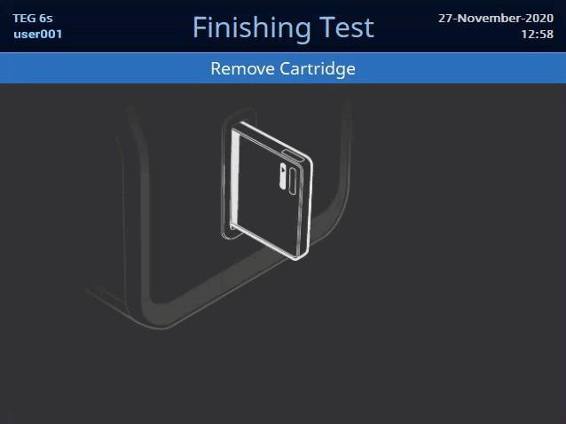
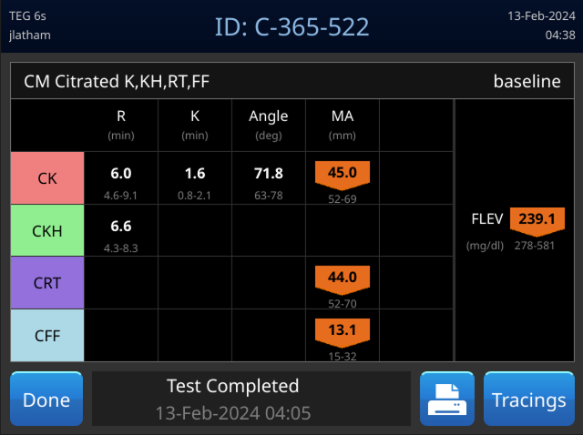
Finishing Test
Patient and QC tests stop automatically when all parameters finalize
Print if desired
Select Done
When prompted Remove Cartridge
Cartridge Port Light Flashing

Slide 47
Results display
Display
Stored test
Icons

Slide 48
Display
Patient Identification
Date and time
Cartridge type
Run time of test
The results shown are from item 07-601-US which is indicated for use in cardiovascular surgery and cardiology procedures

Slide 49
Display: Results
Parameter Units
Test results
Test Type
Reference range
Out of range warning
Press to see tracings
The results shown are from item 07-601-US which is indicated for use in cardiovascular surgery and cardiology procedures
Print Results

Slide 50
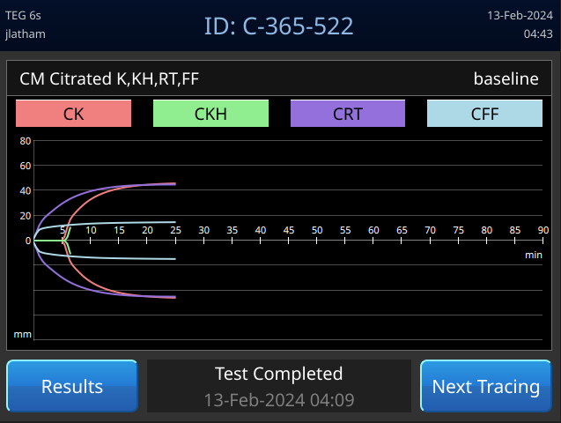
Display: Overlay Tracings
Visual comparison of tracings
Color key for tracings. Touch to go to individual tracing
Press to cycle through tracing displays
Overlaid (all)
Offset (all)
Individual with numerical data
Return to results table
The results shown are from item 07-601-US which is indicated for use in cardiovascular surgery and cardiology procedures

Slide 51
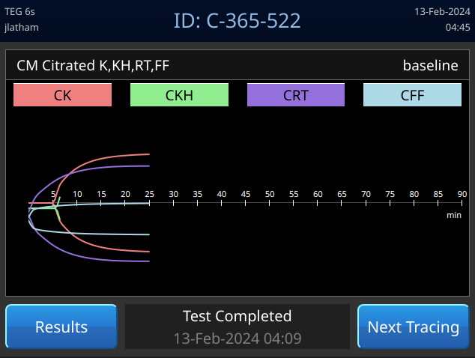
Display: Offset Tracings
Provides a better view when tracing shapes are similar
The results shown are from item 07-601-US which is indicated for use in cardiovascular surgery and cardiology procedures

Slide 52
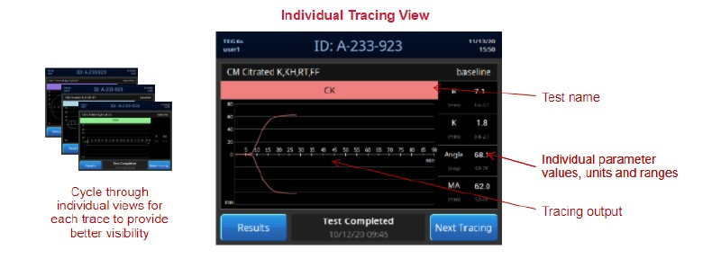
Display: Kaolin Tracing
The results shown are from item 07-601-US which is indicated for use in cardiovascular surgery and cardiology procedures.

Slide 53
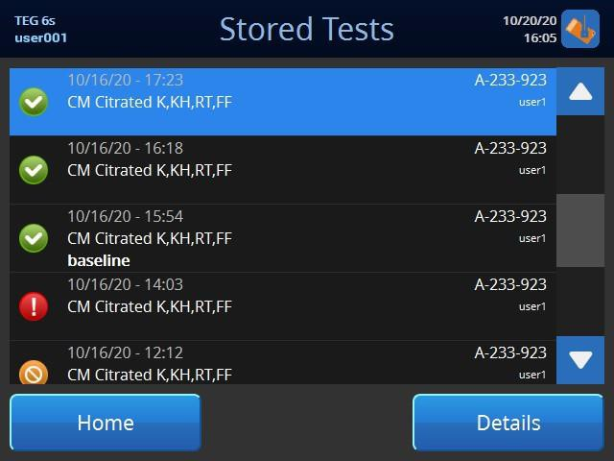
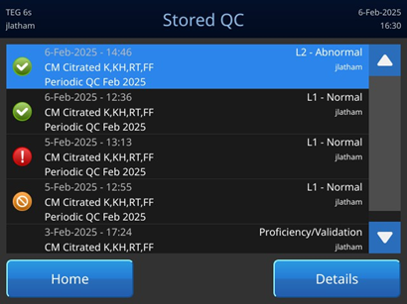
Stored Test/QC Screens
Patient tests
QC tests
05/08/2014 10:39 AM Patient 1 CM User 1

Slide 54
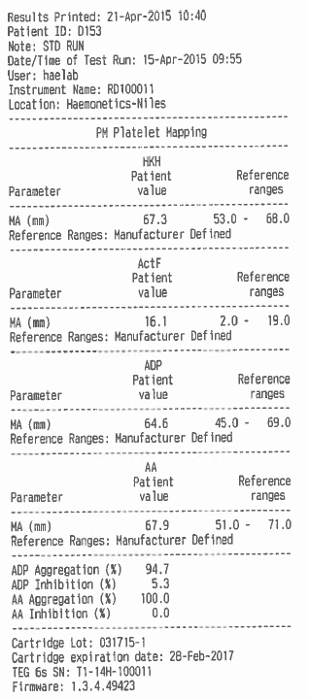
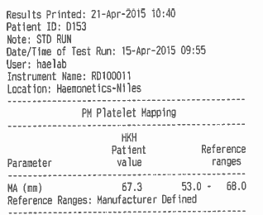
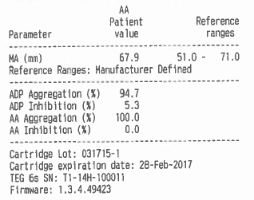
Printout on Thermal Printer
Paper width 76 mm (3.0 in), variable length

Slide 55
Running Quality Control (QC) Reagents

Slide 56
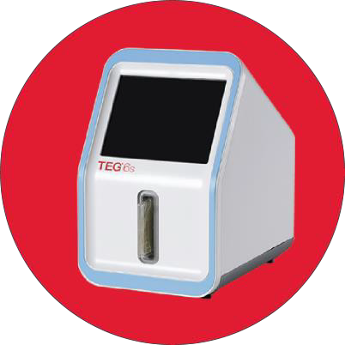
Electronic Analyzer QC
The TEG® 6s analyzer and reagents have been designed and manufactured following ISO 14971 guidelines.
The TEG® 6s has robust self-monitoring and quality control mechanisms.
QC self-checks validated the analyzer’s internal components are functioning correctly, and occur:
Every time the analyzer is powered on (Power On Self-Test, or POST)
Every time a cartridge is inserted
Every time a test is run
Through the incorporation of these three levels of internal QC, all essential functions of the analyzer are checked and verified without the need for external QC materials
Any operational issues are automatically detected and an error or warning is displayed to notify you.
Provides confidence that every time the analyzer is used, it is performing in a consistent manner and producing reliable results.

Slide 57

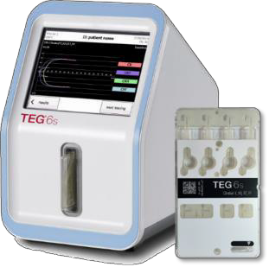
Reagent Quality Control (QC)
Reagent cartridges are manufactured under current Good Manufacturing Practices (GMP) with a validated manufacturing process with in-process controls to ensure lot-to-lot reproducibility and product performance.
Haemonetics recommends that two levels of QC testing be performed for each new shipment of assay cartridges.
Additional QC checks may be performed at predetermined intervals based on the laboratory’s quality control policies. (NOTE: Manufacturers IQCP aid is available upon request)

Slide 58
Quality Control (QC)
Each type of cartridge can be quality controlled by conducting two levels of QC. These include running two levels of commercially available QC material or donor blood samples.
Global Hemostasis (07-601-US, 07-604-US & 07-605-US)
Level 1 QC Reagent kit (07-664-US)
Level 2 QC Regent kit (07-665-US)
PlateletMapping® (07-615-US & 07-614-US)
Normal donor blood*
Abnormal donor blood*/ AntiPlatelet Reagent (07-670-US)**
*Normal and abnormal blood supplied by user from donors who meet the institution’s criteria.
**A General Purpose Reagent available for user-specific application.

Slide 59

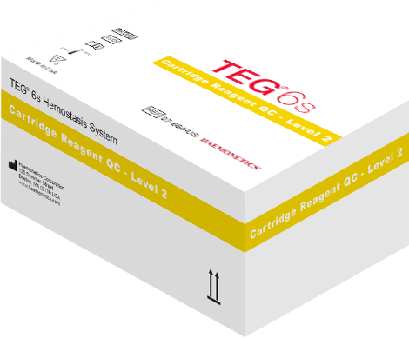


Preparing Quality Control Material
Each QC Reagent kit contains:
12 vials of lyophilized QC reagent
12 vials of DI water
Remove from refrigerator and allow to come to room temperature (10 mins)
Vial of water + Vial of QC material from kit
Citrate – Global Hemostasis cartridge + pipette
Required materials

Slide 60

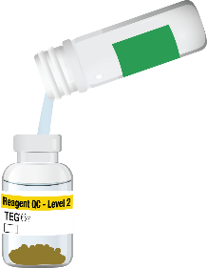
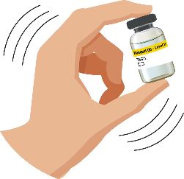

Preparing Quality Control Material
Remove stopper with care, metal seal may have sharp edges.
Tap the water on counter to ensure not water in cap.
Uncap and slowly pour into vial. All water must go into vial. Reinsert stopper and shake vigorously, let stand for 5 minutes then shake vigorously again and let stand for another 5 minutes.
Step 1 Step 2 Step 3 Step 4 Step 5
reconstitute
shake
rest
shake
rest
QC reconstitution

Slide 61

Running Cartridge Reagent QC (07-601-US, 07-604-US or 07-605-US)
Remove desired cartridge from sealed pouch
From the Home screen, press New QC
Do NOT select “New Test” or you will not receive an MA value when running QC
Add any desired ID info on the following “Test Information” screen

Slide 62
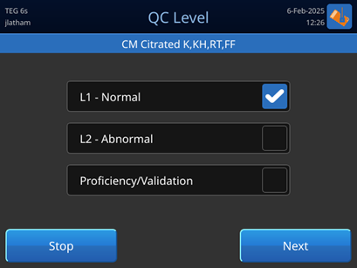
New QC- QC Level Screen
Select the QC test that you wish to run and then touch Next.
Select to run Proficiency/Validation samples and then touch Next.
Note: The “Proficiency/Validation” checkbox is disabled if a QC test previously failed on the analyzer. To re-enable the checkbox, run the applicable QC test.

Slide 63

Insert Cartridge
Insert cartridge into slot (barcode on left side)
Barcode identifies cartridge type, test type, expiration date and lot number
Press Acknowledge to confirm that QC is being run on patient cartridge

Slide 64


Start Test
Add prepared QC reagent or normal blood material to cartridge, filling to or above line
Press Start Test
Arrow indicating fill line

Slide 65


Finish QCTest
When prompted, remove cartridge and properly dispose
View or print test results
Press Done to return Home
Embedded Reference Ranges*
*Note: Embedded Reference Ranges only available for Citrated cartridges and show when Level 1/Level 2 is selected.
Indicates Pass

Slide 66


Proficiency/Validation Test
Select when running Validation or Proficiency samples
Does not include reference ranges, analytical measurement ranges (AMRs), or pass/fail status.

Slide 67
Troubleshooting and maintenance

Slide 68









Status Icon Definitions
Saving data
Exclusive mode
Remote user
Error
Critical error
Warning
Test Timeout
Data being collected
QC Overdue

Slide 69

Errors
Make note of the error code
Follow instructions in error and press Acknowledge

Slide 70


Errors & Warnings During Testing
An error causes the test to stop and may require you to replace the cartridge or to turn the power off and back on in an attempt to clear the error.
A warning does not require you to take a specific action, and the test continues to run.

Slide 71

Critical Alerts
System encounters an unrecoverable error
Note error code and turn analyzer off and restart
If alert does not clear, contact customer support

Slide 72



Cleaning the Analyzer
Wipe down analyzer surface weekly or as needed
Disposable gloves
70 – 95% isopropyl alcohol plus 2” X 2” Gauze pads or germicidal disposable wipes

Slide 73
Thank you

