Slide 1

2025 Wet Prep Competency
Companion Images for Wet Prep MTS Quiz

Slide 2
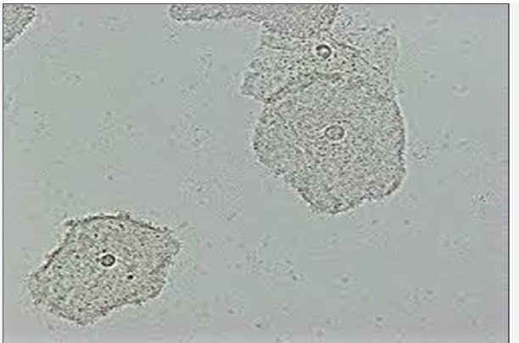
Slide 1

Slide 3
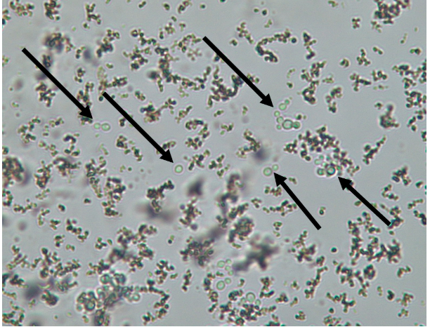
Slide 2

Slide 4
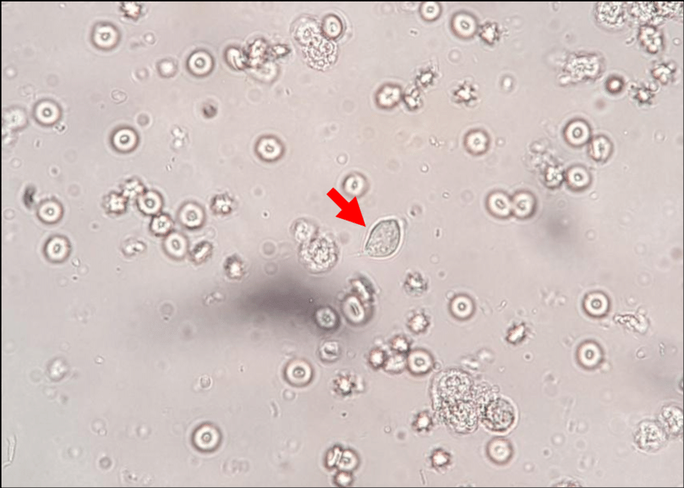
Slide 3

Slide 5
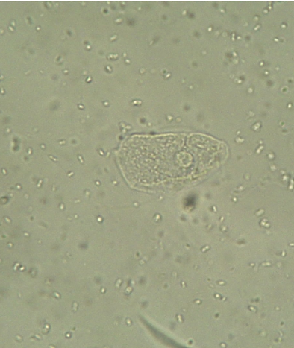
Slide 4

Slide 6
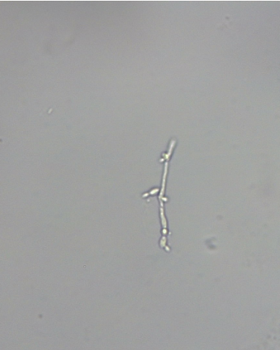
Slide 5

Slide 7
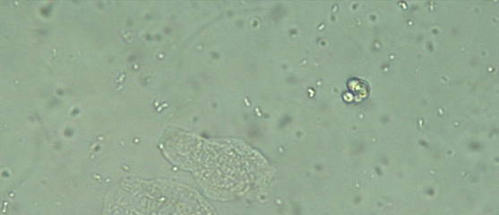
Slide 6

Slide 8
Slide 7

Slide 9
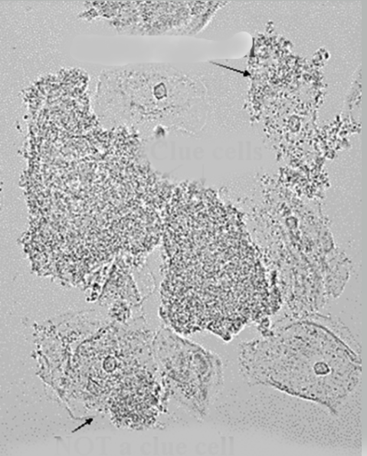
Slide 8

Slide 10
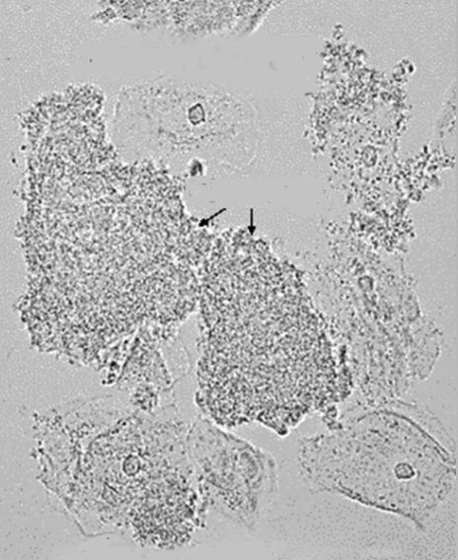
Slide 9

Slide 11
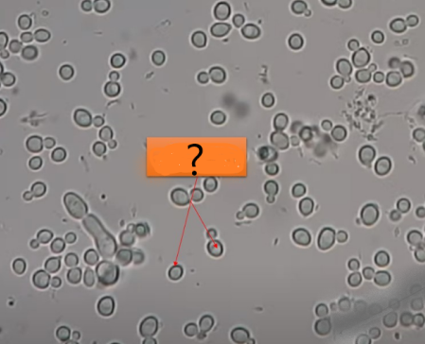
Slide 10

