Slide 1
2016 National Training Program
Module 10
Medicare and Medicaid Fraud and Abuse Prevention
Notes:
Module 10 explains Medicare and Medicaid fraud and abuse prevention, detection, reporting, and recovery.
This training module was developed and approved by the Centers for Medicare & Medicaid Services (CMS), the federal agency that administers Medicare, Medicaid, the Children’s Health Insurance Program (CHIP), and the Federally-facilitated Health Insurance Marketplace.
The information in this module was correct as of May 2016. To check for an updated version, visit CMS.gov/outreach-and-education/training/ cmsnationaltrainingprogram/index.html.
The CMS National Training Program provides this as an informational resource for our partners. It’s not a legal document or intended for press purposes. The press can contact the CMS Press Office at press@cms.hhs.gov. Official Medicare program legal guidance is contained in the relevant statutes, regulations, and rulings.

Slide 2
Session Objectives
This session should help you
Define fraud and abuse
Identify causes of improper payments
Discuss how CMS fights fraud and abuse
Explain how you can fight fraud and abuse
Recognize sources of additional information
Notes:
This session should help you
Define fraud and abuse
Identify causes of improper payments
Discuss how CMS fights fraud and abuse
Explain how you can fight fraud and abuse
Recognize sources of additional information

Slide 3
Lesson 1—Fraud and Abuse Overview
Definition of health care fraud and abuse
Protecting the Medicare Trust Funds and other public resources
Examples of Medicare and Medicaid fraud
Who commits fraud?
Causes of improper payments
Quality of care concerns
Notes:
Lesson 1 provides an overview of fraud and abuse, including the following:
Definition of health care fraud and abuse
Protecting the Medicare Trust Funds and other public resources
Examples of Medicare and Medicaid fraud
Who commits fraud?
Causes of improper payments
Quality of care concerns

Slide 4
Definitions of Fraud and Abuse
Fraud
When someone intentionally deceives or makes misrepresentations to obtain money or property of any health care benefit program
Abuse
When health care providers or suppliers perform actions that directly or indirectly result in unnecessary costs to any health care benefit program
The primary difference between fraud and abuse is intention.
Notes:
Medicare and Medicaid fraud, waste, and abuse affect every American by draining critical resources from our health care system, and contributing to the rising cost of health care. Taxpayer dollars lost to fraud, waste, and abuse harm multiple parties, particularly some of our most vulnerable citizens.
Fraud occurs when someone intentionally deceives or makes misrepresentations to obtain money or property of any health care benefit program.
Abuse occurs when health care providers or suppliers perform actions that directly or indirectly result in unnecessary costs to any health care benefit program.
The primary difference between fraud and abuse is intention.

Slide 5
Protecting Taxpayer Dollars
The Centers for Medicare & Medicaid Services must
  Protect Medicare Trust Funds
    Medicare Hospital Insurance (Part A) Trust Fund
    Supplementary Medical Insurance (Part B) Trust Fund
  Protect the public resources that fund the Medicaid programs
  Manage the careful balance between paying claims quickly and limiting burden on the provider community with conducting reviews that prevent and detect fraud
Notes:
The Centers for Medicare & Medicaid Services’ (CMS’s) mission is to be an effective steward of public funds. CMS must protect the Medicare Hospital Insurance (Part A) Trust Fund and the Supplementary Medical Insurance (Part B) Trust Fund.
The Medicare Hospital Insurance Trust Fund pays for Medicare Part A benefits such as inpatient hospital care, skilled nursing facility care, home health care, and hospice care. It’s funded by payroll taxes, income taxes paid on Social Security benefits, interest earned on trust fund investments, and Part A premiums from people who aren’t eligible for premium-free Part A.
The Supplementary Medical Insurance Trust Fund pays for Medicare Part B benefits including doctor services, outpatient hospital care, home health care not covered under Part A, durable medical equipment, certain preventive services, lab tests, Medicare Part D prescription drug benefits, and Medicare program administrative costs. Its funding is authorized by Congress from Part B premiums, Part D (Medicare prescription drug coverage) premiums, and interest earned on trust fund investments.
The federal government contributes to the annual Medicaid expenditure, and CMS must protect the public resources that fund the 56 state-run Medicaid programs operated by the states, the District of Columbia, and U.S. Territories.
CMS has to manage the careful balance between paying claims quickly and limiting provider burden, versus conducting reviews that prevent and detect fraud.

Slide 6
Examples of Fraud
Medicare or Medicaid is billed for
  Services you never received
  Equipment you never got or that was returned
Documents are altered to gain a higher payment
Misrepresentation of dates, descriptions of furnished services, or your identity
Someone uses your Medicare or Medicaid card with or without your permission
A company uses false information to mislead you into joining a Medicare plan
For recent examples of fraud by region visit, medic-outreach.rainmakerssolutions.com/fraud-in-the-news/
Notes:
Examples of possible fraud include the following:
Medicare or Medicaid is billed for services you never received, equipment you never got or that was returned
Documents that are altered to gain a higher payment
Misrepresentation of dates, descriptions of furnished services, or your identity
Someone else uses your Medicare/Medicaid card with or without your permission
A company uses false information to mislead you into joining a Medicare plan
For recent examples of Medicare fraud by region, visit CMS Outreach & Education Medic at medic-outreach.rainmakerssolutions.com/fraud-in-the-news/ to view the U.S. Department of Justice’s “Fraud in the News” press releases.

Slide 7

Consequences of Sharing a
Medicaid Card or Number
Medicaid-specific lock-in program
  Limits you to certain doctors/drug stores/hospitals
    For activities like ER visits for non-emergency care and using multiple doctors that duplicate treatment/medication
Your medical records could be wrong
You may have to pay money back or be fined
You could be arrested
You might lose your Medicaid benefits
Notes:
If you share your Medicaid card or number with anyone other than your health care providers, there are programs in place and consequences.
The Medicaid lock-in program limits you to certain doctors, drug stores, and hospitals. Lock-in may be used for people with Medicaid in these circumstances:
Visiting hospital emergency departments for non-emergency health concerns
Using 2 or more hospitals for emergency room services
Using 2 or more doctors resulting in duplicated medications and/or treatments
Exhibiting possible drug-seeking behavior
Requesting a specific scheduled medication (narcotics)
Requesting early refills of scheduled medications
Reporting frequent losses of scheduled medications
Using multiple pharmacies to fill prescriptions
Your medical records could be wrong—the next time you go to the doctor, you’ll have to explain what happened so you don’t get the wrong kind of care
You may have to pay money back or be fined
You could be arrested and spend time in jail if found guilty of fraud
You might lose your Medicaid benefits

Slide 8
Who Commits Fraud?
Most individuals and organizations that work with Medicare and Medicaid are honest
However, anyone can commit fraud
  Doctors and health care providers
  Suppliers of durable medical equipment
  Employees of doctors or suppliers
  Employees of companies that manage Medicare billing
  People with Medicare and/or Medicaid
Notes:
Most individuals and organizations that work with Medicare and Medicaid are honest, but there are some bad actors. The Centers for Medicare & Medicaid Services is continually taking the steps necessary to identify and prosecute these bad actors.
Any of the following may be involved in Medicare fraud and abuse:
Doctors and health care providers
Suppliers of durable medical equipment
Employees of doctors or suppliers
Employees of companies that manage Medicare billing
People with Medicare and/or Medicaid
Medicare fraud is prevalent, so it’s important for you to be aware of the various entities that have been implicated in fraud schemes. Those who commit fraud could be individuals who are in, or pretend to be in, any of the above-mentioned groups.

Slide 9
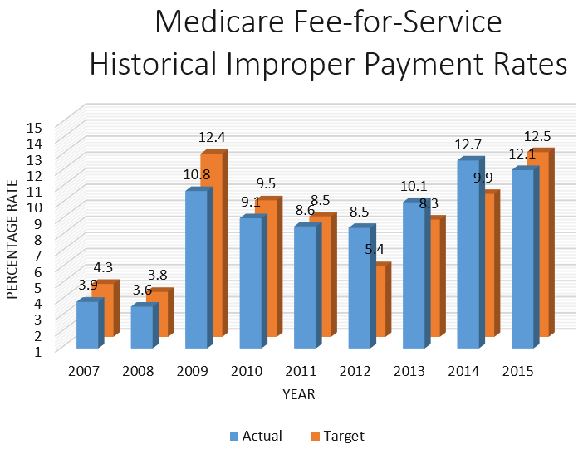
Improper Payment Transparency—Medicare
Medicare Fiscal Reporting Year 2015
Error Rate is 12.1% or $43.3 billion
Notes:
An improper payment, according to the Government Accountability Office, is “any payment that shouldn’t have been made or that was made in an incorrect amount (including overpayments and underpayments) under statutory, contractual, administrative, or other legally applicable requirements.” President Obama established a goal to reduce government-wide improper payments.
You can see from this graph the goal of reduction in each fiscal year (FY). As part of the Accountable Government Initiative, Medicare and Medicaid are considered high-error programs. Medicare processes over 1 billion fee-for-service (FFS) claims per year, and pays over $350 billion for more than 55 million beneficiaries. The FY 2015 improper payment rate was 12.1%, representing $43.3 billion in improper payments. The 2016 Medicare improper payment rate target is 11.5%.
The FY 2015 Medicare FFS improper payment rate decreased from 12.7% in FY 2014 to 12.1% in FY 2015, meeting and exceeding the FY 2015 improper payment rate target of 12.5%. This decrease was driven by a reduction in improper payments for inpatient hospital and durable medical equipment, prosthetics, orthotics, and supplies (DMEPOS) claims. The primary causes of improper payments are insufficient documentation and medical-necessity errors. Insufficient documentation errors for home health claims were the major contributing factors to the FY 2015 improper payment rate.
NOTE: Error rates can be viewed at paymentaccuracy.gov. Medicare claims information is available in the 2015 CMS Statistics Reference Booklet, at
CMS.gov/CMS-Statistics-Reference-Booklet/Downloads/2015CMSStatistics.pdf.

Slide 10
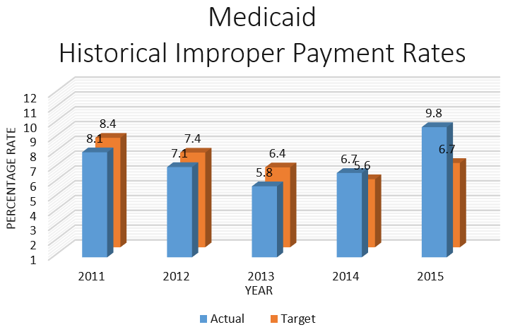
Improper Payment Transparency—Medicaid
Medicaid Fiscal Reporting Year 2015
Error Rate is 9.8% or $29.1 billion
Notes:
Medicaid is the primary source of health coverage for over 68 million Americans and pays more than $433 billion in benefit claims each year. The fiscal year (FY) 2015 improper payment rate was 9.8%, representing $29.1 billion in improper payments.
The national Medicaid improper payment rate is calculated differently than for Medicare. It’s a rolling improper payment rate that includes findings from the most recent 3 measurements (in this case, for FYs 2013, 2014, and 2015). Each time a group of 17 states is measured under Payment Error Rate Measurement, the previous findings for that group of states are dropped from the calculation and the newest findings are added. In general, the national rate is calculated by multiplying each state’s most recently observed error rate by that state’s expenditures and dividing by total expenditures. The 2016 Medicaid improper payment rate target is 11.5%.
NOTE: Error rates can be viewed at paymentaccuracy.gov/. Medicaid claims information is available in the 2015 CMS Statistics Reference Booklet, at
CMS.gov/CMS-Statistics-Reference-Booklet/Downloads/2015CMSStatistics.pdf.

Slide 11


Causes of Improper Payments
Not all improper payments are fraud, but all payments made due to fraud schemes are improper
The Centers for Medicare & Medicaid Services is targeting all causes of improper payments
  From honest mistakes to intentional deception
Most common error is insufficient documentation
Intentional Deception
Notes:
Causes of improper payments include errors, waste, abuse, and fraud—also known as mistakes, inefficiencies, bending the rules, and intentional deception.
The Centers for Medicare & Medicaid Services’ (CMS’s) program integrity activities target all causes of improper payments, from honest mistakes to intentional deception.
Contrary to common perception, not all improper payments are fraud (i.e., an intentional misuse of funds). In fact, the vast majority of improper payments are due to unintentional errors. For example, an error may occur because a program doesn’t have documentation to support someone’s eligibility for a benefit, or an eligible person receives a payment that is too high—or too low—due to a data entry mistake or inefficiencies.
Also, many of the overpayments are payments that may have been proper, but were labeled improper due to a lack of proper documentation. We believe that if agencies had this documentation, it would show that many of these overpayments were actually proper, and the amount of improper payments actually lost by the government would be even lower than the estimated net loss discussed previously.
CMS uses provider education and outreach to help avoid billing errors and will use its payment suspension authorities in cases of suspected fraudulent conduct. These activities are designed to ensure that correct payments are made to legitimate providers and suppliers for appropriate and reasonable services and supplies for eligible beneficiaries.

Slide 12
Preventing Fraud in Medicare
Part C and Part D
Plan agents and brokers must follow CMS’s Marketing Guidelines. Examples of what plans can’t do include
  Sending you unwanted emails
  Coming to your home uninvited to get you to join
  Calling you unless you’re already a member
  Offering you cash to join their plan
  Giving you free meals while trying to sell you a plan
  Talking to you about their plan in areas where you get health care
If you think a Medicare plan broke the rules
  Call 1-800-MEDICARE (1-800-633-4227). TTY users should call 1-877-486-2048.
Notes:
Providers aren’t the only focus in preventing Medicare fraud. Medicare health plans and Medicare Prescription Drug Plans that contract with Medicare have responsibilities beyond billing. Plans are responsible for ensuring that they market to beneficiaries in responsible ways that protect the beneficiary and the Medicare program from marketing practices that could result in fraud. This includes the plan’s agents or brokers who represent them.
Some examples of activities Medicare plans and people who represent them aren’t allowed to do:
Sending you unwanted emails or coming to your home uninvited to sell a Medicare plan.
Calling you unless you’re already a member of the plan. If you’re a member, the agent who helped you join can call you.
Offering you cash to join their plan.
Giving you free meals while trying to sell you a plan.
Talking to you about their plan in areas where you get health care, like an exam room, hospital patient room, or at a pharmacy counter.
NOTE: Although the Medicare Drug Integrity Contractor fights fraud, waste, and abuse in Medicare Advantage Plans (Part C) and Medicare prescription drug coverage (Part D), they don’t handle Part C and Part D marketing fraud. Call 1-800-MEDICARE (1-800-633-4227) to report plans that ask for your personal information over the telephone or that call unsolicited to enroll you in a plan. TTY users should call 1-877-486-2048.

Slide 13
Telemarketing and Fraud—
Durable Medical Equipment (DME)
DME telemarketing rules
  DME suppliers can’t make unsolicited sales calls
Potential DME scams
  Calls or visits from people saying they represent Medicare
  Telephone or door-to-door selling techniques
  Equipment or service is offered free and you’re then asked for your Medicare number for “record keeping purposes”
  You’re told that Medicare will pay for the item or service if you provide your Medicare number
Notes:
There are durable medical equipment (DME) rules for telemarketing. DME suppliers (people who sell equipment such as diabetic supplies and power wheelchairs) are prohibited by law from making unsolicited telephone calls to sell their products.
Potential DME scams include the following:
Calls or visits from people saying they represent Medicare
Telephone or door-to-door selling techniques
Equipment or service is offered free and you're then asked for your Medicare number for “record keeping purposes”
You’re told that Medicare will pay for the item or service if you provide your Medicare number
NOTE: Call 1-800-MEDICARE (1-800-633-4227) to report suspected DME scams. TTY users should call 1-877-486-2048.

Slide 14
Quality of Care Concerns
Patient quality of care concerns aren’t necessarily fraud
  Medication errors
  Change in condition not treated
  Discharged from the hospital too soon
  Incomplete discharge instructions and/or arrangements
Contact your Beneficiary and Family-Centered Care Quality Improvement Organization
  Visit Medicare.gov/contacts
  Call 1-800-MEDICARE (1-800-633-4227). TTY users should call 1-877-486-2048.
Notes:
There’s a specific Quality Improvement Organization (QIO) just to address the concerns of people with Medicare and their families called a Beneficiary and Family-Centered Care (BFCC) QIO.
Patient quality of care concerns aren’t necessarily fraud. Examples of quality of care concerns that your BFCC-QIO can address include the following:
Medication errors like being given the wrong medication; being given medication at the wrong time; being given a medication to which you’re allergic; or being given medications that interact in a negative way. They can evaluate if it merits Medicare Drug Integrity Contractor intervention.
Change in condition not treated, like not receiving treatment after abnormal test results or when you developed a complication.
Discharged from the hospital too soon.
Incomplete discharge instructions and/or arrangements.
To get the address and phone number of the BFCC-QIO for your state or territory, visit Medicare.gov/contacts and search for information on the topic of “Complaints about my care or services.” Or, you can call 1-800-MEDICARE (1-800-633-4227). TTY users should call 1-877-486-2048.

Slide 15
Check Your Knowledge—Question 1
The definition of ____ is when someone intentionally deceives or makes misrepresentations to obtain money or property of any health care benefit program.
Abuse
Improper payment
Fraud
None of the above
Notes:
Check Your Knowledge—Question 1
The definition of ____ is when someone intentionally deceives or makes misrepresentations to obtain money or property of any health care benefit program.
Abuse
Improper payment
Fraud
None of the above
ANSWER: c. Fraud
Fraud occurs when someone intentionally deceives or makes misrepresentations to obtain money or property of any health care benefit program.

Slide 16
Check Your Knowledge—Question 2
Billing errors will always indicate a health care provider’s or supplier’s intent to commit fraud.
True
False
Notes:
Check Your Knowledge—Question 2
Billing errors will always indicate a health care provider’s or supplier’s intent to commit fraud.
True
False
ANSWER: b. False
Contrary to common perception, not all improper payments are fraud (i.e., an intentional misuse of funds). In fact, the vast majority of improper payments are due to unintentional errors. For example, an error may occur because a program doesn’t have documentation to support someone’s eligibility for a benefit, or an eligible person receives a payment that is too high—or too low—due to a data entry mistake or inefficiencies.

Slide 17
Lesson 2—CMS Fraud and Abuse Strategies
The Center for Program Integrity
CMS Program Integrity Contractors
CMS Administrative Actions
Law Enforcement Actions
The Health Care Fraud Prevention Partnership
Health Care Fraud Prevention and Enforcement Action (HEAT) Team
The Fraud Prevention Toolkit at CMS.gov/outreach-and-education/outreach/partnerships/fraudpreventiontoolkit
Provider and Beneficiary Education
Notes:
Lesson 2 discusses the following Centers for Medicare & Medicaid Services (CMS) fraud and abuse strategies:
The Center for Program Integrity
The CMS Program Integrity Contractors
CMS Administrative Actions
Law Enforcement Actions
The Health Care Fraud Prevention Partnership
Health Care Fraud Prevention and Enforcement Action (HEAT) Team
The Fraud Prevention Toolkit at CMS.gov/outreach-and-education/outreach/partnerships/fraudpreventiontoolkit
Provider and Beneficiary Education

Slide 18
The Center for Program Integrity
Consolidates CMS anti-fraud components
Authority came from the Affordable Care Act
More rigorous screenings for health care providers
Reciprocal termination of providers from Medicare, Medicaid, and the Children’s Health Insurance Program
May temporarily stop enrollment in high-risk areas
  Used first in July 2013 and extended into 2016
Temporarily stop payments in cases of suspected fraud
Notes:
The Center for Program Integrity brings together the Medicare and Medicaid program integrity groups under one management structure to strengthen and better coordinate existing and future activities to prevent and detect fraud, waste, and abuse.
Rules permitted by the Affordable Care Act have helped Medicare, Medicaid, and the Children’s Health Insurance Program (CHIP) move beyond the “pay and chase” approach to health care fraud, to a more proactive and transparent approach by
Creating a rigorous screening process for providers and suppliers enrolling in Medicare, Medicaid, and CHIP.
Requiring cross-termination among federal and state health programs, so providers and suppliers whose Medicare billing privileges are revoked, or whose participation has been terminated by a Medicaid or CHIP program, are barred or terminated from all other Medicaid and CHIP programs.
Temporarily stopping enrollment of new providers and suppliers in high-risk areas. Medicare and state agencies are watching for trends that may indicate a significant potential for health care fraud, and can temporarily stop enrollment of a category of providers or suppliers, or enrollment of new providers or suppliers, in a geographic area that has been identified as high risk. CMS used this authority for the first time in July 2013 on new home health agencies in Miami and Chicago, and ambulance companies in Houston based on their risk of fraud to Medicare and Medicaid.
In the 2 years after the implementation of the Affordable Care Act, CMS doubled the number of providers who've had their billing privileges revoked compared to the 2 years prior, thanks to the new screening requirements and other proactive initiatives.

Slide 19
Program Integrity Contractors
A nationally coordinated Medicare/Medicaid program integrity strategy that cuts across regions
  Zone Program Integrity Contractors (ZPIC)
  Recovery Audit Program
  National Benefit Integrity Medicare Drug Integrity Contractor (NBI MEDIC)
  Outreach & Education MEDIC (O&E MEDIC)
  Medicaid Integrity Contractors
Notes:
Program Integrity Contractors are a nationally coordinated Medicare/Medicaid program integrity team of contractors that cuts across regions. They include the following:
Zone Program Integrity Contractors (ZPIC)
Recovery Audit Program
National Benefit Integrity (NBI), Medicare Drug Integrity Contractor (MEDIC)
Outreach & Education MEDIC (O&E MEDIC)
Medicaid Integrity Contractors
NOTE: See also “Contractor Entities At-a-Glance” at CMS.gov/Outreach-and-Education/Medicare-Learning-Network-MLN/MLNProducts/downloads/ContractorEntityGuide_ICN906983.pdf.

Slide 20
Zone Program Integrity Contractors (ZPICs)
Investigate leads generated by the new Fraud Prevention System (FPS) and a variety of other sources
Provide feedback to CMS to improve the FPS
Perform data analysis to identify and investigate cases of suspected fraud, waste, and abuse
Notes:
Zone Program Integrity Contractors (ZPICs) were created to perform program integrity functions in zones for Medicare Part A and Part B; durable medical equipment, prosthetics, orthotics, and supplies; home health and hospice; and Medicare-Medicaid data matching.
ZPIC’s main responsibilities include the following:
Investigate leads generated by the new Fraud Prevention System (FPS) and a variety of other sources
Provide feedback and support to CMS to improve the FPS
Perform data analysis to identify and investigate cases of suspected fraud, waste, and abuse

Slide 21
Zone Program Integrity Contractors (ZPICs)— Continued
Make recommendations to CMS for appropriate administrative actions to protect Medicare Trust Fund dollars
Make referrals to law enforcement for potential prosecution
Provide support for ongoing law enforcement investigations
Identify improper payments to be recovered by Medicare Administrative Contractors
Notes:
Additional Zone Program Integrity Contractor (ZPIC) responsibilities are to
Make recommendations to CMS for appropriate administrative actions to protect Medicare Trust Fund dollars.
Make referrals to law enforcement for potential prosecution.
Provide support for ongoing law enforcement investigations.
Identify improper payments to be recovered by Medicare Administrative Contractors (MACs). CMS relies on a network of MACs to process Medicare claims, and MACs serve as the primary operational contact between the Medicare fee-for-service program and approximately 1.5 million health care providers enrolled in the program.

Slide 22
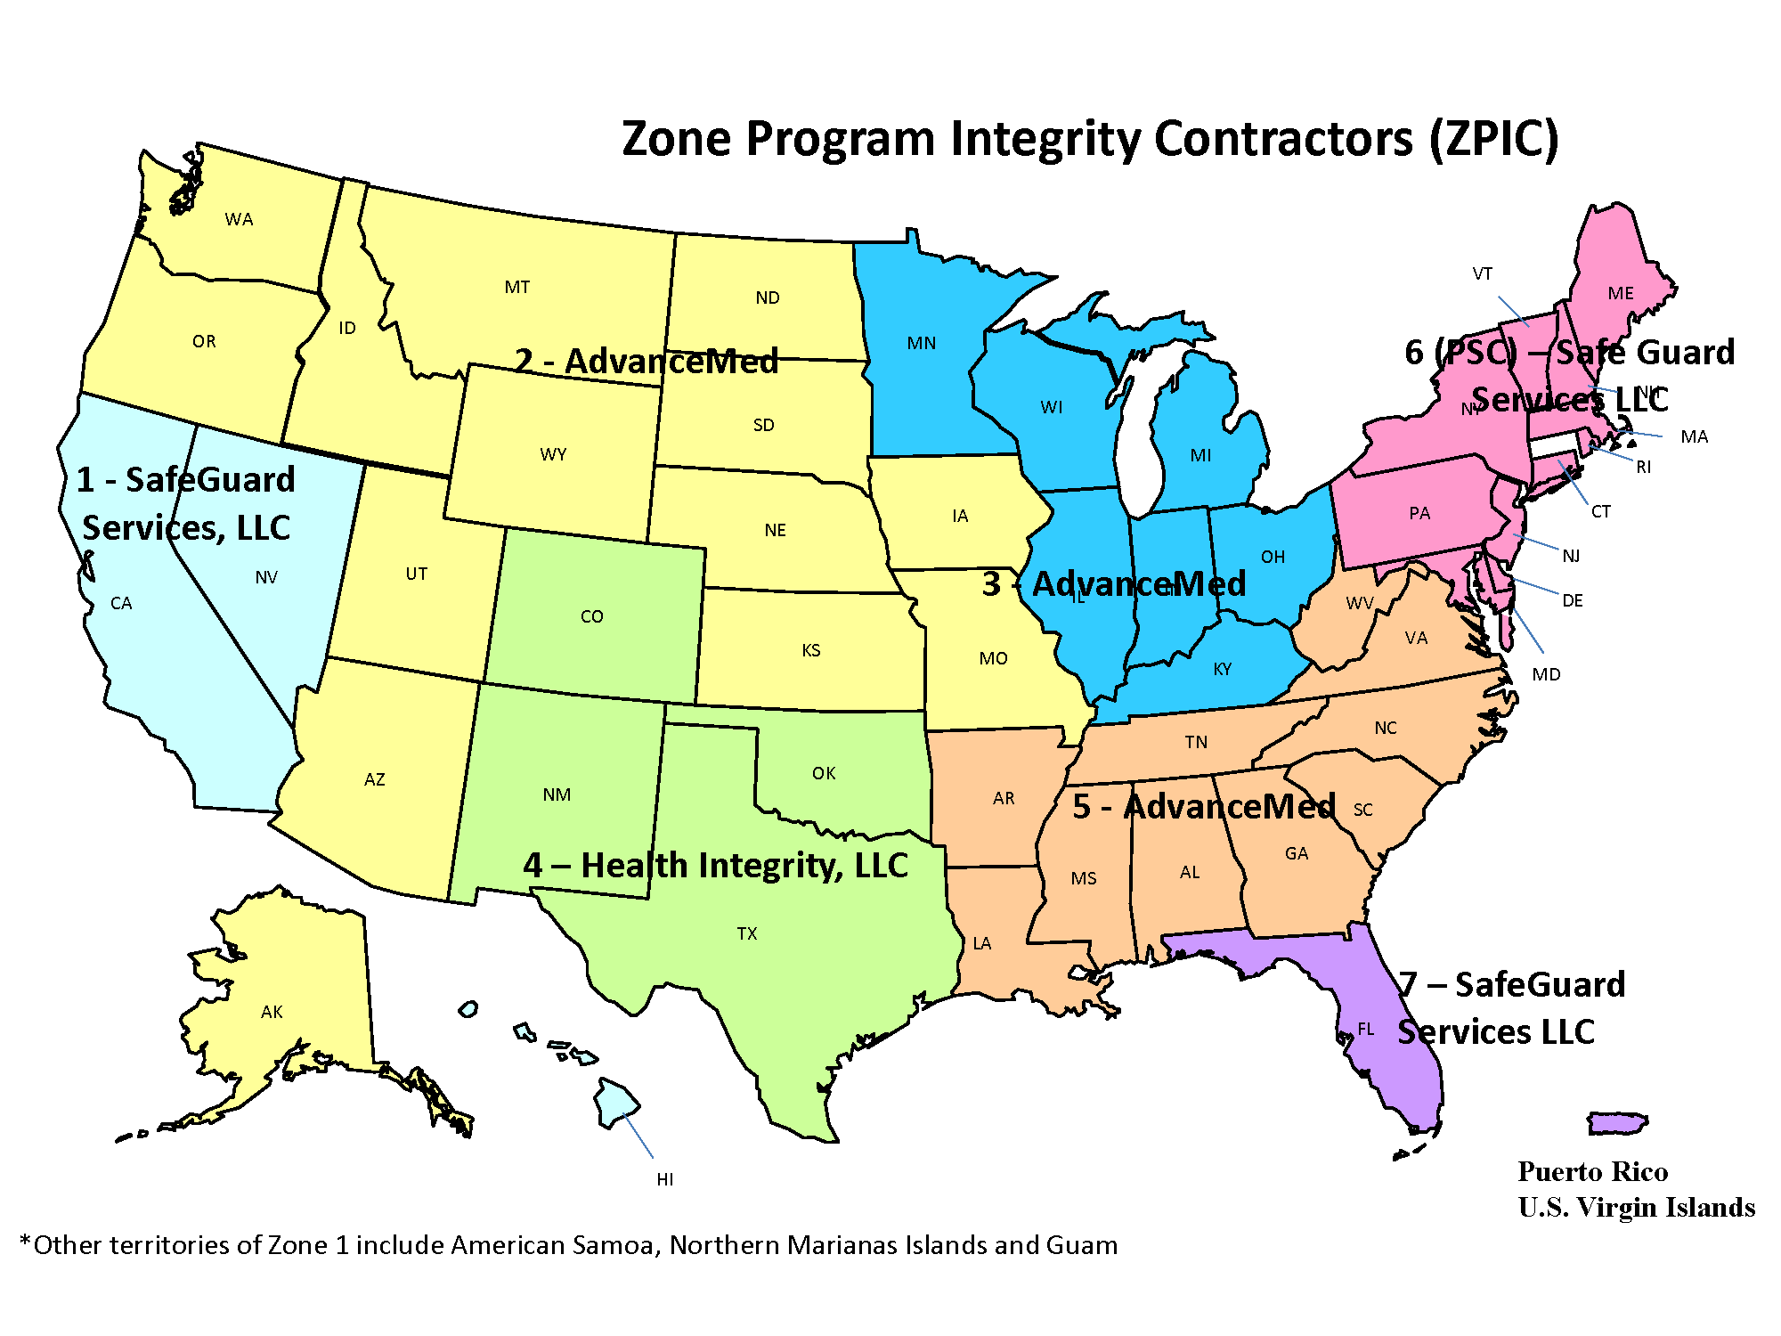
Zone Program Integrity Contractor (ZPIC) Map
Notes:
The Zone Program Integrity Contractor operates in 7 zones. They align with Medicare Administrative Contractor jurisdictions.
Zone 1 is covered by SafeGuard Services, LLC (SGS) and includes California, Hawaii, and Nevada
Zone 2 is covered by AdvanceMed and includes Alaska, Arizona, Idaho, Iowa, Kansas, Missouri, Montana, Nebraska, North Dakota, Oregon, South Dakota, Utah, Washington, and Wyoming.
Zone 3 is covered by AdvanceMed and includes Illinois, Indiana, Kentucky, Michigan, Minnesota, Ohio, and Wisconsin
Zone 4 is covered by Health Integrity and includes Colorado, Oklahoma, New Mexico, and Texas
Zone 5 is covered by AdvanceMed and includes Alabama, Arkansas, Georgia, Louisiana, Mississippi, North Carolina, South Carolina, Tennessee, Virginia, and West Virginia
Zone 6 is covered by SGS and TriCenturion, and includes Connecticut, Delaware, Maine, Maryland, Massachusetts, New Hampshire, New Jersey, New York, Pennsylvania, Rhode Island, Vermont, and the District of Columbia
Zone 7 is covered by SGS and includes Florida and Puerto Rico

Slide 23
Recovery Audit Program
Recovery Audit Program’s mission
  Reduce improper Medicare payments by
    Detecting and collecting overpayments
    Identifying underpayments
    Implementing actions to prevent future improper payments
  Ensure that each Medicare Advantage Plan and Prescription Drug Plan has an anti-fraud plan in effect
States and territories establish Medicaid Recovery Audit Contractors to
  Identify overpayments and underpayments
  Coordinate efforts with federal and state auditors
Notes:
The Recovery Audit Program’s mission is to reduce improper payments through the efficient detection and collection of overpayments, the identification of underpayments, and the implementation of actions that will prevent future improper payments.
The Recovery Audit Contractor (RAC) program was permanently implemented for Medicare Part A and Part B on a nationwide basis. Under the Patient Protection and Affordable Care Act, CMS is required to expand the RAC program to Medicare Part C and Part D. Medicare Part C and Part D RACs must ensure that each Medicare Advantage Plan under Part C and Prescription Drug Plan under Part D has an anti-fraud plan in effect, and review the effectiveness of each anti-fraud plan.
States and territories must establish Medicaid RAC programs and the programs must
Identify and recover overpayments and identify underpayments.
Coordinate their efforts with other auditing entities, including state and federal law enforcement agencies. CMS and states will work to minimize the likelihood of overlapping audits. As of March 26, 2014, all except 2 states reported Medicaid RAC data.
NOTE: For more information, visit the Medicaid “RACs At-a-Glance” webpage at Medicaid-rac.com/medicaid-rac-activity. For Medicare RAC information, visit aha.org/advocacy-issues/rac/contractors.

Slide 24

National Benefit Integrity Medicare Drug Integrity Contractor (NBI MEDIC)
Monitors fraud, waste, and abuse in the Part C and Part D programs in all 50 states, the District of Columbia, and U.S. Territories
Works with law enforcement and other stakeholders
Key responsibilities include
  Investigate potential fraud, waste, and abuse
  Receive complaints
  Resolve fraud complaints from people with Medicare
  Perform proactive data analyses
  Identify program vulnerabilities
  Refer potential fraud cases to law enforcement agencies
Notes:
The National Benefit Integrity (NBI) Medicare Drug Integrity Contractor (MEDIC) monitors and investigates fraud, waste, and abuse in the Part C and Part D plans in all 50 states, the District of Columbia, and U.S. Territories. NBI has investigators throughout the country who work with federal, state, and local law enforcement authorities and other stakeholders.
Health Integrity is the Medicare Part C and Part D program integrity contractor for CMS under NBI MEDIC. Their key responsibilities include the following:
Investigate potential fraud, waste, and abuse
Receive complaints
Resolve fraud complaints from people with Medicare
Perform proactive data analyses
Identify program vulnerabilities
Refer potential fraud cases to law enforcement agencies
NOTE: For more information, visit healthintegrity.org/contracts/nbi-medic.

Slide 25
Outreach & Education MEDIC
(O&E MEDIC)
Created the CMS O&E MEDIC website on behalf of the CMS Center for Program Integrity
  To help those committed to stopping Part C and Part D fraud, waste, and abuse, by providing
    Outreach and education materials
    Professional education
    Regulation and guidance
    Fraud-fighting resources
    General news
Notes:
Medicare Part C and Part D programs lose millions of dollars to fraud, waste, and abuse each year. The Centers for Medicare & Medicaid Services (CMS) Outreach & Education (O&E) Medical Drug Integrity Contractor (MEDIC) has created the CMS O&E MEDIC website to help those committed to stopping Medicare Part C and Part D fraud, waste, and abuse by providing industry-specific tools and resources. Visit medic-outreach.rainmakerssolutions.com/ for relevant
Outreach and education materials
Professional education
Regulation and guidance
Fraud-fighting resources
General news

Slide 26
Medicaid Integrity Contractors (MICs)
Support, not replace, state Medicaid program integrity efforts
Conduct post-payment audits of Medicaid providers
Identify overpayments, and refer to the state for collection of the overpayments
Don’t adjudicate appeals, but support state adjudication process
Three types of MICs: review, audit, and education
Notes:
Medicaid Integrity Contractors (MICs)
Support, not replace, state Medicaid program integrity efforts
Conduct post-payment audits of Medicaid providers
Identify overpayments, and refer to the state for collection of the overpayments
Don’t make an official decision about who’s right in appeals, but support state adjudication process
There are 3 types of MICs:
Review
Audit
Education
State Medical Assistance (Medicaid) Offices have their own program integrity unit in addition to Medicaid Recovery Audit Contractors, and sometimes states have additional program integrity contractors. The in-house program integrity staff members in states perform many of the same functions as Medicaid contractors, including data gathering and analysis, case development, investigations, and provider audits.
NOTE: For more information, visit CMS.gov/medicare-medicaid-coordination/fraud-prevention/medicaidintegrityprogram.

Slide 27
CMS Administrative Actions
When CMS suspects fraud, administrative actions include the following:
  Automatic denials of payment
  Payment suspensions
  Prepayment edits
  Civil monetary penalties
  Revocation of billing privileges
  Referral to law enforcement
  Post-payment reviews for determinations
Notes:
When fraud is detected, the appropriate administrative actions are imposed by CMS:
Automatic denials are a “don’t pay claim” status for items or services ordered or prescribed by an excluded provider.
Payment suspensions are a hold on paying claims until an investigation or request for information is completed.
Prepayment edits are coded system logic that either automatically pay all or part of a claim, automatically deny all or part of a claim, or suspend all or part of a claim so that a trained analyst can review the claim and associated documentation to make determinations about coverage and payment.
Civil monetary penalties are a punitive fine imposed by a civil court on an entity that has profited from illegal or unethical activity. They may be imposed to punish individuals or organizations for violating a variety of laws or regulations. Visit oig.hhs.gov/fraud/enforcement/cmp/ for more information.
Revocation of billing privileges occurs for noncompliance, misconduct, felonies, falsifying information, and other such conditions set forth in 42 CFR,§424.535. Payments are halted and providers are in limbo until the corrective action plan or request for reconsideration process is complete.
Referrals are made to law enforcement.
Conducts post-payment reviews to determine if there were overpayments.

Slide 28
Law Enforcement Actions
When law enforcement finds fraudulent activities, enforcement actions include
  Providers/companies are barred from the programs
  Providers/companies can’t bill Medicare, Medicaid, or Children’s Health Insurance Plan (CHIP)
  Providers/companies are fined
  Arrests and convictions occur
  Corporate Integrity Agreements may be negotiated
Notes:
When law enforcement finds fraudulent activities, enforcement actions include the following:
Providers/companies are barred from the program.
Providers/companies can’t bill Medicare, Medicaid, or Children’s Health Insurance Programs.
Providers/companies are fined.
Arrests and convictions occur.
Corporate Integrity Agreements may be negotiated between the U.S. Department of Health & Human Services, Office of Inspector General (OIG), and health care providers and other entities as part of the settlement of federal health care program investigations arising under a variety of civil false claims statutes. Providers or entities agree to the obligations, and in exchange, OIG agrees not to seek their exclusion from participation in Medicare, Medicaid, or other federal health care programs.

Slide 29
Health Care Fraud Prevention Partnership
Is designed to reduce health care fraud and includes the federal government, state officials, private health insurance organizations, and other health care anti-fraud groups
  Shares information and best practices
  Improves detection
  Prevents payment of fraudulent health care billings across public and private payers
  Enables the exchange of data and information among the partners
Notes:
The Health Care Fraud Prevention Partnership is designed to reduce health care fraud by partnering with the private sector and using data analysis techniques to sort through claims data. The voluntary partnership, which includes the federal government, state officials, private health insurance organizations, and other health care anti-fraud groups, is designed to accomplish the following:
Share information and best practices.
Improve detection.
Prevent payment of fraudulent health care billings across payers.
Enable the exchange of data and information among partners. The long-range goal of the partnership is to use sophisticated technology and analytics on industry-wide health care data to predict and detect health care fraud schemes (using techniques similar to credit card fraud analysis).

Slide 30
Health Care Fraud Prevention and Enforcement Action (HEAT) Team
Joint initiative between U.S. Department of Health & Human Services and U.S. Department of Justice
Improve interagency collaboration on reducing and preventing fraud in federal health care programs
Increase coordination, data sharing, and training among investigators, agents, prosecutors, analysts, and policymakers
Notes:
The Health Care Fraud Prevention and Enforcement Action Team (HEAT) is a joint initiative between the U.S. Department of Health & Human Services (HHS) and the U.S. Department of Justice (DOJ) to combat fraud. HEAT task forces are interagency teams comprised of top-level law enforcement and professional staff members. The team builds on existing partnerships, including those with state and local law enforcement organizations, to prevent fraud and enforce anti-fraud laws. Their goal is to improve interagency collaboration on reducing and preventing fraud in federal health care programs. By deploying law enforcement and trained agency personnel, HHS and DOJ increase coordination, data sharing, and training among investigators, agents, prosecutors, analysts, and policymakers. Project HEAT has been highly successful in bringing forth health care fraud cases and prosecuting them quickly and effectively.
The mission of the HEAT team is to
Gather resources across the government to help prevent waste, fraud, and abuse in the Medicare and Medicaid programs, and crack down on the fraud perpetrators who are abusing the system and costing the system billions of dollars
Reduce skyrocketing health care costs and improve the quality of care by ridding the system of perpetrators who are preying on people with Medicare and Medicaid
Highlight best practices by providers and public sector employees who are dedicated to ending waste, fraud, and abuse in Medicare
Build upon existing partnerships between HHS and DOJ to reduce fraud and recover taxpayer dollars

Slide 31
Medicare Fraud Strike Force Teams
Multi-agency teams that
  Are located in fraud “hot spot” areas
  Use advanced data analysis to identify high-billing levels in health care fraud hot spots
  Coordinate national takedowns
CMS supports Strike Force takedowns
  Performs data analysis
  Suspends payment
Notes:
The joint U.S. Department of Health & Human Services/U.S. Department of Justice Medicare Fraud Strike Force is a multi-agency team of federal, state, and local investigators designed to fight Medicare fraud.
Medicare Fraud Strike Force team locations are evidence of the geographic dispersion of Medicare fraud, with current operations in the identified fraud hot spots of Baton Rouge, Brooklyn, Chicago, Dallas, Detroit, Houston, Los Angeles, Miami-Dade, and Tampa Bay
Strike Force teams use advanced data analysis techniques to identify high-billing levels in health care fraud hot spots
Interagency teams can target emerging or migrating schemes along with chronic fraud by criminals masquerading as health care providers or suppliers
CMS is working collaboratively with federal and state law enforcement partners to increase the recovery of improper payments and fraud by providing data and other support during Health Care Fraud Prevention and Enforcement Action investigations and prosecutions, and suspending payments for providers subject to credible allegations of fraud. For Strike Force news and activities, visit oig.hhs.gov/fraud/strike-force, and stopmedicarefraud.gov/aboutfraud/heattaskforce/index.html.

Slide 32
Provider and Beneficiary Education
Provider education helps correct vulnerabilities
  Maintain proper documentation
  Reduce inappropriate claims submission
  Protect patient and provider identity information
  Establish a broader culture of compliance
Beneficiary education helps identify and report suspected fraud
Notes:
CMS is working to shift the focus to the prevention of improper payments and fraud while continuing to be vigilant in detecting and pursuing problems when they occur. Educating providers and beneficiaries applies to both the Medicare and Medicaid programs.
Provider education helps correct vulnerabilities so that they
Maintain proper documentation
Reduce inappropriate claims submissions by educating providers on common billing mistakes
Protect patient and provider identity information
Establish a broader culture of compliance
Beneficiary education helps them join in the fight against fraud by learning to identify and report suspected fraud. For a copy of the “Program Integrity: Beneficiary Card Sharing Toolkit,” visit CMS.gov/medicare-medicaid-coordination/fraud-prevention/medicaid-integrity-education/beneficiary-education-toolkits/beneficiary-toolkit.html.
“Protecting Yourself & Medicare from Fraud” is a free publication to help people with Medicare get information on how to detect and protect against fraud and identity theft. To read or download this pub, visit Medicare.gov/Publications/PubID_10111.

Slide 33
Check Your Knowledge―Question 3
Which of the following provides authority for new rules, provider screening requirements, and other proactive initiatives to prevent and detect fraud, waste, and abuse?
a. Center for Program Integrity
b. The Affordable Care Act
c. Medicaid Integrity Contractor
d. Recovery Audit Program
Notes:
Check Your Knowledge—Question 3
Which of the following provides authority for new rules, provider screening requirements, and other proactive initiatives to prevent and detect fraud, waste, and abuse?
Center for Program Integrity
The Affordable Care Act
Medicaid Program Integrity Contractor
Recovery Audit Program
ANSWER: b. The Affordable Care Act
Rules permitted by the Affordable Care Act have helped Medicare, Medicaid, and the Children’s Health Insurance Program (CHIP) move beyond the “pay and chase” approach to health care fraud to a more proactive and transparent approach.

Slide 34
Lesson 3—How You Can Fight Fraud
“4Rs” for Fighting Medicare Fraud
Medicare.gov/fraud
Medicare Summary Notices
MyMedicare.gov
1-800-MEDICARE
Senior Medicare Patrol
Protecting Personal Information and ID Theft
Reporting Medicaid Fraud
Helpful Resources
Fraud Prevention Toolkit
Notes:
In Lesson 3, we will learn about how people with Medicare and Medicaid can fight fraud:
Review “4Rs” for Fighting Medicare Fraud
Learn about the resources available at Medicare.gov/fraud
Review Medicare Summary Notices
Highlight the advantages of using MyMedicare.gov
Learn how to report fraud and abuse by using 1-800-MEDICARE
Review the Senior Medicare Patrol program
Learn helpful tips that people with Medicare and Medicaid can use to protect their personal information and how to handle ID theft
Discuss reporting Medicaid fraud
Helpful resources
Fraud Prevention Toolkit

Slide 35
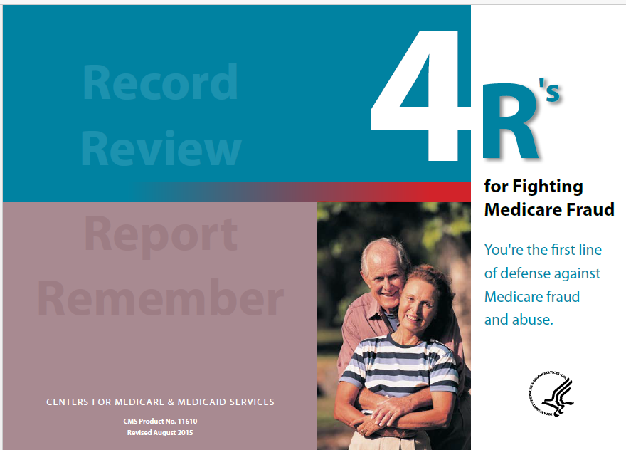
“4Rs” for Fighting Medicare Fraud
Here are some ways you can protect yourself from fraud
  Record appointments and services
  Review services provided
    Compare services actually received with services on your Medicare Summary Notice
  Report suspected fraud
  Remember to protect personal information, such as your Medicare card and bank account numbers
Notes:
Record the dates of doctor’s appointments on a calendar. Note the tests and services you get, and save the receipts and statements from your providers. If you need help, ask a friend or family member. Contact your local Senior Medicare Patrol (SMP) program to get a free “Personal Health Care Journal.” To locate the SMP program in your area, use the SMP locator at smpresource.org, or call 1-877-808-2468.
Review for signs of fraud, including claims you don’t recognize on your Medicare Summary Notices (MSNs), and advertisements or phone calls from companies offering free items or services to people with Medicare. Compare the dates and services on your calendar with your MSNs to make sure you got each service listed and that all the details are correct. If you find items listed in your claims that you don’t have a record of, it’s possible that you or Medicare may have been billed for services or items you didn’t get. Visit MyMedicare.gov, or call 1-800-MEDICARE (1-800-633-4227) to review your Medicare claims. TTY users should call 1-877-486-2048. If you’re in a Medicare Advantage Plan (like a Health Maintenance Organization or Preferred Provider Organization) or Medicare Prescription Drug Plan, call your plan for more information about a claim. You can get help from your local SMP program with checking your MSNs for errors or suspected fraud.
Report suspected Medicare fraud by calling 1-800-MEDICARE (1-800-633-4227). TTY users should call 1-877-486-2048. When using the automated phone system, have your Medicare card with you and clearly speak or enter your Medicare number and letter(s). If you identify errors or suspect fraud, the SMP can also help you make a report to Medicare.
Remember to protect your Medicare number. Don’t give it out, except to your doctor or other health care provider. Never give your Medicare number in exchange for a special offer. Medicare will never contact you and ask for personal information, like your Medicare or bank account numbers. Never let someone use your Medicare card, and never use another person’s card.
The “4Rs for Fighting Fraud,” (CMS Product No. 11610), is available at Medicare.gov/Pubs/pdf/11610.pdf.

Slide 36
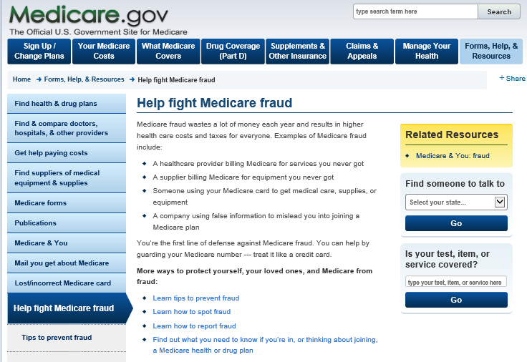
Medicare.gov/fraud
Tips to prevent fraud
Learn how to spot fraud
Learn how to report fraud
Find out what you need to know if you’re in, or thinking about joining, a Medicare health or drug plan
Notes:
You’re the first line of defense against Medicare fraud. Medicare.gov/fraud is a good place for you to learn about resources available to protect yourself, your loved ones, and Medicare. You’ll learn
Tips to prevent fraud
How to spot fraud
How to report fraud
What you need to know if you’re in, or thinking about joining, a Medicare health or drug plan

Slide 37
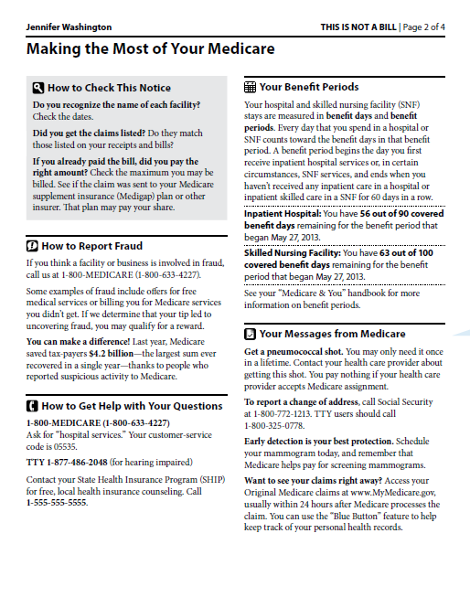
Medicare Summary Notice (MSN)
CMS redesigned the MSN for Part A and Part B to make it easier to read and spot fraud
Shows all your services or supplies
  Billed to Medicare in a 3-month period
  What Medicare paid
  What you owe
Read it carefully
Notes:
There’s a Part A, a Part B, and a durable medical equipment (DME) Medicare Summary Notice (MSN). The MSN shows all services and supplies that were billed to Medicare, what Medicare paid, and what you owe each provider. You should review your MSN carefully to ensure that you got the services and supplies for which Medicare was billed.
CMS redesigned the MSN to make it simpler for people with Medicare to understand, spot, and report fraud (on page 2).
For more information or to view samples of the Part A, Part B, and/or DME MSNs, visit Medicare.gov/forms-help-and-resources/mail-about-medicare/medicare-summary-notice-msn.html.
Visit Medicare.gov/pubs/pdf/summarynoticea.pdf to see how to read your Part A MSN.
Visit Medicare.gov/pubs/pdf/summarynoticeb.pdf to see how to read your Part B MSN.
Visit Medicare.gov/pubs/pdf/SummaryNoticeDME.pdf to see how to read your DME MSN.
NOTE: Medicare Advantage Plans provide an Explanation of Benefits that provides similar information.

Slide 38
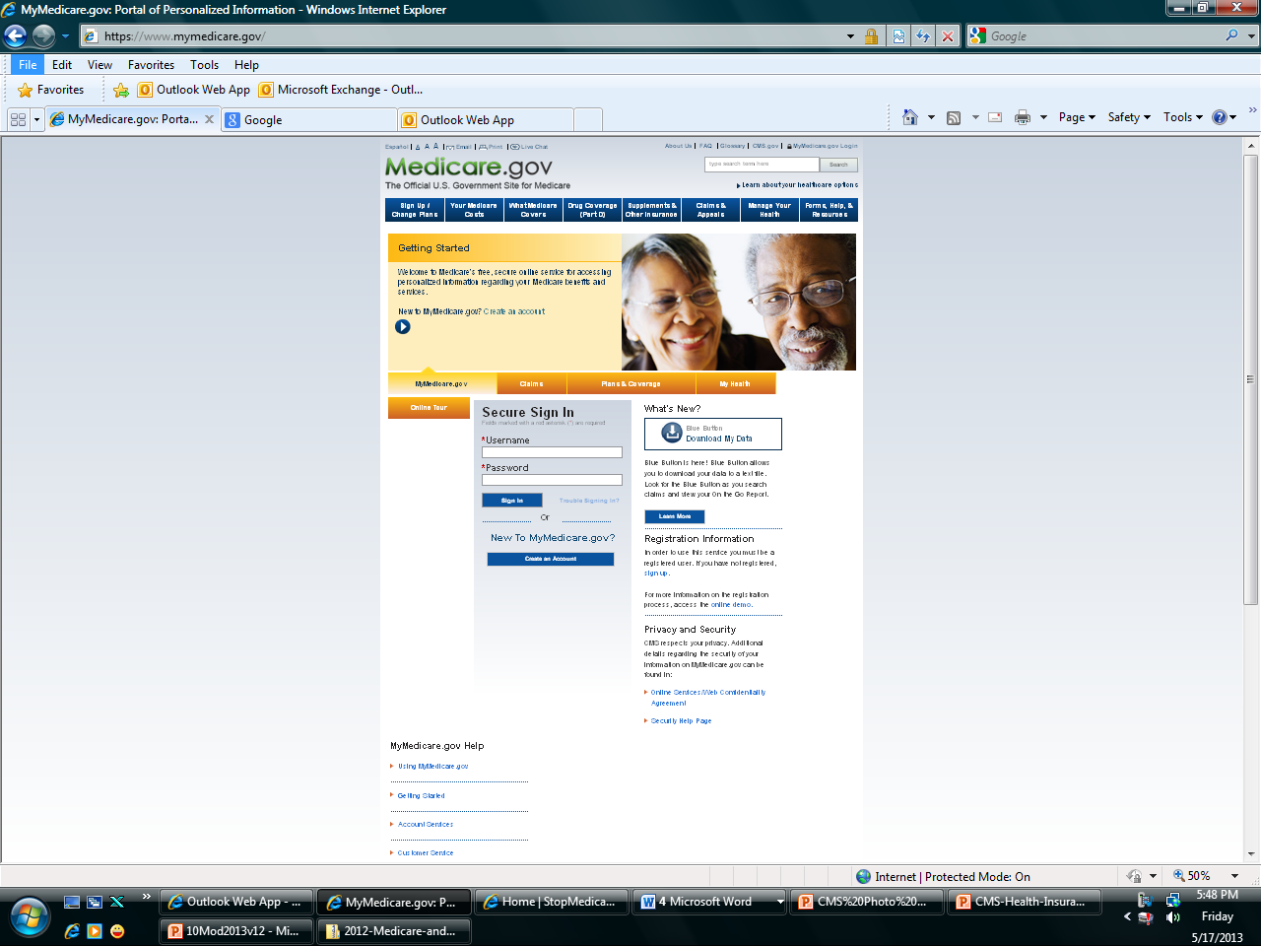
MyMedicare.gov
Secure site to manage personal information
You register to
  Review eligibility, entitlement, and plan information
  Track preventive services
  Keep a prescription drug list
Review claims for Medicare Part A and Part B
  Available almost immediately after they are processed
Select the “Blue Button” to download your data to a text file
Notes:
MyMedicare.gov is Medicare’s free, secure online service for accessing personalized information regarding Medicare benefits and services. MyMedicare.gov provides you with access to your personalized information at any time.
View eligibility, entitlement, and preventive service information.
Check personal Medicare information, including Medicare claims, as soon as they’re processed.
Check your health and prescription drug enrollment information as well as any applicable Part B deductible information.
Manage your prescription drug list and personal health information.
Review claims for Medicare Part A and Part B and identify fraudulent claims. You don’t have to wait to get your Medicare Summary Notice (MSN) in the mail to view your Medicare claims. Visit MyMedicare.gov to track your Medicare claims or view electronic MSNs. Your claims will generally be available within 24 hours after processing.
If there’s a discrepancy, you should call your doctor or supplier. Call 1-800-MEDICARE if you suspect fraud. TTY users should call 1-877-486-2048.
NOTE: To use this service you must register on the site. Newly eligible beneficiaries are automatically registered and sent a personal identification number.

Slide 39
1-800-MEDICARE (TTY 1-877-486-2048)
Beneficiary fraud complaints received
  Help target certain providers/suppliers for review
  Show where fraud scams are heating up
Using the Interactive Voice Response System
  Access up to 15 months of claims
  Check for proper dates, services, and supplies received
    If not checking claims on MyMedicare.gov
Notes:
People with Medicare can call 1-800-MEDICARE (1-800-633-4227) to make a complaint and report fraud. TTY users should call 1-877-486-2048.
The Call Center has an Interactive Voice Response (IVR) system available for people who haven’t registered or don’t use MyMedicare.gov. The IVR can access 15 months of Original Medicare claims processed on their behalf, if it’s available. The data gathered helps CMS
Target providers or suppliers with multiple consumer complaints for further review.
Track fraud complaints to show when fraud scams are heating up in new areas. Using existing data in this innovative way enables CMS to target providers and suppliers with multiple consumer complaints for further investigation.
Before you report errors, fraud, or abuse, carefully review the facts and have the following information ready:
The provider’s name and any identifying number you may have
Information on the service or item you’re questioning
The date the service or item was supposedly given or delivered
The payment amount approved and paid by Medicare
The date on your Medicare Summary Notice
Your name and Medicare number (as listed on your Medicare card)

Slide 40
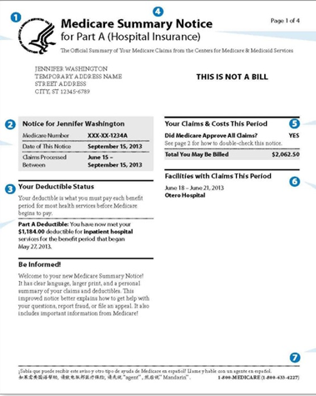
Learning Activity
John has concerns and wants to discuss his Medicare Summary Notice with you.
What are some things that might indicate fraud?
Notes:
Learning Activity
John has concerns and wants to discuss his Medicare Summary Notice with you. What are some things that might indicate fraud? (Discussion is on the next slide.)

Slide 41
Learning Activity:
What Might Indicate Fraud?
Was he charged for any medical services he didn’t get?
Do the dates of services look unfamiliar?
Was he billed for the same thing twice?
Does his credit report show any unpaid bills for medical services or equipment you didn’t receive?
Has he received any collection notices for medical services or equipment he didn’t receive?
Notes:
Medicare Summary Notice–Activity–What questions should you ask?
Was he charged for any medical services he didn’t get?
Do the dates of services look unfamiliar?
Was he billed for the same thing twice?
Does his credit report show any unpaid bills for medical services or equipment he didn’t receive?
Has he received any collection notices for medical services or equipment he didn’t receive?

Slide 42
Fighting Fraud Can Pay
You may get a reward if you meet all of these conditions:
  You call either 1-800-HHS-TIPS (1-800-447-8477) or call 1-800-MEDICARE (1-800-633-4227) to report suspected fraud. TTY users should call 1-877-486-2048.
  The suspected Medicare fraud you report must be investigated and validated by Medicare contractors.
  The reported fraud must be formally referred to the Office of Inspector General for further investigation.
  You aren’t an excluded individual.
  The person or organization you’re reporting isn’t already under investigation by law enforcement.
  Your report leads directly to the recovery of at least $100 of Medicare money.
Notes:
You may get a reward of up to $1,000 if you meet all of these conditions:
You call either 1-800-HHS-TIPS (1-800-447-8477), or call 1-800-MEDICARE (1-800-633-4227) to report suspected fraud. TTY users should call 1-877-486-2048.
The suspected Medicare fraud you report must be proven as potential fraud by the Zone Program Integrity Contractor (the Medicare contractors responsible for investigating potential fraud and abuse), and formally referred as part of a case by one of the contractors to the Office of Inspector General for further investigation.
You aren’t an “excluded individual.” For example, you didn’t participate in the fraud offense being reported. Or, there isn’t another reward that you qualify for under another government program.
The person or organization you’re reporting isn‘t already under investigation by law enforcement.
Your report leads directly to the recovery of at least $100 of Medicare money.
For more information, call 1-800-MEDICARE (1-800-633-4227). TTY users should call 1-877-486-2048.
To read the press release, visit HHS.gov/news/press/2013pres/04/20130424a.html and the Code of Federal Regulations at CFR 420.405 ”Rewards for information relating to Medicare fraud and abuse.”

Slide 43

The Senior Medicare Patrol (SMP)
Education and prevention program aimed at educating people with Medicare on preventing, identifying, and reporting health care fraud
Active programs in all states, the District of Columbia, Puerto Rico, Guam, and U.S. Virgin Islands
Seeks volunteers to represent their communities
Nationwide toll-free number: 1-877-808-2468
For more information visit smpresource.org
Notes:
The Senior Medicare Patrols (SMPs) empower and assist people with Medicare, their families, and caregivers to prevent, detect, and report health care fraud, errors, and abuse through outreach, counseling, and education. SMPs are grant-funded projects of the U.S. Department of Health & Human Services, U.S. Administration for Community Living. Their work is in 3 main areas:
Conduct Outreach and Education. SMPs give presentations to groups, exhibit at events, and work one-on-one with people with Medicare. Since 1997, more than 30 million people have been reached during community education events, more than 6.5 million people with Medicare have been educated and served, and more than 46,000 volunteers have been active.
Engage Volunteers. Protecting older persons’ health, finances, and medical identity while saving precious Medicare dollars is a cause that attracts civic-minded Americans. In 2014, 53 SMP programs engaged over 5,249 volunteers nationally.
Receive Beneficiary Complaints. When people with Medicare, caregivers, and family members bring their complaints to the SMP, the SMP makes a determination about whether or not fraud, errors, or abuse is suspected. When fraud or abuse is suspected, they make referrals to the appropriate state and federal agencies for further investigation.
There are SMP programs in each state, the District of Columbia, Puerto Rico, Guam, and the U.S. Virgin Islands. SMPs seek volunteers to represent the program in their communities.
NOTE: For an in-depth overview of the SMP program, and for information for your local area, visit smpresource.org, or call the nationwide toll-free number at 1-877-808-2468. Callers receive information about the SMP program and are connected to the SMP in their state for individualized assistance. This number can also be found in the “Medicare & You” handbook and other national Medicare and anti-fraud publications that reference the SMP program. You can also email them at info@smpresource.org.

Slide 44
Protecting Personal Information
Only share with people you trust
  Doctors, other health care providers, and plans approved by Medicare
  Insurers who pay benefits on your behalf
  Trusted people in the community who work with Medicare, like your State Health Insurance Assistance Program (SHIP) or Social Security
Call 1-800-MEDICARE (1‑800‑633‑4227) if you aren’t sure if a provider is approved by Medicare
  TTY users should call 1‑877‑486‑2048
Notes:
Keep your personal information safe, such as your Medicare, Social Security, and credit card numbers. Only share this information with people you trust, such as
Your doctors, other health care providers, and plans approved by Medicare
Insurers who pay benefits on your behalf
Trusted people in the community who work with Medicare, like your State Health Insurance Assistance Program (SHIP) or Social Security
Call 1-800-MEDICARE (1‑800‑633‑4227) if you aren’t sure if a provider is approved by Medicare. TTY users should call 1‑877‑486‑2048.

Slide 45
Identity Theft
Identity theft is a serious crime
  Someone else uses your personal information, like your Social Security or Medicare number
    If you think someone is using your information
  Call your local police department
  Call the Federal Trade Commission’s ID Theft Hotline at 1-877-438-4338. TTY users should call 1-866-653-4261.
    If your Medicare card is lost or stolen, report it right away
  Call Social Security at 1-800-772-1213
  TTY users should call 1-800-325-0778
Notes:
Identity theft is when someone else uses your personal information, like your Social Security or Medicare number. It’s a serious crime. Currently, CMS is aware of 5,000 compromised Medicare provider numbers (Parts A/B/D) and 284,000 compromised beneficiary numbers.
If you think someone is using your information, you have options:
Call your local police department.
Call the Federal Trade Commission’s ID Theft Hotline at 1-877-438-4338. TTY users should call 1-866-653-4261.
If your Medicare card is lost or stolen, report it right away:
Call Social Security at 1-800-772-1213.
TTY users should call 1-800-325-0778.
For more information about identity theft or to file a complaint online, visit ftc.gov/idtheft.
You can also visit You can also visit stopmedicarefraud.gov/toolkit/documents/fightback_brochure_rev.pdf to view “Medical Identity Theft & Medicare Fraud.” to view “Medical Identity Theft & Medicare Fraud.”

Slide 46
Reporting Suspected Medicaid Fraud
Medicaid Fraud Control Unit (MFCU) investigates and prosecutes
  Medicaid fraud
  Patient abuse and neglect in health care facilities
  Call the Office of the Inspector General at 1-800-447-8477 (TTY 1-800-377-4950)
    They also certify and annually re-certify the MFCU
State Medical Assistance (Medicaid) office
  See state listing for Medicaid
    Download contacts at CMS.gov/Medicare-Medicaid-Coordination/Fraud-Prevention/FraudAbuseforConsumers/Downloads/smafraudcontacts-oct2014.pdf
Notes:
There are organizations to which you may report suspected Medicaid errors, fraud, or abuse:
Medicaid Fraud Control Units (MFCUs) investigate and prosecute Medicaid fraud as well as patient abuse and neglect in health care facilities. You may direct complaints of suspected Medicaid fraud directly to an MFCU. Download contacts at oig.hhs.gov/fraud/medicaid-fraud-control-units-mfcu/files/contact-directors.pdf.
The Office of Inspector General (OIG) certifies and annually re-certifies each MFCU. You can contact the U.S. Department of Health & Human Services OIG.
Online: Report Fraud Online (forms.oig.hhs.gov/hotlineoperations/)
By mail: HHS Tips Hotline, P.O. Box 23489, Washington, DC 20026-3489
Call: 1-800-447-8477. TTY users should call 1-800-377-4950.
You can also report suspected fraud and abuse to your State Medical Assistance (Medicaid) office. You may locate them at CMS.gov/Medicare-Medicaid-Coordination/Fraud-Prevention/FraudAbuseforConsumers/Downloads/smafraudcontacts-oct2014.pdf.
Learn more about Medicaid fraud at Medicaid.gov/medicaid-chip-program-information/by-topics/program-integrity/program-integrity.html.

Slide 47
Key Points to Remember
The key difference between fraud and abuse is intention
Improper payments are often mistakes
CMS fights fraud and abuse with support from Program Integrity Contractors
You can fight fraud and abuse with the 4Rs: Record, Review, Report, Remember
There are many sources of additional information
Notes:
Key points to remember include the following:
The difference between fraud and abuse is intention
While there are many causes of improper payments, many are honest mistakes
The Centers for Medicare & Medicaid Services (CMS) fights fraud and abuse with support from Program Integrity Contractors and partnerships with organizations such as Senor Medicare Patrols and the private industry
You can fight fraud and abuse with the 4Rs: record, review, report, and remember
There are many sources of additional information

Slide 48
Resources
Resources | Resources | Medicare Products
Centers for Medicare & Medicaid Services (CMS) 1-800-MEDICARE (1-800-633-4227) TTY users should call 1-877-486-2048 Medicare.gov MyMedicare.gov - MyMedicare.gov/ Medicare.gov/fraud Social Security 1‑800‑772‑1213 TTY users should call 1‑800‑325‑0778 ssa.gov Senior Medicare Patrol Program smpresource.org National Health Care Anti-Fraud Association NHCAA.org | NBI Medic’s Parts C&D Fraud Reporting Group 1-877-7SAFERX (1-877-772‑3379) healthintegrity.org/contracts/nbi-medic/reporting-a-complaint NBI MEDIC at 1-877-7SafeRx (1-877-772-3379) CMS Outreach & Education MEDIC medic-outreach.rainmakerssolutions.com/ 2015 HCFAC Report OIG.hhs.gov/publications/docs/hcfac/FY2015-hcfac.pdf Medicaid Beneficiary Education CMS.gov/Medicare-Medicaid-Coordination/Fraud-Prevention/Medicaid-Integrity-Education/edmic-landing.html Prevention Toolkit CMS.gov/outreach-and-education/outreach/partnerships/fraudpreventiontoolkit CMS Program Integrity CMS.gov/ About-CMS/Components/CPI/Center-for-program-integrity.html Fraud Hotline 1-800-HHS-TIPS (1-800-447-8477) TTY 1-800-337-4950 Fax 1-800-223-8162 | “Medicare Authorization to Disclose Personal Information” form CMS Product No. 10106 “Help Prevent Fraud: Check Your Medicare Claims Early!” CMS Product No. 11491 and No. 11492 “Protecting Yourself & Medicare From Fraud” CMS Product No. 10111 “Quick Facts About Medicare Plans and Protecting Your Personal Information” CMS Product No. 11147 “4Rs for Fighting Fraud” CMS Product No. 11610 “You Can Help Protect Yourself and Medicare From Fraud Committed by Dishonest Suppliers” CMS Product No. 11442 To access these products View and order single copies at Medicare.gov/Publications/Search. Order multiple copies (partners only) at productordering.cms.hhs.gov. (You must register your organization.)
Medicare and Medicaid Fraud and Abuse Prevention
48

Slide 49
Fraud Prevention Toolkit
Visit CMS.gov to access the Fraud Prevention Toolkit, which includes
  The 4Rs brochure
    Record, Review, Report, and Remember
  Fact sheets on preventing and detecting fraud
  Frequently Asked Questions
CMS.gov also has information about the Center for Program Integrity and fraud prevention efforts in Original Medicare (fee-for-service), Part C and Part D, and Medicaid
Notes:
The Centers for Medicare & Medicaid Services (CMS) provides a fraud prevention toolkit located on CMS.gov that includes
The 4Rs brochure—(Record, Review, Report, and Remember)
Fact sheets on preventing and detecting fraud
Frequently Asked Questions
CMS.gov also has information about the Center for Program Integrity and fraud prevention efforts in Original Medicare (fee-for-service), Part C and Part D, and Medicaid.
NOTE: For more information on the fraud prevention toolkit, visit CMS.gov/outreach-and-education/outreach/partnerships/fraudpreventiontoolkit.
For the latest news and information from the Center for Program Integrity, visit CMS.gov/about-cms/components/cpi/center-for-program-integrity.html.

Slide 50
This Training Provided by the
CMS National Training Program (NTP)
For questions about training products, email training@cms.hhs.gov.
To view all available NTP training materials,
or to subscribe to our email list, visit
CMS.gov/outreach-and-education/training/CMSNationalTrainingProgram.
Notes:
This training is provided by the Center for Medicare and Medicaid National Training Program (NTP).
For questions about training products, email training@cms.hhs.gov.
To view all available NTP materials, or to subscribe to our email list, visit CMS.gov/outreach-and-education/training/CMSNationalTrainingProgram.

