Slide 1
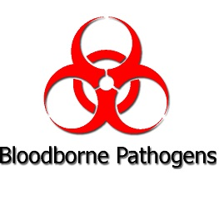

Bloodborne Pathogens
Bloodborne Pathogens Standard (29 CFR 1910.1030)
Minnesota Urology

Slide 2
Objectives:
Define Bloodborne Pathogens Standard (29 CFR 1910.1030)
Define bloodborne pathogens
Identify workers who are at risk of exposure to bloodborne pathogens
Identify key aspects of a Bloodborne Pathogen Exposure Control Plan
Describe methods for controlling exposure to bloodborne pathogens
Describe steps to take when exposed to a bloodborne pathogen

Slide 3
Bloodborne Pathogens Standard employer requirements:
Establish an exposure control plan & update it annually
Make post-exposure evaluation and follow-up available to any employee who has an exposure incident.
Implement the use of universal precautions.
Identify and use engineering controls.
Use labels and signs to communicate hazards.
Provide personal protective equipment (PPE).
Make hepatitis B vaccinations available to all employees at risk of occupational exposure.
Provide information and training to employees.
Maintain employee medical and training records

Slide 4
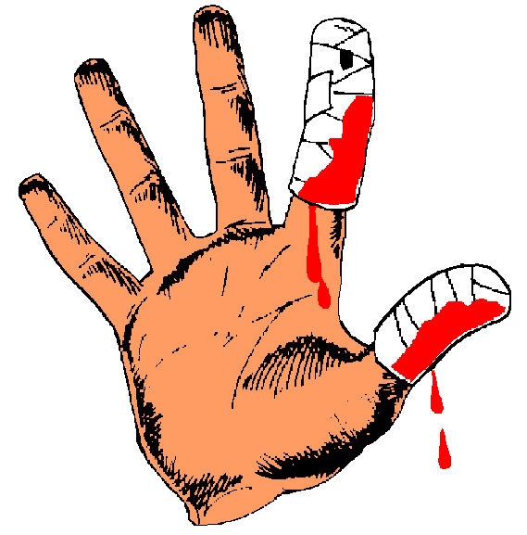

Bloodborne Pathogens (BBP)
BBPs are specific microorganisms transmitted in human blood or bodily fluids, which can cause disease.
There are three major BBPs:
  Hepatitis B (HBV)
    causes inflammation of the liver that might lead to liver failure
    preventable by vaccine
  Hepatitis C (HCV)
    causes inflammation of the liver,
    no vaccine to prevent infection
  Human Immunodeficiency Virus (HIV)
    HIV is a human retrovirus that causes AIDS (Acquired Immune Deficiency Syndrome).
    no vaccine to prevent infection

Slide 5
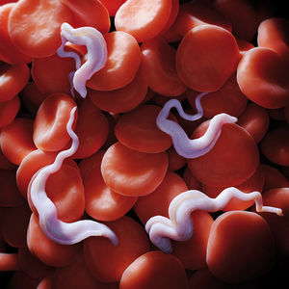
Other Potentially Infectious Materials:
  Bacteria, Fungi, Parasites
  Viruses, including oncogenic (cancer causing) viruses
  Recombinant DNA from infectious agents
  Cell or tissue cultures of human origin

Slide 6

A survey of DNA fragments circulating in the blood suggests the microbes living within us are vastly more diverse than previously known.
99 percent of that DNA has never been seen before.

Slide 7
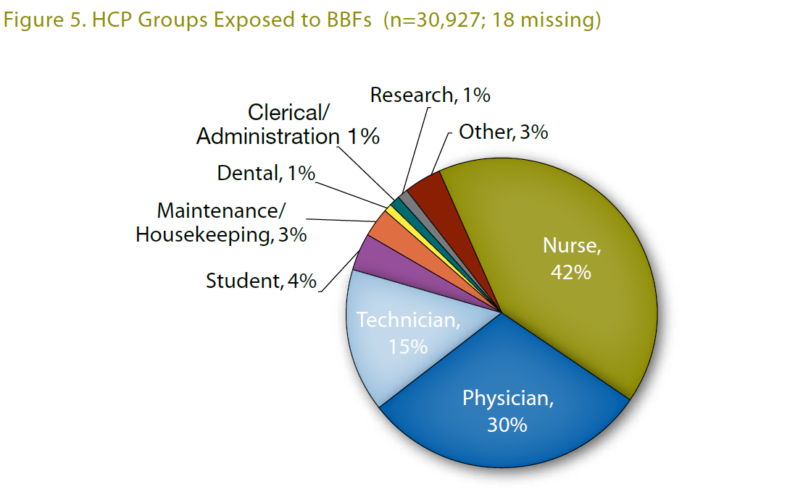

Who is at risk of exposure to bloodborne pathogens?
Workers in healthcare, including first responders, laboratory staff, housekeeping staff, nurses, MAs and other healthcare personnel, may be at risk.

Slide 8
Bloodborne Pathogen Exposure Control Plan
See section 3 of Metro Urology’s Safety Manual
Exposure Determination
Proper training of all employees
Ensures employee are offered Hepatitis B vaccination
Methods of Compliance
Notes:
MNU Annual determination

Slide 9


Minnesota Urology must ensure that all employees at risk of occupational exposure participate in a training program which must be provided to the employee during working hours.

Slide 10
Training shall be provided:
  At hire;
  Annually within one year of their previous training;
  When job tasks or procedures are changed or when those changes affect the employee's occupational exposure.

Slide 11
Universal (Standard) Precautions
“Precautions to protect against exposure must be taken when there is any potential for exposure to bodily fluids. It is assumed that all bodily fluids have the potential to transmit disease”
The Universal Precaution Rule:
Treat all human blood, bodily fluids and other potentially infectious materials
as if they are infectious.

Slide 12
Routes of exposure
Bloodborne Pathogens are transmitted through contact with human blood and bodily fluids. Transmission routes include:
  sharps exposures
  sexual activity
  sharing of needles
  mother-to-child exposures at birth
  pregnant women infected with HIV can pass it to their babies during pregnancy, delivery, and breast feeding.

Slide 13
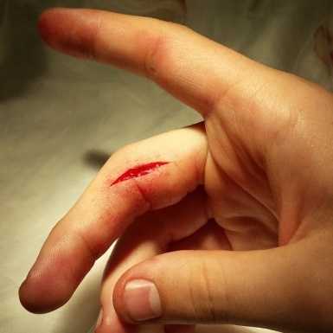
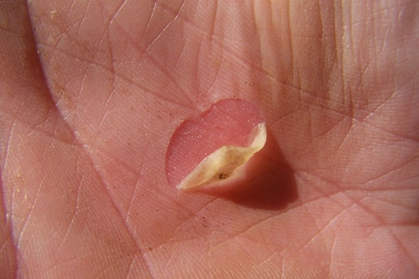
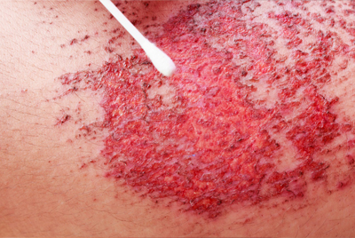
Routes of Exposure
Unbroken skin is a good barrier against BBPs, but infectious materials can enter through skin openings such as:
  Open sores
  Cuts
  Abrasions
  Acne
  Sunburn
  Blisters
BBPs may also be transmitted through mucous membranes:
  Nose
  Mouth
  Eyes

Slide 14
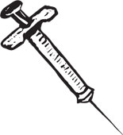
Needle stick injury
People who work with hypodermic syringes and other needle equipment are most at risk for needlestick injuries.
Injuries can occur when people use, disassemble, or dispose of needles.
If improperly disposed of, needles can become concealed in linen or garbage and injure other workers who encounter them unexpectedly.
Notes:
Needlestick injuries are wounds caused by needles that accidentally puncture the skin.
Needlestick injuries are a hazard for people who work with hypodermic syringes and other needle equipment. These injuries can occur at any time when people use, disassemble, or dispose of needles. When not disposed of properly, needles can become concealed in linen or garbage and injure other workers who encounter them unexpectedly.

Slide 15
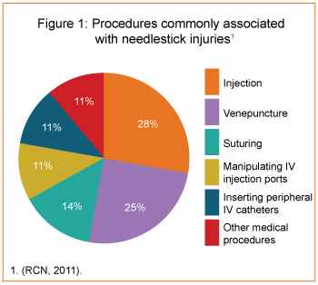
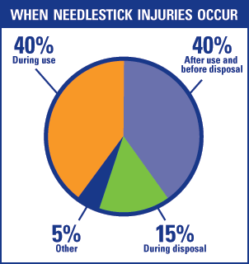

Slide 16
Exposure control plan (ECP)
The OSHA BBP Standard requires employers to have written documents explaining how they will implement the standard, provide training to employees, and eliminate or minimize employees’ occupational exposure to bloodborne pathogens.
The ECP must be tailored to the institution and plans must be accessible to all employees, either on-line or in an area where they are available for review on all shifts.

Slide 17
Exposure control plan (ECP)
The ECP includes:
  Determination of employee exposure risk
  Implementation of various methods of exposure control, including:
    Universal (Standard) precautions
    Engineering and work practice controls
    Personal Protective Equipment (PPE)
    Waste segregation, treatment and disposal, including sharps
    Hepatitis B vaccination
    Post-exposure evaluation and follow-up
    Communication of risks and training for employees
    Recordkeeping - training records, employee health records, exposure/incident records
    Procedures for evaluating circumstances surrounding exposure incidents

Slide 18
Exposure control plan (ECP) cont…
Administrative Controls including risk assessments, are steps taken by supervisors and individual employees, including:
    Conducting a risk assessment of materials in use
    Following vaccination and training schedules;
    Training employees on the risks of, and how to handle specific infectious materials;
    Promoting individual awareness of PPE and engineering controls to minimize or eliminate exposure risk

Slide 19
Exposure control plan (ECP) cont…
Sharps Precautions - Be careful when using needles, scalpels, glass pipettes and other sharp instruments or devices. When handling sharps:
    Do not recap, bend, break, or manipulate needles by hand;
    Do not remove used needles from disposable syringes;
    Place used sharps in labeled or color-coded puncture-resistant, leak-proof, closable, sharps containers;
    Do not overfill sharps containers;
    Consider the use of alternative, non-sharps equipment when possible.

Slide 20
Exposure control plan (ECP) cont…
Personal Protective Equipment (PPE) - Whenever you may be exposed to infectious materials you must wear the appropriate PPE. PPE places a barrier between you and infectious material.
    PPE should be readily accessible
    Always wear PPE in exposure situations, such as when splashing is possible
    Remove and replace PPE that is torn or punctured, or that loses its ability to function as a barrier to potentially infectious materials
    Remove PPE before leaving the work area
    Properly dispose of contaminated PPE in biohazard containers

Slide 21
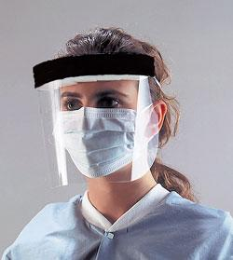
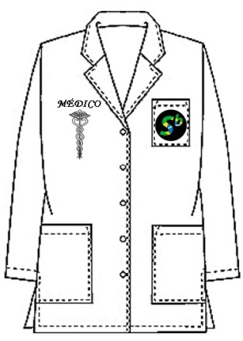
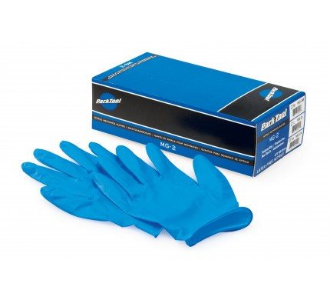

Exposure control plan (ECP) cont…
Types of Personal Protective Equipment (PPE):
  Gloves
  Protective clothing such as gowns, aprons, lab coats, clinic jackets, or similar outer garments
  Eye protection devices, such as masks, goggles or glasses with solid side shields, or chin-length face shields

Slide 22

Exposure control plan (ECP) cont…
Hand Hygiene - Most common mode of pathogen transmission is via hands!
  Employees must wash their hands with soap and water:
    immediately or as soon as possible after removal of gloves or other PPE.
    whenever they leave the work area, go on break, or before eating.
    following contact with blood or other potentially infectious materials.

Slide 23
Exposure control plan (ECP) cont…
Engineering Controls – physical methods to minimize or reduce risk exposure, such as leak-proof sample containers, biohazard waste bins or a bio-hood
  Containment - managing materials to reduce or eliminate potential exposures to employees, the general public and the outside environment.
    Primary containment consists of good microbiological techniques, appropriate vaccinations or immunizations, appropriate PPE and safety equipment.

Slide 24
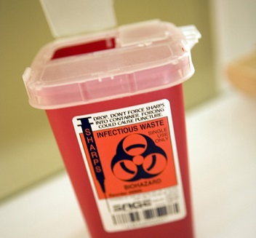
Exposure control plan (ECP) cont…
  Needlestick Prevention – options for minimizing or eliminating exposure risk
    Sharps disposal containers
    self-sheathing needles
    safer medical devices, such as sharps with engineered sharps injury protections
    needleless systems may be used to minimize exposure risk.

Slide 25
Accidents and Injuries
If you are exposed to blood or other potentially infectious or hazardous materials:
  If you experience a needlestick or sharps injury, immediately wash needlestick or cut with soap and water.
  Splashes to the nose, mouth, or skin should be flushed with water.
  Irrigate eyes using eyewash for 10 to 15 minutes.
  Report the incident to your supervisor.
  Immediately seek medical treatment

Slide 26
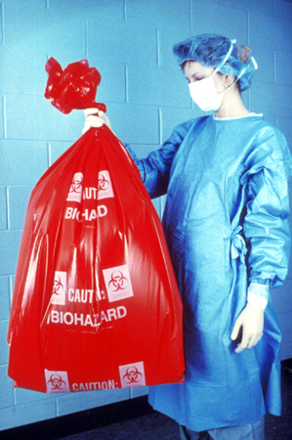
Controlling Exposures
Regulated waste disposal:
  Dispose of regulated waste in closable, leak-proof red or biohazard labeled bags or containers
  Dispose of contaminated sharps in puncture-resistant, leak-proof, closable sharps container
Source: OSHA DTE
Notes:
The Bloodborne Pathogens standard uses the term, "regulated waste," to refer to the following categories of waste which require special handling: (1) liquid or semi-liquid blood or OPIM; (2) items contaminated with blood or OPIM and which would release these substances in a liquid or semi-liquid state if compressed; (3) items that are caked with dried blood or OPIM and are capable of releasing these materials during handling; (4) contaminated sharps; and (5) pathological and microbiological wastes containing blood or OPIM.
It is the employer's responsibility to determine the existence of regulated waste. This determination is not based on actual volume of blood, but rather on the potential to release blood (e.g., when compacted in a waste container). If OSHA determines, on a case-by-case basis, that sufficient evidence of regulated waste exists, either through observation (e.g., a pool of liquid in the bottom of a container, dried blood flaking off during handling), or based on employee interviews, citations may be issued if the employer does not comply with the provisions of the standard on regulated waste.
Regulated waste shall be placed in containers which are:
Closable;
Constructed to contain all contents and prevent leakage of fluids during handling, storage, transport or shipping;
Labeled or color-coded in accordance with paragraph (g)(1)(i) of the standard; and
Closed before removal to prevent spillage or protrusion of contents during handling, storage, transport, or shipping.
If outside contamination of the regulated waste container occurs, it shall be placed in a second container. The second container shall be:
Closable;
Constructed to contain all contents and prevent leakage of fluids during handling, storage, transport, or shipping;
Labeled or color-coded in accordance with paragraph (g)(1)(i) of the standard; and
Closed before removal to prevent spillage or protrusion of contents during handling, storage, transport, or shipping.
Disposal of all regulated waste shall be in accordance with applicable regulations of the United States, States and Territories, and political subdivisions of States and Territories.

Slide 27
Hepatitis B Virus Infection
>200 million carriers worldwide
Established cause of chronic hepatitis and cirrhosis
Human carcinogen - cause of up to 80% of hepatocellular carcinomas
Can survive outside the body at least 7 days and still be capable of causing infection.

Slide 28
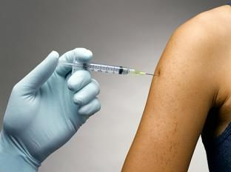
Controlling Exposures
Hepatitis B vaccination:
Offered to all employees at risk of exposure
Provided at no cost to employees (within 10 days to employees with occupational exposure)
Declination form
Source: OSHA DTE
Notes:
The hepatitis B vaccination series must be made available to all employees who have occupational exposure. The employer does not have to make the hepatitis B vaccination available to employees who have previously received the vaccination series, who are already immune as their antibody tests reveal, or for whom receiving the vaccine is contraindicated for medical reasons. The hepatitis B vaccination must be made available within 10 working days of initial assignment, after appropriate training has been completed. All medical evaluations and procedures, including the hepatitis B vaccine and vaccination series, are to be provided according to the current recommendations of the U.S. Public Health Service (USPHS).
If an employee declines the hepatitis B vaccination, the employer must ensure that the employee signs a hepatitis B vaccine declination. The declination form is found in Appendix A of the standard.
Employees have the right to refuse the hepatitis B vaccine and/or any post-exposure evaluation and follow-up. Note, however, that the employee needs to be properly informed of the benefits of the vaccination and post-exposure evaluation through training. The employee also has the right to decide to take the vaccination at a later date if he or she so chooses. The employer must make the vaccination available at that time.
The responsibility lies with the employer to make the hepatitis B vaccine and vaccination, including post-exposure evaluation and follow-up, available at no cost to the employees.

Slide 29
Summary
Treat all human blood, bodily fluids and other potentially infectious materials as if they are infectious
There are 3 major Blood-borne pathogens: Hepatitis B, Hepatitis C and HIV.
The most common mode of transmission of pathogens is the hands
Wear proper PPE in exposure situations

Slide 30
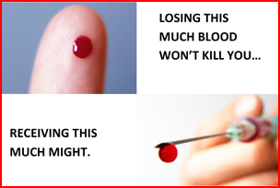
What Questions Do You Have?

Slide 31
