Slide 1
Good Documentation Practices
April 2018
Human Resources

Slide 2
Scenario
In reviewing weekly time cards, a supervisor (Sarah Stevens) identifies a continued pattern of tardiness with an employee (Joe Smith). Sarah had a conversation with Joe two weeks ago regarding the tardies. However, it appears the behavior is continuing with two more tardies this week.
What should the manager do next?
Seek to Understand

Slide 3
Seek to Undersand
During the seek to understand, Joe explained he got delayed in the Starbucks line twice after ordering his coffee before coming to work.
Sarah determines it’s time for the next step, a written warning.

Slide 4
Documentation
Good or Bad?
I talked to Joe today about this tardiness. He said he got stuck in line at Starbucks. This keeps happening. Joe is not very responsible. Joe needs to improve his behavior.
BAD – Why?

Slide 5
Documentation
Good or Bad?
4/5/2018 – Sarah Stevens, Supervisor and Joe Smith, Receptionist
I talked to Joe today in my office about his pattern of tardies that I’m seeing on his time card. I reminded him that we had a previous conversation on March 22nd, 2018 about him being late for work and that I had indicated, at that time, he needs to improve by getting to work and punching in on time. He said he remembered that conversation. I showed him that since then he’s had two more tardies on his time card; one on March 24th, and the other on April 3rd, 2018. I asked him what the reason was for each of those tardies. He said he got delayed in the Starbucks line both mornings and that’s what caused him to be late. I let him know I will be following up with him on next steps related to his tardiness.
Written by: Sarah Stevens, Supervisor
GOOD – Why?

Slide 6
Good vs. Bad Documentation
Good | Bad
Dates | Opinions
Full names and titles | Vague
Facts | Missing dates and names
Specifics “Who said what” | Missing facts
Who authored

Slide 7
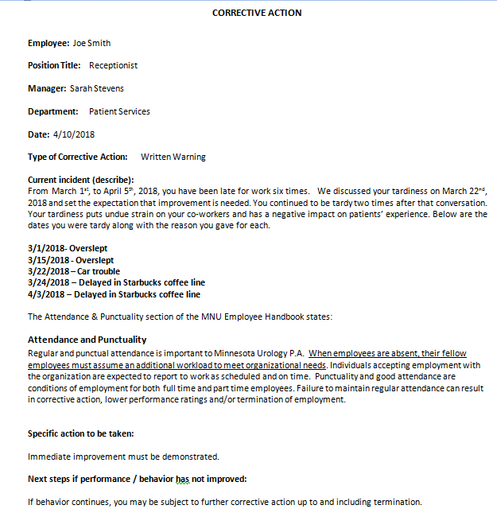
Properly Written CA
Use established template.
Ensure HR reviews before delivery to employee
Accurate Info.
Only indicate “written warning”, not “Final”
Facts only with dates. Referenced previous warnings. Impact on organization and others
Setting clear expectation with timing. Reminding them of how they should have known.
Legal Disclaimer
of next steps

