Slide 1
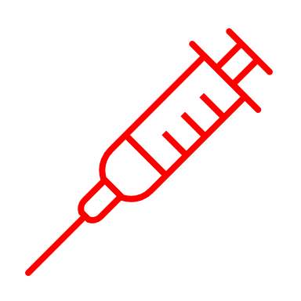
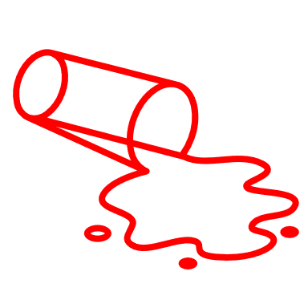
Bloodborne pathogen site specific
Task Procedures for SHS laboratory at OLIN

Slide 2
Many tasks that we perform in our laboratory can expose us to Bloodborne pathogens
Understanding the hazards in the specific tasks and work practices used to limit your risk are important things to know.
Some tasks that may involve risks are:
Phlebotomy procedures
Specimen handling and transport
Specimen aliquot and removal of stopper from specimens
Blood spill clean up
Laboratory surface cleaning
Centrifuge cleaning
Biosafety cabinet cleaning
Disposal of specimens
Waste management

Slide 3
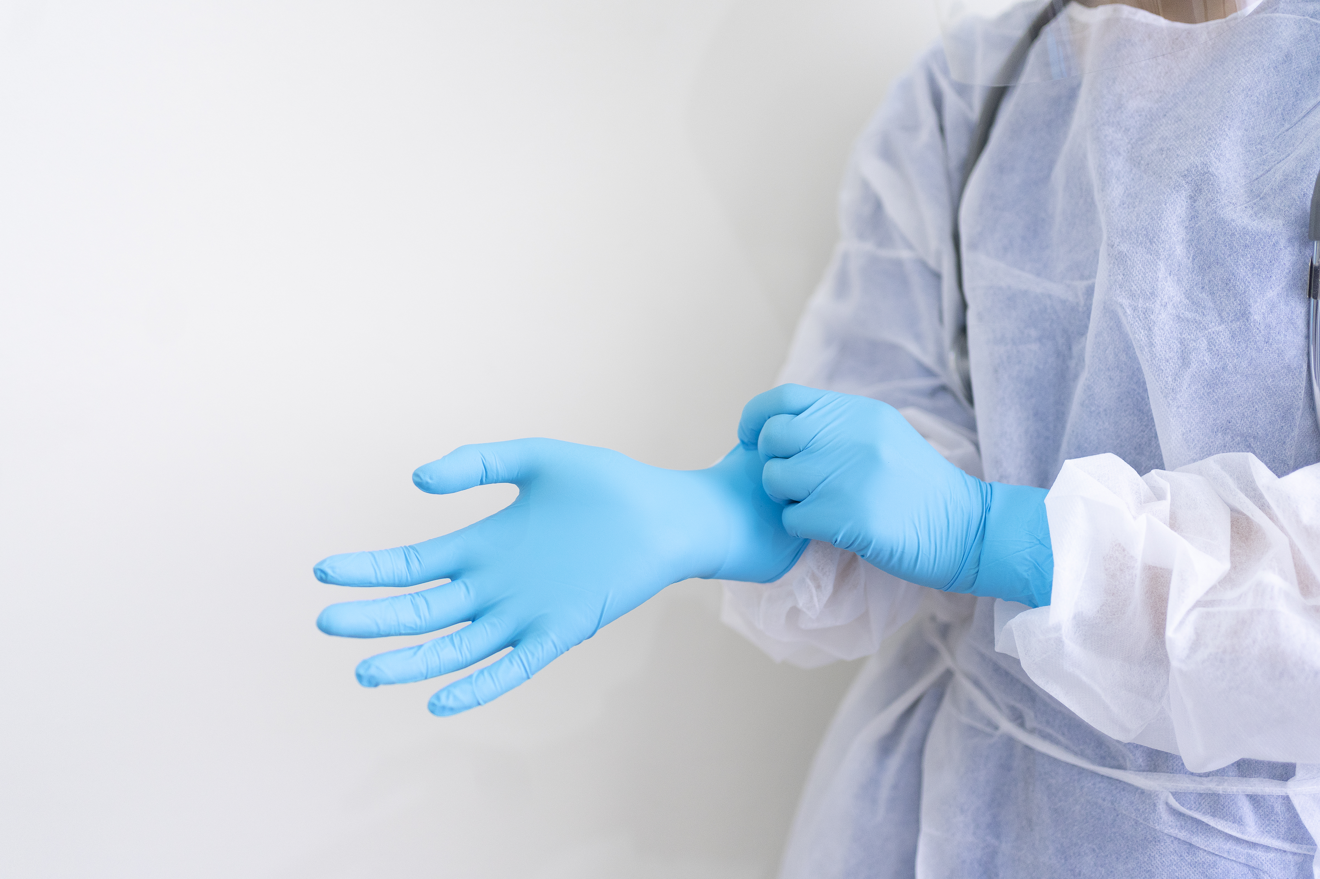
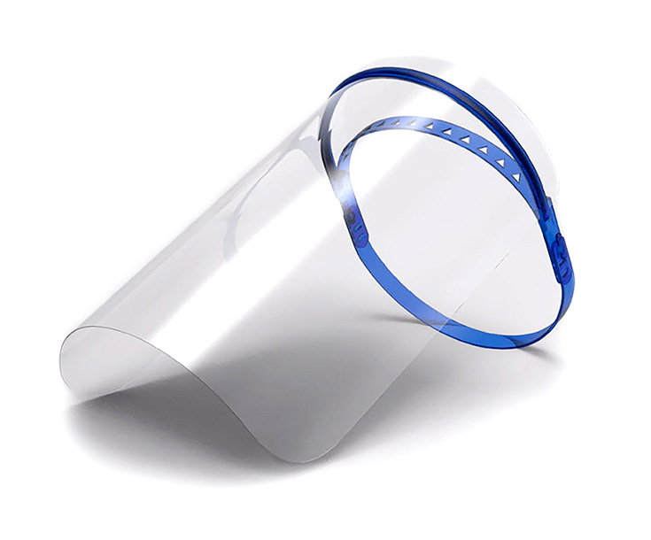
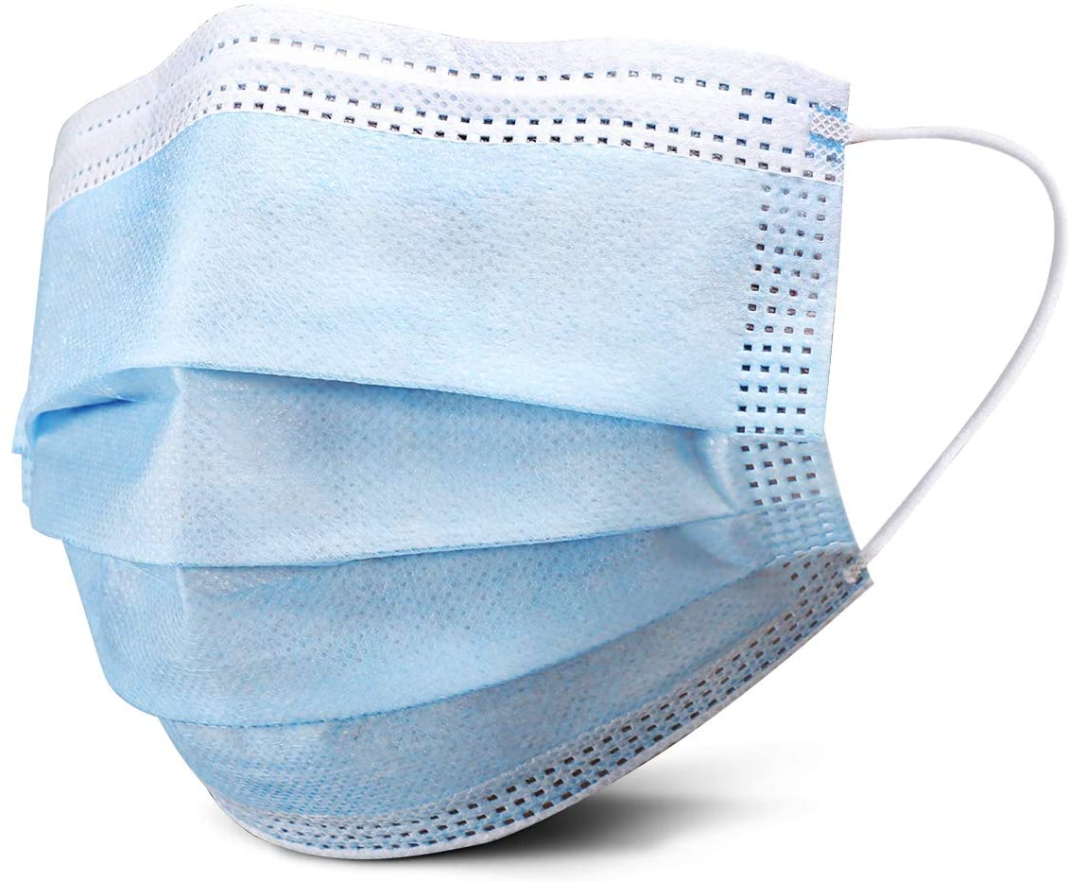
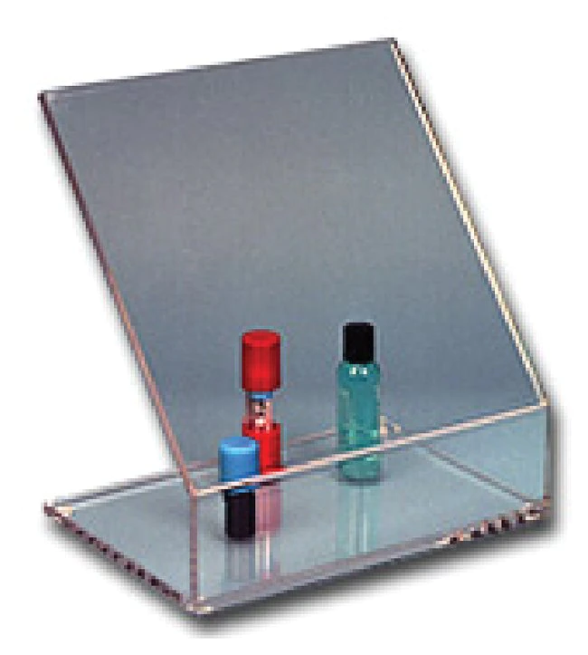
Proper PPE available for Lab tasks
Non latex gloves
Lab coat
Face shield
Face mask
Safety/splash Shield
Closed toe shoes

Slide 4
How to use and where to find PPE
Nitrile gloves of all sizes can be found in the storage room. If you need additional sizes or want to try a different brand, let your supervisor know.
Wearing face masks in medical facilities is an OSHA requirement.
Be sure to have a surgical mask that covers your mouth and nose when patient contact is expected.
Face shields or goggles are optional when interacting with patients.
They should be used/worn when a potential for a splash to your mucus membranes and eyes are possible.

Slide 5
Other engineering controls to help protect us and limit our risk
Biohazard bags. All specimens should be transported in biohazard bags or be placed in a biohazard labeled container for transport to and from the laboratory.
Safety needles with shield.
All of the needles that we use for venipuncture should be fitted with a mechanism to cover the exposed sharp prior to disposal
Plastic vacutainer tubes.
Most of the tubes that we use for phlebotomy and laboratory testing are made of plastic. This will limit any possible exposure from a broken blood sample tube.

Slide 6
Other work practices that help protect us and limit our risk
Hand washing. Washing hands with soap and water when visibly contaminated with blood or other potentially infectious material is a valuable tool to prevent infection.
Eye wash.
Having an eyewash available to be used in the event of a splash exposure to the mucus membranes or eyes is a valuable tool for laboratory testing
Sharps container.
It is important to dispose of all sharps and needles in a sharps container. This can help prevent exposure to puncture wounds or cuts from glass or needles used in the laboratory.
Safety shields/splash guards.
When opening tubes and aliquoting specimens, using a barrier such as a plexiglass safety shield prevents a splash exposure to the individual that is performing this task.

Slide 7
Phlebotomy procedures
Use universal precautions throughout the procedure
Hazards:
Blood borne pathogens
Infectious disease
sharps exposure
Engineering controls:
Safety lok blood collection set
Multi-sample needles with safety shield
Blood transfer devices
Plastic Vacutainer tubes
biohazard sharps containers
Personal Protective Equipment:
Lab coat
Gloves
Mask
goggles/face shield
Work Practices that limit risk:
Use of proper PPE
Washing hands when the clean-up is completed
Annual review of safer sharps
Evaluation of new safer sharp products prior to implementation.

Slide 8
Specimen handling and transport
Use universal precautions throughout the procedure
Hazards:
Blood borne pathogens
Infectious disease
Engineering controls:
Ziploc Bags
Reference laboratory specimen bags
Reference laboratory transport bags
Biohazard transport coolers
Biohazard labeled basket
Personal Protective Equipment:
Lab coat
Gloves
Work Practices that limit risk:
Use of proper PPE
Washing hands when gloves are removed
.

Slide 9
Specimen aliquot and removal of stopper
Hazards: Blood borne pathogens
Engineering controls: Splash shield and transfer pipettes
PPE: Gloves, lab coat, safety shield
Work Practices to limit risk: wearing proper PPE, wash hands or use hand sanitizer when gloves are removed.

Slide 10
In the Event of a Blood spill…
Blood or Body Fluid Spill (one mL or less of fluid):
Blood or Body Fluid Spill Greater than 1 mL and/or Broken Tubes of Blood:
Wipe up spill with paper towel, gauze, or similar absorbent material if spill is on hard surface. If spill is on plastic-backed absorbent paper (counter-savers), fold up paper with blood to the inside and discard.
Apply approved disinfectant (SaniZide) to the area and allow to sit for 10 minutes. Wipe up with paper towel.
Replace plastic-backed paper if applicable.
Sprinkle Zorbitol Plus powder over the spill to absorb and contain the liquid.
Clean up the resulting gel and any broken glass with the plastic scoop and detachable scraper from the spill kit.
Place the scoop with the waste into the Zorbilope (envelope.) Dispose in biohazard bag.
Spray the contaminated area with SaniZide, let sit for 10 minutes, and wipe clean.
Complete a Problem Monitor to report the spill and give to Lab Manager.
Close off area to traffic. Student phlebotomist will immediately notify Medical Technologist of spill. Medical Technologist will use splash goggles, lab coat, nitrile gloves, and follow the Laboratory procedure
Hazard:
Blood borne Pathogens- blood
Caustic Chemical - disinfectant
Engineering Controls:
Disposable dust pan and broom
biohazard bag
spill kit
Personal Protective Equipment
splash goggles
lab coat
nitrile gloves
Work Practices that limit risk:
close off the area
use of proper PPE
Use engineering controls to pick up the absorbed spill
Contact EHS, if any questions arise during the clean-up
Wash hands when the clean-up is completed

Slide 11
Laboratory surface cleaning
Use approved disinfectant to clean all laboratory surfaces that have the potential for contact with blood or body fluids
Hazards:
Engineering Controls:
Personal protective equipment
Blood borne pathogens
Caustic Chemical
SaniZide plus prepared disinfectant
Sani-cloth Plus germicidal disposable cloth
Lab coat
Gloves
Goggles
Work Practices that limit risk
Use of proper PPE
Wash hands when clean-up is completed

Slide 12
Centrifuge cleaning
Wipe interior of centrifuge with SaniZide weekly
If a tube breaks in the centrifuge or there is any visible fluid in the centrifuge, use the spill kit
Never open a centrifuge until it has come to a complete stop.
Hazards:
Blood borne pathogens
Caustic chemical
Engineering Controls:
SaniZide prepared disinfectant
Centrifuges that lock while in use
Plastic vacutainer tubes
Personal Protective equipment:
Lab coat, gloves, mask, goggles
Work Practices that limit risk:
Use of proper PPE
Wash Hands when the clean-up is completed

Slide 13
Disposal of Specimens and waste management
All Blood specimens are kept refrigerated in sample racks for one week.
Specimens are then disposed of by placing in bagged biohazard container.
When full the biohazard waste bag is tied closed and placed into large drums for incineration.
Waste drums are picked up according to MSU policy for biohazard waste pick-up*
Hazards:
Engineering Controls:
Personal protective equipment
Blood borne pathogens
Biohazard bags
Biohazard containers
Biohazard Waste drums
Lab coat
Gloves
Work Practices that limit risk
Use of proper PPE
Wash hands when clean-up is completed
*All waste is to be disposed of within 90 days from start of collection

Slide 14
In the event of an exposure know what to do:
Needlestick:
Wash affected area thoroughly for at least 15 minutes, allow to bleed
Notify supervisor as soon as possible
Obtain authorization to bill forms and be checked at Lansing Urgent Care
Share Patient/source info if available and get permission to test their samples
Splash in eye/mucous membrane:
Use Eyewash and rinse area for at least 15 minutes
Notify supervisor as soon as possible
BBP EXPOSURE forms
What are they?
Where are they?

Slide 15
Remember… Safety First!

