Slide 1
Hemolysis in a patient with recent thrombectomy
Lori Racsa, D.O.
November 17, 2015

Slide 2
Case Presentation
Patient sample received into lab and was severely hemolyzed; the patient had four specimens rejected
Tech called to the floor to see if they could get a peripheral draw versus a line draw and the floor had sent a peripheral stick the last time
What is going on?

Slide 3
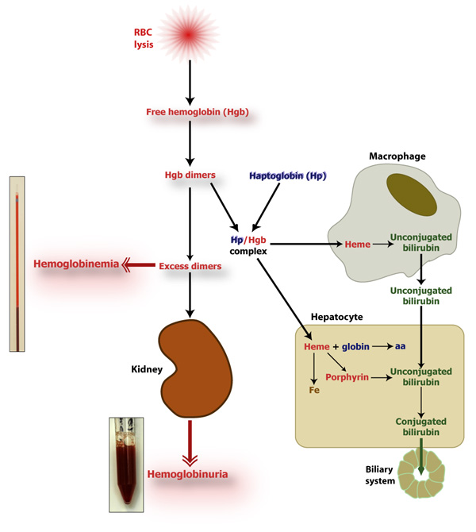
Hemolysis differential
Intravascular: occurs within circulation
http://www.eclinpath.com/wp-content/uploads/intravascular-hemolysis-new.jpg
Notes:
Hemolytic uremic syndrome, thrombotic thrombocytopenic purpura, DIC, mechanical destruction (valves)
Laboratory values:
Increased LDH, total bili
Decreased haptoglobin (usually undetectable)
Schistocytes on peripheral smear
Hemoglobinuria

Slide 4
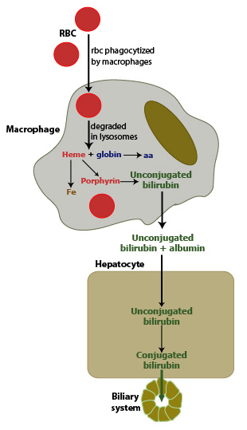
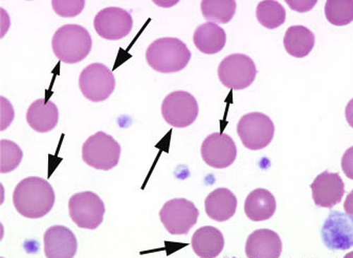
Hemolysis Differential
Extravascular: Typically occurs in the reticuloendothelial system
Notes:
http://www.eclinpath.com/wp-content/uploads/extravascular-hemolysis-new.jpg
Auto-immune anemia, Hereditary disorders (hereditary spherocytosis)
Laboratory Values:
LDH and haptoglobin are normal
Spherocytes on peripheral smear
Urine should be negative for blood

Slide 5
Back to the case….
Patient is a 59 year old male with a past medical history of Type II Diabetes, Hypertension, hyperlipidemia, peripheral artery disease, and coronary bypass x3
HPI: Patient was working outside when he noticed his right foot had a cold, “dead” feeling

Slide 6
Case Presentation
Patient was taken to the operating room for stent placement with t-PA infusion for presumed clot
This procedure did not work out
One of his previously placed stents had 100% occlusion
Taken back and had mechanical thrombolysis with the “AngioJet”

Slide 7
Notes:
In addition to lysing the clot, the device also hemolyzes red cells in the process
http://media.corporate-ir.net/media_files/irol/97/97164/presentations/march03/sld034.htm

Slide 8
Other literature has shown:
3.6 fold increase in mean plasma Hb with significant decrease in haptoglobin following percutaneous thrombectomy
Decrease in Hematocrit by up to 4.6% with red urine
Hemolysis seems to be more severe in patients with partially occluded vessels because more red cells are coming into contact with the instrumentation

Slide 9
Case Presentation
Patient then developed acute kidney injury and was started on hemodialysis

Slide 10
Notes:
The patient developed renal failure with a bump in creatinine from 1.01 to 3.78 – dropped back down to 1.67 and on f/u 1.27

Slide 11
Case Presentation
Patient improved and was sent home

Slide 12
Questions?

Slide 13
Mike’s case

