Slide 1
Heparin: everything you wanted to know in five minutes or less
Lori D Racsa, D.O.
Clinical Pathologist/Medical Microbiologist
PTPG/Unity Point Methodist
October 14, 2015

Slide 2
Coagulation Cascade
http://www.practical-haemostasis.com/Screening%20Tests/pt.html

Slide 3
Heparin: when and how is it used
Prevention of venous or arterial thromboembolism
Subcutaneous administration
Ex/ preventing blood clots while in the hospital
No monitoring necessary
Low-Molecular weight heparin another option
Diagnosed thromboembolic event
Deep Vein Thrombosis, Pulmonary embolism
IV administration
Must have a bolus to reach therapeutic levels → followed by maintenance dose
Laboratory testing is crucial for monitoring
Usually a short period while transitioning to therapeutic doses of Warfarin

Slide 4
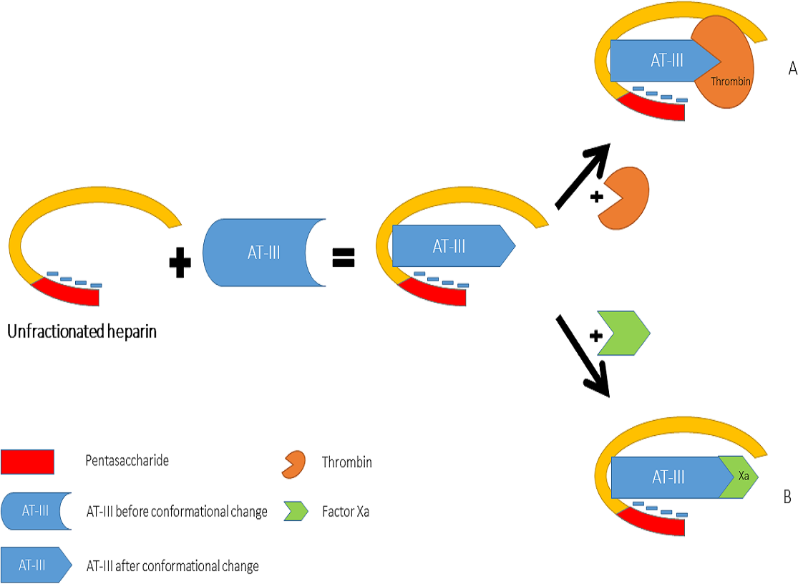
Heparin action on ATIII
https://peerj.com/articles/691/#fig-2
Notes:
Anti-thrombin binds to thrombin and Xa, albeit slowly due to the receptor site conformation
- When heparin binds to ATIII – it changes the conformation and allows it to bind to Thrombin and Xa with a much higher affinity

Slide 5
Laboratory Testing – how do we monitor
PTT therapeutic range: 50-80 seconds
Or 2.5-3x normal range (21.5-32.5 seconds)
Anti-Xa if anyone has seen the Stago can be used, but more likely in Low Molecular Weight Heparin

Slide 6
Trouble Shooting our PTT results
What if we get a result of PTT over 100?
Factor 12 deficiency?
A rare-ish coagulation disorder with no risk of bleeding but abnormal PTT results – usually greater than 100
Heparin contamination?
Where was the draw from
Was the pump turned off
Hepzyme
Other causes, but likely not over 100 seconds
Lupus anti-coagulant
Other Factor deficiencies (8, 9, etc)

Slide 7
Heparin: Things to Remember
Notes:
Partial thromboplastin time measures the intrinsic pathway – how long does it take for blood to clot
Draw with the blue top tube, usually second in order of draw if doing blood cultures as well
Make sure the tube is filled appropriately, as the anticoagulant ratio is critical

Slide 8
Heparin: Things to Remember
When drawing: make sure you stop the administration of heparin, want to get an accurate result – cannot have heparin directly in the sample
Need to wait to let the blood flow through so that the heparin is actively working and we are not measuring heparin exactly
Half-life: 30 – 60 minutes (depending on the dose/weight of the patient)
Keep the drip stopped for as minimal time as possible – we don’t want to have the patient lose the therapeutic dose or another bolus may have to be administered

