Slide 1
Bronchoalveolar lavage
A quick guide to BAL specimens in the Hematology laboratory
Notes:
This template can be used as a starter file for presenting training materials in a group setting.
Sections
Right-click on a slide to add sections. Sections can help to organize your slides or facilitate collaboration between multiple authors.
Notes
Use the Notes section for delivery notes or to provide additional details for the audience. View these notes in Presentation View during your presentation.
Keep in mind the font size (important for accessibility, visibility, videotaping, and online production)
Coordinated colors
Pay particular attention to the graphs, charts, and text boxes.
Consider that attendees will print in black and white or grayscale. Run a test print to make sure your colors work when printed in pure black and white and grayscale.
Graphics, tables, and graphs
Keep it simple: If possible, use consistent, non-distracting styles and colors.
Label all graphs and tables.

Slide 2
Utilities of Analysis
Evaluation of immunocompromised patients for the presence of opportunistic infections
Diagnosis of interstitial lung disease, airway disease and alveolar hemorrhage
Detection of infection and monitoring antibiotic therapy
Notes:
Give a brief overview of the presentation. Describe the major focus of the presentation and why it is important.
Introduce each of the major topics.
To provide a road map for the audience, you can repeat this Overview slide throughout the presentation, highlighting the particular topic you will discuss next.

Slide 3
Specimen Considerations
1. Specimen collection
Involves infusion of saline through a bronchoscope by aspiration of bronchial contents for cellular examination and culture
2. Specimen handling
BAL specimens are usually separated into two samples
bronchial sample - first aliquot recovered
aleolar sample – consists of subsequent 3 to 5 aliquots which are recovered
Specimens should be analyzed immediately, within 1 hour for cellular counts
Notes:
This is another option for an Overview slides using transitions.

Slide 4
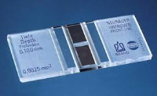
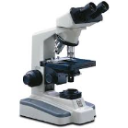
Hematological Examination
WBC and RBC counts are calculated using the standard Neubauer counting chamber
Slides for differential are prepared by cytocentrifugation
Cells are counted and classified

Slide 5
Cells and Inclusions seen in BAL specimens
Cells / Inclusions | Clinical Significance
Macrophages | Normal, most frequently seen ( > 80%), decreased in sarcoidosis ( 55% or less )
Lymphocytes | Normal < 15% Increased in interstitial lung disease, drug reactions, pulmonary lymphoma and non bacterial infections
Neutrophils | Normal < 3% Elevated in cigarette smokers, bronchopneumonia, toxin exposure and diffuse alveolar damage
Eosinophils | Normal < 1-2% Elevated in asthma, drug-induced lung disease, infections, hypersensitivity, pneumonitis and eosinophillic pneumonia

Slide 6
Cells / Inclusions | Clinical Significance
Erythrocytes | Alveolar hemorrhage
Phagocytized erythrocytes | Alveolar hemorrhage
Hemosiderin-laden Macrophages | Alveolar hemorrhage
Bronchial epithelial cells | Normal, more numerous in bronchial wash specimens
Sulfur granules | Actinomyces infection
Langerhans cells | Langerhans cell histiocytosis, Cigarette smokers
Cytomegalic cells | CMV Infection
Dust particle inclusions | Pneumoconioses or asbestos exposure
Fat droplets – lipid laden macrophages | Fat embolism

Slide 7
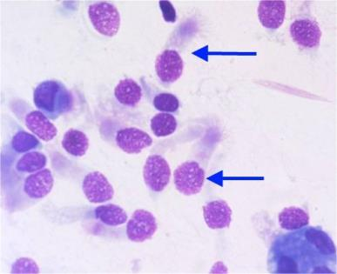
Cells seen in Bronchial Lavage Specimens
Bronchial Epithelial Cells
Notes:
This is another option for an Overview slide.

Slide 8
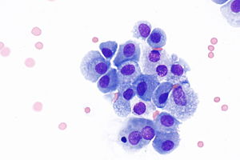
More Bronchial Epithelial Cells
Macrophages
Notes:
What will the audience be able to do after this training is complete? Briefly describe each objective how the audience will benefit from this presentation.

Slide 9
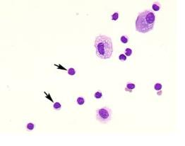
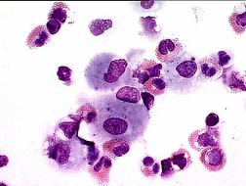
Neutrophils
Lymphocytes
Eosinophils
Notes:
Use a section header for each of the topics, so there is a clear transition to the audience.

Slide 10
Summary
Practice makes perfect
Ask coworkers for assistance when needed
Refer to your policy/procedure for additional information
Notes:
Summarize presentation content by restating the important points from the lessons.
What do you want the audience to remember when they leave your presentation?
Save your presentation to a video for easy distribution (To create a video, click the File tab, and then click Share. Under File Types, click Create a Video.)

