Slide 1
Polymerase chain reaction (PCR)
Unity Point Health, Proctor; August 25, 2016
Lori D. Racsa, DO
Notes:
We had a potential false positive HPV PCR on our Roche Cobas
- I asked what the CT was and there was not

Slide 2
What is PCR
Basic definition: a process used to amplify small quantities of molecular material into thousands of copies in order to identify a sequence.
  In molecular microbiology, leads to the identification of a species
  In cancer biology, leads the identification of mutations that may be causing the cancer or lead to specific therapies that target that gene identified

Slide 3
First step in performing PCR
Prior to performing PCR (amplification), the nucleic acids must be extracted
  Usually a very manual process with lots of pipetting and washing, use of magnetic beads
    Must be in a clean room
  Performed automatically with our Roche 480

Slide 4
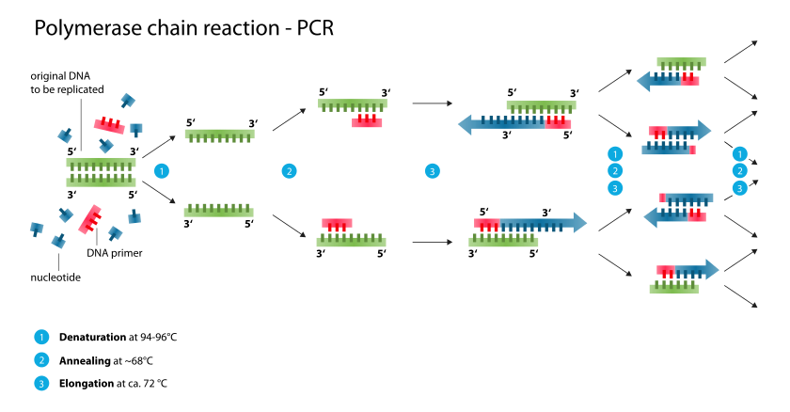
PCR
Notes:
Master mix – includes DNA primers and nucleotides
Denaturation step: This step is the first regular cycling event and consists of heating the reaction to 94–98 °C for 20–30 seconds. It causes DNA melting of the DNA template by disrupting the hydrogen bonds between complementary bases, yielding single-stranded DNA molecules.
Annealing step: The reaction temperature is lowered to 50–65 °C for 20–40 seconds allowing annealing of the primers to the single-stranded DNA template. This temperature must be low enough to allow for hybridization of the primer to the strand, but high enough for the hybridization to be specific, i.e., the primer should only bind to a perfectly complementary part of the template. If the temperature is too low, the primer could bind imperfectly. If it is too high, the primer might not bind. Typically the annealing temperature is about 3–5 °C below the Tm of the primers used. Stable DNA–DNA hydrogen bonds are only formed when the primer sequence very closely matches the template sequence. The polymerase binds to the primer-template hybrid and begins DNA formation. It is very vital to determine the annealing temperature in PCR. This is because in PCR, efficiency and specificity are affected by the annealing temperature. An incorrect annealing temperature will cause an error in the test.
Extension/elongation step: The temperature at this step depends on the DNA polymerase used; Taq polymerase has its optimum activity temperature at 75–80 °C,^{[12][13]} and commonly a temperature of 72 °C is used with this enzyme. At this step the DNA polymerase synthesizes a new DNA strand complementary to the DNA template strand by adding dNTPs that are complementary to the template in 5' to 3' direction, condensing the 5'-phosphate group of the dNTPs with the 3'-hydroxyl group at the end of the nascent (extending) DNA strand. The extension time depends both on the DNA polymerase used and on the length of the DNA fragment to amplify. As a rule-of-thumb, at its optimum temperature, the DNA polymerase polymerizes a thousand bases per minute. Under optimum conditions, i.e., if there are no limitations due to limiting substrates or reagents, at each extension step, the amount of DNA target is doubled, leading to exponential (geometric) amplification of the specific DNA fragment.

Slide 5
Detection
Once amplified, the product has to be detected
  Old school:
    Southern Blot: DNA
    Northern Blot: RNA

Slide 6
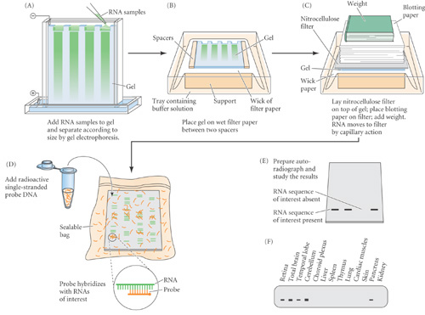
Old School

Slide 7
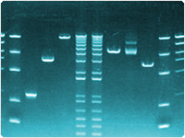
Matching of base pairs

Slide 8
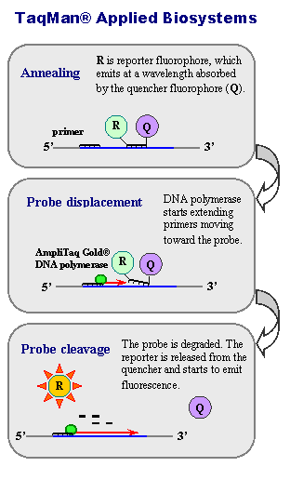
New School: real time PCR
Notes:
Specificity is conferred at three levels: via two PCR primers and the probe
http://www.ncbi.nlm.nih.gov/probe/docs/techqpcr/

Slide 9
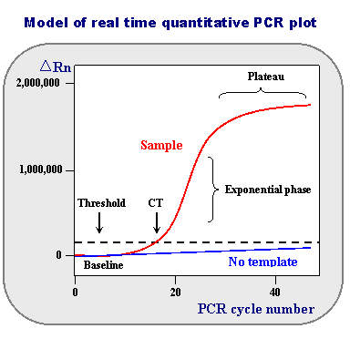
Real time PCR
Notes:
Baseline
is defined as PCR cycles in which a reporter fluorescent signal is accumulating but is beneath the limits of detection of the instrument.
ΔRn
is an increment of fluorescent signal at each time point. The ΔRn values are plotted versus the cycle number.
Threshold
is an arbitrary level of fluorescence chosen on the basis of the baseline variability. A signal that is detected above the threshold is considered a real signal that can be used to define the threshold cycle (Ct) for a sample. Threshold can be adjusted for each experiment so that it is in the region of exponential amplification across all plots.
Ct
is defined as the fractional PCR cycle number at which the reporter fluorescence is greater than the threshold. The Ct is a basic principle of real time PCR and is an essential component in producing accurate and reproducible data.

Slide 10
Other types of PCR
Reverse-transcriptase PCR
  Take an RNA virus and make into DNA
Nested PCR
  Two pairs of amplification primers
    After first primer a second round of PCR with a separate set of primers
  If using real time – probe would be second set

Slide 11
Other types of PCR
Multiplex
  Multiple primer sets are included in the reaction to detect more than one target at a time

Slide 12
Other items to consider
In larger molecular labs:
  Dirty room: where samples are prepared/extracted
  Clean room: where primers and probes are kept
  Amplification/post-amplification room: where PCR products are
Cannot move from one area to the next without changing gloves/gowns
  Automated platforms make this less of an issue but still need to be very careful

Slide 13
Where does Biofire fit into this?
Multiplex, nested real-time PCR
Simple, sample to answer assay, no purification of nucleic acids or manual processes that normal molecular labs have

Slide 14
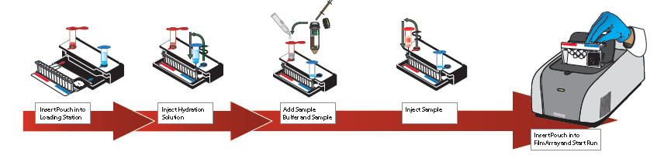
Biofire set-up

Slide 15
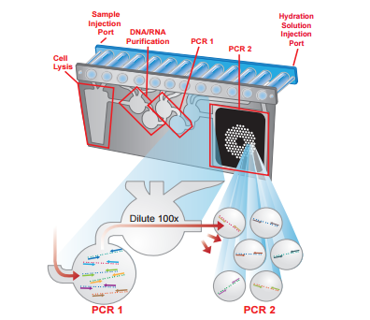
What is going on in the pouch

Slide 16
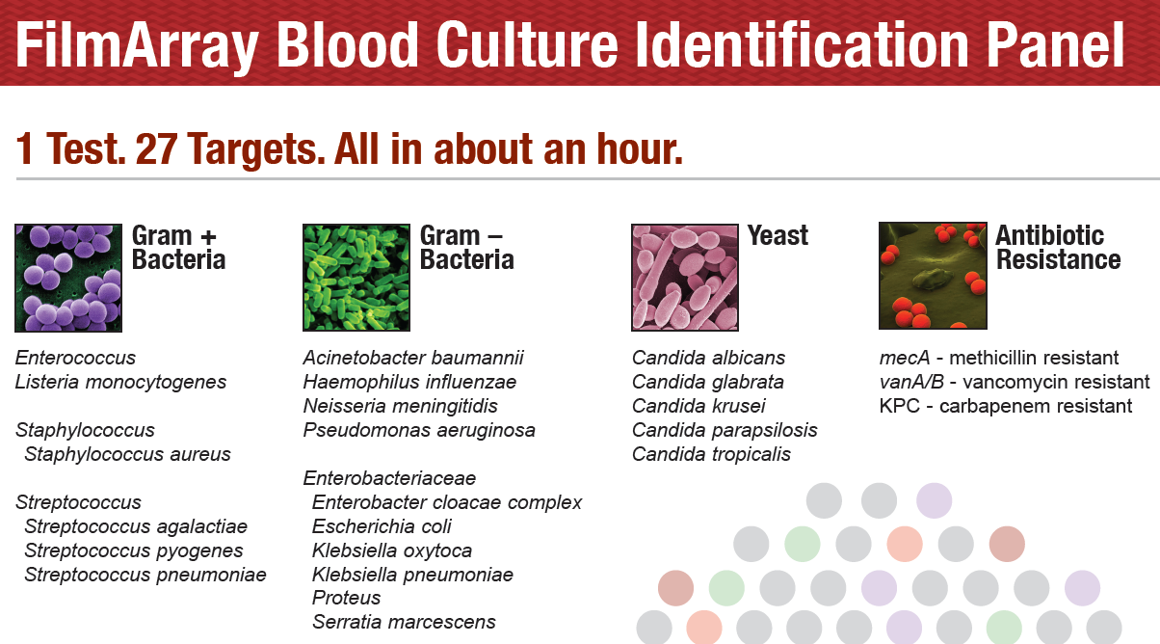
Assays Unity Point currently uses

Slide 17
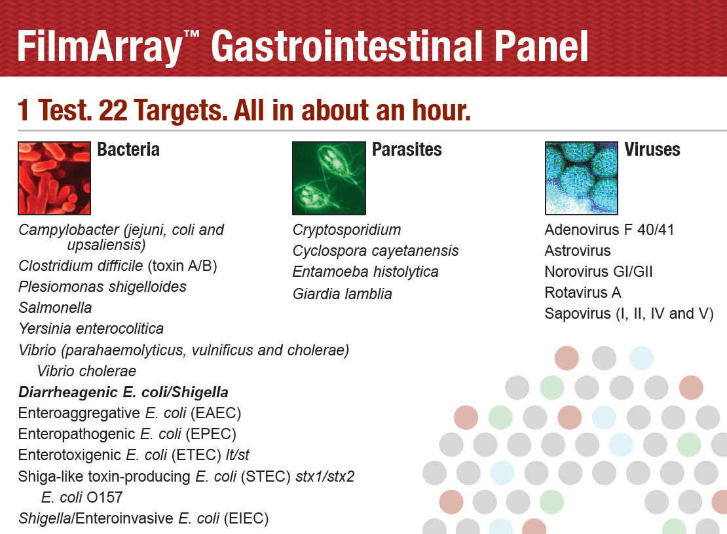
Stool Panel

Slide 18
What did that replace
Shiga toxin antigen test
Campylobacter antigen
Giardia/Crypto antigen
Rotavirus antigen
  All of those had QC, took more tech time with the manual set up

Slide 19
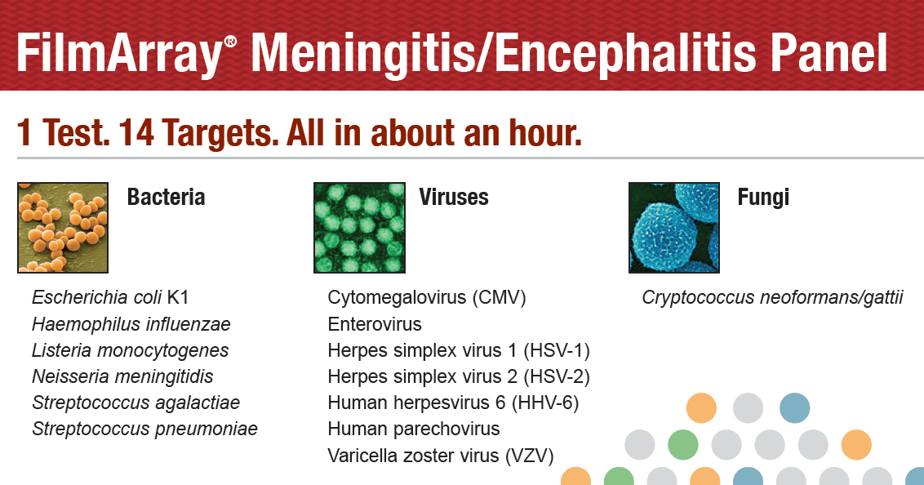
Meningitis Panel

Slide 20
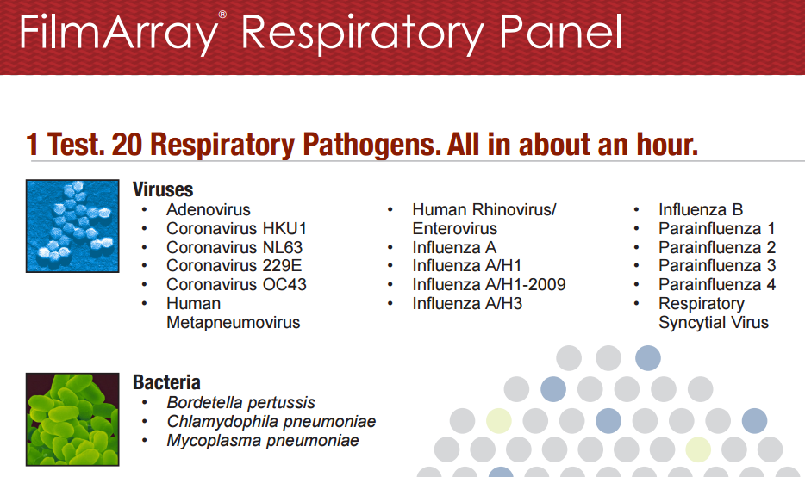
To come? Respiratory Panel

Slide 21
Roche 4800 – back to our dilemna (or is it dilemma?)
Real time PCR
There are CT values, but we cannot see them
  A lot of FDA approved platforms are proprietary
  If we know the CT values we can help determine if potential false positive by noting a higher CT value
Molecular gurus don’t like “black box” molecular assays because you cannot trouble shoot

Slide 22
Questions?

