Slide 1
Laboratory Specimens
Specimen Priorities & Turnaround Reporting of Results
Labeling of Laboratory Specimens
Specimen Rejection Criteria

Slide 2
The Department of Pathology has established various collection and testing priorities for the improved medical management of patients.
Specimens are collected, processed, analyzed and reported according to the priority in which they were ordered.

Slide 3
Specimen Ordering Priorities & Turnaround Reporting
These priorities include:
STAT – This priority designates a laboratory procedure vital to the immediate medical management of the patient.
The STAT priority will be drawn and reported within 75 minutes.

Slide 4
Specimen Ordering Priorities & Turnaround Reporting
These priorities include:
ROUTINE – This type of request should be utilized when the physician does not need the test results immediately but would like a report on the same day.
Routine draws are scheduled hourly throughout the day, between 0700 and 2200 hours.
ROUTINE

Slide 5
Specimen Ordering Priorities & Turnaround Reporting
These priorities include:
ROUTINE – AM DRAW – This type of request should be utilized when the physician would like the draw to be completed during morning rounds.
AM Draws start at 0230 and results should be on the chart by 0700 in most cases.
ROUTINE AM DRAW

Slide 6
Specimen Ordering Priorities & Turnaround Reporting
These priorities include:
TIMED STUDIES – This priority should be used when the specimen needs to be collected at a specific time or at specific intervals. The collection is expected to happen within 30 min of the scheduled time. Results will be provided as available, but are not handled as STATs.
For example, drug levels, bilirubin, Troponin, etc.
TIMED STUDIES

Slide 7
Specimen Ordering Priorities & Turnaround Reporting
These priorities include:
Add–on Test Requests – This should be used when requesting that additional testing be performed on a specimen already in the lab.
Add-on test requests can be processed after assessing the acceptability of the specimen.
Ex: Age of specimen, Type of specimen–Serum/Plasma/Whole blood, Quantity of specimen, Storage requirements
Add – on Test Requests

Slide 8
Labeling of Laboratory Specimens
Comparison of patient identifiers on the label to the patient's armband must be performed prior to collection of the specimen.

Slide 9
Why is this so important?
Correct labeling is needed to meet the Joint Commission’s National Patient Safety Goal of correct patient identification.
The purpose of this goal is to protect patients from adverse consequences related to improper patient identification (e.g. wrong treatment, wrong medications).
The labeling must occur in the presence of the patient, matching the information on the label to the patient identifiers.

Slide 10
What is proper specimen labeling?
Label must include:
Patient’s complete first and last name
Patient’s Medical Record number (or date of birth for patient who has not been issued an armband)
If Blood Bank testing is required , refer to the policy for labeling with a blood bank arm band at each facility
Date collected
Time of collection (in military time)
Initials of the person collecting the specimen
If these requirements are not met the specimen will be considered incorrectly labeled.

Slide 11
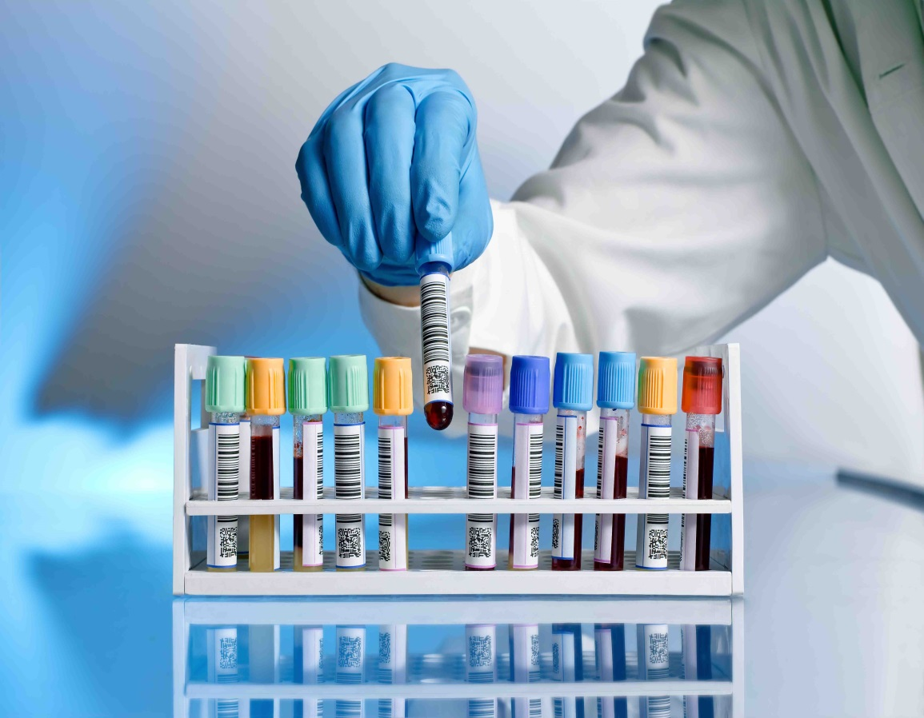
Incorrectly labeled specimens
If the specimen is one that can be recollected by venipuncture or otherwise (e.g. urine sample) the client will be notified that a new specimen is required.
If the specimen is not easily recollected (e.g. CSF/body fluids, surgical collections, blood gases), the person who originally collected the specimen must acknowledge the identity of the specimen and fix accordingly. This will include in person relabeling and will be determined on a case by case basis at the discretion of the laboratory.

Slide 12
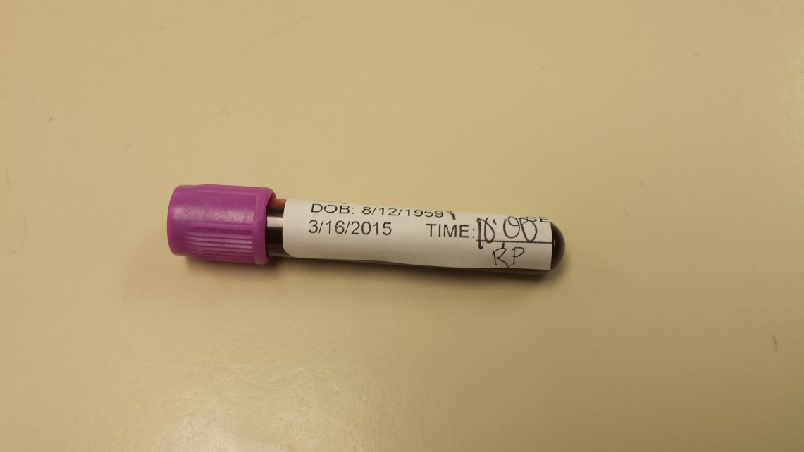
Correct Placement of Labels
Proper placement of labels is essential for all specimens. Labels must be straight, wrinkle-free, and oriented as demonstrated to the left.
Take note that the label is placed near the top of the tube cap and there are no wrinkles or overlap.
The label contains all required information and the collector’s date, time, and initials are present and legible.

Slide 13
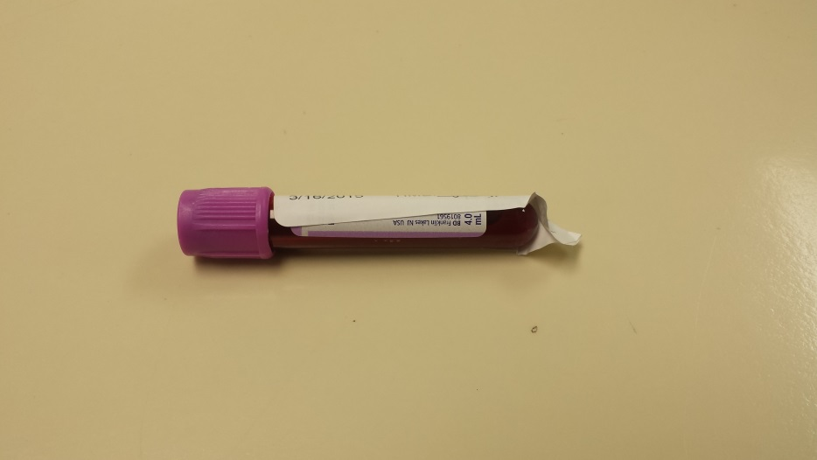
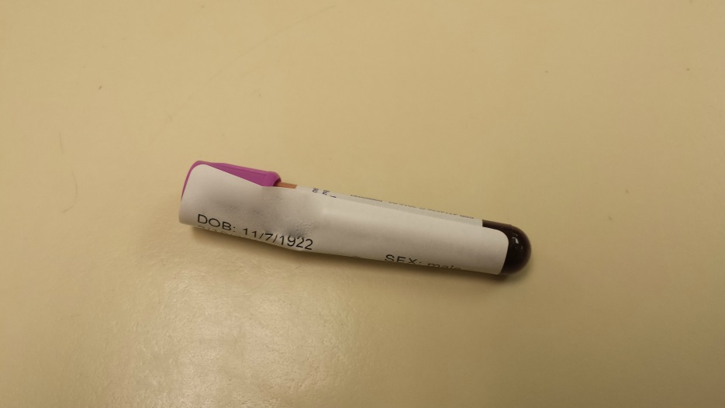
Incorrect placement of labels
If you have labels that are incorrectly sized, please take care to remove any overlapping label.
The tube on the top is placed correctly towards the tube cap, but still overlaps. It is acceptable to remove the excess label at the bottom as long as no pertinent information is lost.
The tube on the bottom is incorrectly labeled as it overlaps the cap. Move the label below the cap and remove excess label hanging from the bottom of the tube, once again taking care that no pertinent information is lost.

Slide 14
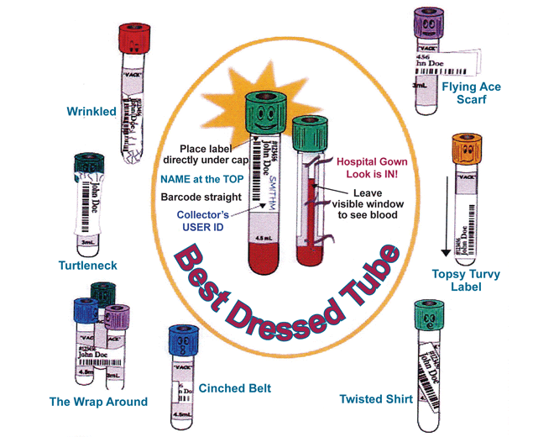
Best Dressed Tube
Don’t be a fashion disaster.
STRIVE TO BE BEST DRESSED!

Slide 15
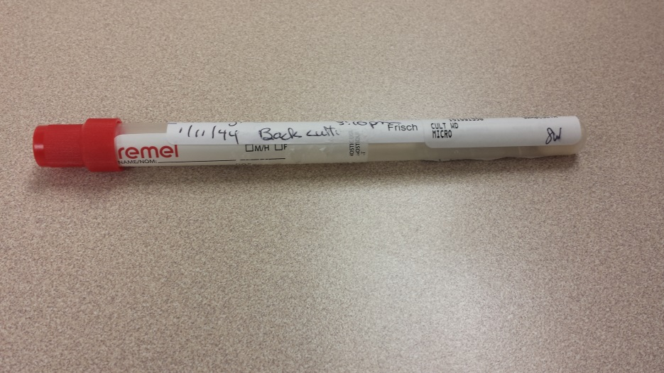
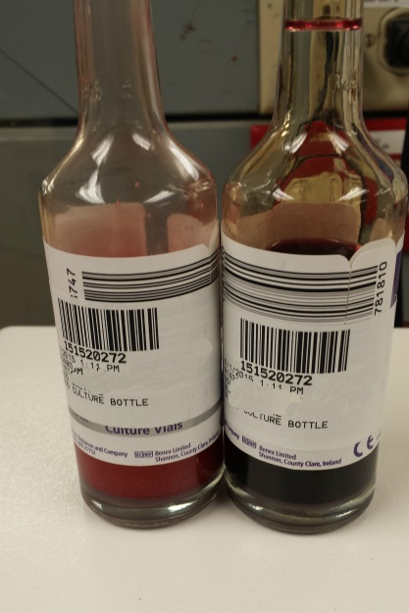
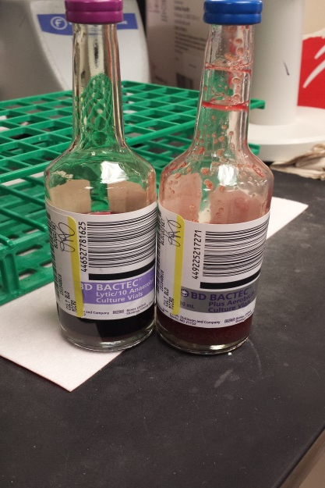
Labeling Micro Specimens
For micro swabs, please indicate specimen source on the primary label along with date/time of collection and collector’s initials.
Upon receipt into the laboratory, place all patient labels so they do not cover this primary label or the source. An example can be seen to the left.
For blood cultures, please indicate the source on the primary label along with the time of collection and collector’s initials. When placing any labels onto blood cultures take care NOT to cover the bottle barcode as this interferes with testing. An example of improperly labeled bottles can be seen to the left and correctly labeled bottles to the right.

Slide 16
Specimen Rejection Criteria
Specimens that may be rejected due to clotting / low volume ( Lavender, Light Blue & Pink). To prevent clotting, invert specimen gently 8-10 immediately after collection to mix the anti-coagulant.
Specimens that may be rejected due to hemolysis ( Green, Gold & Red)
Specimens must meet minimum volume requirements as stated in the Laboratory Manual
Please refer to the “LAB MANUAL” link located on the intranet homepage for additional information

Slide 17
Summary
The Joint Commission’s National Patient Safety Goal of correct patient identification is to protect patients from adverse consequences.
Label must include:
Patient’s complete first and last name
Patient’s Medical Record number (or other unique identifier such as date of birth)
Date and time of collection (in military time)
Initials of the person collecting the specimen
Specimen source if indicated
Incorrectly labeled specimens that can be recollected by venipuncture or otherwise (e.g. urine sample) will require a new specimen to be submitted.
Specimens that cannot be easily recollected (e.g. CSF/body fluids, surgical collections, blood gases), will require the person who originally collected the specimen to present in person, acknowledge the identity of the specimen and fix accordingly. This will be determined on a case by case basis at the discretion of the laboratory.
Correct placement of labels is near the top of the tube with no overlap or wrinkles.
For more information about specimen collection, please visit the following links:
https://www.testmenu.com/methodistmedical
https://www.unitypoint.org/peoria/services-specimen-collection.aspx

