Slide 1
Manual Result Entry

Slide 2
Manual Result Entry
Due to an increase in manual result reporting errors, we have prepared this presentation to educate you about the steps to take to report results correctly.
The following slides will guide you through the screen sequence for manual result entry.

Slide 3
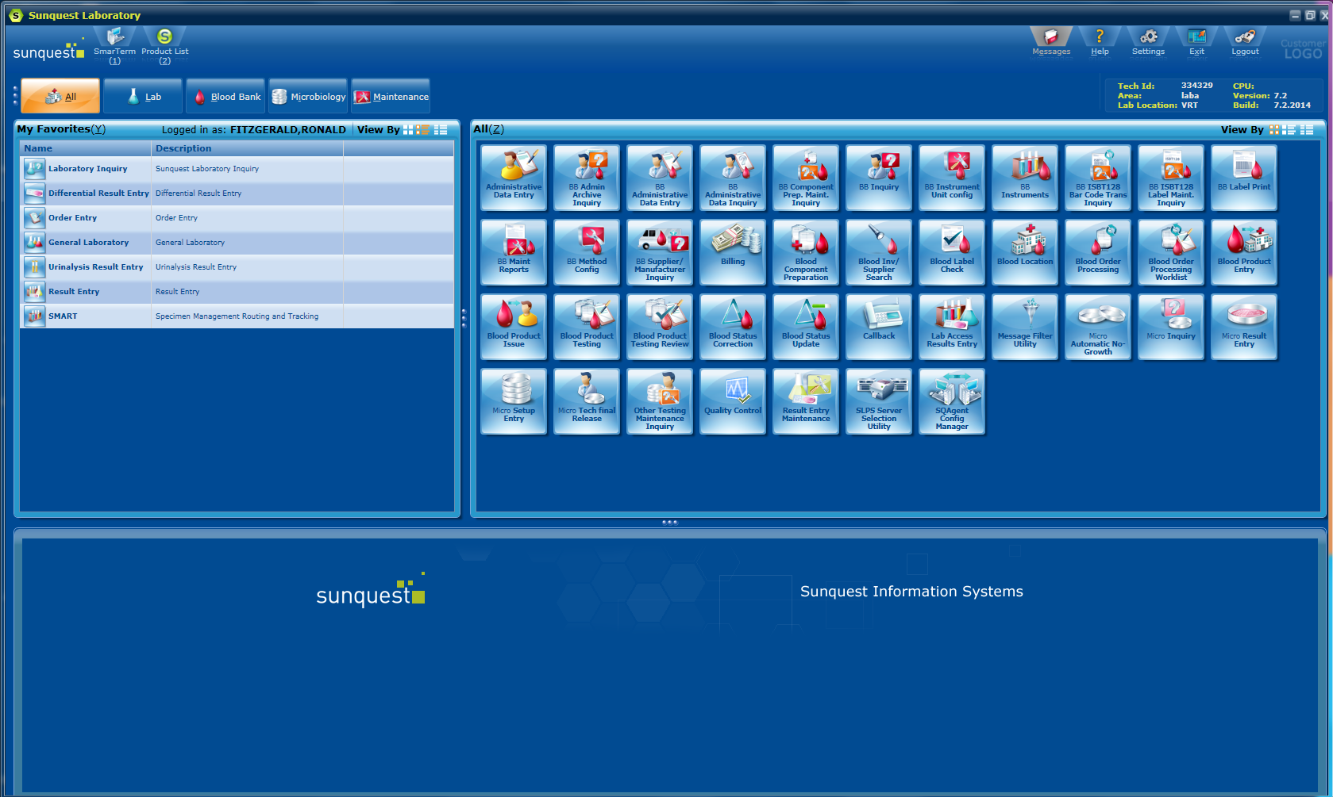
Step 1: Click on Result Entry from the home screen

Slide 4
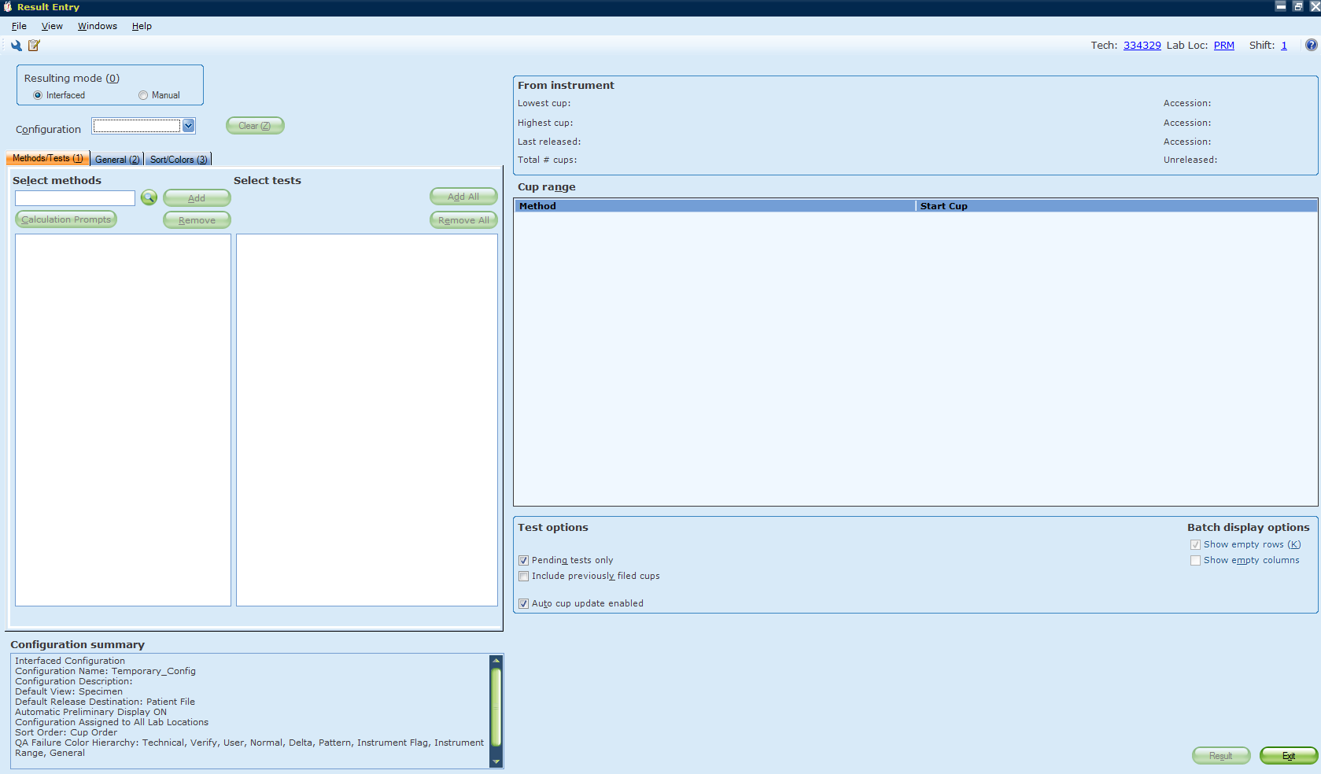
Step 2: Select Manual Resulting mode

Slide 5
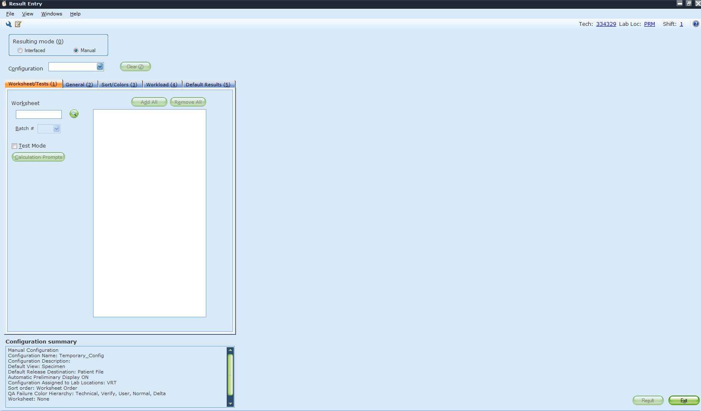
Step 3: Click on Configuration drop down menu and select appropriate worksheet

Slide 6
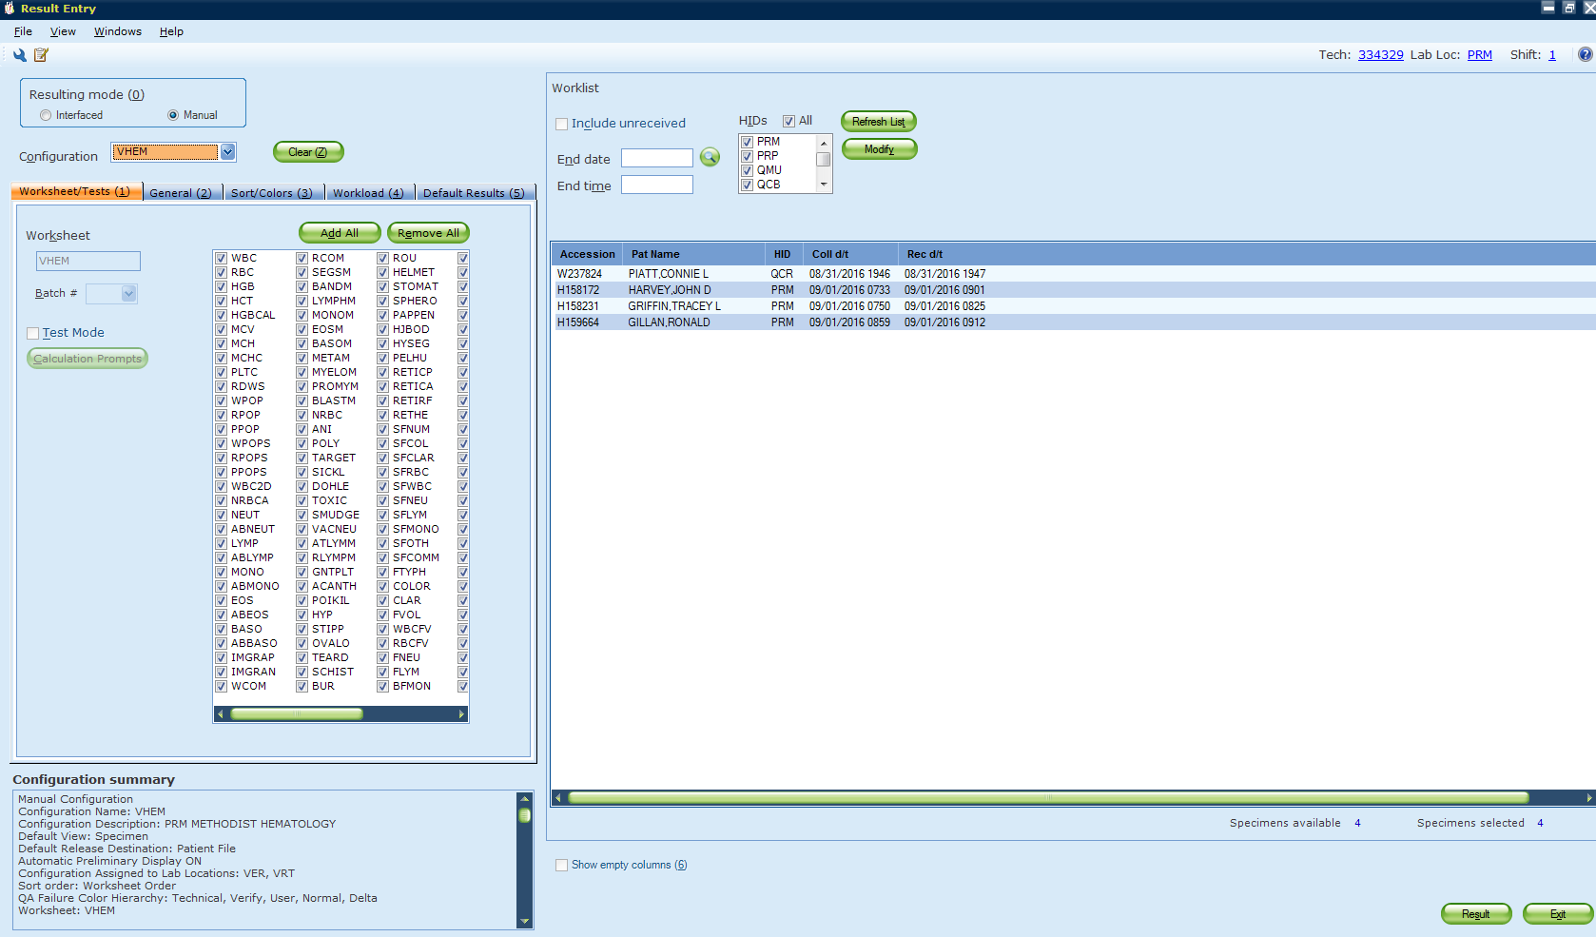
Step 4: Click on modify in the worklist

Slide 7
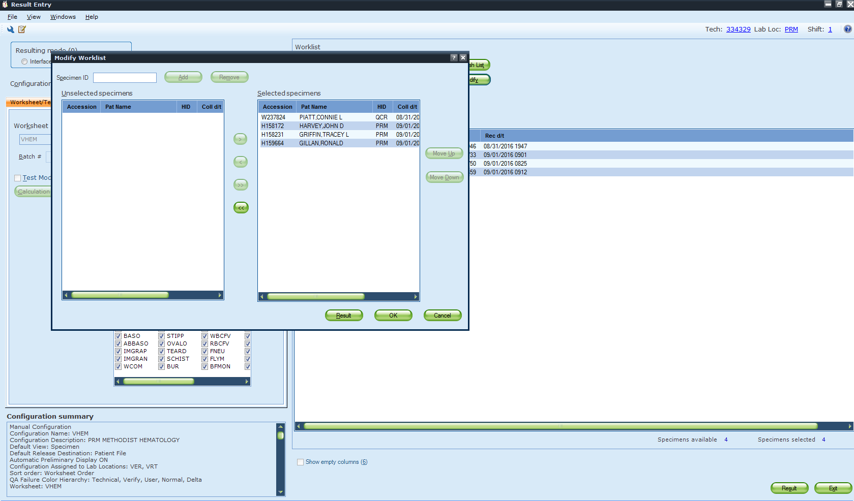
Step 5: Click on arrow to move all selected specimens to the left (move to unselected)

Slide 8
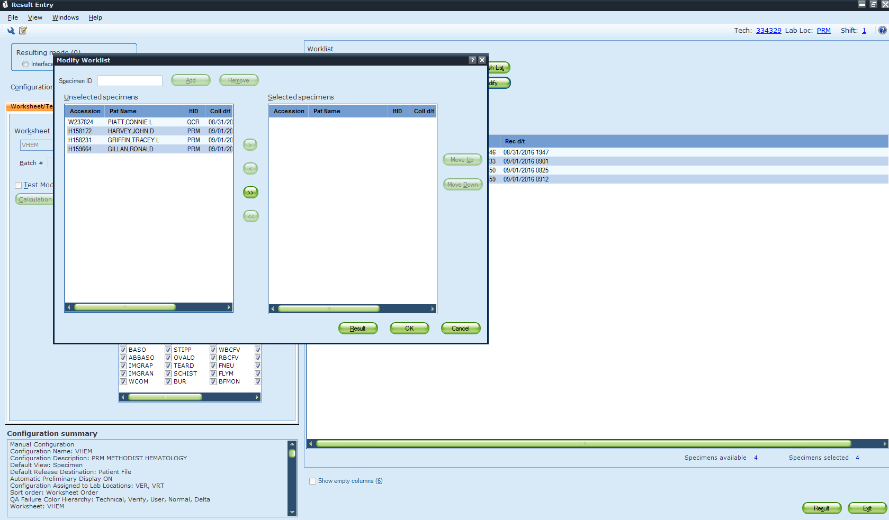
Step 6: Click & highlight the correct specimen & click on arrow to move to the right (move to selected)

Slide 9
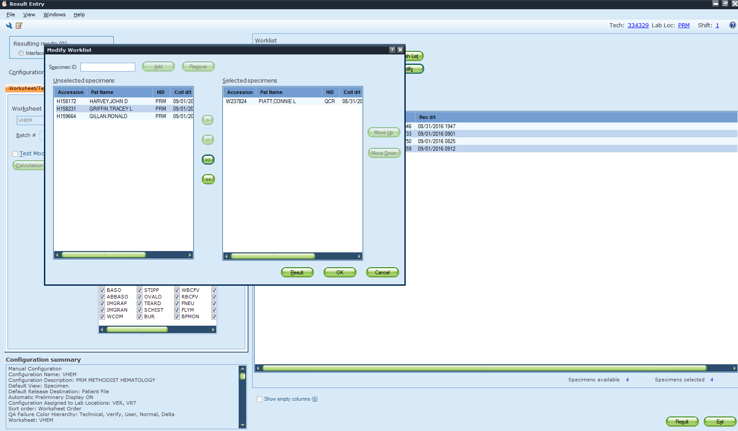
Step 7: Verify that you have selected the correct specimen & click on Result
Correct specimen

Slide 10
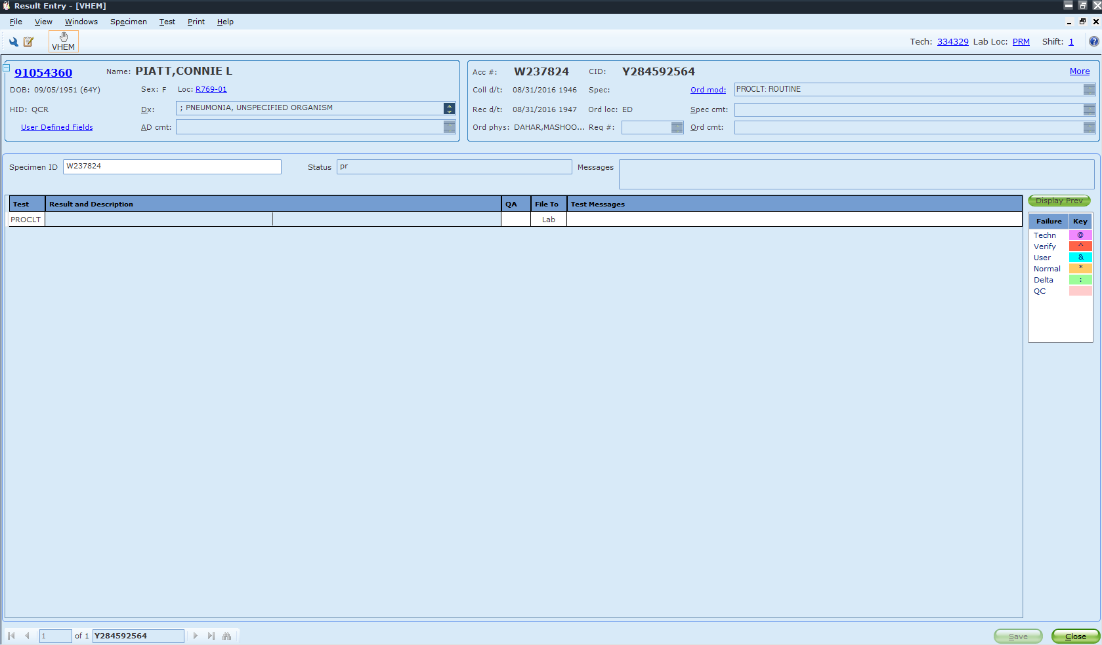
Step 8: Click result field & enter data (remember to check for two patient identifiers)

Slide 11
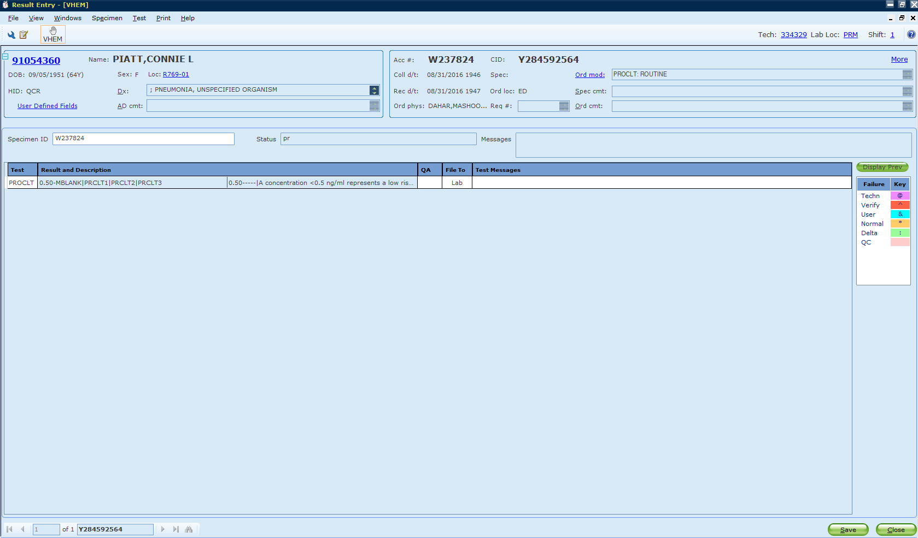
Step 9: Click on Save to finalize & release results

Slide 12
Step 10: You did it!

