Slide 1
The Brain Eating Amoeba (Scientifically known as Naegleria fowleri)
Lori Racsa, DO
September 6, 2016

Slide 2
Case Presentation
21-year-old female presented with a fever, headache, and nuchal rigidity
Had swam in the Mississippi river 5 days earlier
Lumbar puncture performed with concern for Naegleria fowleri – what the heck is that?

Slide 3
Naegleria fowleri
The brain eating amoeba is a free living amoeba that lives in warm, fresh water; usually stagnant lakes, but can be fresh lakes and rivers
Causes primary amebic meningoencephalitis (PAM)
Other amoeba include Acanthamoeba, Balamuthia mandrillaris
Both of these can cause granulomatous amebic encephalitis and cutaneous infections
Acanthamoeba also causes keratitis (take proper care of your contacts or wear glasses!)

Slide 4
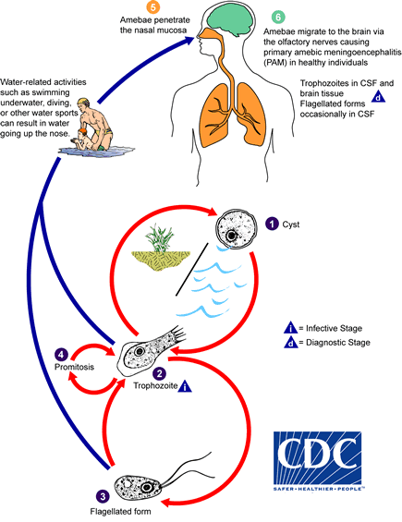
Life cycle
http://www.cdc.gov/parasites/naegleria/pathogen.html
Notes:
Can remain dormant as cysts in soil, cold water
Converts to trophozoite stage which can then enter the nasal mucosa

Slide 5
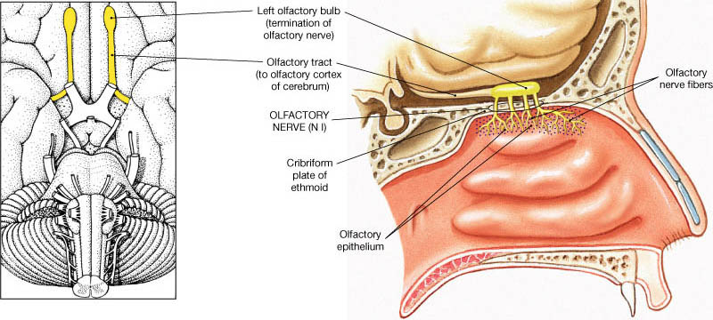
Pathogenesis
Flagellated form of the trophozoite penetrate the olfactory nerves to gain access the to the central nervous system
Notes:
Olfactory nerves fibers pass through the cribiform plate, part of the ethmoid bone
As people age, the cribiform plate becomes more solidfied, and there are theories that this is why younger people are generally more likely to be infected with Naegleria instead of older
Could also be that older people don’t swim in stagnant lakes, but this sounds more scientific
http://msk-anatomy.blogspot.com/2014/12/cranial-nerves-anatomy.html?view=classic

Slide 6
Pathogenesis continued
Causes a rapidly fatal suppurative infection of the brain and meninges
Notes:
Patient received an investigational drug called miltefosine
Two of the other survivors also received this drug (anti-parasitic)
Decrease the patient’s body temperature (induced hypothermia) and also treat with anti-fungal (amphotericin B)

Slide 7
Signs and symptoms
Similar to bacterial meningitis
Headache, fever, nausea, vomiting
Usually starts around 5 days after exposure
Anywhere from 1-9 days has been reported
Rapidly fatal
Death within 2-5 days is common

Slide 8
Treatment
Only four people have survived PAM in 50 years
Treatment includes:
Decrease body temperature (therapeutic hypothermia)
Use of antifungals and a new treatment called miltefosine
Notes:
Interesting side note, Miltefosine has a plant in florida where the boy contracted Naegleria

Slide 9
How do you get Naegleria?
Water has to be forced up the nasal passage
Most cases in the United States have been in the southern states
Most common cause is swimming/diving in lake water
Has occurred in under-chlorinated drinking water (not a problem in Peoria!) being used with:
a Neti-pot
Slip-n-slide
Ritual nasal rinsing

Slide 10
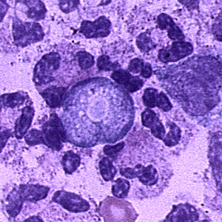
Identifying in patient specimens
CSF is usually the primary source of identifying the organisms
Notes:
http://uvmecoparasit.wikia.com/wiki/Naegleria_fowleri
Large central karyosome with granular cytoplasm that contains vacuoles
Size ranges from 7-35 micrometers

Slide 11
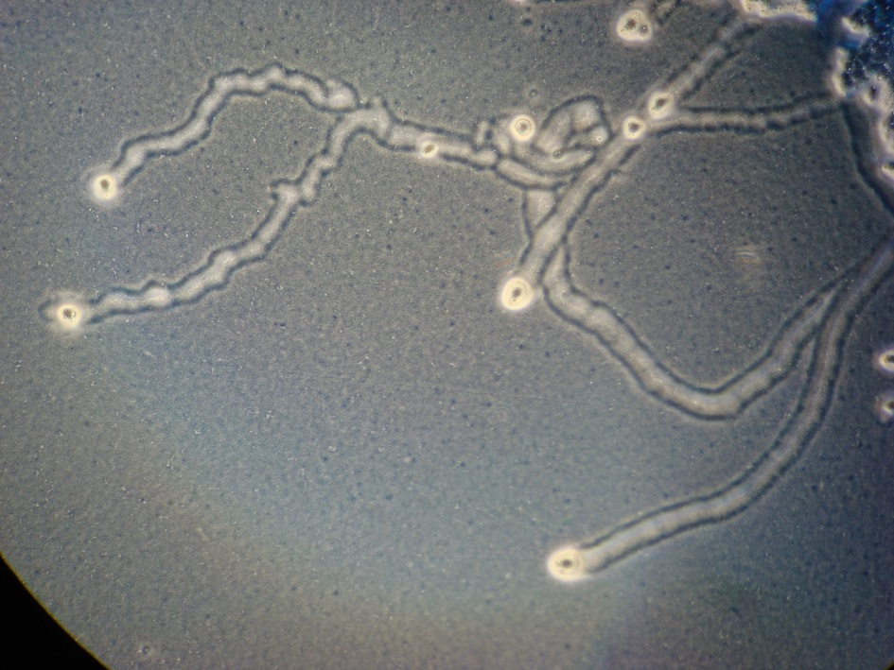
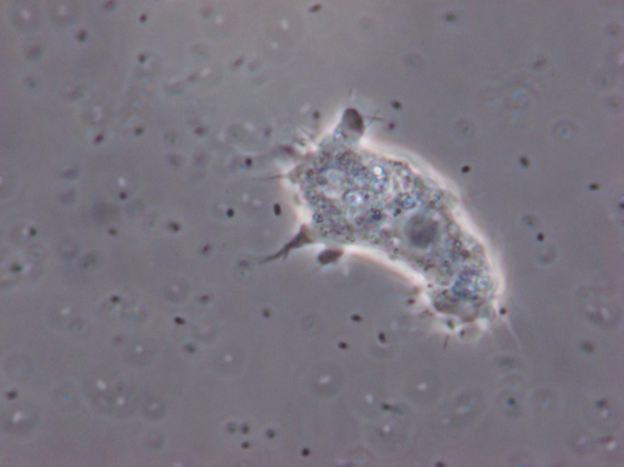
Culture
https://catalog.hardydiagnostics.com/cp_prod/Content/hugo/FreeLivingAmebaeMedia.html
Notes:
Purchased media that a law of E. coli is grown on with the patient specimen dropped on the lawn of E. coli and let them start to grow (can prepare up to a week in advance).
Drop 2-3 drops of spinal fluid on the prepared plate and if there are amoeba you can see tracks of them eating the E. coli
Can use a phase contrast microscope to see the amoeba forms
Can also identify in histology specimens

Slide 12
Patient follow-up
Patient did not have amoeba
No other organism identified in the CSF
Patient recovered and was discharged home

Slide 13
Questions?

