Slide 1
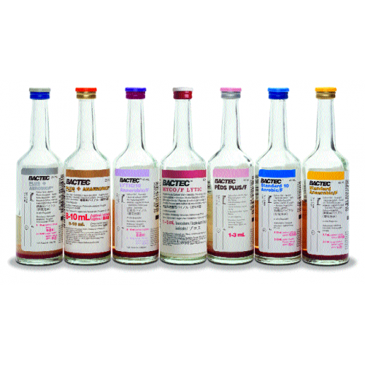
Drawing Blood Cultures
Lori Racsa, DO
Clinical Pathologist/Medical Microbiologist
Phlebotomy
October 2016

Slide 2
Why we draw blood cultures
Sepsis is defined as a potentially life-threatening organ dysfunction caused by a dysregulated host response to an infection
The infection can start anywhere in the body: joint, heart valve, skin
Sepsis is more common in patients who have decreased immune responses: elderly, chronically ill, patients receiving chemotherapy
When patients have signs and symptoms of sepsis blood cultures allow us to try to identify the organism causing sepsis

Slide 3
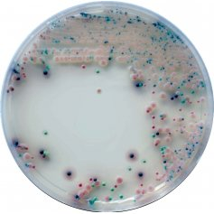
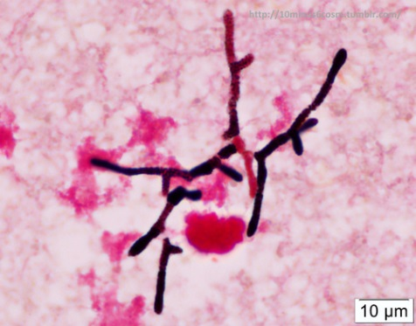
Downside to blood cultures
Sepsis can be caused by bacteria, yeast, molds, and viruses
We can only identify bacteria and yeasts, sometimes molds (Fusarium) but viral etiologies are not detected

Slide 4
Downside to blood cultures
There are times bacteria are at higher counts in the blood (usually when fevers are spiking) and we cannot always catch that time when we draw
Historically, this is why blood cultures were drawn 8 hours apart over a 24-hour period, with an increased likelihood of catching that febrile time

Slide 5
New Standards for blood culture draws
Studies have been done that show it is better to get a larger amount of blood than waiting for the fever to peak in order to draw (Cumitech 31)
Now recommended you draw blood cultures simultaneously from different sites
Amount of blood makes a difference
Studies have shown that by drawing 40mL of blood (two culture sets), recovery of organisms can be increased by 19%

Slide 6
Our procedure
Draw two sets of blood cultures
Drawn from two different sites (venous access)
These need to be two different accession numbers
This is very important because there are times different organisms grow and it also helps us determine if there are contaminants present by evaluating the organisms from one accession to the next

Slide 7
Our procedure (continued)
Draw 8-10mL for each bottle
See previous information on organism recovery
You do not need to wait 15 minutes prior to drawing the second set of blood cultures any longer, draw one set right after the other at the second site
What if the patient is a hard stick?
Remove the needle, re-clean, and redraw the second set of cultures with a new accession number
Again, you do not have to wait any time period to do this, you can do it immediately

Slide 8
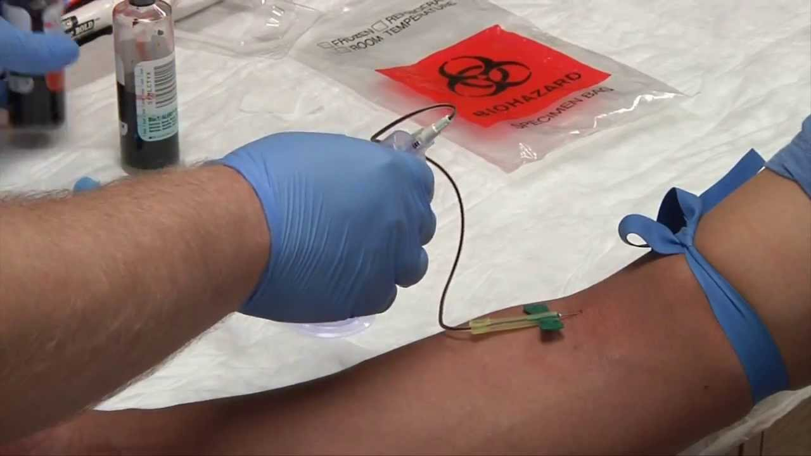
Questions?

