Slide 1
Fairview Laboratories: Specimen Tracking and Transport

Slide 2
Objectives
Following this presentation, you will be able to:
Describe the sending and receiving standard work for laboratory specimens.
Prepare specimens for transport with courier according to the “Packaging and Labeling Specimens for Shipping and Transport” procedure.
Demonstrate understanding of standard packaging and labeling of laboratory specimens.

Slide 3
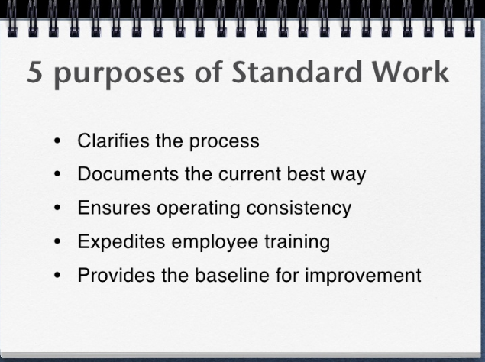
Purpose of These Changes
To implement standard work for tracking and processing of all specimens transported on behalf of Fairview Laboratories.
To implement standard audit to verify compliance with standard work.

Slide 4
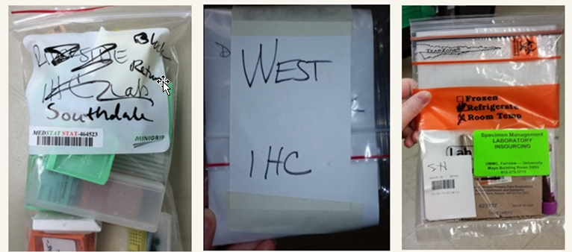
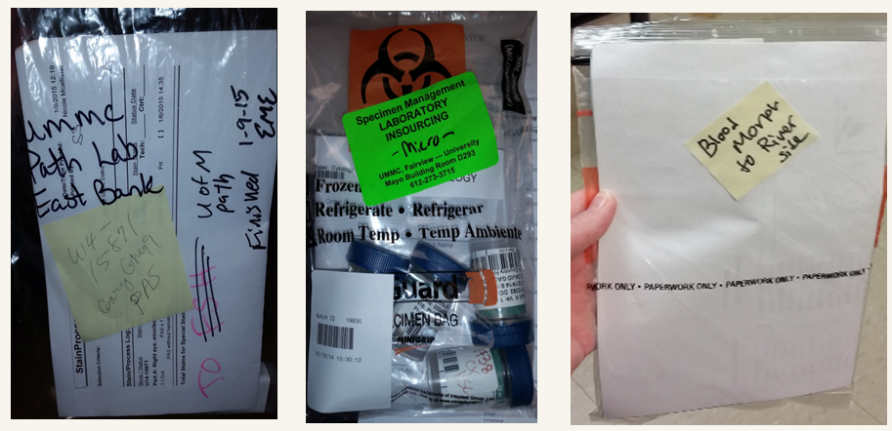
Current State

Slide 5
Why Is This Important?
Lost specimens and/or mishandled specimens affect:
Quality of patient care
RCA (Root Cause Analysis) events put us at legal risk
Brand Reputation
Laboratory expense(s) for investigation/re-work, etc.
CMS (Center for Medicare and Medicaid Services) now mandates that certain lost specimens are considered reportable events (i.e. irretrievable, irreplaceable specimens).

Slide 6
Procedure
Please read the procedure that outlines the changes and requirements that are highlighted in this module.
Specimen Packaging and Labeling for Shipping & Transport

Slide 7
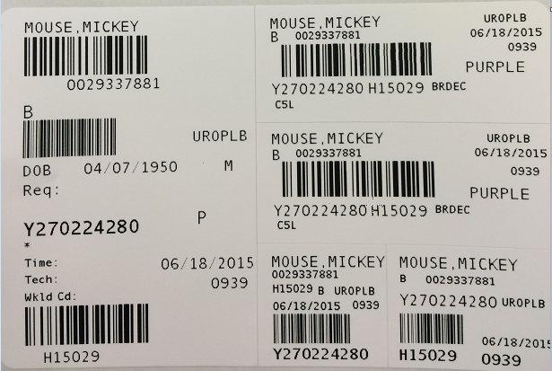
Sunquest Label Refresher
Accession number (Starts with letter for day of the week)
Hospital ID (HID)
Sunquest test code
Sunquest test spot (ex. BRDEC needs a decant step to create a child label which will route the test code to the final testing spot)
Container ID (CID- unique number that starts with Y and is followed by a 9 digit number)
Patient Order location code (Found on the big label, and each of the CID and small labels)

Slide 8
Lab Guide Refresher
Lab Guide is on the Fairview Intranet
Intranet location: Laboratory Services→ Find a Test
Each test should be looked up in Lab Guide to determine:
  Collection & Processing instructions
  Testing location

Slide 9
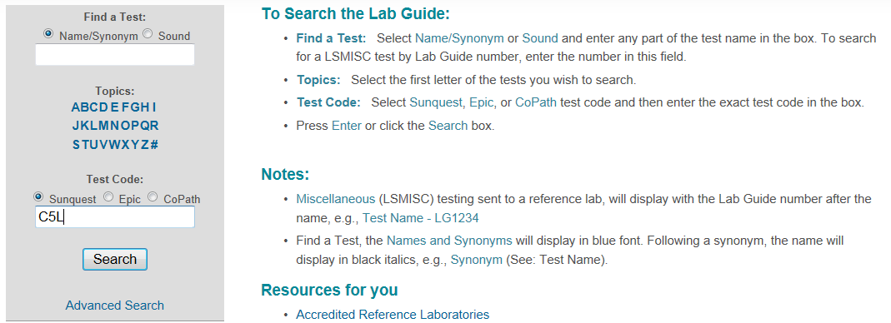
Lab Guide Refresher example:
Find test in lab guide (ex: Sunquest test code C5L)

Slide 10
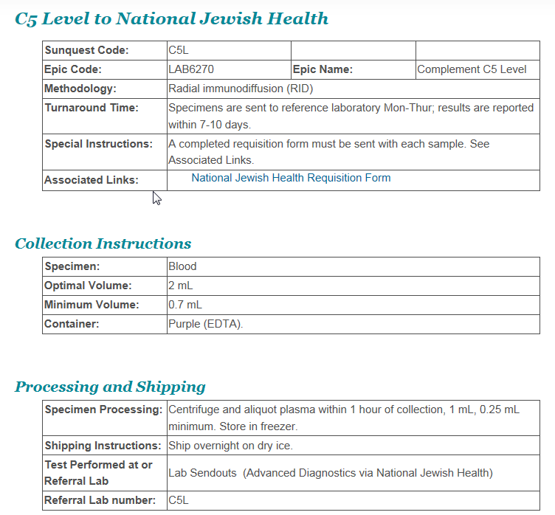
Lab Guide Refresher example:
Review collection and processing instructions
3. Determine where specimen needs to be sent for testing

Slide 11
Sending Laboratory Responsibilities
Refer to the Fairview Lab Guide to review test requirements and processing instructions.
Mandatory:
All clinical laboratory specimens must be ready for testing prior to packaging and transport/shipment according to Lab Guide instructions.
Note: If test is not in Lab Guide, follow the reference laboratory’s processing and shipping instructions.
All clinical laboratory specimens must be labeled with a Sunquest CID label prior to batching.

Slide 12
Tracking in Sunquest: Obtain a CID Label
Generate Sunquest CID label for each specimen by one of the following ways:
  Release the order in Epic and receive it in Sunquest.
  Order the correct Sunquest tracking code per Epic/Paper Order on the appropriate CSN/Account.
  Receive the appropriate test code(s) and/or Anatomic Pathology tracking code (i.e. NGNCT, SRGPTH) in Sunquest.

Slide 13
Tracking in Sunquest: Generate a Batch
Generate a batch in Sunquest by scanning individual specimen CID barcode(s) and obtain a batch label. Click here to view procedure: Processing a transport Batch
  Miscellaneous test (XMISC) order steps must be completed in Sunquest. Click here to view procedure: Miscellaneous (LAB4909) Order Workaid.
  ROB (Reference Outbound Batch) if necessary. Click here to view procedure: Reference Outbound Batches (ROB) .
      Note: This is only done by sites where no direct pick-up to reference lab is available.

Slide 14
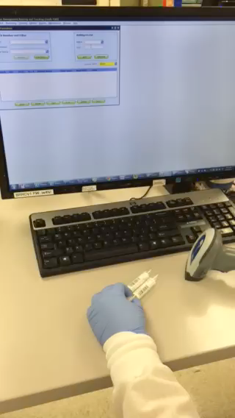
Tracking in Sunquest: Generate a Batch
Hover mouse on picture and click play button ( )below video to play
  Generate a batch in Sunquest by scanning individual specimen CID barcode(s) and obtain a batch label. Click here to view procedure: Processing a Transport Batch.

Slide 15
Where to Send Specimens
Place specimen(s) in a Fairview Medical Laboratory custom color-coded (temperature specific) shipping biohazard bag. Regular, generic biohazard (UMMC only) or clear bags will be used for internal shipping (within a facility).
Specimens must be batched to Specimen Management or IDDL only (unless sending lab has a direct courier route or an on-demand courier is requested).
For all laboratories that have a direct courier route to another Fairview laboratory, all specimen(s) must be put on a Sunquest transport batch.

Slide 16
Sending Laboratory Responsibilities
Pull a batch filter at least once per shift:
  Review any unaccounted for specimens on filter and investigate.
  Do not save this filter because it will create a batch of specimens not ready/available for transport. Click here to view procedure: Processing a Transport Batch.

Slide 17
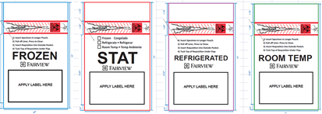
New Specimen Packaging
Custom specimen bags will now be used at all laboratory sites to package specimen(s) being sent to an external Fairview lab.
They come in 2 sizes (6x9” and 12x15”) and will be color coded and printed to indicate shipping temperature:
    Blue=Frozen
    Red=STAT
    Purple=Refrigerated
    Green=Room Temp
  Note: Shipping temperature must be checked with Sharpie on red STAT specimen bag.

Slide 18
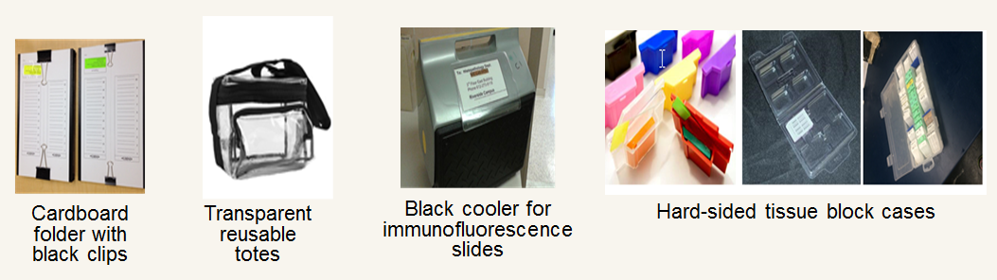
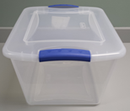
New Specimen Packaging
Anatomic Pathology Laboratories will use the following materials to send between their sites:
Clear plastic tote

Slide 19
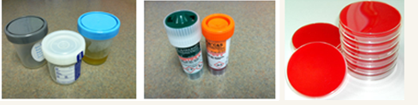
Packaging Specimens: Guidelines
Include any necessary paperwork in the external document pocket.
Tightly seal any sterile screw-top (i.e. urine, body fluids, stool) containers.
Package sterile screw-top containers, GCPCR/CHPCR, and culture plates separate from all other specimen types.
  Note: All clinical specimen types can be packaged together at appropriate temperature with the exception of sterile screw-top containers, GCPCR/CHPCRa, and culture plates (images above).

Slide 20
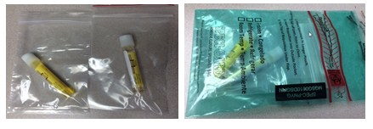
Packaging Specimens: GCPCR & CHPCR
Package all GCPCR & CHPCR containers individually (urine or swab Genprobe) into single small zip lock plastic bags.
Individual zip lock bag(s) containing GCPCR & CHPCR will be batched and placed in one biohazard bag and sent to IDDL.

Slide 21
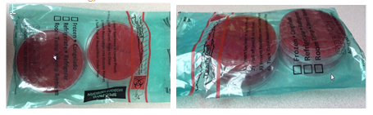
Packaging Specimens: Culture Plates
IDDL culture plates can be stacked 2 plates high with no more than 4 plates per bio-hazard bag.
Note: Do not use tape of any kind to secure culture plates.

Slide 22
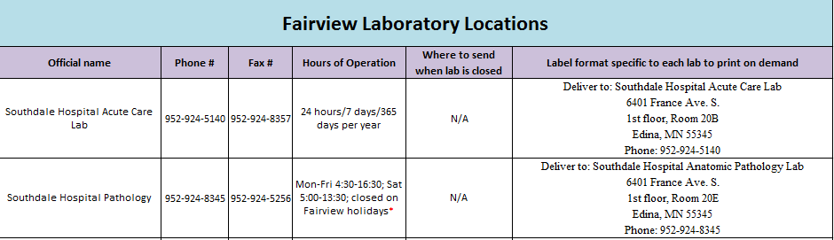
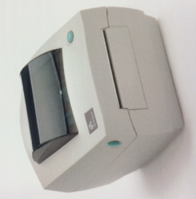
Standard Specimen Bag Labeling
Obtain an on-demand shipping label by scanning the appropriate barcode for the receiving laboratory from the standard spreadsheet (image below left).
All printers are obtained from and supported by Coridian (image above right).
Note: Refer to Coridian Printer Workaid for on-demand shipping label printing instructions and guidelines

Slide 23
Labeling Specimens Bag(s) for Transport
All shipping labels must include the destination name, address, and phone number according to the following format:
      Deliver to: [Official Laboratory Name]
      [Street Address]
      [Building, Level, Room/Suite Number]
      [City, State, Zip code]
      Phone: [Contact phone number including area code]
Shipping information must never be covered on the biohazard bag (including the biohazard logo, shipping temperature, the destination address, and/or batch label).

Slide 24
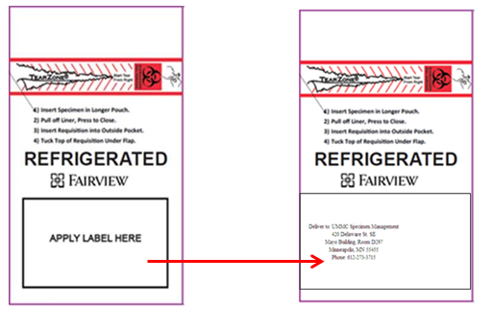
Labeling specimens Bag(s) for Transport
Place the transport shipping label onto the designated area on the bottom portion of the specimen bag over the black-outlined box that states “Label here”.

Slide 25
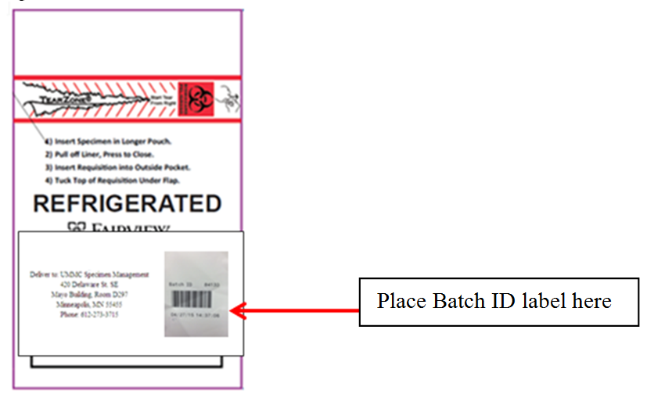
Labeling Specimens Bag(s) for Transport
Place the Sunquest batch label on top of the print-on-demand shipping destination label on the right.
Note: Placing the batch label on top of the on-demand shipping label will prevent batch labels from falling off at various temperature ranges.

Slide 26
Print-on-Demand Printer Issues?
DO NOT contact TSC/Fairview IT for print-on-demand printer issues
Coridian customer service should be contacted for print-on-demand printer issues:
  Monday through Friday 8AM to 5PM
  Phone number: 952-361-9980
  Website: http://www.coridian.com
Each hospital laboratory site will have at least one back-up printer available. Contact site lab manager for location.
Note: If print-on-demand printer is unavailable, address labels must be hand written using the standard format from the standard spreadsheet.

Slide 27
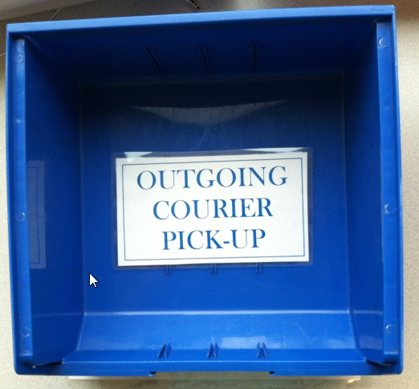
Outgoing Specimen(s): Courier Pick-up
All outgoing specimens ready for testing and courier pick-up must be placed in the appropriate BLUE outgoing courier pick-up bin.
Note: There will be a BLUE outgoing courier pick-up bin available for all shipping temperatures.

Slide 28

Incoming Specimen(s): Courier Drop-off
All incoming specimens will be dropped off in the designated RED courier drop-off bin.

Slide 29
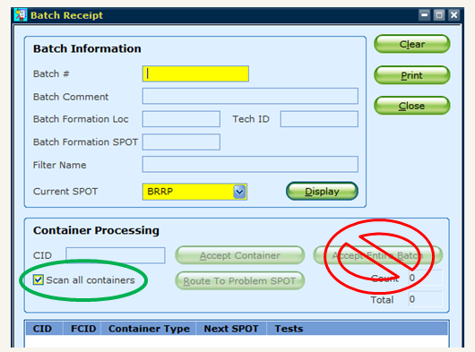
Receiving Laboratory Responsibilities
Disband all batched specimens using Sunquest SMART by scanning the CID label on each specimen individually
  Never accept the entire batch
Note: Verify the “Current spot” is correct for your receiving location.

Slide 30

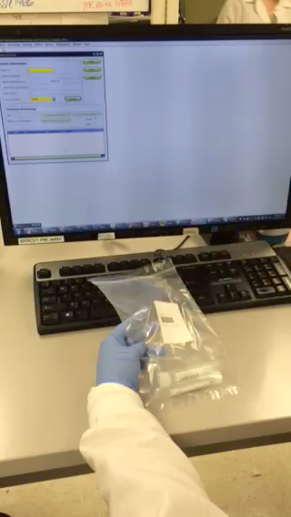
Tracking in Sunquest: Disbanding a Batch
  Disband a batch in Sunquest by scanning individual specimen CID barcode(s). Click to view procedure: Processing a Transport Batch.

Slide 31
Receiving Lab Responsibilities
Any CID(s) left on the batch must be investigated immediately
  Discarding of custom bags:
    Custom bags can be disposed of in regular trash because the tear off top destroys the biohazard symbol.
    If bag is soiled, dispose in biohazard trash bin.

Slide 32
Receiving Location Responsibilities
If specimen is at final testing location, proceed with testing.
If specimen is not at final testing location:
  Disband batch by scanning CID label(s) individually
  Batch specimen(s) by scanning CID label(s) individually
  Package and label for transport or shipment

Slide 33
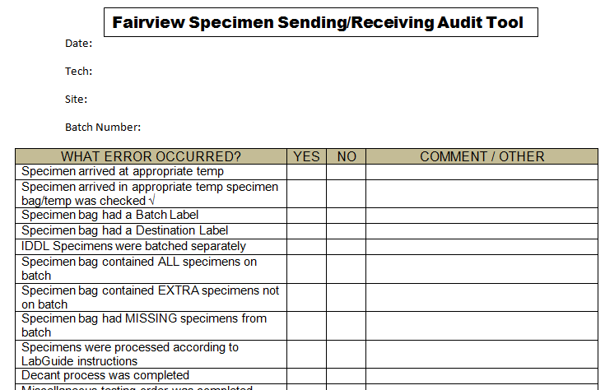
Compliance and Education
Audits will be done by each site on an on-going database (partial image of audit tool below)
Specimen Management will complete the audit as part of their daily work to identify issues.
Results will be shared with the System Transport & Courier committee

Slide 34
Summary
All specimen(s) must have a Sunquest CID and be ready for testing prior to transport/shipment.
All specimens must be tracked in Sunquest by scanning individually CID(s) to create and disband batches.
Specimen(s) must be packaged according the procedure Specimen Packaging and Labeling for Shipping & Transport and labeled using standard format.

Slide 35
Who to contact with questions
The following individuals are site representatives:
Cytology: Jana Holler
FMG Clinics: Lisa Karnik & Michelle Stevens-Brioschi
Lakes: Helen Brenny
Northland: Tonya Kindseth
Outreach: Joy Case
Pathology: Brooke Eguia
Ridges: Kari Amacher
Southdale: Mila Montemurro-Healy
Specimen Management: Karri Cargill & Sherry Davis
UMMC East Bank: Brad Lemke
UMMC West Bank: Vicki Zebroski

