Slide 1

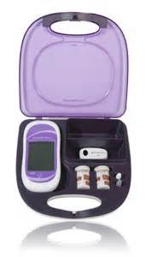

Point of Care Testing:
ACCU-CHEK® Inform II
Glucose Meter

Slide 2
Why Training?
The use of blood glucose meters by untrained staff, without adequate management supervision of the equipment and without the use of quality control procedures, can lead to misleading results, adversely affecting the treatment of patients”
Newcomers must have competency assessed: initially at 6 months, 1 year and annually thereafter.

Slide 3
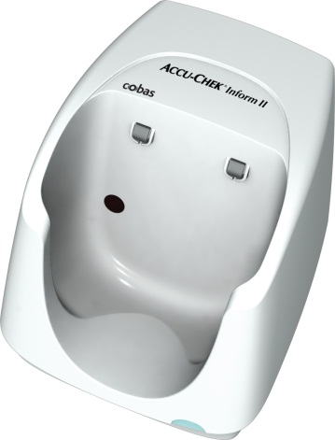
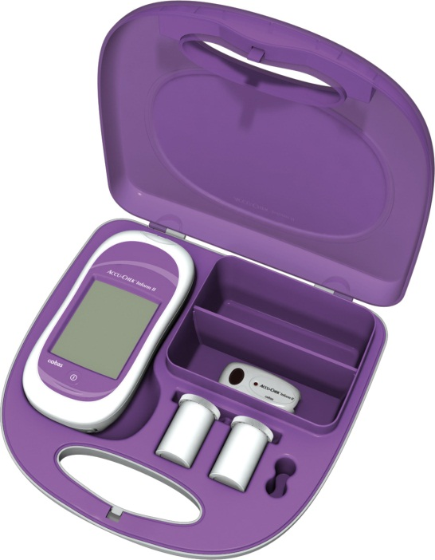
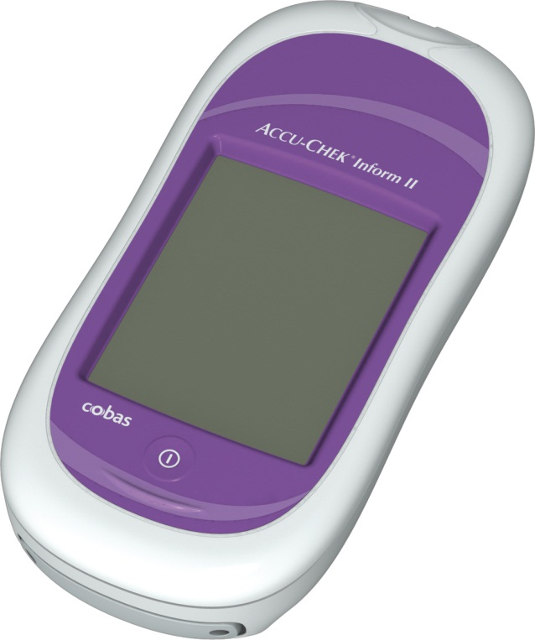
Accu-Chek Inform II
Base Unit (BU)
Automatic data transfer and battery charge.
Green light – standby
Red light – data transfer
Tote Box
Meter, strips, Control 1 & 2, lancets
Accu-Chek Inform II
Notes:
Explain the 3 components of the system emphasizing the charging function of the base unit. Docking the ACI II on the base unit when not in use will ensure that the meter is operational when required. Inform 2 also in Wireless.
6 hours to fully charge meter– Ideally, meters should always stay in base units. From a fully dead battery, if placed back in the base unit, it takes about 60 minutes to charge it enough to run a test. But the meter can be used at any level of battery life, as it is charging.
May use training guide to go over all 3 components in more detail, so not to miss any info.
Code Key is not mentioned here as the training is geared to nursing end users and they will never see it, only POCCs use the code key reader to input the lot numbers of reagents.

Slide 4
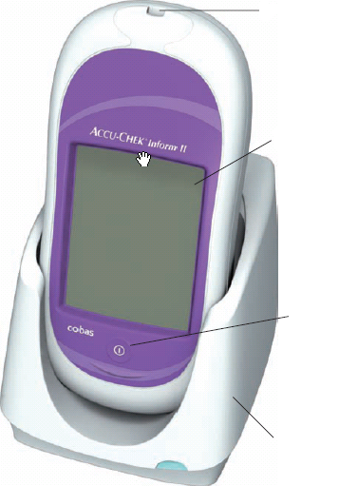
Accu-chek Inform II
FRONT VIEW
Test Strip Port
Touch screen
On/off button
Base unit
Notes:
On/Off Button – Press and hold down to display screen contents. Check that screen is full of icons and the segments that form the “8”s are intact.
Ensure all areas of the screen are clearly visible. Screen should be checked each time meter is switched on , minimum daily.
(meter may have been dropped and the screen may have been damaged / not display figures clearly e.g may display a 3 but should be an 8 – this could have implications to the treatment given)
Memory Buttons – Do not use memory function in clinical setting as not able to input patient identification into meter. This should NEVER be used in a professional setting.
Storage – The meter and all associated consumables should be stored at room temperature. Avoid extremes of heat/cold.
Measuring Range – 0.6 – 33.3mmol/L

Slide 5
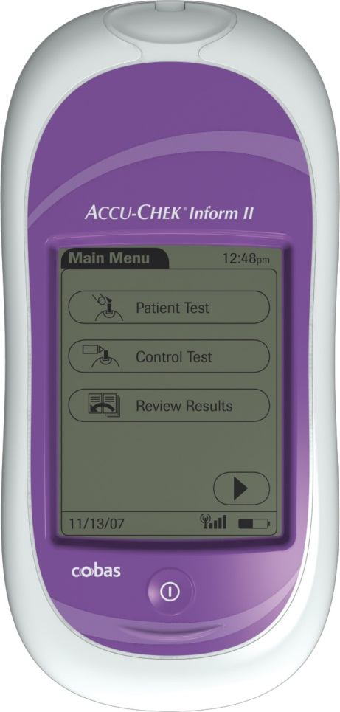
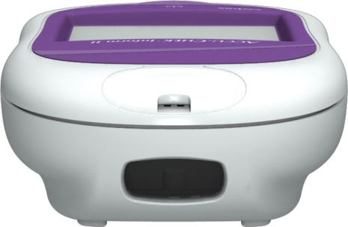
Accu-Chek Inform II
FRONT VIEW
Test Strip Port
Barcode Scanner (Laser)
Operator ID
Patient ID
Control Solution 1 & 2
Inform II strip vial
Touchscreen-Main menu with 3 options (finger touch only )
On/Off Button
Notes:
Test Strip Port: Insert the test strip here – it is the ONLY opening on meter
The integrated barcode scanner can be used to read operator and patient IDs, and reagent lot numbers (test strips and controls).-Ensure that you don’t flash bar code scanner at eyes-yours or others.
Touchscreen (touch-sensitive display): This screen allows you to perform patient and controls tests, review results. To select any of these functions, simply touch the button on the screen.-Use fingers only
On/Off Button: Press this button to turn the meter on or off. In addition, you can activate or deactivate the backlight with this button.

Slide 6
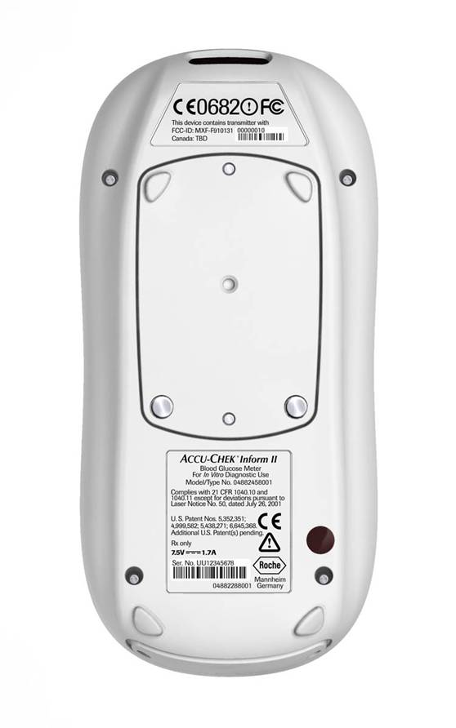
Accu-chek Inform II
Bar code scanner
Back View
Battery Pack
Infra-red window for communication
Notes:
The reset button should be used to correct unspecified errors when the meter is not responding for any reason, examples include when the screen freezes, or when an error code is encountered. The reset button is a REBOOT only, with no loss of patient data or meter configuration settings.
However, if this is a reoccurring issue-meter should be sent to lab for investigation
Wireless card reader information may be zone specific

Slide 7
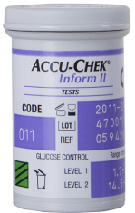
Accu-Chek Inform II Strips
Code Key information loaded by POCC
Stored @ Room Temperature
Test Strip Code, Quality Control Range, Expiration and Lot # Bar Code is on each vial
Scan or verify lot number with each use
Once opened initial and date
Replace cap immediately after each use
Expiration date on vial is valid for “open” or “closed” vial expiration date
Notes:
Strips can be handled without any issue, although make sure cap is replaced as soon as possible after opening between each use. Strips are sensitive to extreme humidity. Strips are good until the expiration date, (opened or un-open) no need to date test strip vials!
Explain that there are 2 levels of controls ,Level 1 and 2 and that the solutions are stable at room temp up to 3 months after opening the vial or through the expiration date, whatever comes first. Write opening date on vials.
Blue dye in control solutions-will stain clothing

Slide 8
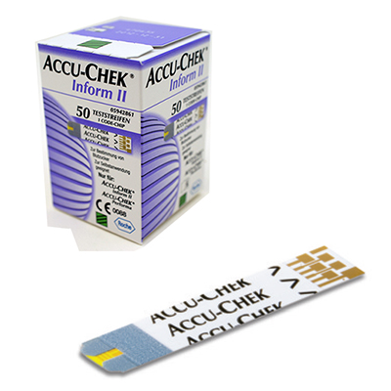
Accu-chek Inform II Stips
Sample volume detection
Robust End Dosing Strip
Fast 5 Second Result
0.6μL sample size
Notes:
Test Strip – Is robust and can be handled as long as hands are clean, dry & free from alcohol gel. They are dosed at the tip of the strip. (End dosing strip).
You must ensure when applying blood/QC solution that the yellow test pad is completely covered for accurate results.
Storage of test strips: The lid must be kept firmly closed on the pot as exposure to heat & humidity can cause the test strips to give inaccurate results. If the lid is left off – dispose of the pot of test strips. Performa test strip pot has a flip top lid to prevent lid becoming stuck in the workstation!
Validation before use – On insertion of the test strip you must validate that the 3 digit code on the pot of test strips corresponds with the code displayed on the screen of the meter before performing a test.
Check expiry date of test strips before use.
Uderdose detection (error code E4) prevents using a strip with insufficient sample.
The Performa strip also compensates for temperature, humidity & Haematocrit – gives error messages if unable to compensate.
The Performa strip also detects sample type: blood /QC

Slide 9

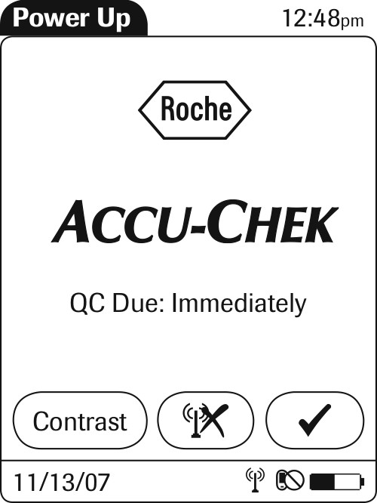
Accu-Chek Inform II
Power up screens
Notes:
The battery icon shows the current battery level. A completely filled icon indicates a fully charged battery, and a partial charge is displayed as a partially filled battery icon .
If during meter self-check an error is detected, the appropriate error message appears on-screen.

Slide 10
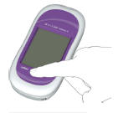
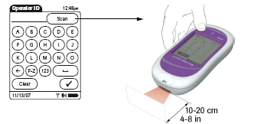
Start Up – User Identification.
Step 1: Press and release the On/Off button . The system is now on.
Step 2: The Power Up screen appears.
Step 3: Scan operator ID.
Operator ID is unique to user and needed for all activities
* Do not share your operator ID/badge with other staff!
Notes:
Scanner icon is white when in “Scan Ready” mode. Icon turns black when in “Scan mode” – only 10 seconds. If barcode to be scanned has not been read by meter in that timeframe, operator must wait till scanner is in white “Scan Ready” mode again, then try to scan again.

Slide 11
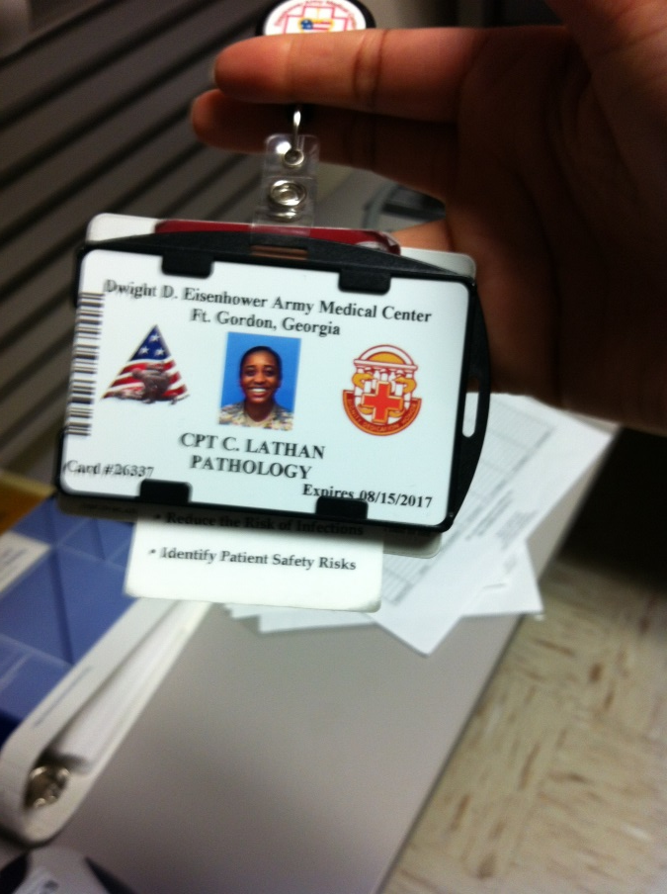
Scan barcode on badge
What is an Operator ID?
  Your DoD ID is your Operator ID and is used to identify you as the person performing a glucose test.
  Scan the bar-code on the front of your badge.
  If your ID comes up “Operator ID is invalid” try docking your meter and try again. If it still does not work, contact POCT Staff.

Slide 12
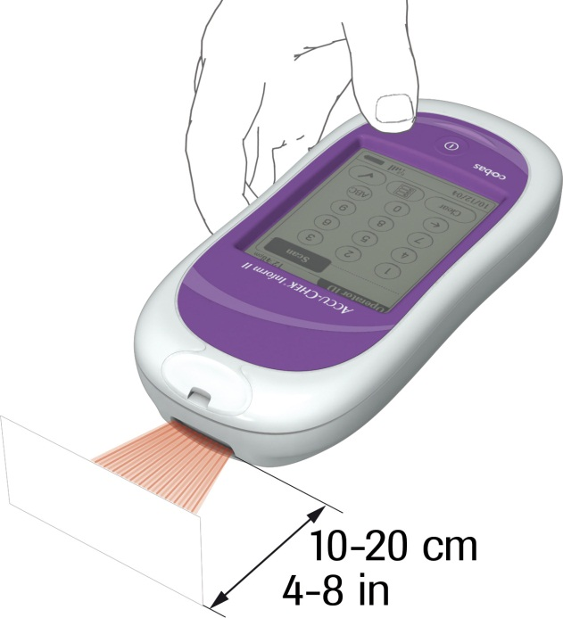
Remember:
Scanning is everything
Scanning prevents manual entry errors and results going to the wrong patient chart.
If you must manually enter a number, double check it before you press the enter button. This should be a rare issue.

Slide 13
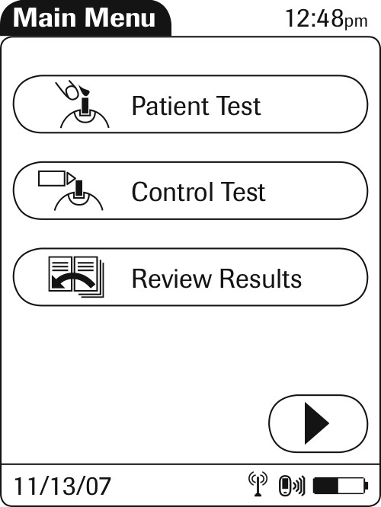
Main Menu Screen

Slide 14
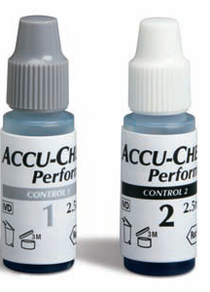
ACCU-CHEK® Controls:
When opening a new box of ACCU-CHEK® Controls,
  record the open date and 3 month expiration date on the vial
  Circle the manufacturer’s expiration date printed on the label, if less than 30 days.
  Prior to performing QC, check the expiration date on the control vials.
  Store glucose control solutions at room temperature (less than 90°F, 32°C). Do not freeze.
Must write date when opened and 3 months to Discard along with initials

Slide 15
Quality Control Frequency
Control testing must be performed at the following times:
Every 8 hours/every shift, or meters will lock out patients testing.
When a new vial of test strips are opened
When a vial of strips has been left opened
If the meter has been dropped

Slide 16
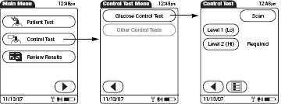
Quality Control Screens

Slide 17
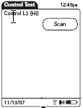
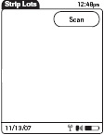
Control/ Strip Confirmation
Touch the scan symbol on the screen to enter the lot # of the Control/Strips
Scan the lot number on the control vial
Scan the lot number on the test strips
Notes:
POCCs will program lots (both QC and Strip lots) to be used thru code key reader and RALS System.
System will not allow outside lots not programmed in system to be used. Error message will appear.

Slide 18
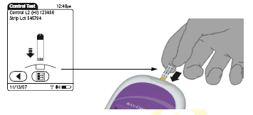
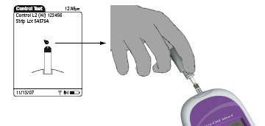
Performing Quality Control Test
“Flashing Drop” symbol appears.
Meter is ready for QC sample.
Remove cap and apply control solution.
“Flashing Arrow” symbol appears.
Insert test strip into test strip port.

Slide 19
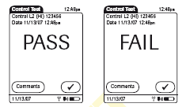
Result Screen

Slide 20
Actions for Failed Control Test
If “FAIL” appears touch “ ”. You may enter up
to 3 comments.
• Repeat failed control.
• For “FAIL” control result consider the following.
  The test strip vial has been left opened for a period of time
  Procedural error
  The test strip or controls have been exposed to very high or low temperatures
  The control solutions are expired and/or contaminated.
NOTE: Report two consecutive failures to laboratory Point of Care Coordinator (POCC)706-787-8359

Slide 21
Start Patient Testing
Scan your Operator ID Badge
Select “Patient Test” on the screen.
Scan the patient’s armband
Note: If the patient’s armband cannot be scanned, carefully enter the patient’s ID number manually, and verify the identification in the meter before accepting the entry.

Slide 22
Always Identify the patient
Per Hospital policy all patients must be identified with two identifiers
  Full name and date of birth

Slide 23
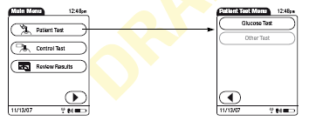
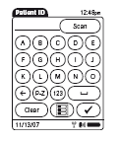
Patient Testing
Step 1: Select patient test from menu
Step 2: Select Glucose Test
Step 3: Scan in Patient hospital number. (Meter will prompt you to confirm patient details)
Step 4: Scan in Test strips

Slide 24
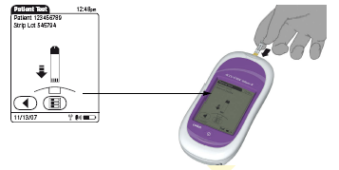
Check test strip code and insert strip.
Patient Testing
* Check Patients details at top of screen

Slide 25
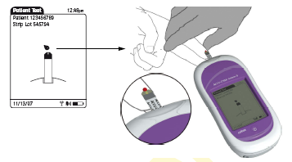
Apply patient blood when prompted.
Patient Testing
* Make sure to wipe away the first drop of blood.
Notes:
Sample size is 0.6 ul
5 seconds to result
Fill the target window completely-insufficient sample will give an error code
Avoid placing meter at angle which allows
blood (or QC) to drip into strip port opening.

Slide 26
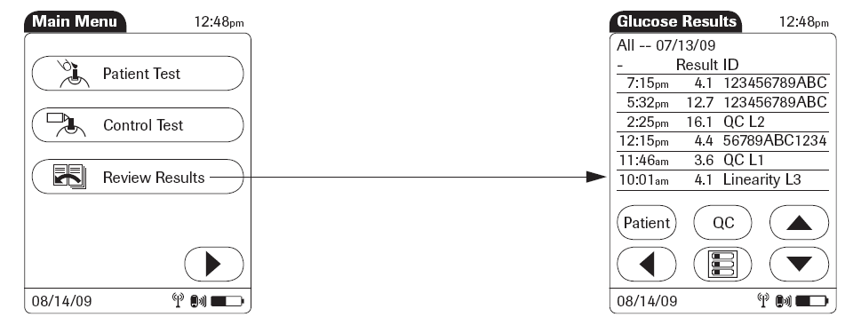


Review Results
From main menu screen touch ‘Review Results’. (Patient/QC)
Stored test results are displayed in a sequential list.
Touch or to scroll up or down in the list. Results are grouped by date.

Slide 27
Review Results Cont.
Touch an entry in list to display related details.
Touch ‘Patient’ symbol to display results for a specific patient only – Test results available with date and time of test only, no Patient specific ID.

Slide 28
Testing yourself or Co-Workers
It is a work rule violation to test yourself or co-workers.
Exception to this is an emergency, the person will need to go to the Emergency Room for assistance.

Slide 29
Clean meter Daily
Meter, Base Unit, and Carrying Case Cleaning Procedure:
Meter must be turned off and the base unit must be unplugged
prior to cleaning.
Clean the outside of the Accu-Chek Inform II System with hospital approved disinfecting wipes only. With the meter upside down begin cleaning the device, avoiding the strip opening. Moisten all surface areas of the meter ensuring to remove all visible soil. Allow to dry according the hospital policy to be fully disinfected.
Follow the same guidelines for cleaning the base, avoiding contact with the electrical leads

Slide 30
Interpretation of Results
Reference Ranges
POC Glucose Ranges
  Normal 70-100 mg/dL
DDEAMC Reference Ranges are:
  Critical LO= Less than 50 mg/ dL
  Critical HI= greater than 450 mg/dL
( If you get any of these values, it indicates the results are outside the reading range and you must repeat the test.)
If you get a value that exceeds the normal range value but in within the high and low parameters please ensure you notify the HCP and notate this value in the patients record.
**NOTE: The meter will read as low as 10 mg/dL and will be indicated by a reading of “LO” on the meter display. It will read higher than 600 mg/dL and will be indicated by a “HI” reading on the meter display.**

Slide 31
Alert Values
****All alert values must be repeated using a fresh sample from new stick.
Actions taken must be documented in the meter by entering a comment.
  Report to caregiver or provider, and follow his/her recommendations.
  Alert values obtained must be reported immediately to the care nurse for assessment of the patient.
  Results must be verified by the clinical laboratory if requested by the provider.

Slide 32
Limitations
Due to medical conditions:
Hematocrit should be 10-65%
Lipemic samples (triglycerides) >1800 mg/dl
Galactose blood concentrations >15 mg/dL
Impaired peripheral circulation
For further information refer to Test Strip package insert or SOP

Slide 33
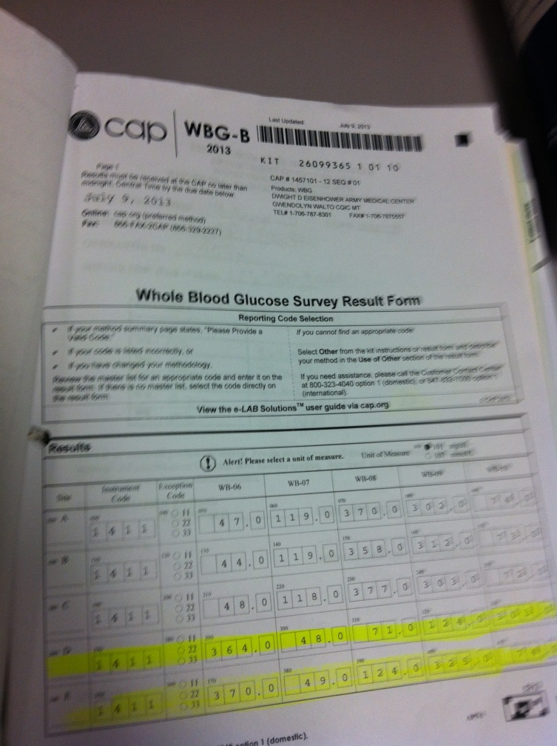
Proficiency Testing
Proficiency Testing (PT) will be delivered 3 times per year.
Each sample will need to be performed on all meters on your unit.
Independently, run samples in PROFICIENCY TESTING mode, a POCT Staff member will be present to assist.
Record the results on the form provided.
If an operator’s performance results in an out-of-range PT, the POCT staff will observe, using the same specimen, to re-access their competency.

Slide 34
Summary
• Finger stick:
Remove/dry all alcohol form puncture site.
Wipe first drop of blood off and use second drop for testing.
• Applying Sample:
Make sure the yellow target area is filled with blood.
Do not lay meter on soft surfaces.
• Repeat test if results are critical or if they appear inconsistent with patient’s symptoms.
• Close lid containing strip promtly.

Slide 35
Training Competency
Step One
• Print out the documentation showing you have
passed the test.
Step Two
• Let your Unit POCT Trainer know you have
completed this portion of your training and present
him/her with documentation.
Step Three
• Demonstrate your performance of a ACCU-CHEK®
Inform II Glucose test for your trainer. Have the training documented on your glucose competency sheet and have your Unit POCT Trainer submit a memorandum to the POCT Staff so your information can be updated in the system.
Step Four
Place all certificates and training records in your CAF Folder.

Slide 36
References
POCT 5.4 WHOLE BLOOD GLUCOSE TESTING
ACCU-CHEK INFORM® II SYSTEM
POCT 5.0 Quality Control/Quality Improvement Policy

Slide 37
Competency Assessment

Slide 38



