Slide 1
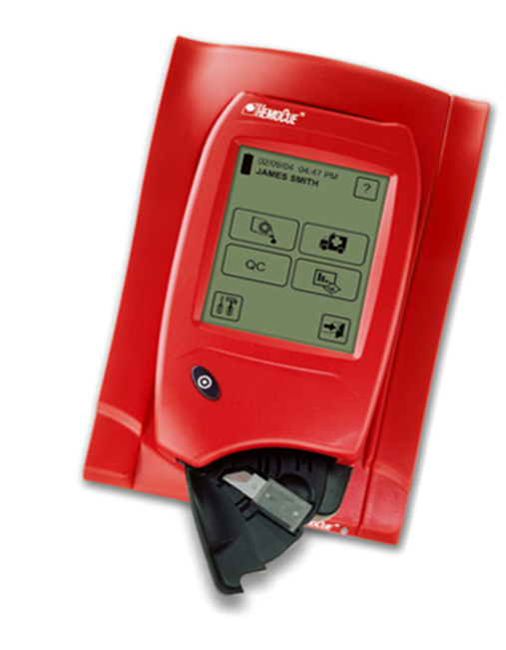
HemoCue 201 DM System Operator Training

Slide 2
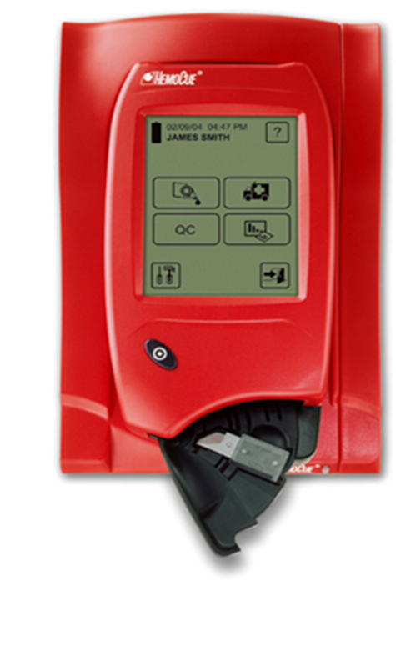
Training Outline
HemoCue 201 DM System
Overview
Analyzers
Docking Stations
Instructions for Testing
QC Testing
Patient Testing
Data Management
Downloading
Exporting Results
Analyzer Maintenance
Troubleshooting
Support
Point of Care Testing

Slide 3
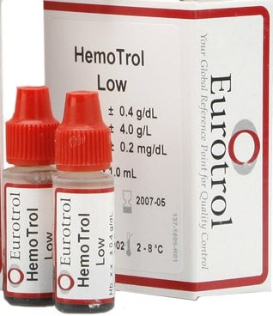
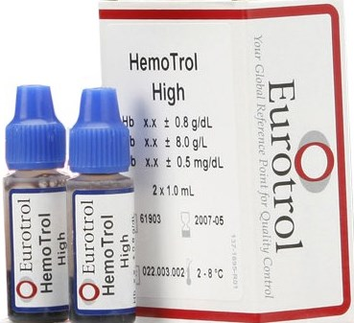
HemoCue 201 DM System
HemoCue® Hb 201 DM Analyzer
HemoCue® Primary Docking Station
HemoCue® Hb 201 Microcuvettes
HemoTrol Low and High Quality Control

Slide 4
HemoCue 201 DM System
Hemoglobin Measuring Range: 0-25.6 g/dL
Test Time: 15-60 seconds
The Analyzer stores: 4000 Patient/Stat Tests, 500 QC Tests
NOTE: ONLY HemoCue Microcuvettes should be used in HemoCue Analyzers
The systems are intended for in-vitro diagnostic use only.

Slide 5
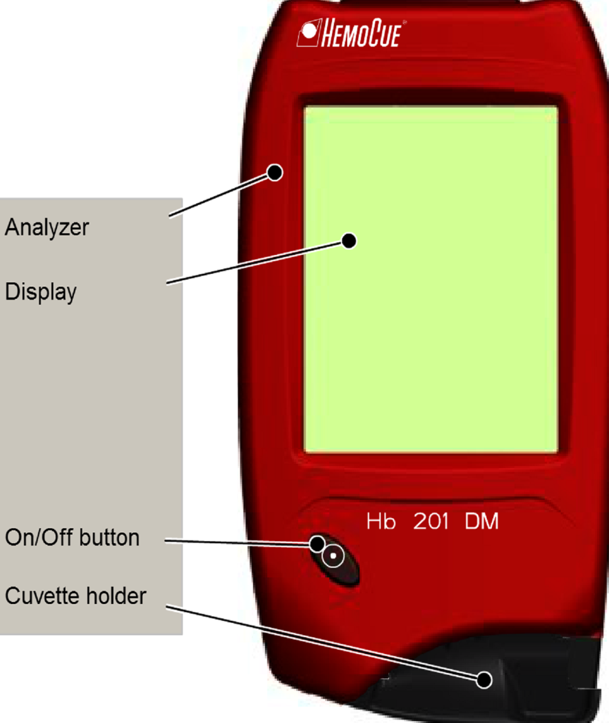
HemoCue 201 DM System
Front Panel
Start the analyzer by pressing the On/Off button. The images will be visible on the display.
All navigation and information handling is performed by pressing the touch buttons on the display. Do not apply excess pressure.
Activate the display by moving your finger away from the display.
To perform a measurement fill the cuvette with sample and place in the cuvette holder.

Slide 6
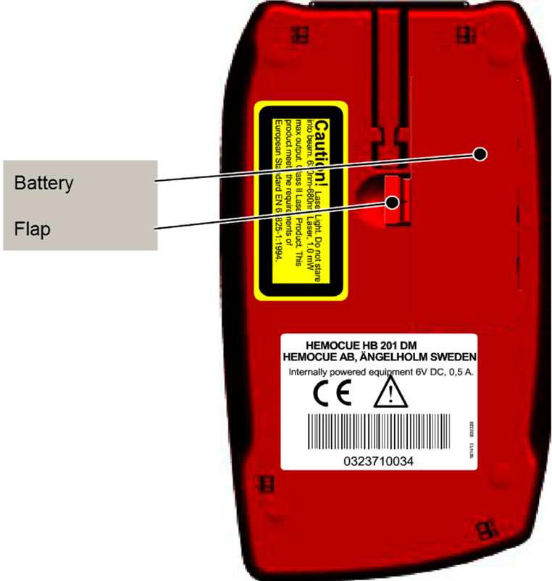
HemoCue 201 DM System
Back Panel
The analyzer can be powered by the rechargeable battery or by a standard electric outlet via an AC outlet.
The battery life is dependent on the frequency of use of the analyzer, approximately 2 years. Replace the battery if the analyzer fails to operate after you attempt to recharge the battery.
To remove the battery, press the flap. Carefully loosen the battery and lift it upwards.
Note: Only the HemoCue® 201 DM Battery can be used in the analyzer.

Slide 7
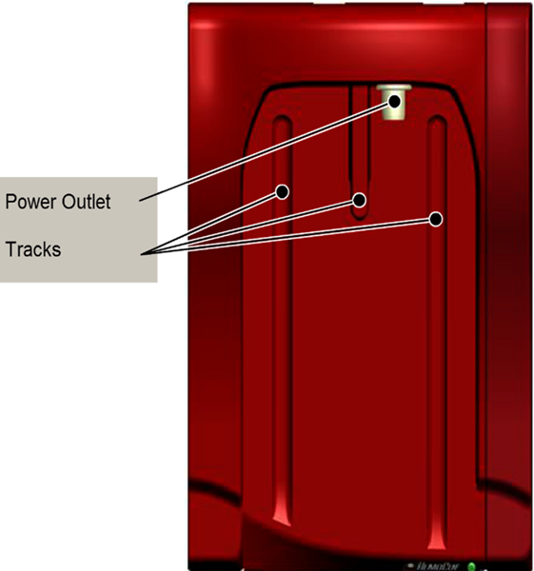
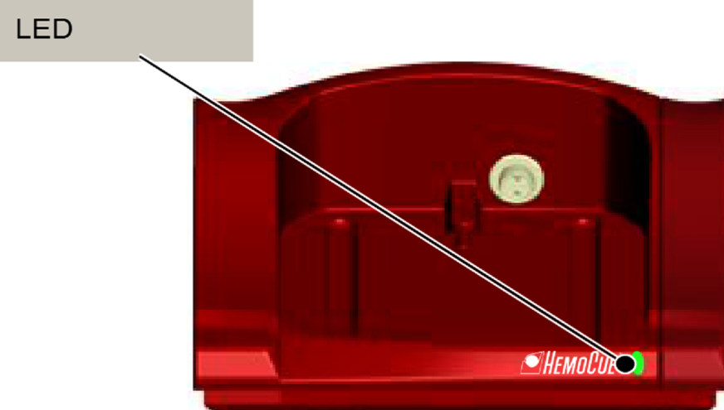
HemoCue Docking Station
Allows for the remote transfer of data and management of the analyzers from a central point.
Charges the analyzer battery while it is docked.
The combined power-USB signal outlet is not a standard USB port but a special connector that fits the analyzer to the docking station.
Docking Station LED Light
GREEN
Steady: Analyzer battery is fully charged
Flashing: Analyzer battery is charging
RED
Indicates No Network Communication (Only applicable to the HemoCue® Primary Docking Station

Slide 8
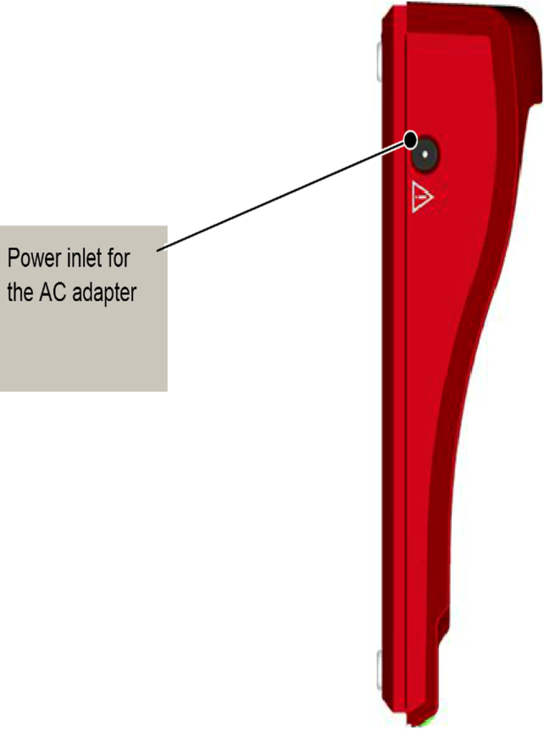
HemoCue 201 DM System
LEFT SIDE:
DOCKING STATION
BACK PANEL:
DOCKING STATION
The USB port for setting up the HemoCue® Primary Docking Station and the Network port for data communication via a LAN is located.
The power inlet for the AC Adapter is located here.

Slide 9
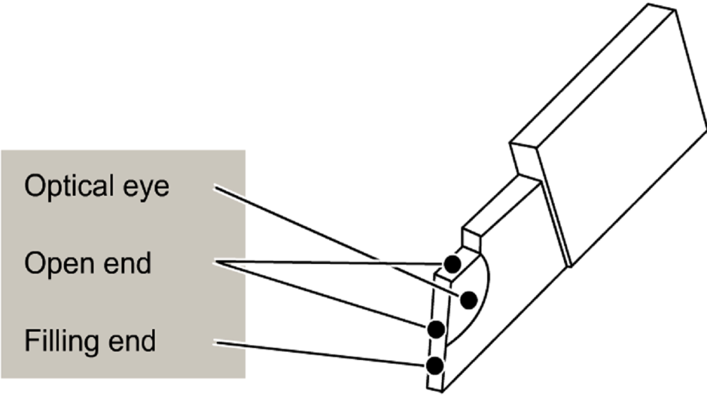
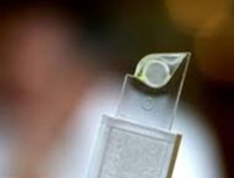
HemoCue Microcuvettes
The HemoCue Technique:
Based on an optical measuring microcuvette of a small volume and a short light path.
Makes it possible to sample the blood, mix and chemically react it with the reagents within the same cuvette that is used for measurements.
The microcuvette is made of polystyrene. Light passes through the wall of the optical eye to allow a photometric determination in undiluted blood.

Slide 10
HemoCue 201 DM System
HemoCue® Hb 201 Microcuvettes
Stored at room temperature in a dry place.
Stable for 3 months, once canister is opened.
HemoTrol Low and High Quality Control
Store unopened in refrigerator 2-8°C (35-46° F)
Once opened and recapped properly stable for 30 days at room temperature or refrigerated 2-30° C (35-86° F)

Slide 11
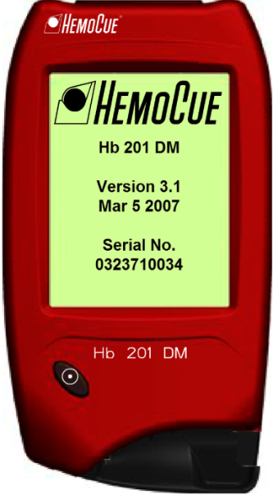
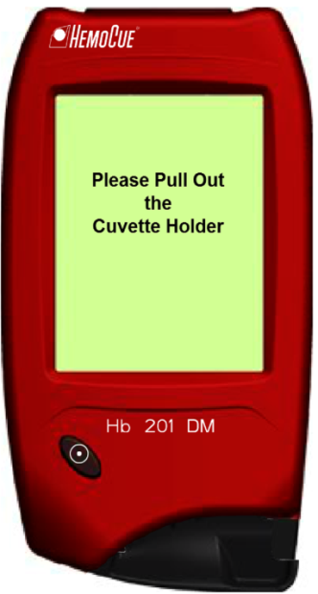
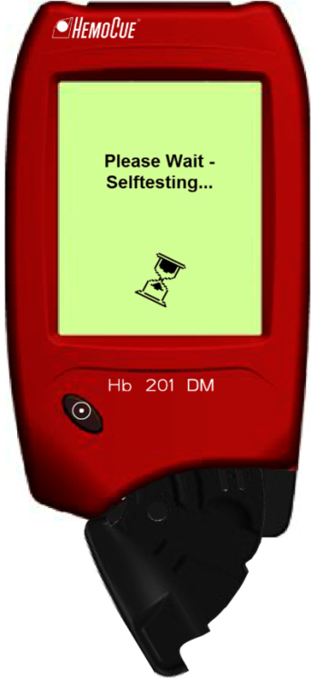
HemoCue 201 DM Systems
TURN ON THE ANALYZER
Press the power button and wait about 10 seconds.
The HemoCue logo will be displayed along with information about the analyzer.
Open the cuvette holder.
The analyzer will perform a Self-Test to verify that the optronic unit is working correctly.

Slide 12
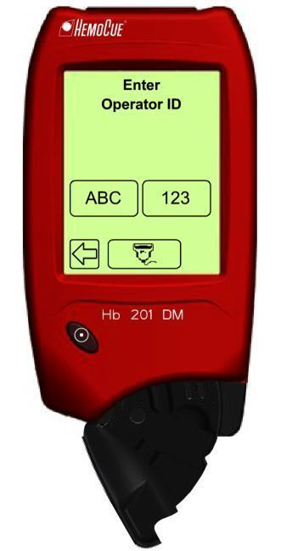
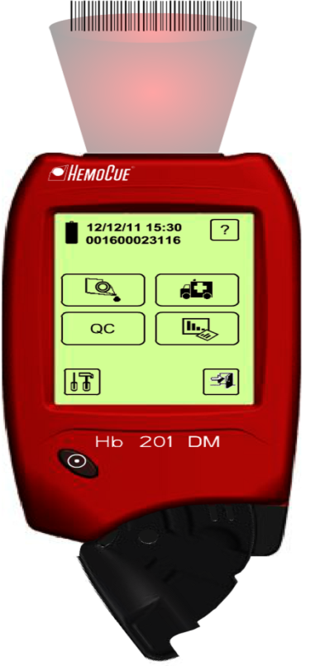
HemoCue 201 DM Systems
LOG IN
Using the Touch Screen
Gently press the Alpha or Numeric with your fingertip.
The button will remain highlighted as long as it is being pressed.
The button is activated when you remove your finger.
Using the Barcode Scanner
Press the Barcode Scanner Button on the Touch Screen.
The information from the Barcode appears on the display.
Release the scanner button when the analyzer identifies the barcode.

Slide 13
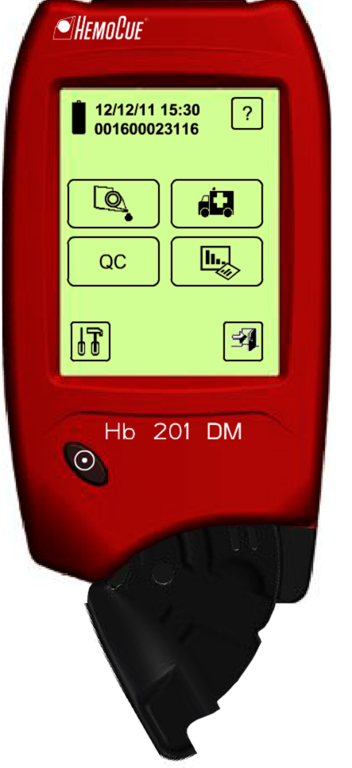
HemoCue 201 DM Systems
Main Menu Icons
Battery
Level
Online
Help
Battery Level (approx. 100
hours of continuous use)
Online Help
Patient Test
QC Test
Review Data
Settings
Exit/Log Off
Stat Test
Stat
Test
Patient Test
QC Test
Review
Data
Settings
Exit/
Log off

Slide 14
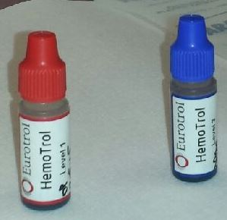
Quality Control Testing
Supplies:
HemoCue Microcuvettes
Eurotrol HemoTrol Levels 1 & 3
Parafilm
Gloves
Lint free tissue

Slide 15
Quality Control Testing
Quality Control Testing (QC)
ELECTRONIC QUALITY CONTROL (EQC)
The analyzer will run an internal electronic Self Test every time the analyzer is turned on, and every 8 hours of continuous operation.
The result of the Self Test is stored as an Electronic QC (EQC) and may be reviewed in “Stored Data” under QC.
If the Self Test fails, an error code will be displayed, and no measurements can be made until corrective action is taken.

Slide 16
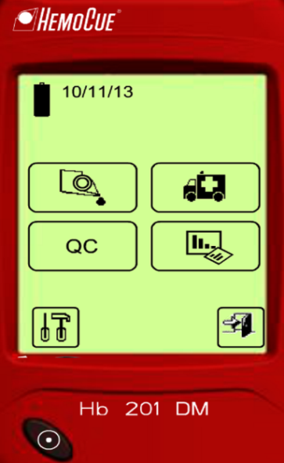
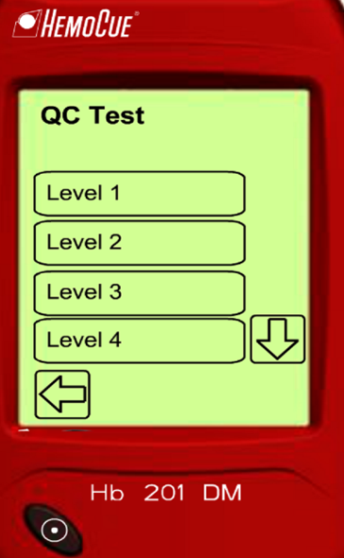
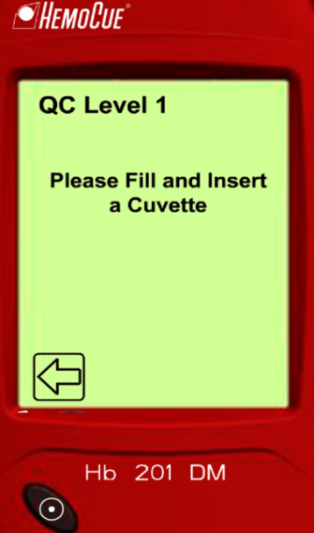
Quality Control Testing
Liquid QC Testing
Press the QC button.
Select level of QC.
Follow the instructions
on the screen.
See next slide for filling cuvette instructions.

Slide 17
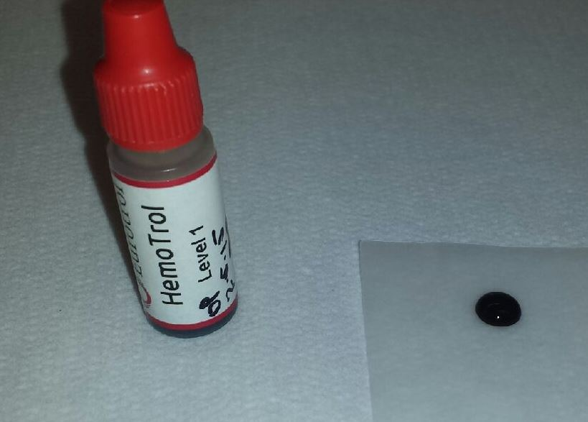
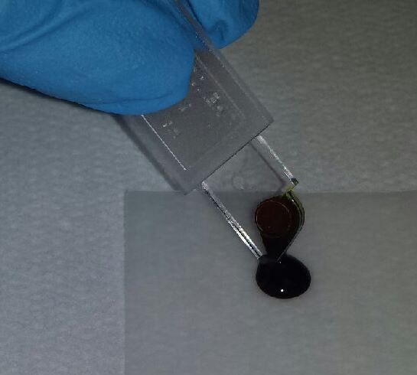
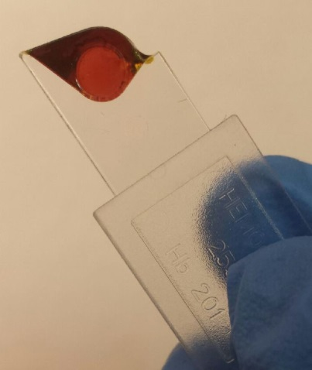
Quality Control Testing
Sample Preparation:
Allow the control to stand for 15 minutes at room temperature.
Gently mix the vial 8-10 times before sampling.
Dispense a drop of control on Parafilm.
Fill the cuvette by introducing the cuvette tip to the middle of the sample. Fill completely.
Wipe excess sample from control vial and recap.
Ensure no air bubbles are in the optical eye.

Slide 18
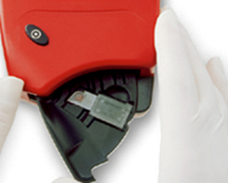
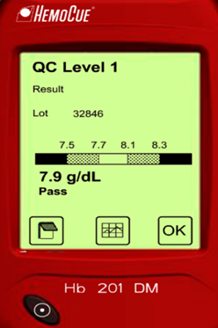
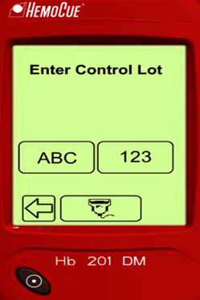
Quality Control Testing
Testing:
Place filled cuvette in holder and gently close.
Scan appropriate Control Lot Card
Record QC results.
Open holder and discard cuvette in appropriate receptacle.
Complete next level of control.

Slide 19
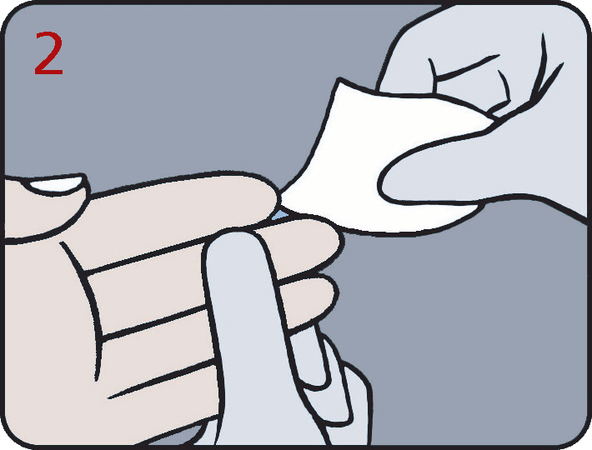
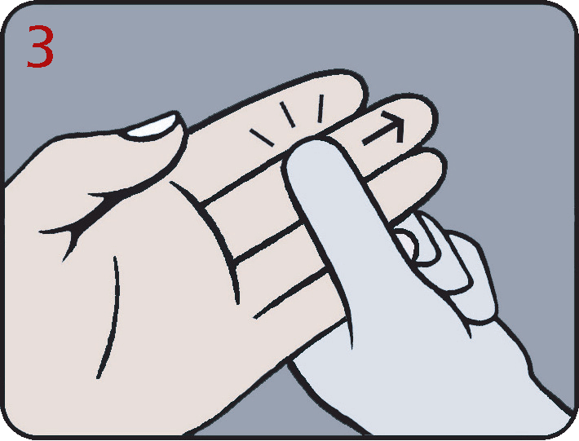
Capillary Sampling
Make sure the patient’s hand is warm and relaxed. Use only middle or ring fingers for sampling. Avoid fingers with rings.
Clean with disinfectant and allow to dry completely or wipe off with a dry, lint free tissue.
Using your thumb, lightly press the finger from the top of the knuckle towards the tip. This stimulates the blood flow towards the sampling point.

Slide 20
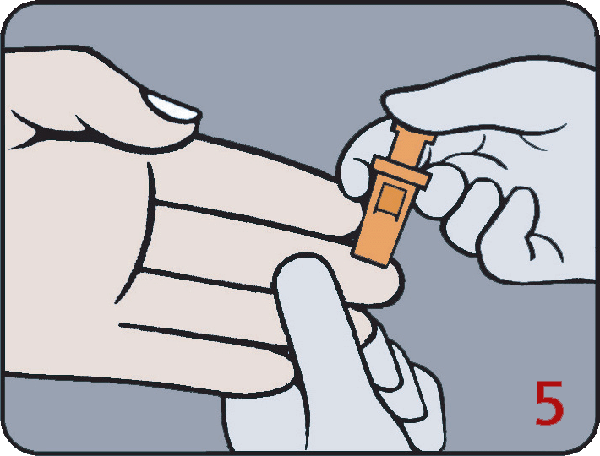
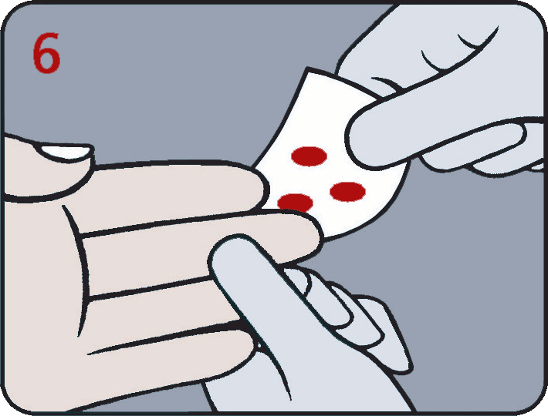
Capillary Sampling
For best blood flow and least pain, sample at the side of the fingertip, not the center.
While applying light pressure toward the fingertip, puncture the finger using the lancet.
Wipe away the first 2 or 3 drops of blood with a lint free wipe.
Note: Do not use cotton balls

Slide 21
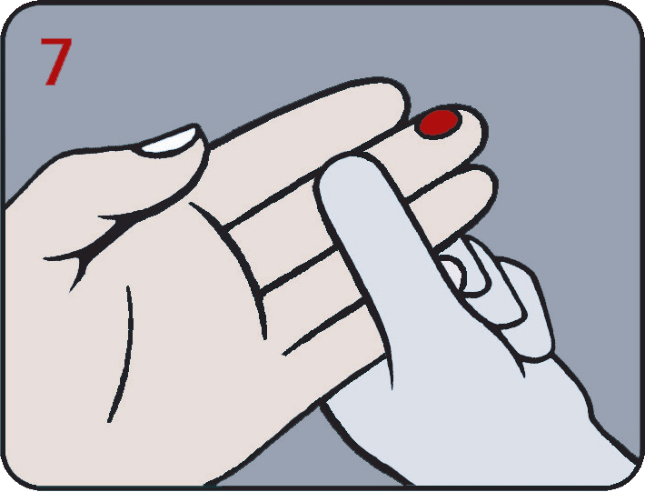
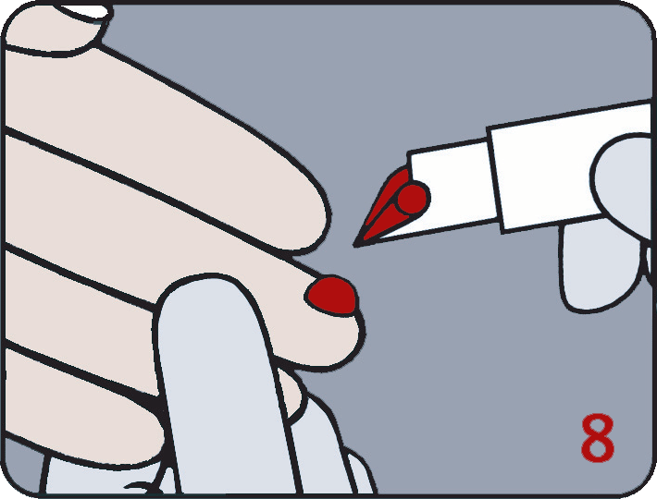
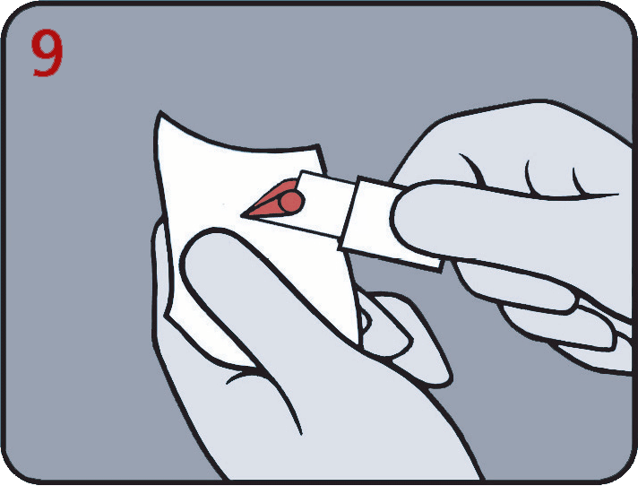
Capillary Sampling
Re-apply light pressure towards the fingertip until another drop of blood appears.
When the blood drop is large enough, fill the cuvette completely in one continuous process. Do not refill a partially filled cuvette.
Wipe off excess blood from the outer surface of the cuvette with a lint free wipe, being careful not to touch the open end of the cuvette.
Make sure that blood is not drawn out from the cuvette during this process!

Slide 22
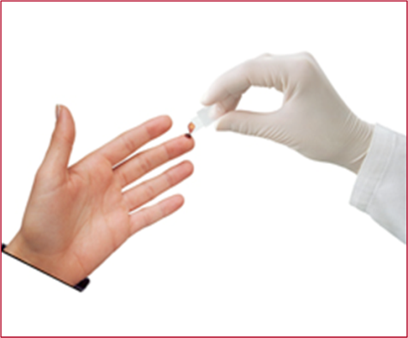
Capillary Sampling
Look for air bubbles in the filled cuvette. If any air bubbles are present in the optical eye, fill a new cuvette. Small bubbles around the outer edge can be ignored.
If a second sample is to be taken from the same finger stick, wipe away the remains of the initial sample and fill a second cuvette from a new drop of blood!
Place the filled cuvette in the cuvette holder.
(Hb – within 10 min/ Glucose – within 40 sec)
If the cuvette is inserted without any button being pressed, the analyzer will enter the Patient Test procedure.
Push the cuvette holder to the measuring position.
Before obtaining a blood sample, the analyzer should be in the “Ready” mode!

Slide 23
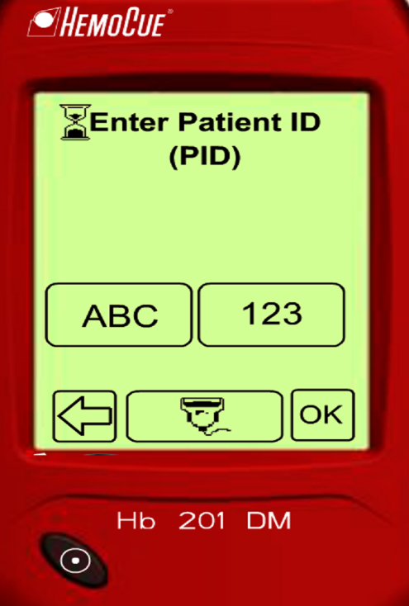
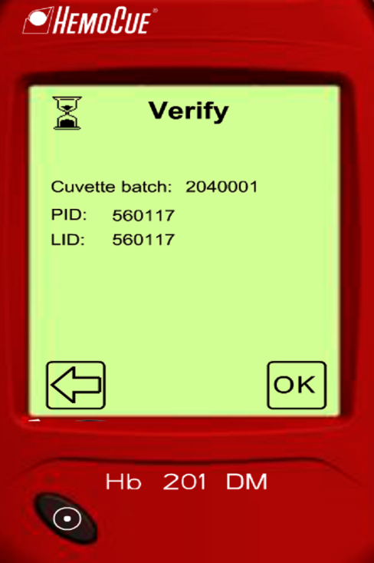
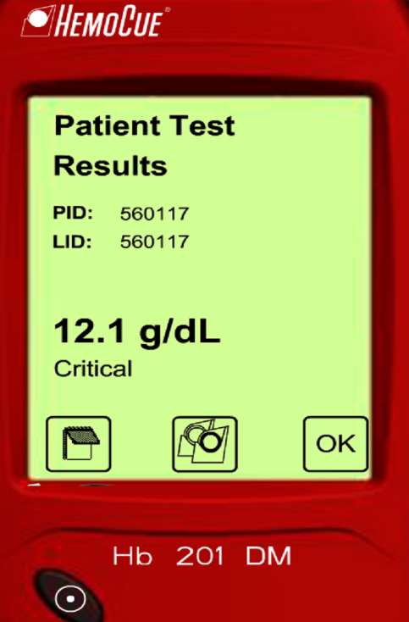
Instructions for Testing
PATIENT TESTING
Enter the Patient ID (PID) using the Alpha Numeric Keypad or the Barcode Scanner
Verify the information entered and then press OK. If changes are needed, press the Arrow button to go back to the previous screen.
When the test is complete, the result is displayed.

Slide 24
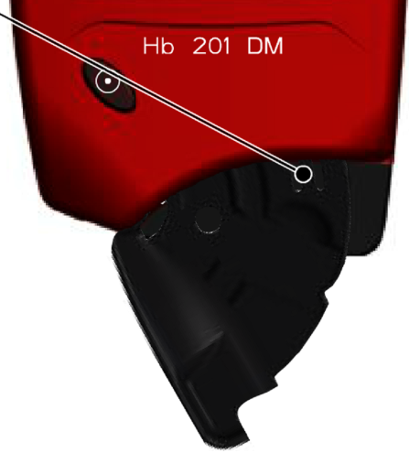
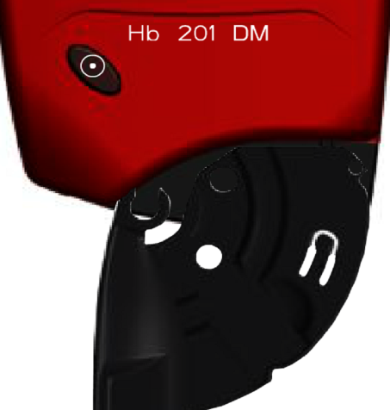
Analyzer Maintenance
CLEANING THE CUVETTE HOLDER
catch
Pull the cuvette holder out to the loading position. Carefully press the small catch positioned in the upper right hand corner of the cuvette holder.
While pressing the catch, carefully rotate the cuvette holder sideways as far as possible to the left Gently remove the cuvette holder from the analyzer.
Clean the cuvette holder with alcohol or mild detergent.
Allow the cuvette holder to dry completely (15 min) before re-inserting it into the analyzer

Slide 25
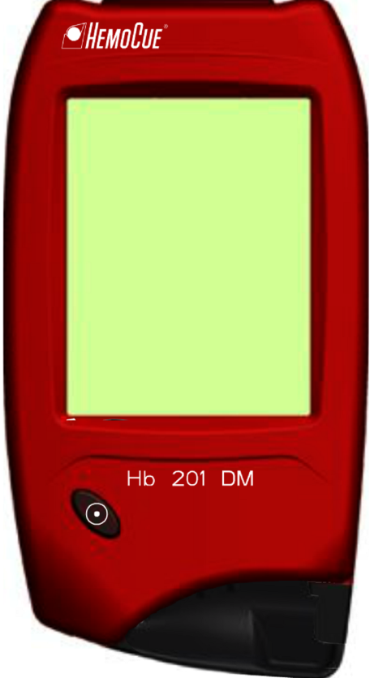
Analyzer Maintenance
Cleaning the analyzer
The display may be cleaned with alcohol with no additives or soap and water. Do not use bleach.
The outer case of the analyzer and docking stations may be cleaned with alcohol or a mild soap solution.
The barcode scanner glass should be cleaned gently with alcohol.
Before performing any maintenance on the analyzer, ensure that power is turned off and the device is unplugged from any AC power source!

Slide 26
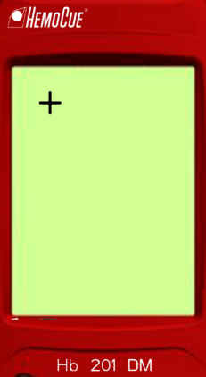
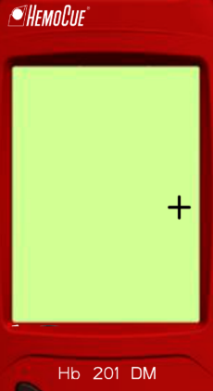
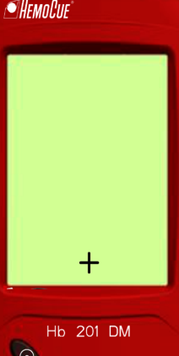
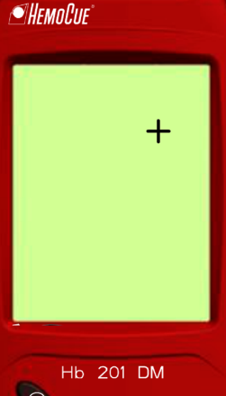
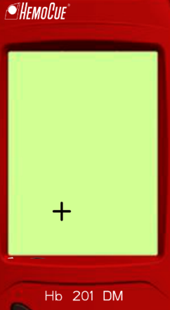
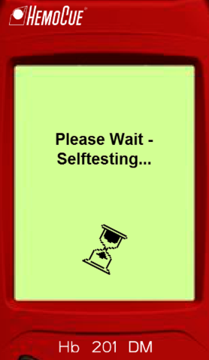
Analyzer Maintenance
Calibrating the Display
Make sure the analyzer is turned off. The display should be blank.
To calibrate the display, press and hold the On/Off button for more than 10 seconds.
A plus (+) sign will appear in the upper left corner of the Display.
Gently press the center of the (+) with a blunt object.
A second (+) will appear to the right of the window
Press the center of the (+)
A third (+) will appear in the lower center of the display
Press the center of the (+)
A fourth (+) will appear in the upper right display
Press the center of the (+)
A fifth (+) will appear in the lower display
Press the center of the (+)
Open the cuvette holder
The analyzer will perform a Self Test
Calibration is complete

Slide 27
Analyzer Troubleshooting
Symptom | Explanation | Action
The analyzer shows an error code. | May be an occasional fault. | Turn the analyzer off and turn it back on after 30 seconds. Take a new cuvette and repeat the measurement. If the problem continues, see the specific error code below.
E00 | No stable endpoint found within the time range. 1) The cuvette is faulty. 2) The circuit board is out of order. | 1a) Check the expiration date of the cuvette. 1b) Take a new cuvette and repeat the measurement. 2) The analyzer needs service, contact Technical Support.
E01 – E05 | Faulty Optics or Electronics. (Error code E01 or E02 usually means that the analyzer needs cleaning.) | a) Turn the analyzer off and clean the optronic unit as described in the Maintenance Section. b) The analyzer needs service, contact Technical Support.
E06 | Unstable blank value. The analyzer may be cold. | Turn the analyzer off and allow it to reach room temperature. If the problem persists, contact Technical Support.

Slide 28
Limitations of the Method
The measurement needs to be started no later than 10 minutes after filling the microcuvette.
Mixing samples for an extended period can produce increased oxygen pressure and viscosity that may give falsely high results.
If “HHH” is displayed, the result exceeds the measuring range of the system.
Values above 23.5 g/dL (235 g/L, 14.6 mmol/L) must be confirmed using a suitable laboratory method.
pH values between 6.3-9.0 do not interfere with the system.
Sulfhemoglobin is not measured with this method.

Slide 29
Non-Interfering Substances
Following substances have not been found to interfere:
Acetaminophen (20 mg/dL)
ascorbic acid (3 mg/dL)
conjugated bilirubin (40 mg/dL)
unconjugated bilirubin (20 mg/dL)
creatinine (30 mg/dL)
ibuprofen (40 mg/dL)
leukocytes (600 x 109 /L),
lipemia (intralipid 4000 mg/L, triglycerides approximately 1000 mg/dL)
salicylic acid (50 mg/dL)
tetracycline (20 mg/dL)
trombocytes (2100 x 109 /L)
urea (500 mg/dL),
uric acid (20 mg/dL)
The highest concentration or percentages tested is referred to in
brackets. Intereference studies have been performed according to NCCLS Document EP-74.

Slide 30
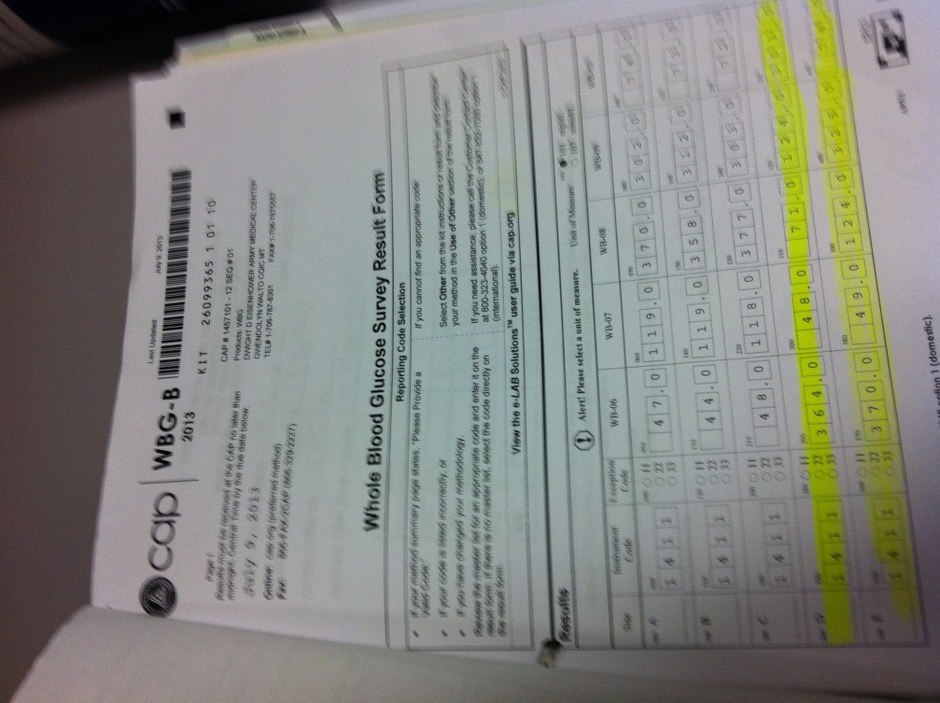
Proficiency Testing
Proficiency Testing (PT) will be delivered 3 times per year.
Each sample will need to be performed on all meters on your unit.
Independently, run samples in PROFICIENCY TESTING mode, a POCT Staff member will be present to assist.
Record the results on the form provided.
If an operator’s performance results in an out-of-range PT, the POCT staff will observe, using the same specimen, to re-access their competency.

Slide 31
Competency Assessment
Competency Assessment training frequency:
Initial (before any patient testing)
six months (after initial competency)
one year (from initial)
annually there after
Initial training consist of
lecture
hands-on
written exam
A competency checklist is also a part of the training.

Slide 32
Problems
Please contact
Point of Care Testing at 787-8359 or 706-830-1621
Or 706 787 0227

