Slide 1
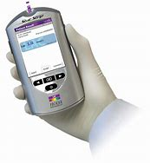
Point of Care Testing: Nova Stat Strip Glucose Meter

Slide 2
Waived Testing
Waived testing is lab testing that has been “waived “by the lab for other non-laboratory personnel to perform
It is also called “Point of Care Testing”(POCT) because it is performed at the patient’s bedside or directly at the POINT of patient care rather than being sent to a lab.
Waived testing differs from regular lab testing in that the specimen is not only collected, but also tested and results interpreted by non-laboratory personnel.

Slide 3
Waived Testing
Physicians base their treatment and plan of care on these results, so accuracy is crucial!
Waived testing is both highly monitored and highly scrutinized

Slide 4
Training & Competency
Only those operators who have completed training and have demonstrated competency may perform POCT blood glucose testing.
Initial competency
Attending training session on the glucose meter
Successfully completing a written examination
Demonstrating competence through the proper performance and interpretation of quality control
Maintaining competency
Annual online education
Demonstration of competence in the use of the meter as above

Slide 5
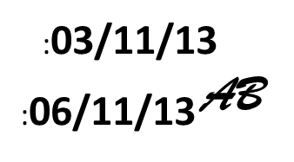
Quality Control (QC)
Two QC samples, Level 1 (Low) and Level 3 (High)
MUST be performed satisfactorily, once every 24 hrs.
– If this is not done, the meter will lock out users until QC is performed
All test strips and control bottles must be dated with the open date and expiration date and initials.
This is a Laboratory Regulatory Requirement!

Slide 6
QC Procedure
Log-in by scanning your DDEAMC badge
Choose QC
Scan the vial of test strips
Press “Accept”
Scan Control solution Level 1
Press “Accept
Place the test strip into the meter
There will be a feeling of resistance as you insert the strip

Slide 7
QC Procedure
Gently mix control solution and apply drop to strip
After 6 seconds, view results (PASS/FAIL)
– FAIL requires a comment
Discard test strip
Repeat procedure with Level 3 control solution

Slide 8
QC Procedure - Troubleshooting
If QC fails, the following troubleshooting steps should be taken
Check your Strips and QC solution expiration date
Make sure the QC solution has been mixed thoroughly
Repeat control test, record comment on meter
Open new set of controls and repeat test
Open new test strips and repeat test

Slide 9
QC Procedure - Troubleshooting
If QC continues to fail after these steps…
STOP TESTING
Take the meter out of service
Contact the POCT Staff for assistance
Teria Thomas, MT(ASCP)
Point of Care Testing Coordinator
DDEAMC Department of Pathology, 1-J17
POCT Office: 706-787-8359
teria.a.thomas.civ@mail.mil

Slide 10
Nova Stat Strips®
Once opened, test strips are good for 180 days (6 months minus 4 days) or manufacturer’s expiration date
Store at room temperature and tightly cap as these strips are sensitive to both light and moisture.

Slide 11
Control Solutions
Once opened, control solutions are good for 3 months or until expiration date on the vial.

Slide 12
Specimen Collection
Capillary, venous, neonatal (including cord blood, and arterial whole blood specimens may be used
Remember to use Standard Precautions when obtaining blood samples and performing patient testing

Slide 13
Capillary Blood Collection (Finger stick/Heel Stick)
(Important: only trained staff may use the glucose meters. Access to the meter is by scanning personal Trust ID badge. Use of someone else’s badge may result in disciplinary action)
Verify the patient’s ID with 2 unique identifiers:
– FULL Name & DOB
Remove meter from docking station
Don Gloves
If an isolation room, place glucometer into clear Specimen bag

Slide 14
Capillary Blood Collection (Finger stick/Heel Stick) CONTD.
Select an appropriate sampling site
Palm side of the finger tip
Lateral or medial plantar surface of the infant heel
Warm the site if needed.
Clean site with 70% alcohol and allow to air dry.

Slide 15
Capillary Blood Collection (Finger stick/Heel Stick) CONTD.
Holding hand downward, massage finger with thumb toward tip to stimulate blood flow
Press “Login”. Press “Scan” while pointing bar code reader at ID badge barcode
From the Patient Test screen press “Accept”
“Enter Strip Lot” screen is displayed. Scan the strip lot number from the side of the strip container. Press “Accept”

Slide 16
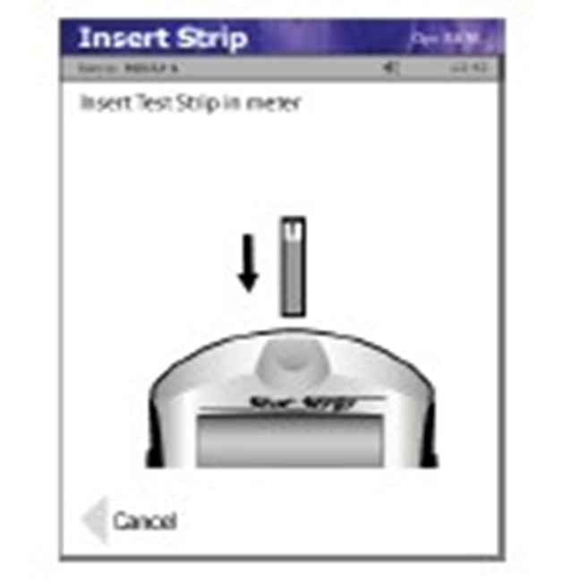
Capillary Blood Collection (Finger stick/Heel Stick) CONTD.
Enter the patient’s ID by scanning their arm band barcode,
Press “Accept”
Insert Strip, there will be a feeling of slight resistance as the strip is inserted into the meter.

Slide 17
Safety Lancets
TWIST, do not pull the lancet needle cover off
Hold the lancet against skill surface, do not press into the skin
Trigger the lancet by pressing on the lever-like trigger.
Lancets will immediately “safety” the needle

Slide 18
Capillary Blood Collection
Wipe off the first drop of blood, using gauze or cotton ball
Allow a small drop of blood to form by gently applying intermittent pressure. Do Not Milk the site.
Hold the meter in a horizontal position
– This will prevent blood from entering and contaminating the meter

Slide 19
Capillary Blood Collection
Touch the end of the test strip to the drop of blood. Capillary action will cause the blood to flow in the 4 wells on the test strip.

Slide 20
Capillary Blood Collection
The strip must fill completely upon touching the blood droplet
If the test strip wells do not fill completely, discard the test strip and repeat the test with a new strip.
– Do not attempt to add more blood.
The Result will appear in 6 seconds

Slide 21
Capillary Blood Collection
You must ACCEPT or press OK to complete and transfer the data to the patient’s record.
Results will not transfer to the medical record if you do not press ACCEPT or OK
To accept /reject the result, press the Accept /Reject soft key
To add a comment before accepting or rejecting the result, press the “Comment” key. Accept your comment and then accept or reject the result
A comment must always be added if rejecting a result

Slide 22
Capillary Blood Collection
The nurse enters the results in the patient’s notes, and the appropriate action taken if any
Discard the test strip and repeat with a new strip.
Discard all contaminated patient materials in appropriate biohazard containers.
Dispose of used lancets into sharps container

Slide 23
Results
The Nova Stat Strip glucose meter reads results between 10-600 mg/dL
A result reading higher than 600 will read as “HI”
A result reading lower than 10 will read as “LO”
Any out-of-range result will be displayed in red
Results within normal range (65>115) will be displayed in blue
If results are inconsistent with the clinical presentation, consider retesting, performing quality control testing or sending a blood specimen to the lab

Slide 24
Interpretation of Results Reference Ranges
DDEAMC Reference Ranges are:
Critical LO= Less than 50 mg/ dL
Critical HI= greater than 450 mg/dL
( If you get any of these values, it indicates the results are outside the reading range and you must repeat the test.)
If you get a value that exceeds the normal range value but in within the high and low parameters please ensure you notify the HCP and notate this value in the patients record.
**NOTE: The meter will read as low as 10 mg/dL and will be indicated by a reading of “LO” on the meter display. It will read higher than 600 mg/dL and will be indicated by a “HI” reading on the meter display.**

Slide 25
Alert Values
****All alert values must be repeated using a fresh sample from new stick.
Actions taken must be documented in the meter by entering a comment.
Report to caregiver or provider, and follow his/her recommendations.
Alert values obtained must be reported immediately to the care nurse for assessment of the patient.
Results must be verified by the clinical laboratory if requested by the provider.

Slide 26
Cleaning the Meter
Wipe meter with a Sani-Cloth® wipe
The meter must remain visibly wet with the disinfectant for 2 full minutes.
Immediately follow with a dry tissue cloth to remove all cleaning residue
If meter screen develops a light film, wipe a gauze moistened with water.

Slide 27
Cleaning the Meter
For patients on “Special Enteric Contact Isolation” meters are to be placed in clear specimen bags for use at the bedside
Once out of the room, the meter must be cleaned with Clorox Bleach wipe.
The meter must remain visibly wet with the bleach for 5 minutes. Wipe with a damp cloth afterwards to remove any bleach residue.
Do not spray solutions on the meter!
This could damage the meter

Slide 28
Batteries
The meter should ALWAYS be docked when not in use
The Nova Stat Strip glucose meter is powered by a rechargeable lithium battery
– Do not throw them away
If the battery in the meter is dead, contact the Point of Care Staff for a replacement (706) 787-8359

Slide 29
Safety
The battery used in this meter may present a fire or chemical burn hazard if mishandled
Do not disassemble, heat above 100 degrees C (212 degrees F) or incinerate
Do not stare into the Laser light or point it towards anyone’s eyes while scanning a barcode

Slide 30
Transmission of Results
Push meter firmly into tote docking station until you see an hourglass appear.
Make sure that the yellow light on the tote is lit indicating that there is a connection.

Slide 31
Docking the Nova StatStrip Glucose Meter
When the meter has successfully connected you will see the screen below.
The meter has sent results to the data manager and received updates on operators and reagents.

Slide 32
Trouble shooting
Steps to resolve a problem may include:
Repeating controls, mixing before retesting.
Repeating a control with a new bottle of control material.
Clean the glucometer with a saniwipe.
Remove and place back into the meter the battery.
Redock the glucometer. If the glucometer docking device does not show lights on in front, check the electrical connectedness of the docking site.
If the meter freezes, remove the battery and place back in again.

Slide 33
Factors Influencing Accuracy of Test Results

Slide 34
Factors Influencing Accuracy of Test Results

Slide 35
Common Nova StatStrip Glucose Meter Error Codes/Alerts

Slide 36
Common Nova StatStrip Glucose Meter Error Codes/Alerts

Slide 37
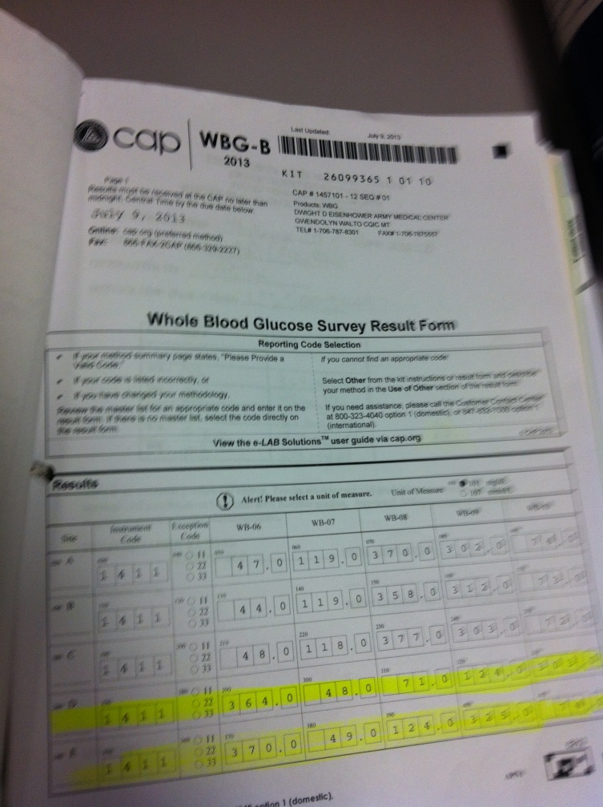
Proficiency Testing
Proficiency Testing (PT) will be delivered 3 times per year.
Each sample will need to be performed on all meters on your unit.
Independently, run samples in PROFICIENCY TESTING mode, a POCT Staff member will be present to assist.
Record the results on the form provided.
If an operator’s performance results in an out-of-range PT, the POCT staff will observe, using the same specimen, to re-access their competency.

Slide 38
Annual Training Competency
Take online test at medtraining.org
Notify POCT Staff that you have completed this portion of your training and present documentation.
Demonstrate your performance of a Nova StatStrip® Glucose test for your trainer, by testing a patient and quality control. Document the training on your competency sheet and have your Unit POCT Trainer submit a memorandum to the POCT Staff so your information can be updated in the system.
Place all documentation of training in your CAF folder.

Slide 39
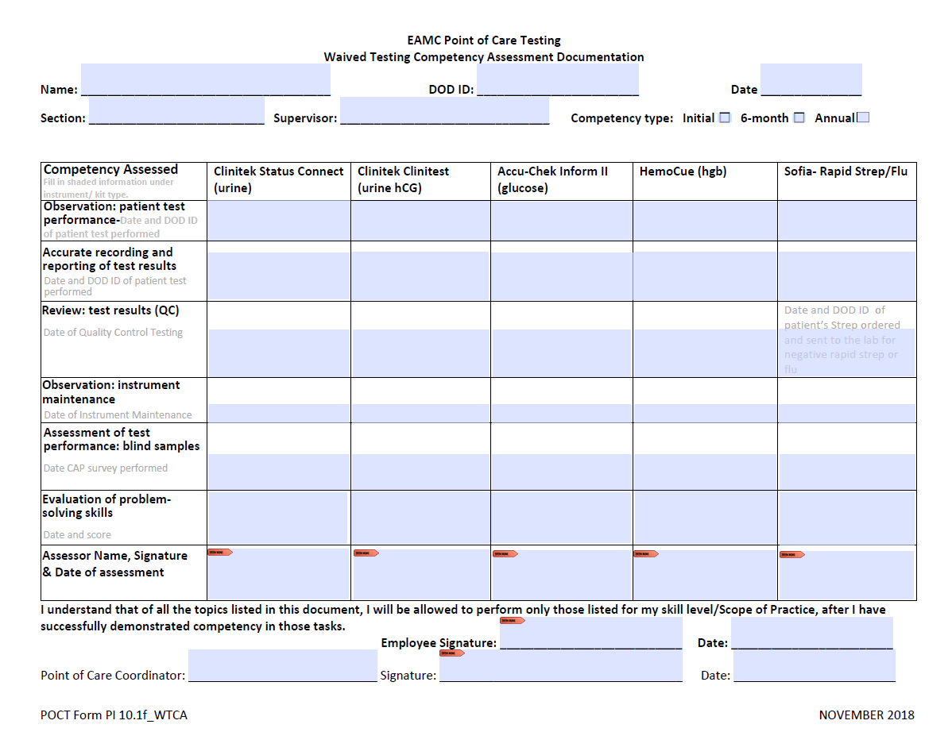
Competency Assessment

Slide 40
Contact Information
Teria Thomas, MT(ASCP)
Point of Care Testing Coordinator
DDEAMC Department of Pathology, 1-J17
POCT Office: 706-787-8359
teria.a.thomas.civ@mail.mil
1LT Charmaine Ibarra
Chief, Point of Care Testing
DDEAMC Department of Pathology, 1-J18A
POCT Office: 706-787-0227
POCT Mobile: 706-339-6428
charmaine.a.ibarra.mil@mail.mil

