Slide 1

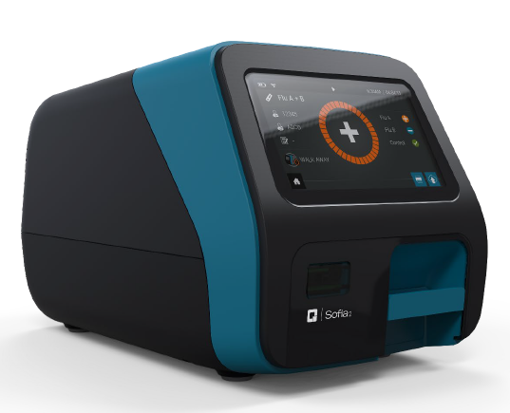

Point of Care Testing:
Sofia 2

Slide 2
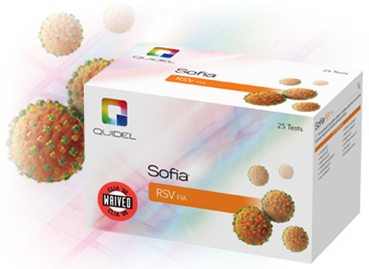
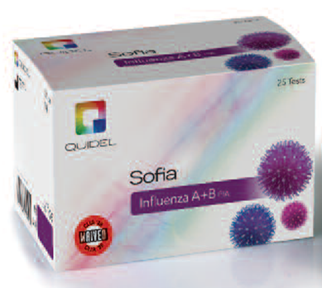
Sofia 2Tests
Influenza A+B and RSV

Slide 3
Influenza A+B & RSV
Influenza (flu) is a contagious respiratory illness caused by influenza viruses. It can cause mild to severe illness.
Respiratory syncytial virus, or RSV, is a respiratory virus that infects the lungs and breathing passages.
Symptoms: Fever, Fatigue, Cough, Headaches

Slide 4
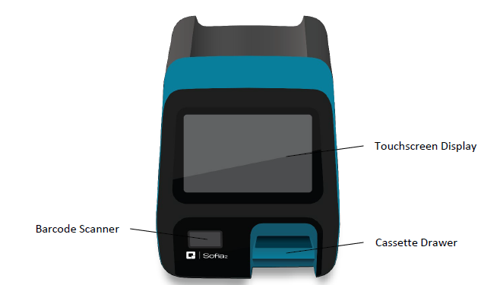
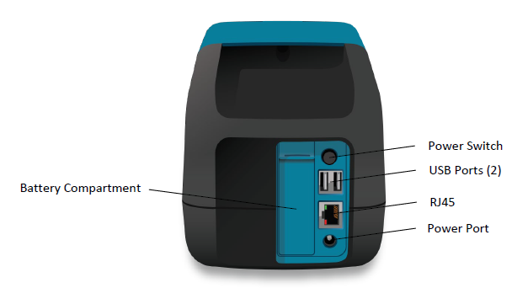
Analyzer

Slide 5
Principle
  The Sofia 2 Analyzer uses a fluorescent tag that is illuminated by an Ultraviolet (UV) light source to generate specific results.
  Precautions:
    Always operate on a level dry surface not in direct sunlight.
    Never move the analyzer while there is a test in progress.
    Use only the power adapter that was provided with the analyzer.

Slide 6
Test Kit
Test Kit- Store at room temperature (15-30°C) for duration of shelf life. Test device must remain in sealed pouch until ready to use.
  25 individually packaged cassettes
  25 reagent tubes
  25 reagent solution vials
  25 sterile nasal swabs (flu) or 25 nasopharyngeal swabs (RSV)
  25 pink fixed volume pipettes (250µL)
  25 clear pipettes (120 µL)
  Positive Control Swab
  Negative Control Swab
  Package Insert
  Quick Reference Instructions
  QC card

Slide 7
Precautions
  To obtain accurate results, package insert instructions must be followed.
  When collecting nasal swab sample, use the swab supplied in the kit.
  Use the provided pipettes in accordance to test procedure.
  Do not write on the barcode of the cassette.
  As the detection reagent is a fluorescent compound, no visible results will form on the test strip. Sofia 2analyzer must be used for result interpretation.

Slide 8
Quality Control
3 types of QC for the Sofia 2 and the cassette:
  Sofia 2 Calibration Check procedure
  Built-in procedural control features
  External Controls

Slide 9
Calibration Check
Sofia 2 Calibration Check Procedure:
Performed every 30 days. The analyzer will be set up to remind the user to complete this process.
Required function that checks the optics and calculation systems using a specific calibration cassette.
Insure that the calibration cassette is stored in the provided storage pouch between uses to protect from light exposure

Slide 10
Calibration Check cont’d
Select “Calibration” from main menu
Follow prompts, insert the calibration cassette and gently close the drawer.
Sofia 2 analyzer performs the Calibration check automatically within 2 mins with no user input.
Sofia 2 indicates when it is complete.
Contact POCT if the calibration check does not pass.

Slide 11
Built-in Procedural Controls
Each time a test is run, the procedural control zone is scanned by Sofia 2 and the result is displayed on the screen.
Document the procedural controls on log along with test results.
A valid result obtained by procedural controls demonstrates test flowed correctly and integrity of the cassette was maintained.

Slide 12
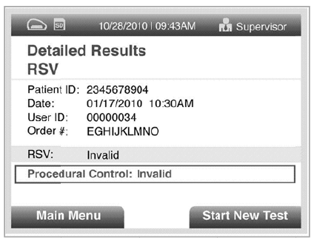
Procedure cont’d
If the test does not flow correctly, Sofia 2 will indicate that the result is invalid. If this happens, review the procedure, repeat test with new patient and use a new cassette.

Slide 13
External QC
Performed with new lot and new shipments of kits.
Select “Run QC” on the Main menu.
When prompted, scan the QC card located on QC box.
  Keep QC card attached to the box.
Select desire mode (WALK AWAY or READ NOW)

Slide 14
External QC
Use the control swabs provided in the kit.
***Positive Control Must be Run First***
Perform controls using the Nasal/Nasopharyngeal Swab Test Procedure

Slide 15
Nasal Swab Collection
Nasal Swab- Use the nasal swab supplied in the Influenza A+B kit.
  Carefully insert the swab into the nostril with the most visible secretion.
  While gently rotating, push the swab until resistance is met, <1 inch into nostril.
  Rotate the swab several times against the nasal wall then remove it from the nostril.

Slide 16
Nasopharyngeal Swab
Use a nylon flocked nasopharyngeal swab supplied in the RSV kit.
  Carefully insert swab into nostril which visibly has the most secretion.
  Keep the swab near the septum floor of the nose while gently pushing the swab into the posterior nasalpharynx.
  Rotate the swab several times then remove it from the nasopharynx.

Slide 17


Swab collection
Preferred method for the Influenza kit is the nasal swab. Nasal swabs are included in the kit.
Preferred method for RSV kit is using the nasopharyngeal swab. Nasopharyngeal swabs are included in this kit.

Slide 18
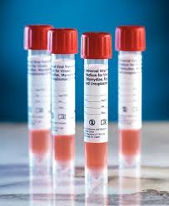
Transport
Specimen should be run as soon as possible after collection.
If transport is required, minimal dilution is recommended. One milliliter or less is suggested.

Slide 19
Transport Media
Recommended Viral Transport Media:
Recommended Viral Transport Media | Recommended Storage Condition
 | 2-8°C | 25°C
Copan Universal Transport Media | 72 hours | 72 hours
Hank’s Balanced Salt Solution | 24 hours | Not recommended
M4 | 72 hours | 72 hours
M4-RT | 72 hours | 72 hours
M5 | 72 hours | 72 hours
M6 | 72 hours | 72 hours
Modified Liquid Stuarts | 6 hours | Not recommended
Saline | 24 hours | 4 hours
Starplex Multitrans | 72 hours | 72 hours

Slide 20
Nasal/Nasopharyngeal Swab Procedure
1. Verify that the desired mode is set: “WALK AWAY” or “READ NOW”
2. Prepare reagent
  1. Flick or shake the reagent solution vial so all fluid is in the bulb.
  2. Twist off the tab.
  3. Slowly dispense all of the reagent solution into the reagent rube.
  4. Gently swirl the reagent tube to dissolve its contents.

Slide 21
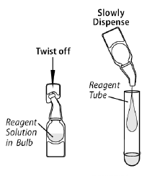
Procedure cont’d

Slide 22
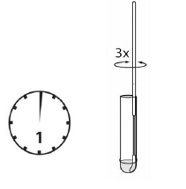
3. Place the patient sample into the reagent tube. Swirl at least 3 times while pressing the head against the bottom and side of the tube.
  Leave swab in the Reagent Tube for 1 minute

Slide 23

4. Roll the swab head against the inside of the tube as you remove it. Dispose of swab in biohazard waste.
  Do NOT squeeze the tube, it can break easily.

Slide 24
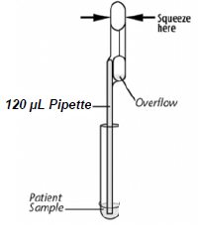
5. Fill the provided Clear 120 µl fixed volume pipette with the patient sample from the reagent tube.
To fill the pipette:
  Firmly squeeze the top bulb
  Still squeezing, place pipette tip into specimen
  With pipette tip in specimen, slowly release
  pressure on bulb to fill the pipette.

Slide 25
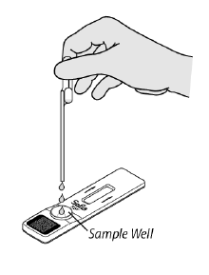
6. Firmly squeeze the top bulb to empty contents of the pipette into the cassette sample well.
  Extra liquid left over in the overflow bulb should be left there.

Slide 26
Test Mode
WALK AWAY MODE
  Immediately insert the cassette into the Sofia 2.
  The Sofia 2 will automatically time the test development, display and print the test result.
READ NOW MODE
  Cassette is left on bench for 15 minutes.
  Then, the cassette is placed into the Sofia 2.
  Sofia 2 will scan and display results within 1 min.
  The cassette MUST stand 15 mins! No sooner.

Slide 27
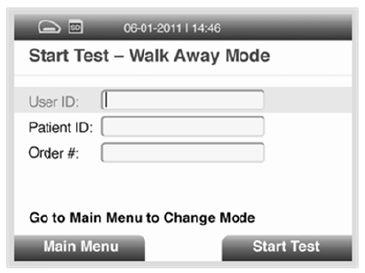
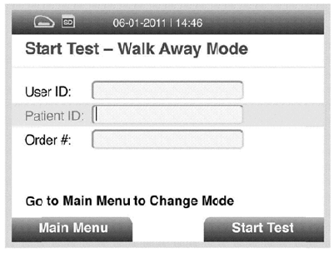
Run Test
1. Input the User ID with the scanner or manually enter the data.
2. Input Patient ID with the scanner or manually enter the data.

Slide 28
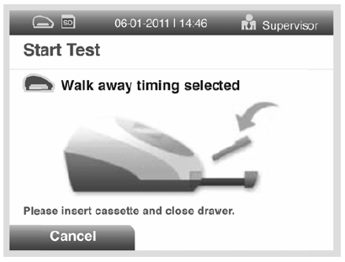
3. Press Start Test and the drawer will open automatically
Insure the desired mode is chosen, WALK AWAY or READ NOW.

Slide 29
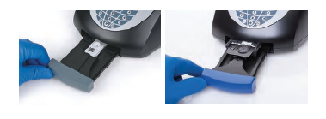
Procedure
4. Insert the prepared patient cassette into the Sofia 2 drawer and gently close the drawer.

Slide 30
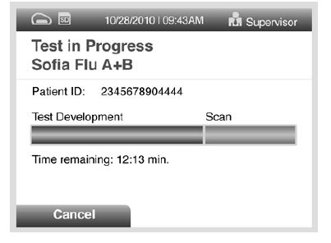
5. The Sofia 2 will start automatically and display the progress.
  WALK AWAY mode, results will be displayed in approximately 15 mins
  READ NOW mode, results will be displayed within 1 min

Slide 31
Interpretation
When test is complete, results will be displayed on the screen and printed.
Test lines are fluorescent, they cannot be seen with the naked eye.
If the procedural control is “invalid,” test is invalid. Retest with new sample and new cassette.

Slide 32
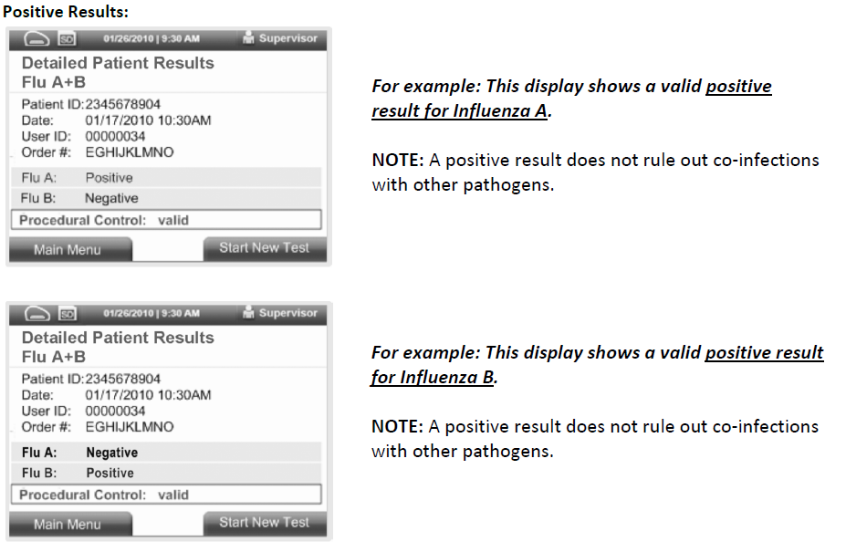
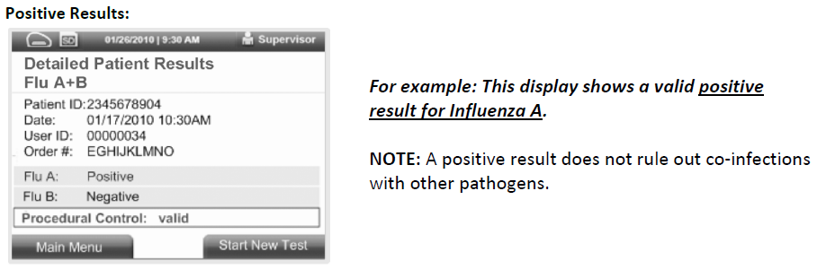
Positive Results

Slide 33
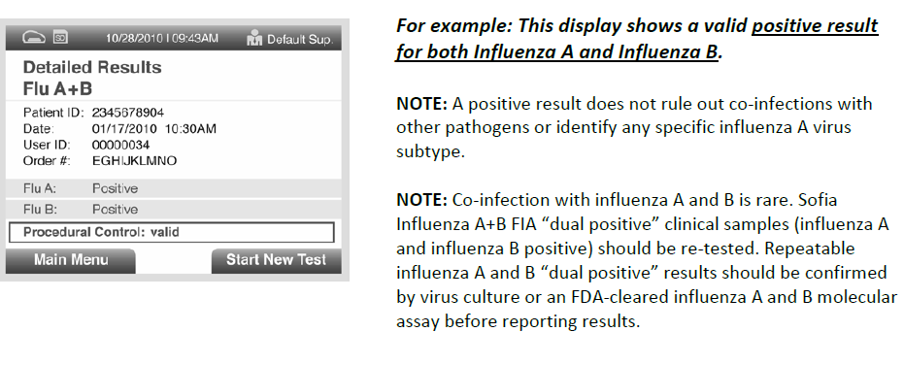
Positive A+B

Slide 34
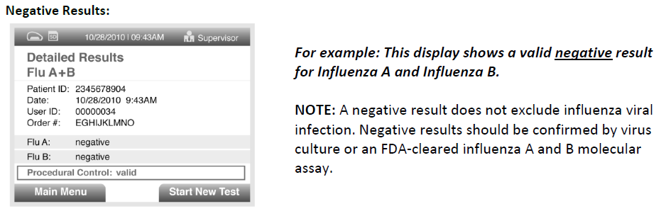
Negative Results

Slide 35
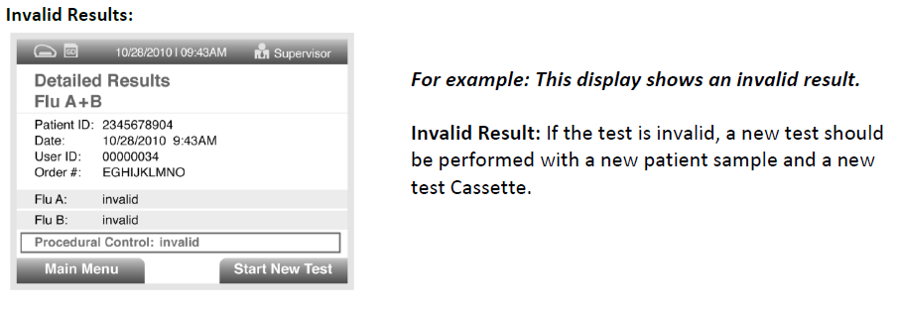
Invalid Results

Slide 36
Maintenance
The only attempted maintenance that should be done are
  Replacing paper
  Changing batteries
  Cleaning external surfaces and Cassette drawer
Shutdown and unplug the analyzer before performing maintenance

Slide 37
Maintenance
Use a soft cloth with 70% alcohol or 0.6% bleach solution to clean exterior of the analyzer. Wipe the external surfaces and cassette drawer only.
Do NOT clean interior of the analyzer!
Do NOT submerge drawer in cleaning solution!

Slide 38
Training Competency
Step One
• Print out the documentation showing you have
passed the test.
Step Two
• Let your Unit POCT Trainer know you have
completed this portion of your training and present
him/her with documentation.
Step Three
• Demonstrate your performance for your trainer. Have the training documented on your glucose competency sheet and have your Unit POCT Trainer submit a memorandum to the POCT Staff so your information can be updated in the system.
Step Four
Place all certificates and training records in your CAF Folder.

Slide 39
Contacting POCT Staff
Any Problems or Questions contact Point of Care Staff at
787-8359/0227 or 706-339-6428
Or e-mail us at:
teria.a.thomas.civ@mail.mil

Slide 40


Training Competency
Step One
• Print out the documentation showing you have
passed the test.
Step Two
• Let your Unit POCT Trainer know you have
completed this portion of your training and present
him/her with documentation.
Step Three
• Demonstrate your performance of a ACCU-CHEK®
Inform Glucose test for your trainer. Have the training documented on your glucose competency sheet and have your Unit POCT Trainer submit a memorandum to the POCT Staff so your information can be updated in the system.
Step Four
Place all certificates and training records in your CAF Folder.

