Slide 1
2018 Laboratory Fire Safety Training

Slide 2
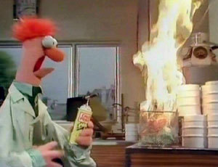
Identifying fire in the lab
Flames or smoke = FIRE
Open flames are not permitted in the laboratory

Slide 3
Fire Response - RACE
If you see flames or smell smoke:
Rescue – remove all employees, patients, and visitors from the area
Alarm – pull the nearest fire alarm/pull box on your way out
Contain – close all the doors on your way out, leave the lights ON.
Extinguish/Evacuate – use a fire extinguisher if you feel safe doing so, or evacuate to the next fire compartment

Slide 4
Extinguishing the fire - PASS
If you decide to fight the fire, proper fire extinguisher use is:
Pull – the pin from the top of the extinguisher
Aim – the nozzle at the base of the fire
Squeeze – the handle of the fire extinguisher
Sweep – the nozzle back and forth at the base of the fire until it is extinguished

Slide 5
Types of Fire Extinguishers
The hospital uses
ABC fire extinguishers that are suitable for most types of fires.

Slide 6
Evacuate
If you must evacuate:
Move to a safe location on the same floor first (horizontal evacuation)
If it is not safe on the same floor, move to a lower or higher floor that is not in the path of the fire (vertical evacuation)
If you must evacuate the building, go to the designated meeting place

Slide 7
Evacuate the building

Slide 8
Hudson Lab Evacuation
Follow the instructions from the person in charge of the building.
Make sure to check in with them once you are outside the building so they know you are safe.

Slide 9
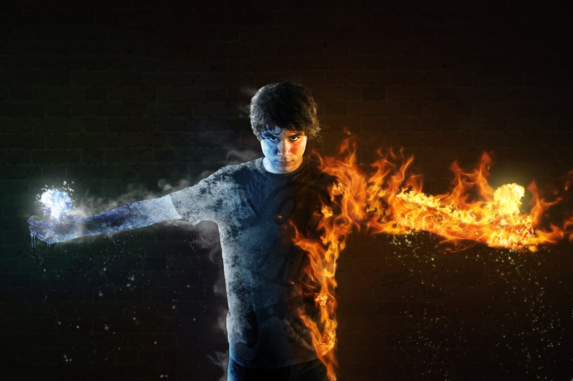
Clothing fires
If your clothes catch fire, do not run.
Stop, Drop, Roll until the fire is out
Or lay down and have someone put a fire blanket on you

Slide 10
Remain Calm
Do not use elevators
Do not yell “Fire!”
Help others evacuate
Close flammable chemical
cabinets
Close hood sashes

Slide 11
Need more information?
Refer to
Laboratory Safety Manual
Chapters 2 and 12

Slide 12
Thank you for continuing to
work safely in the laboratory!

