Slide 1
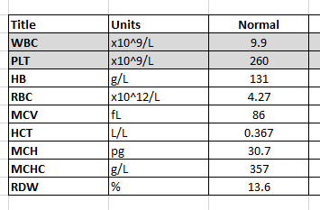
Presented are the parameters of a NORMAL FBE.
HB, RBC, MCV and RDW are measured directly on the analyser.
The HCT is calculated from RBC x MCV / 1000.
The MCH is calculated from HB / RBC.
The MCHC calculation is expressed in a number of ways
a) HB / ( RBC x MCV ) x 1000
b) HB / ( HCT )
c) MCH / MCV x 1000

Slide 2
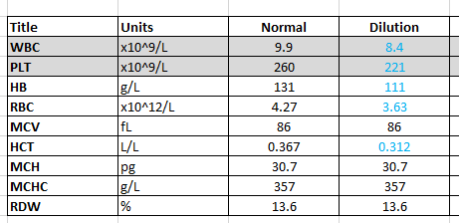
A common complication of FBE collections in the hospital setting is dilution from a normotonic drip line.
Assuming the patient is relatively stable and the WBC and PLT counts are not fluctuating you would see a reduction in some of the measured and calculated parameters.
The cell size (MCV), ratio of red cell content (MCH), cellular concentration (MCHC) and cellular spread (RDW) remain unchanged.

Slide 3
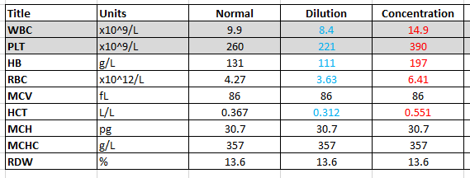
The reverse pattern is often seen in patients who present with dehydration. Check clinical details and notes such as abdominal pain, nausea or vomiting where patients often stop drinking fluids.
Assuming the patient is relatively stable and the WBC and PLT counts are not fluctuating you would see an increase in some of the measured and calculated parameters.
The cell size (MCV), ratio of red cell content (MCH), cellular concentration (MCHC) and cellular spread (RDW) remain unchanged.

Slide 4
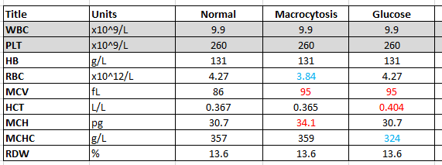
The two most common causes of macrocytosis in the hospital setting a biological and artefactual.
Biological can include medical condition such as liver disease or hypothyroidism or medications such as methotrexate. In this instance both the MCV and MCH should increase by a similar percentage while the MCHC remains constant.
The most common artefactual macrocytosis in the laboratory is secondary to hypertonic drip fluid eg glucose drip. In this instance the MCV will increase, the MCH will remain constant and the MCHC falls directly proportionately to the MCV shift.
As a rough guide, a 1fL change in MCV will move the MCHC by 3 g/L in the opposite direction

Slide 5
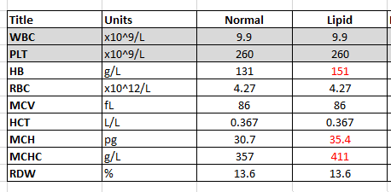
The common causes of high MCHC are
In-vitro haemolysis
Cold Agglutinin
Hereditary spherocytosis
Lipaemia
The most common cause of lipaemia in the hospital setting is TPN or TPN from the drip line.
TPN is viscous and sticky and has an approximate “HB” of 300 g/L
TPN alone will increase the measured HB and calculated MCH and MCHC

Slide 6
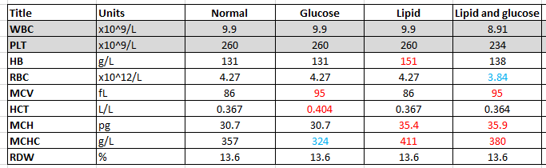
The added complication of TPN is that TPN contamination of the FBE sample is often associated with a high glucose level.
The TPN gives a false high HB.
The high glucose level, just as in diabetic ketoacidosis, can give a false high MCV to further complicate the picture.
The dilution of the RBC and false high MCH are still evident but the HB dilution is hidden by the lipid interference.
The false high MCV from the glucose can minimise or even mask the interference in MCHC from the false high HB

Slide 7
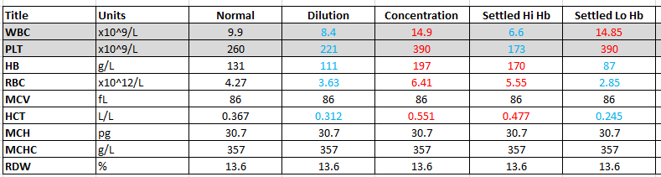
The next most common cause of sampling error is syringe collection with settling. This often occurs in the emergency department as the same puncture point is used to sample bloods and then insert an access point.
In this instance the syringe of blood settles on it’s side with red cells on the bottom and the buffy coat of WBC and PLT on top.
When the syringe is picked up to fill the collection tube(s), the first tubes filled receive the most RBC and the least WBC and PLTS.
The final tube(s) receive the least RBC and the most WBC and PLTS.
Considering our tube draw order has FBE a fair way down the list it is not surprising that we usually see false low HB rather than false high HB.

