Slide 1
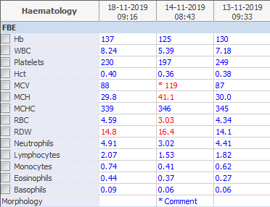
MCV delta within 1 day
Biochemistry unsuitable
Note MCV up, MCH up but MCHC unchanged.
Consider WBIT but Biochem supports contamination
If it were glucose
MCV up, MCH unchanged and MCHC down proportional to MCV
If it were lipid
MCV unchanged, MCH up, MCHC up.
This is a combination of Glucose and TPN
MCV up due to glucose
MCH up due to TPN lipid falsely elevating the HB
MCHC unchanged because it was down due to glucose and up due to TPN/lipid to the same value.
If however, this change was seen over months, you could consider a macrocytic drug such as hydroxyurea increasing the MCV and therefore the MCH while not affecting the MCHC.
Delta check 1 day – TPN/Glucose/Lipid/WBIT
Delta check Months – Macrocytic drug

