Slide 1
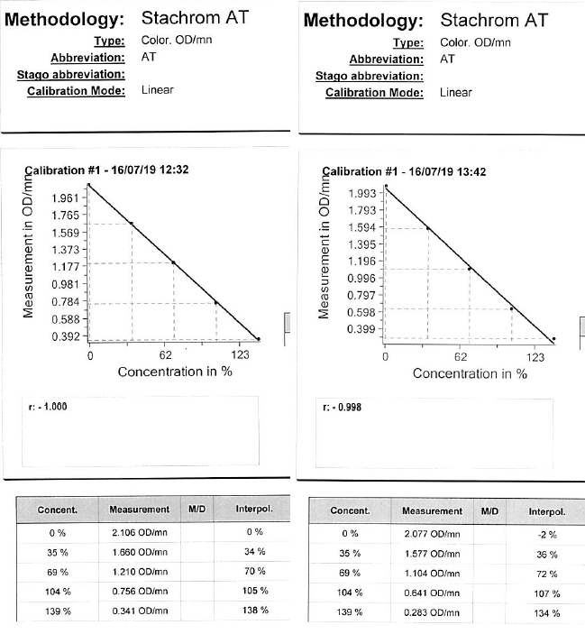
This is two calibration curves for ATIII
The left is Stago Max and the right is Maxine.
These are from July 2019.
Note:
The r² are 1.000 and 0.998 respectively
Stago Max OD range 2.106 to 0.341
Stago Maxine OD range 2.077 to 0.283
The predicted calibration levels (Concent) and the calculated levels (Interpol) are quite close.
These appear to be good calibration curves.
Max is slightly better than Maxine

Slide 2
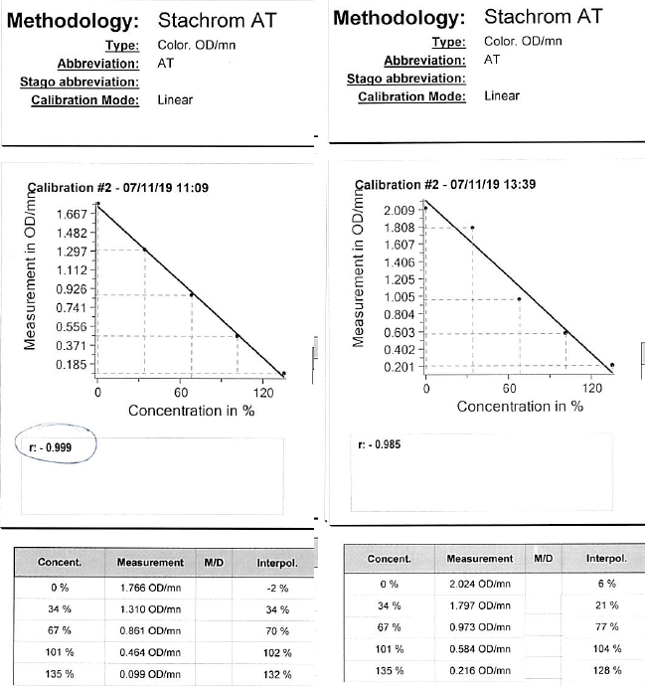
This is two calibration curves for ATIII
The left is Stago Max and the right is Maxine.
These are from Nov 2019 on a new batch of ATIII
The r² are 0.999 and 0.985 respectively
Stago Max OD range 1.766 to 0.099
Stago Maxine OD range 2.024 to 0.216
The predicted calibration levels (Concent) and the calculated levels (Interpol) are quite close on Max.
The predicted calibration levels (Concent) and the calculated levels (Interpol) are not close on Maxine.
The calibration “worked” on Max but then didn’t on Maxine. This is highly unusual.
Further review shows a significant difference in OD ranges between Max and Maxine today.
There is also a significant change in OD’s from the previous batch – this is unusual.

Slide 3
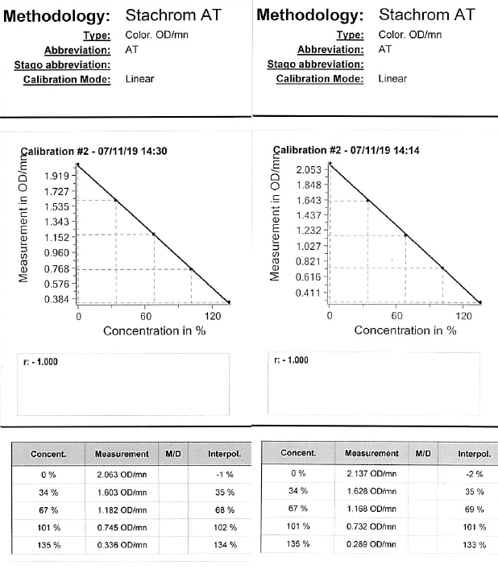
This is two calibration curves for ATIII
The left is Stago Max and the right is Maxine.
These are from Nov 2019 from new batch of ATIII
A new reagent set has been made up.
The r² are 1.000 and 1.000 respectively
Stago Max OD range 2.063 to 0.336
Stago Maxine OD range 2.137 to 0.289
The predicted calibration levels (Concent) and the calculated levels (Interpol) are quite close on both analysers.
The 0% OD’s have increased from 1.766 and 2.024 respectively.
The 135% OD’s have increased from 0.099 and 0.216 respectively.
This coincided with a new lot number of reagent.
Always compare previous calibration times/OD’s for change.
Always be familiar with reconstitution requirements - the first reagent set had only been reconstituted for 30 minutes.
The difference in OD’s between Max and Maxine (previous page) reflected the 2.5 hr delay in calibration between analysers and was a hint to what was going on – The reagent was reconstituting during the process.

