Slide 1
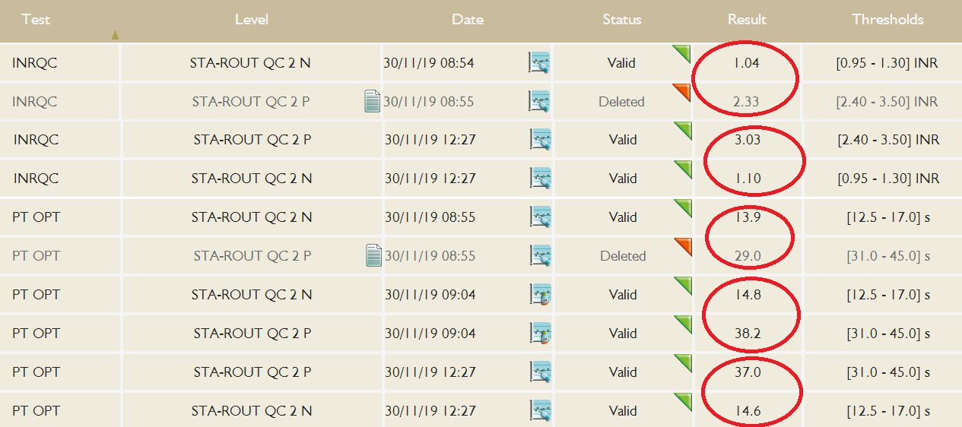
Pathological INR QC out at 09:00 on Maxine.
Normal INR QC ok but slightly lower than usual.
No stir bar in the NeoPTimal reagent.
New reagent, same QC, Results now back in range
Handy Note #1 Reagent issues can often only affect one QC level – usually the pathological.
Handy Note #2 Always re-run both levels of QC even if only one is out.
Note sure why the results are short and not long.

