Slide 1
Morphology workflow and Overview
A guide to morphology standardisation of workflow

Slide 2
Workflow – Why is it important?
The workflow in morphology is just as important as the morphology itself.
There is no point in doing a film if it doesn’t transmit, transmits incorrectly or fails to archive.
If the workflow is not monitored and managed then priority samples might not get expedited.
If the workflow is not monitored and managed then “completed” samples might not transmit to the host.
If the workflow is not monitored and managed then “completed” samples might not archive.
If priority samples and archiving are not progressing correctly then delta checking may create additional unnecessary blood films.

Slide 3
Availability of slides and workflow
Slides are to be readily accessible for ALL staff.
The red tray should be shared by all staff, processed first and then ongoing.
The yellow tray should be shared by all staff, processed second and then ongoing.
Blue trays are then done next by all staff and filed in levels by day if we are behind.
Trays are to be stored in the orientation pictured so all staff can easily access them from both sides of the slide tray.

Slide 4
Ideal Screen Layout
The ideal screen lay out is to use dual screen extended desk top.
This enables
quick copy and paste of the Ur number from remisol into powerchart
visualisation of both current and historic information at the same time
ALL films should have a cerner powerchart enquiry.

Slide 5
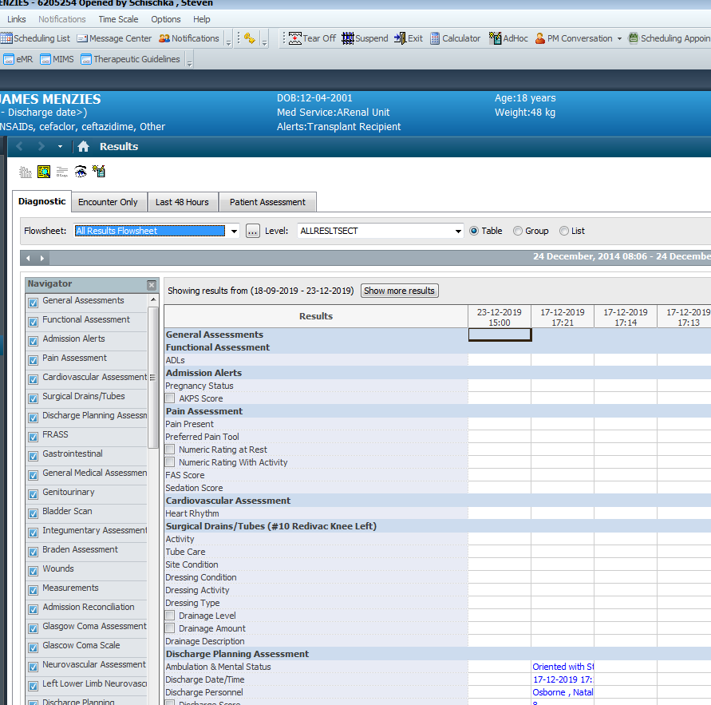
Quick view to pathology
If powerchart opens to “All results”(high lit in blue) press “P” “P” to get to pathology view quickly.

Slide 6
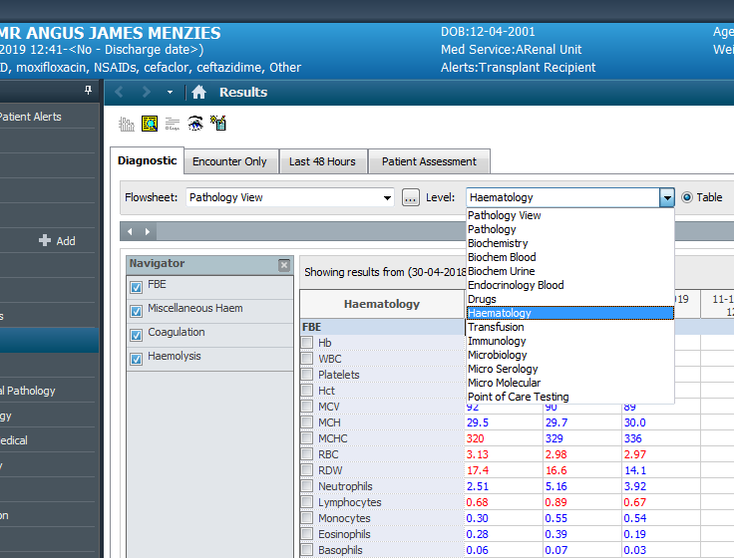
Quick view to Haematology
From pathology view click on the drop down then “H” will take you to haem, “B” will take you to biochem etc

Slide 7
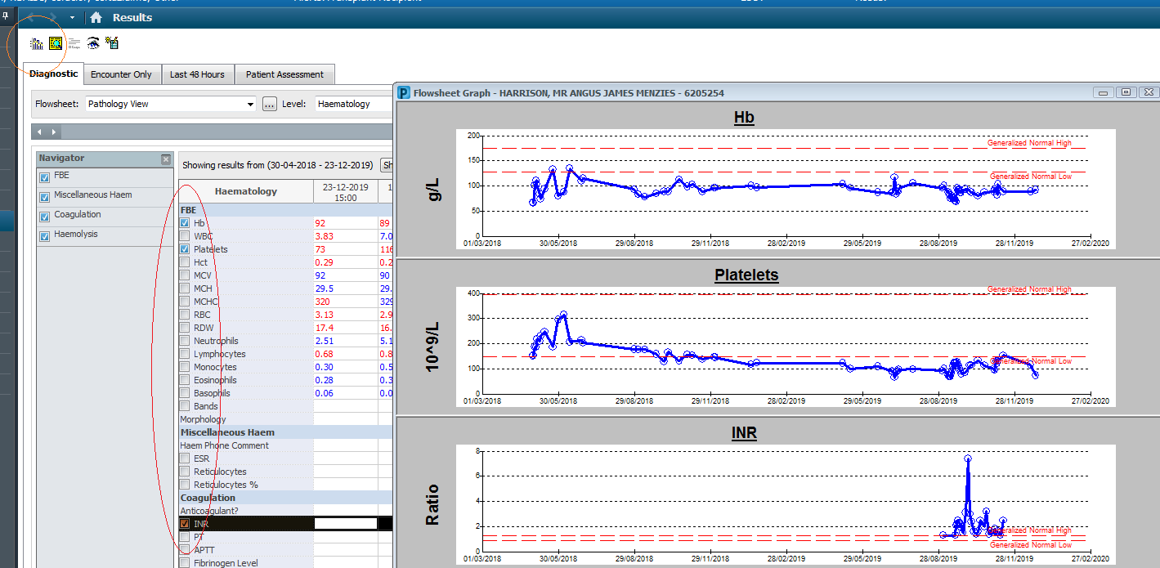
Graphing results
All blood films should have a powerchart enquiry done to make sure you know the full context of why you are doing the film. You can click on the items in the red oblong and then click on the icon in the red circle to quickly view a graph of historic trends.
This can be very helpful for eg Iron/Thal or thrombocytopenia, neutropenia, blasts or abnormal cells/history.

Slide 8
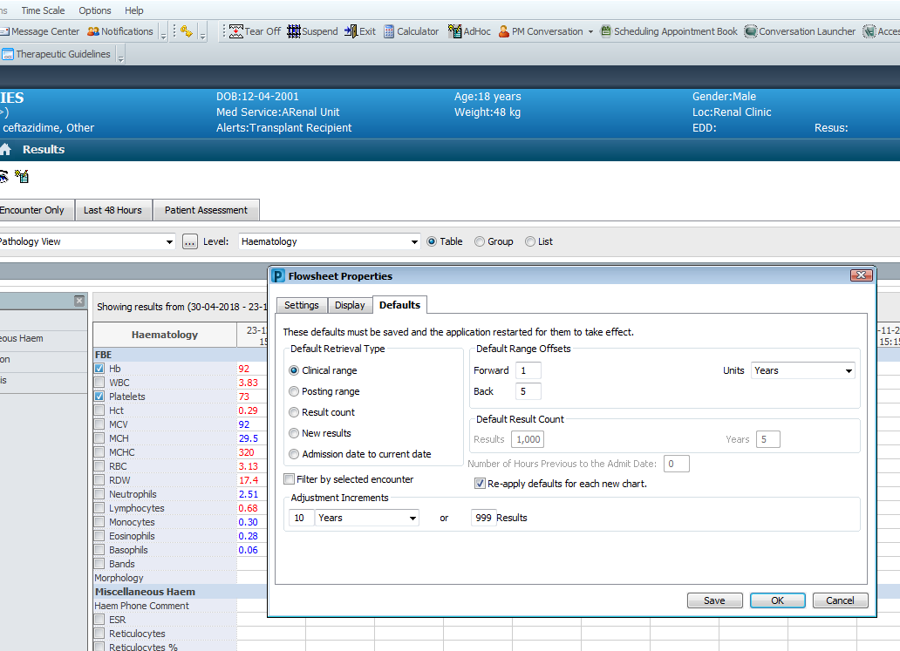
Default view - setup
Go to “Options” “Properties” “Defaults” and change your clinical or posting defaults to years, +/- the number of years you want.
Change your default result count to 1000 (result count tab).
Click save, then close and then re-open powerchart.
Your defaults will now be permanent.

Slide 9
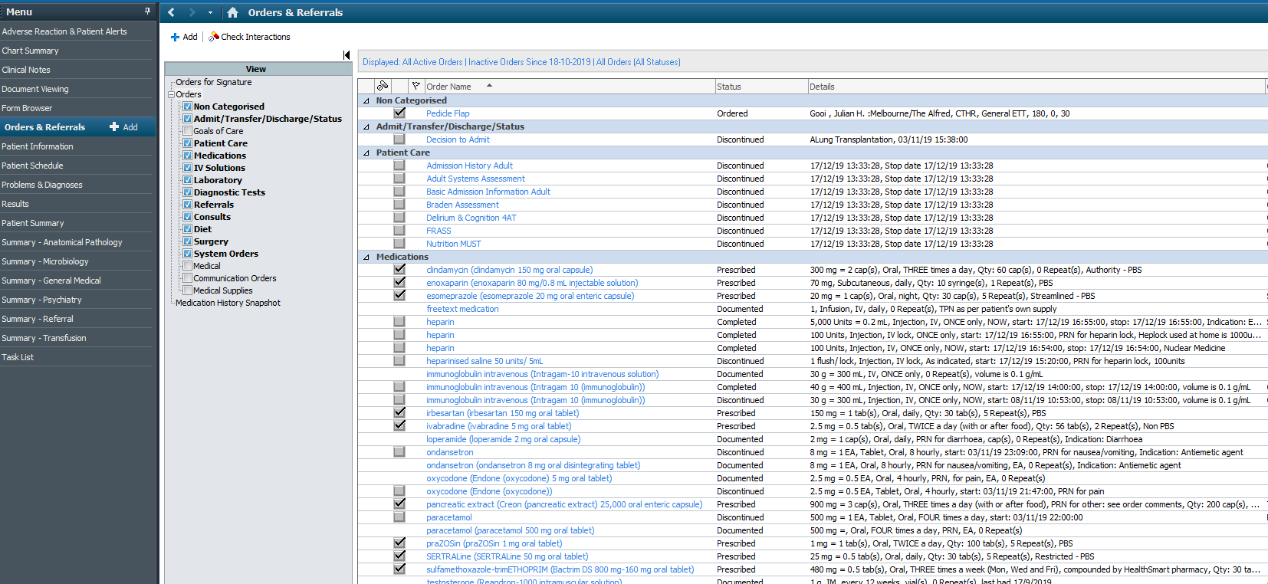
Orders and Referrals
Can give you a quick view as to why tests are being asked for.

Slide 10
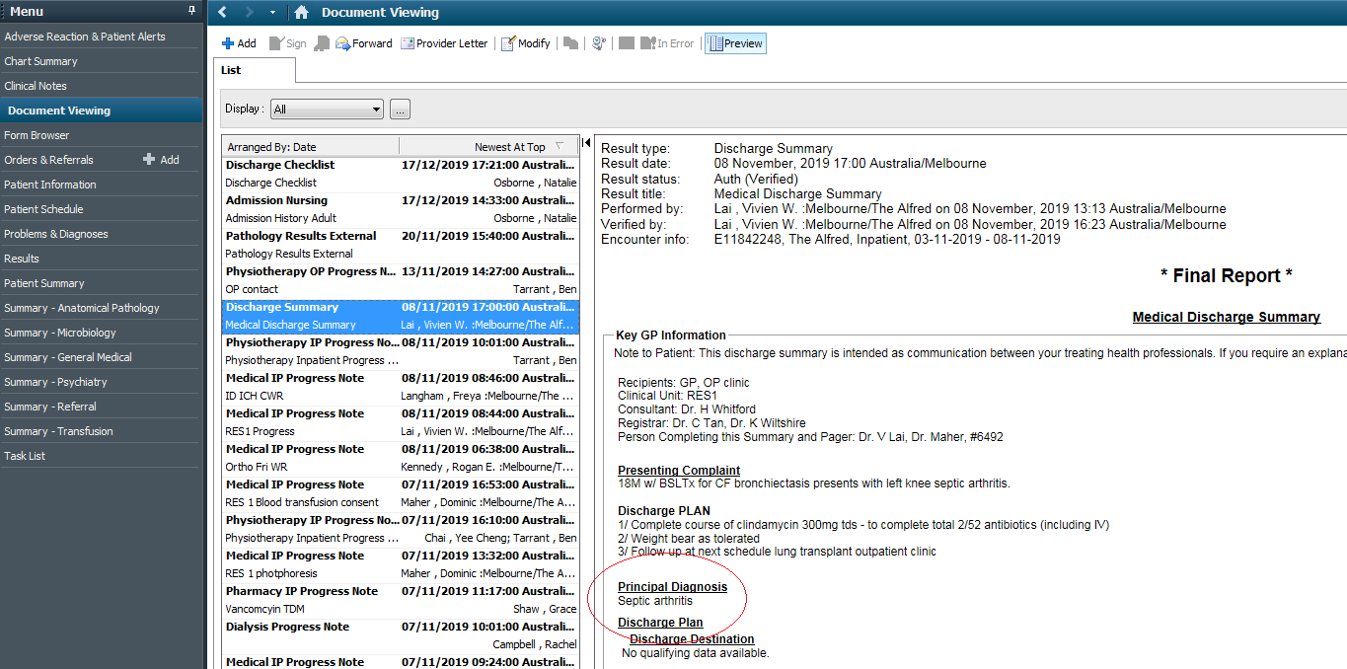
Document viewing
Will give you a quick view as to why the person is in hospital or what treatment they have had.

Slide 11
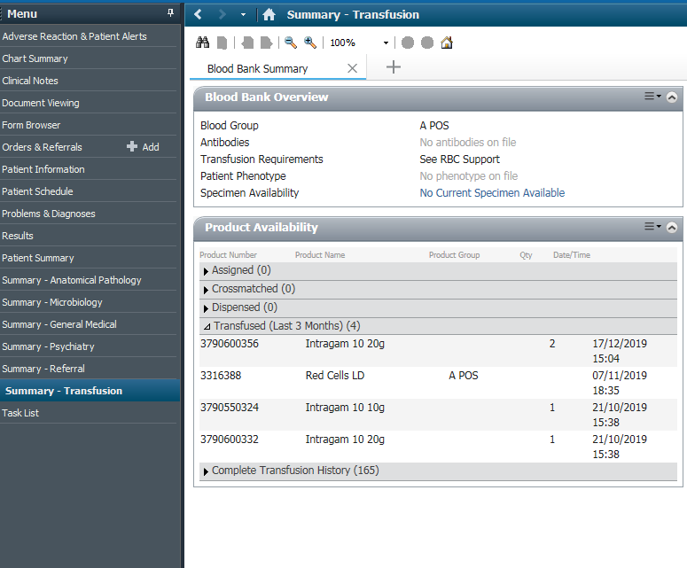
Summary – Transfusion.
Will give you a quick view as to what products the patient has received.
eg Blood, Platelets, or Anti-A from IVIG causing spherocytes.
This will also help confirm aberrant HB’s where there is a quite recovery in HB with no transfusion.

Slide 12
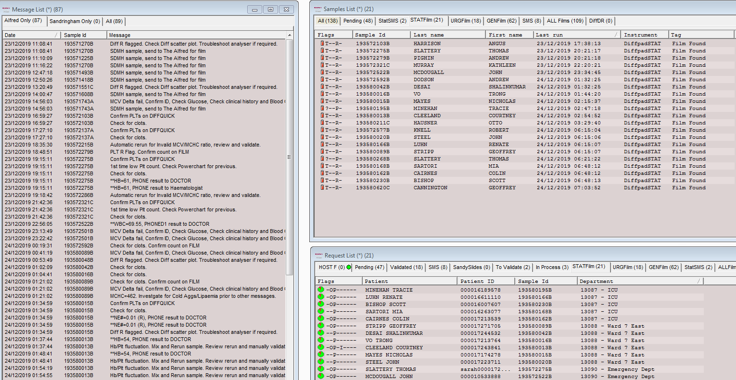
Remisol Advance
Message list – Shows all the messages until a sample is archived.
Samples list – Shows tracking of blood films.
Request list – Shows location and completion indicator ie Green Pie

Slide 13
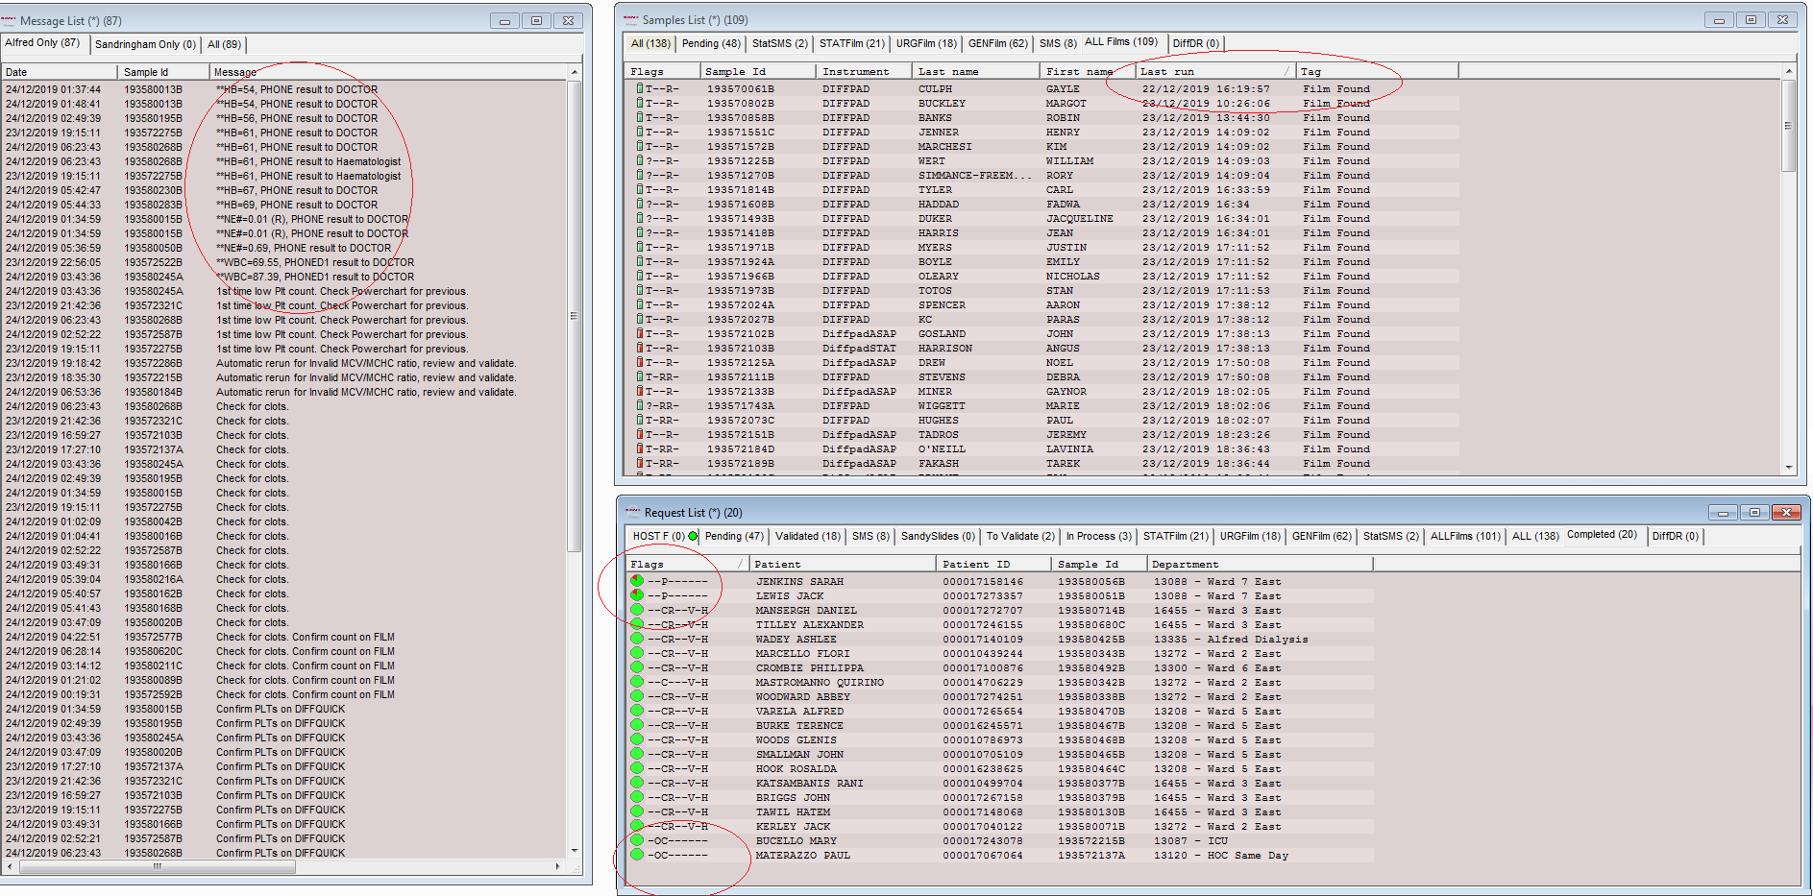
Remisol Advance
From this screen I can see 4 areas to “follow-up” - Sort message tab by “message”.
Abnormal telephoned results which aren’t finished or archived yet – watch their timestamp.
1 blood film out of sync – 1 film from the 22^{nd.}
2 completed results which aren’t complete – pie still contains red.
2 completed results which haven’t transmitted to host and archived – green pie no “V” “H”.

Slide 14
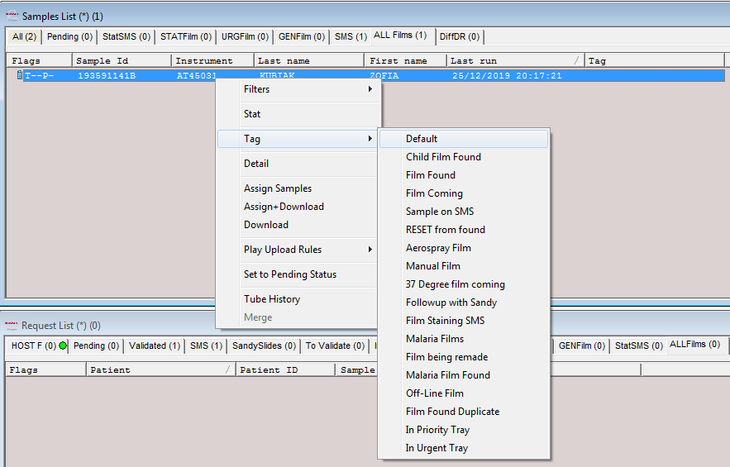
Tagging Blood Films
Tag films to indicate the most useful text for the next person eg
In Priority tray, In Urgent tray, Film being re-made or back on SMS or 37 degree film coming or Malaria film (in malaria tray) are far more helpful than just “Film Found”.
Film found is most appropriate for a routine sample progressing normally through the system.
Film found duplicate can be really helpful when sorting lists which can be sorted by “tag”

Slide 15
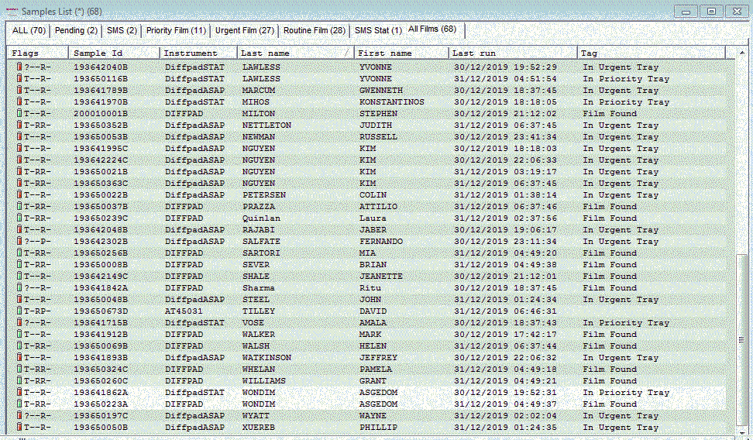
Duplicate Blood Films
Sorting the films by name will also show you the duplicate films in process.
Find the duplicate films and either
Vet one or more films and file
Move all multiple film patients into the urgent tray for “mass vetting” or examination

Slide 16
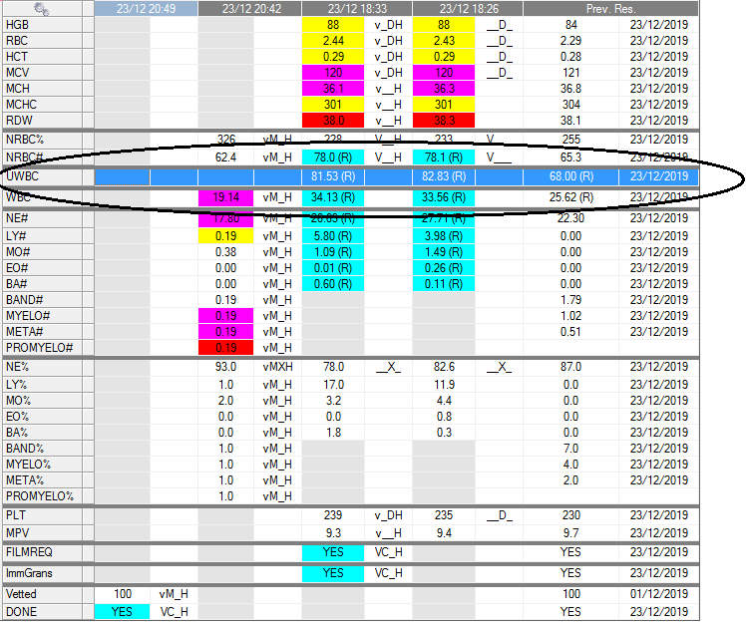
Problem Solving
Held up and not archived due to UWBC.
Future delta checking not working.
Delete or verify the UWBC line.

Slide 17
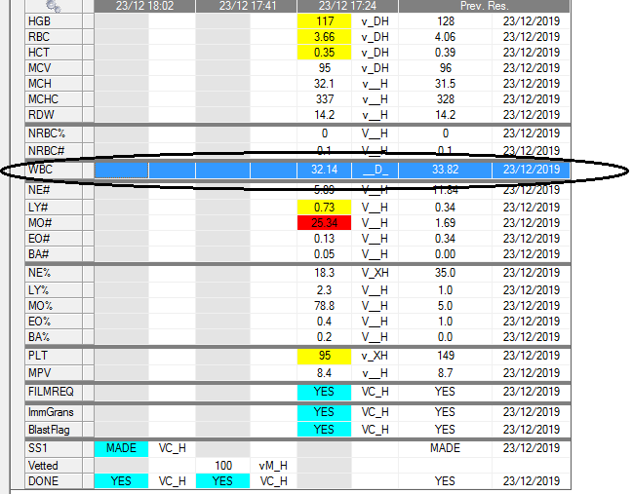
Problem solving
Unusual workflow. WBC manually entered via ARE but WBC not verified in remisol and therefore not archiving.
Delta checking not working.
Validate the WBC.

Slide 18
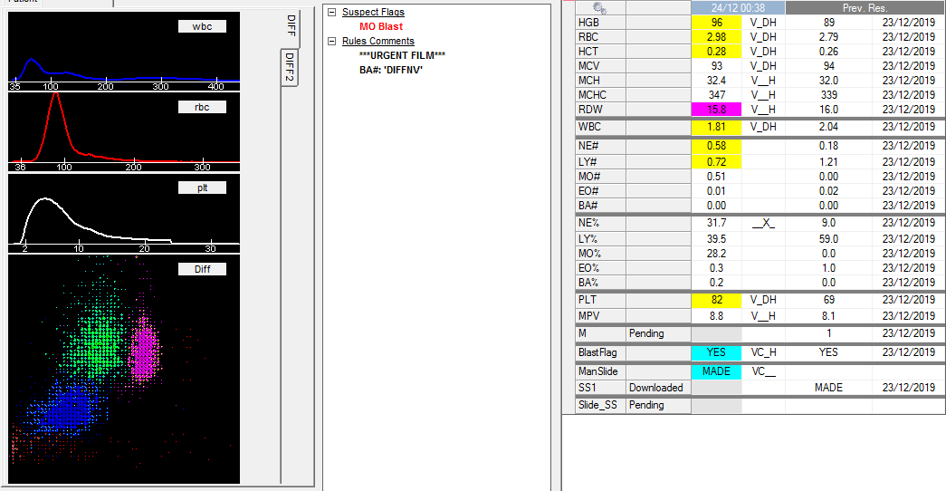
Problem solving
Incomplete sample in the complete remisol tab ? Accidental assignment to complete tab.
Not in the appropriate morphology tab ie priority due to blast flag.
At risk of falling behind or being missed.
Move to priority film tab and delete the “Slide_SS” pending and “SS1” (man slide made)

Slide 19
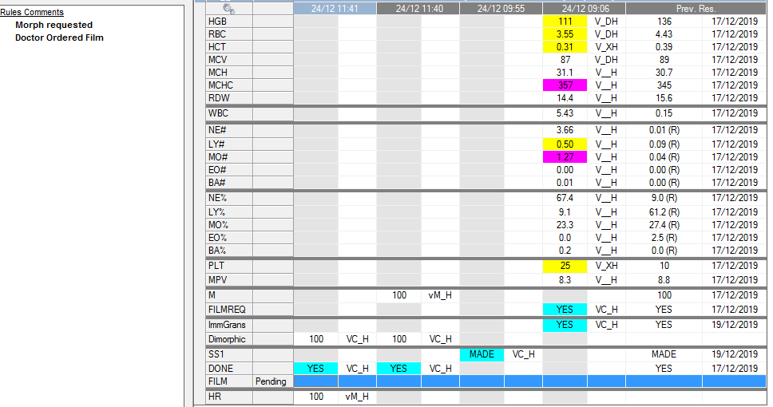
Problem Solving
One of the Dr Ordered Film rules is broken.
We have to remove “FILM” manually at the moment.
Awaiting Coulter feedback on this.

Slide 20
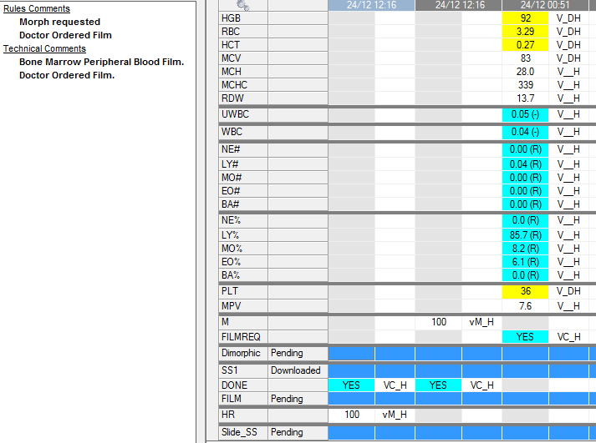
Problem Solving
4 lines to delete

Slide 21
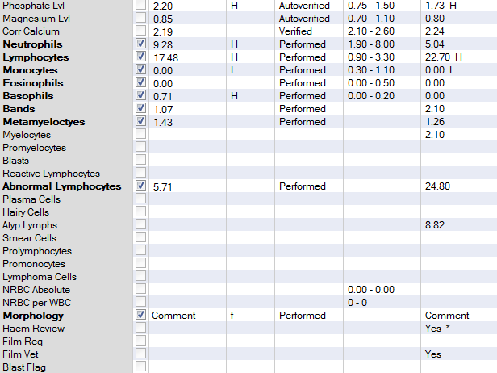
Problem Solving
BE care full when diffing abnormal cells – as per below the abnormal lymphocytes were diffed into the atypical lymphocyte key by accident.
This will require result entry into abnormal lymphs and error correction to atypical lymphocytes
Differentials with Abnormal Lymphocytes will not auto verify – go to “ARE” and verify.
Always check cerner powerchart after completing a film with abnormal cells in the differential.

Slide 22
Type it in
Type it in is our quick entry typing system.
“Most” commenting is covered by these keys.
Staff “should” only use type it in commenting and then limited free-text as required.
Suggestions for key improvements are always welcome.

Slide 23
Type it in
Type it in is our quick entry typing system.
“Most” malaria and blast commenting is covered by these keys.
Staff “should” use the blast cell descriptors and structure as a guide to make sure all components are commented on.
Suggestions for key improvements are always welcome.

