Slide 1
New Blood Film QAP
There is a new Blood Film QAP program available for staff.
Notification will come through MTS.
Submission is excel based and password protected.
Results will be de-identified and tabulated.
This will assist in registration requirements, standardising commenting and selecting future education session topics.

Slide 2
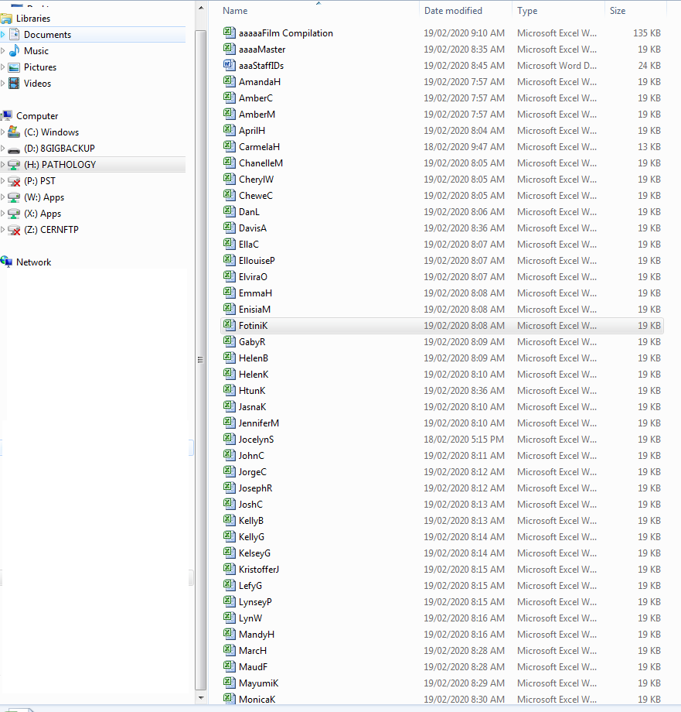
File Location
H:\shared\MORPHOLOGY QAP
Your file is either
First name + first letter of surname
Or
Surname + first letter of first name
Your password is your staff ID.
If your password doesn’t work – let me know.
DO NOT CHANGE YOUR PASSWORD.

Slide 3
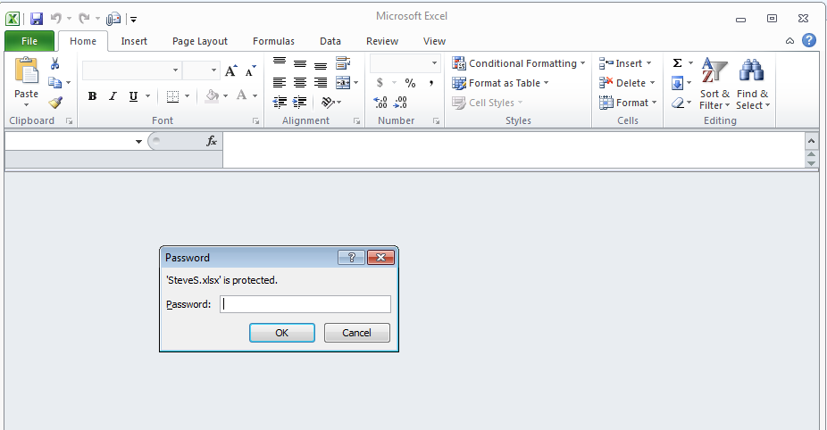
When opening your file – enter your staff ID

Slide 4
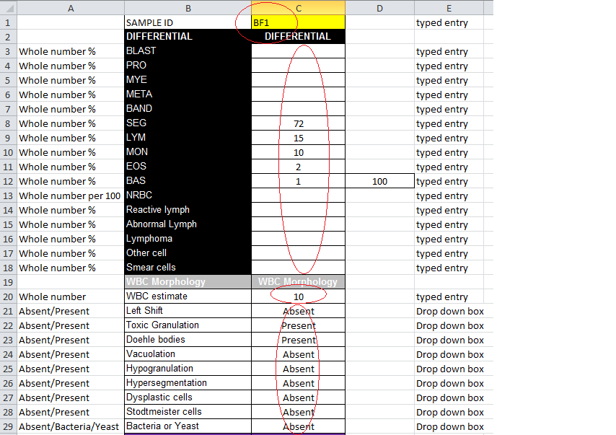
Enter the ID of the film you are doing
Manually type in your diff in % and NRBC / 100 WBC
Enter your WBC estimate to a whole number
Use the drop down box* to describe your WBC
Click in the cell*
A down arrow will appear*
Select your comment from the down arrow*

Slide 5
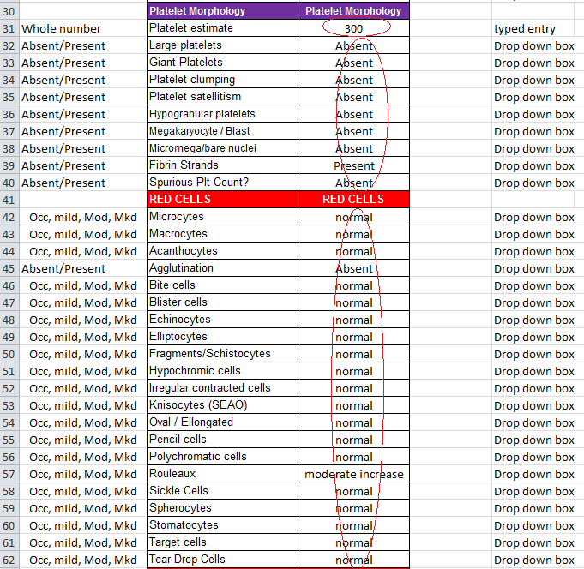
Click in the cell*
A down arrow will appear*
Select your comment from the down arrow*
Enter your PLT estimate to a whole number
Use the drop down box to describe your PLT morphology
Use the drop down box to describe your RBC morphology

Slide 6
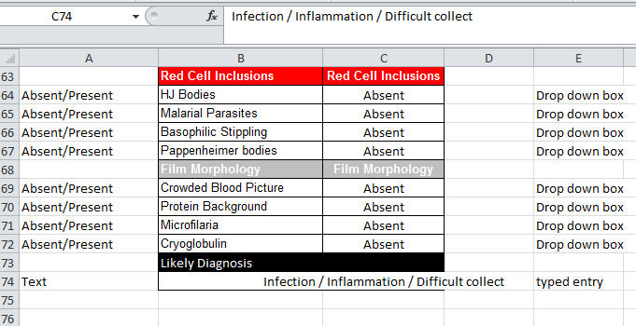
Inclusions, “gross” film changes and diagnosis.
Use the drop down box to describe your Inclusion morphology
Use the drop down box to describe your “Film” morphology
Enter text in line C74 with your diagnosis. The full text is visible in the tool bar as you type it in.
Then SAVE THE FILE. ( DO NOT CHANGE YOUR PASSWORD)

Slide 7
Thank You !

