Slide 1
Flow cytometric assessment of T-cell clonality
Radha

Slide 2
T- cell lymphoproliferative disorders
A heterogeneous group of haematological malignancies
Vary greatly in immunophentype, molecular landscape, clinical manifestations and disease trajectory

Slide 4
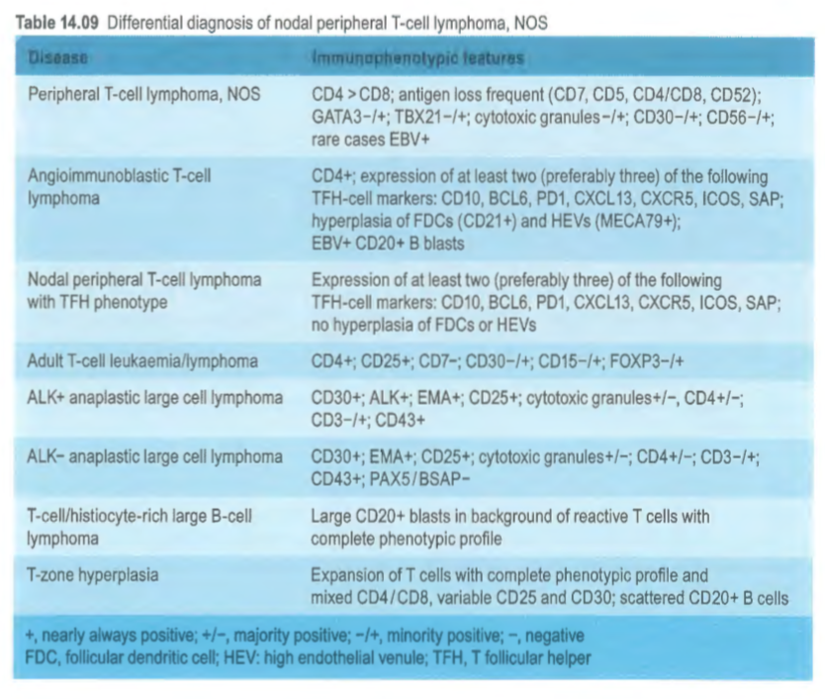

Slide 5
Difficulties in assessing T cell malignancy by flow cytometry
Significant overlap between reactive T-cell subsets and T-cell neoplasia
Eg
Absent or dim CD7
Expanded gamma/delta population
Double negative (CD4- CD8-) population

Slide 6
Difficulties in assessing T cell malignancy by flow cytometry
Definitive marker of clonality not widely available
Most T cells are alpha/beta, only small minority are gamma/delta

Slide 8
TRBC1

Slide 9
TRBC1

Slide 10
Anti-TRBC1 antibody
Anti-TCR antibody (clone JOVI.1)
Recognises only one of two mutually exclusive TCR constant beta regions which are randomly selected during TCR gene rearrangement
Thereby used as a surrogate of T cell clonality
Similar to Ig light chain restriction to detect clonal B cells
Conjugated to FITC

Slide 11
Antibody Panels

Slide 12
Processing
Fresh PB, bone marrow, tissue in RPMI
Stain with antibody cocktail for 15min at RT
Lysis RBCs with BD FACS lysis solution
Single wash with PBS buffer
FacsCanto II, Kaluza 2.1

Slide 13
Analysis
Double exclusion
Gate on lymphocytes
Identify CD3+ T cells, CD7+/CD3- NK cells, colour code T-cell subsets based on TCR γδ
Calculate each subset as % lymphocytes to identify grossly abnormal T or NK cell expansions
T cells 54-82%, CD4+ T cells 24-55%, CD8+ T cells 11-38%, NK 5-35%
Normal CD4:CD8 ratio = 1-4:1 (usually ~2:1)

Slide 14
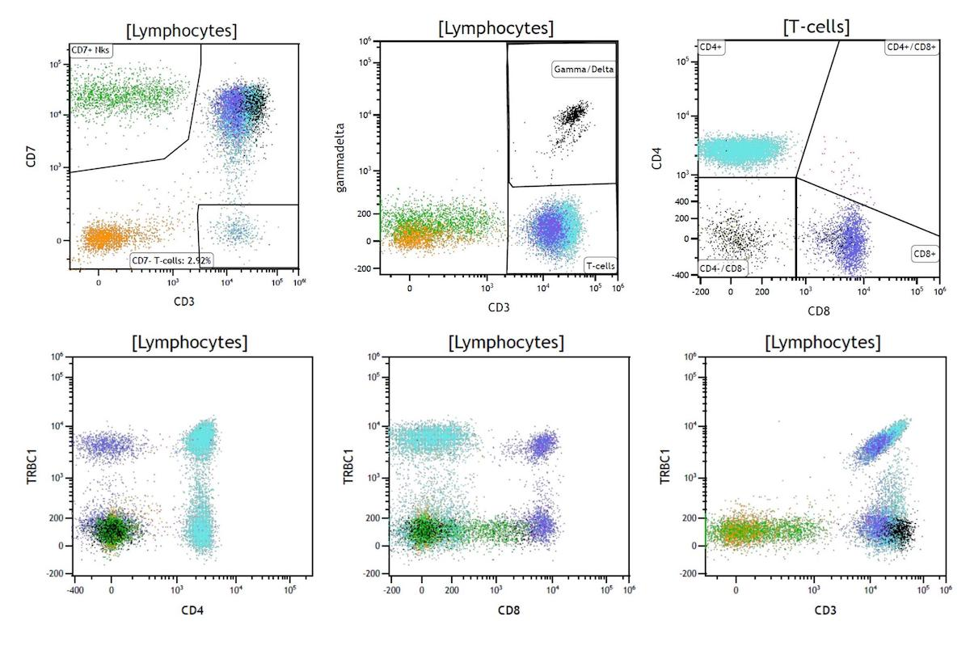
Helper T cells
NK cells
TCRγδ+ T-cells
Cytotoxic T cells
Notes:
γδ T lymphocytes are a minor subset (1–10%) of human peripheral blood T cells. Most (>70%) are CD4⁻CD8⁻ [double negative (DN)], some (30%) are CD8⁺CD4⁻

Slide 15
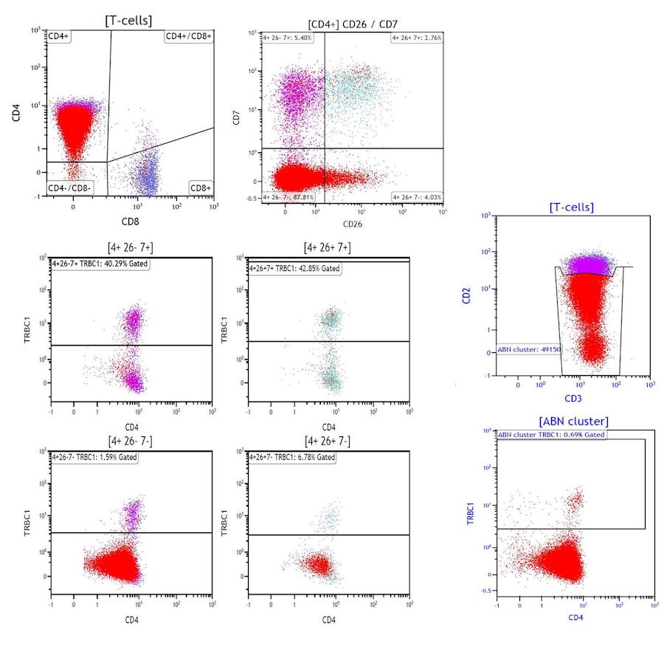
Sezary Panel

Slide 16
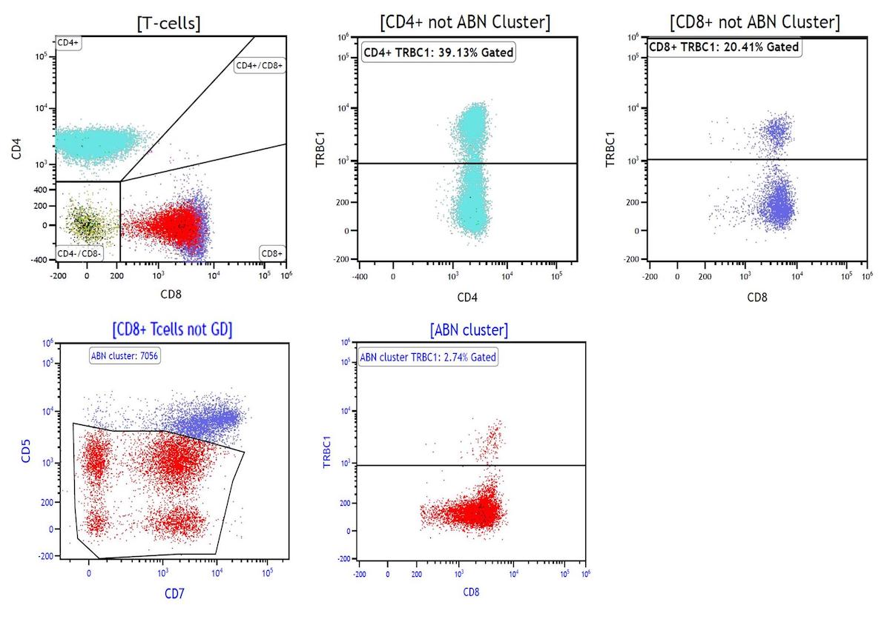
T-cell Panel
Notes:
T- LGL
Dimished/absent CD5 and CD7

Slide 17
Analysis
At this point, neoplastic T cells have shown:
DISTINCT immunophenotypically abnormal T cell population
Markedly expanded T cell subset
Distinct T-cell subset with predominantly unimodal TRBC1 expression concerning for clonality
Use a custom dot plat with 2 most discriminative antigens to narrow down on an immunophenotypically homogeneous subset
Analyse this population for percentage TRBC1+ events on a CD3 vs TRBC1 dot plot
Need at least 200 events to accurately evaluate TRBC1 pattern- limit of detection is a clonal population <1% of lymphocytes

Slide 18
Interpretation
Separation of T-cell abnormal subsets on routine gating strategies is imperfect→ results in a very skewed rather than purely unimodal TRBC1 expression
<15% or 85% TRBC1 expression in a distinct T-cell cluster allows demonstration of clonality in all appropriately gated CD3+/ TCRαβ+ T-cell neoplasms.
Can occasionally see a TRBC1 ^{dim} peak as a clonal population
Occasional small benign CD8+/CD4- clones identified (T-CUS) correspond to non-malignant clonal T-LGL
Relatively high incidence (up to 25% in pts with this group)- so only reported when account for >15% lymphocytes or immunophenotype concerning for neoplasm

Slide 19
interpretation
CD4+/CD8- clones always reported irrespective of size and immunophenotypic features
Final interpretation dependent on
Immunophenotype
Size
Specimen type
Clinical history
Prior flow results
Significance of findings, DDx, suggestions for follow/up

Slide 20
Conclusions
Simple, rapid, accessible
High sensitivity and specificity >90% for neoplasia
Eliminates TCR Vβ repertoire analysis by flow or separate molecular TCR testing (which is not highly accurate)
Highly dependent on narrowing down on an immunophenotypically distinct T-cell cluster and assessing TRBC1 expression on this optimally gated population
Awareness of T-CUS

Slide 21
Caveats
Should analyse TRBC1 staining on the specific T-cell subset of interest which is looking abnormal (cluster analysis)
Only applicable to TCRαβ clones
Cannot assess clonality on TCRγδ‐positive T cells and CD3‐negative cells
These cells do not express either TRBC1 or TRBC2
Can’t exclude TRBC1 on the Sezary panel
CD8 T cell subset analysis first need exclusion of TCRγδ‐positive T cells which, again, will be negative for TRBC1 and so can skew result

Slide 22
